Slide 1
Analyzing imaging data an open-source collaboration
A.P. Kaestner, J. Bilheux, C. Carminati, T. Minniti, M. Morgano, M. Schulz, M. Lerche, T. Shinohara, H. Sato, R. Woracek, T.H. Rod, M. Strobl
11th World Conference on Neutron Radiography, Sydney, September 1-5, 2018

Slide 2
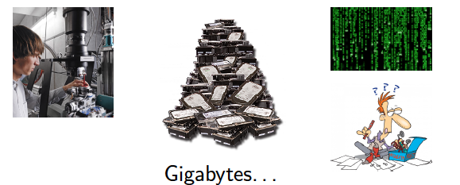
What happens after an imaging experiment?

Slide 3

Science paradigms and neutron imaging
Empirical “Schöni Bildli”
  Observing and describing phenomena
  Already the old Greeks did it
Theoretical – analytical, many NI experiments
  Describing observations by model, abstraction/generalization
  Newton
Computational – Some NI
  Complex models, detailed problems → Simulations
Data exploration – Few NI
  Analysis by data management and statistics
Need computational methods

Slide 4
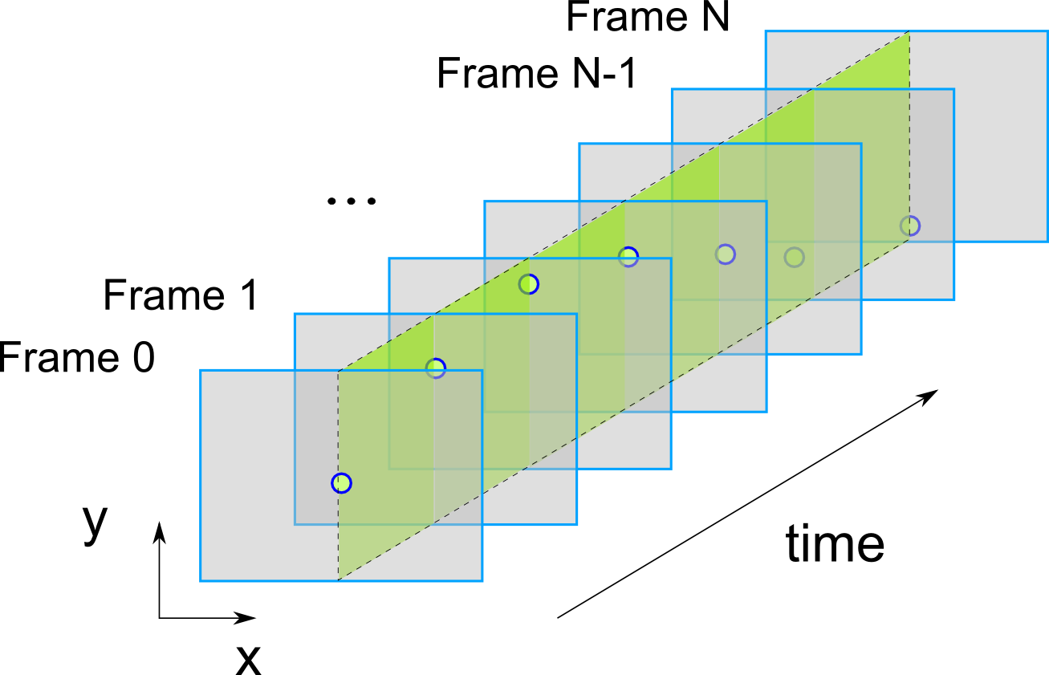
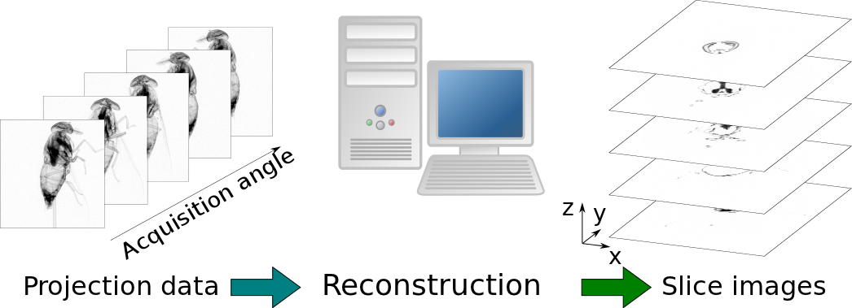
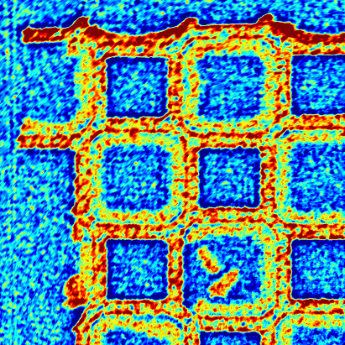
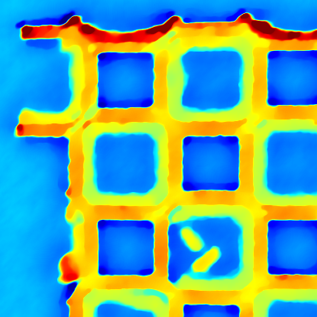
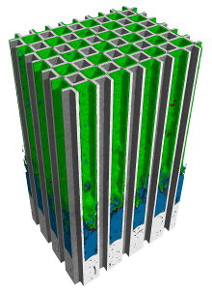
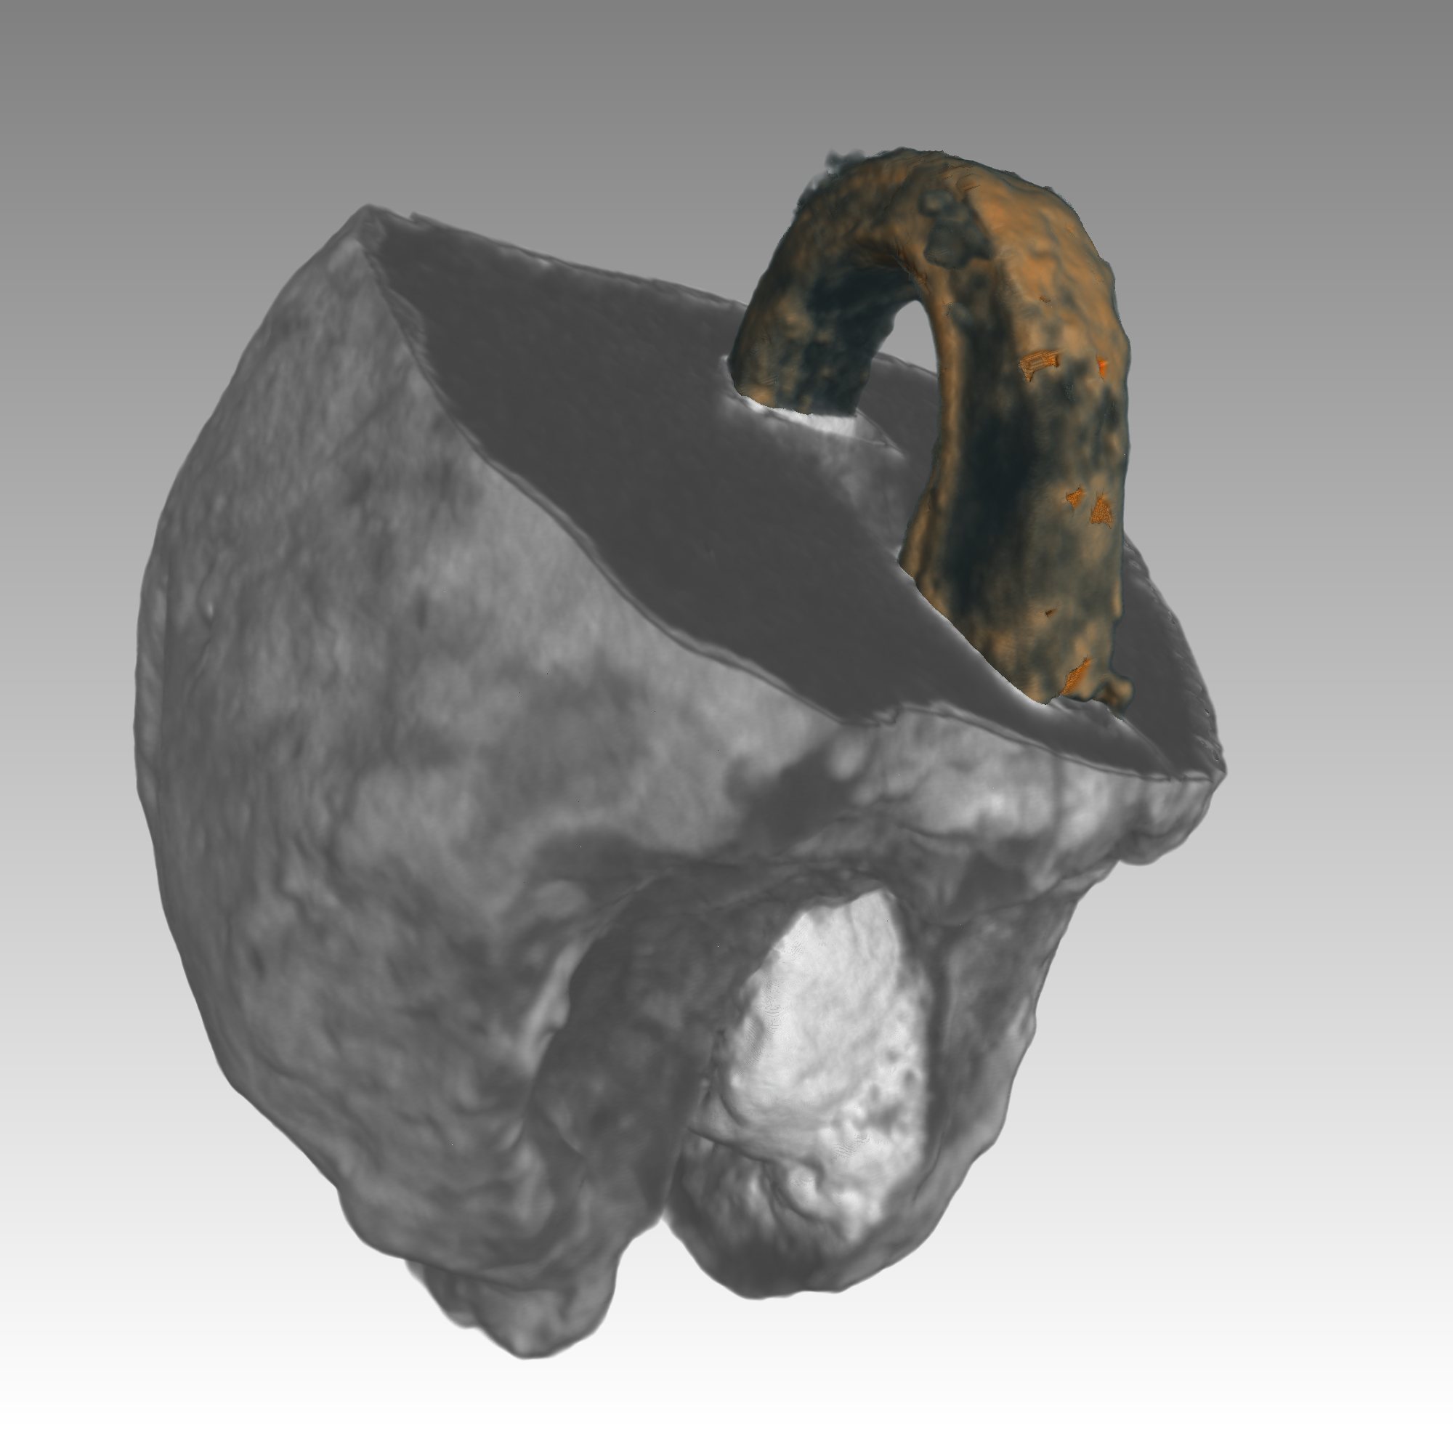
Data processing
Data processing can be a very labor- and computationally intense task
Basic processing |  | Minutes, hours
CT reconstruction |  | Minutes, hours
Image processing |  | Hours
Visualization Analysis |  | Hours, days

Slide 5
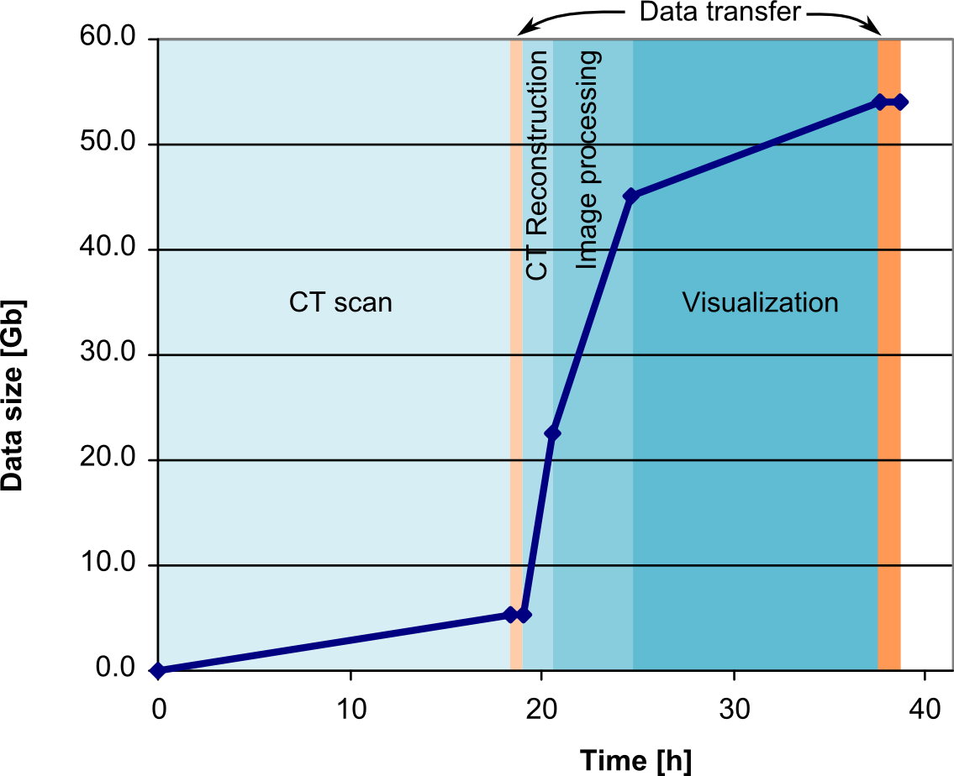
Data analysis is time-consuming!
+ evaluation
+ modeling
+ publication
Months of work from experiment to publication…
… if ever!!!

Slide 6
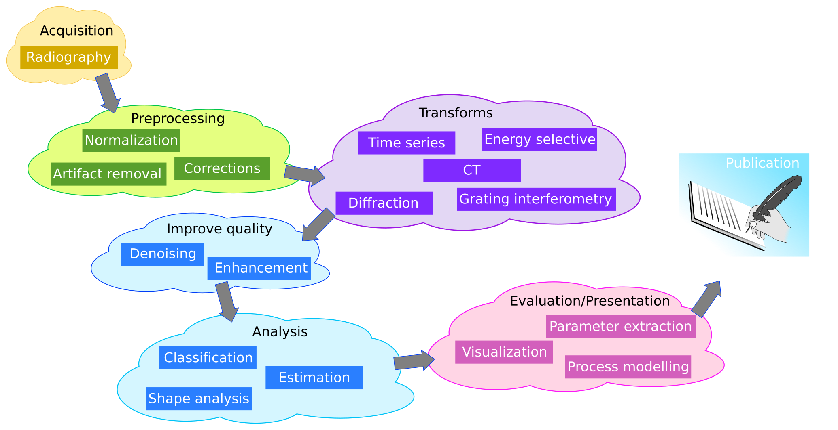
Analysis workflow
Needs creative interaction
Can be generalized

Slide 7
Characterizing neutron imaging data
Data quality
Limited number of observations long experiment times
Low SNR weaker sources
Less sharp than X-rays detection principle
Data structure
Single modality traditional transmission imaging
Temporal dependency time series
Multi modality combining images from different sources
Multi energy material response, mixes
Tensor valued magnetism, strain, diffraction
Investigations often only involve few or even single samples → Generalization?

Slide 8
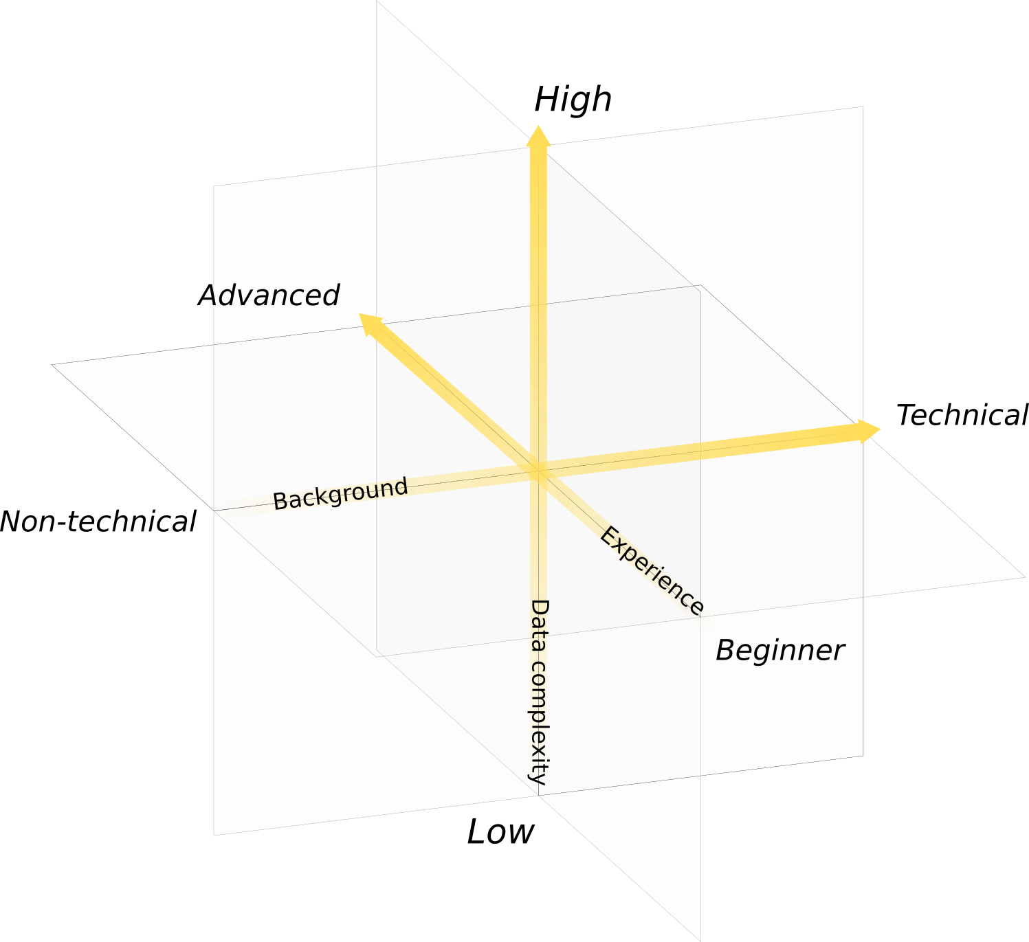
Data evaluation fitness of users
Users neutron imaging have very different background and experience

Slide 9
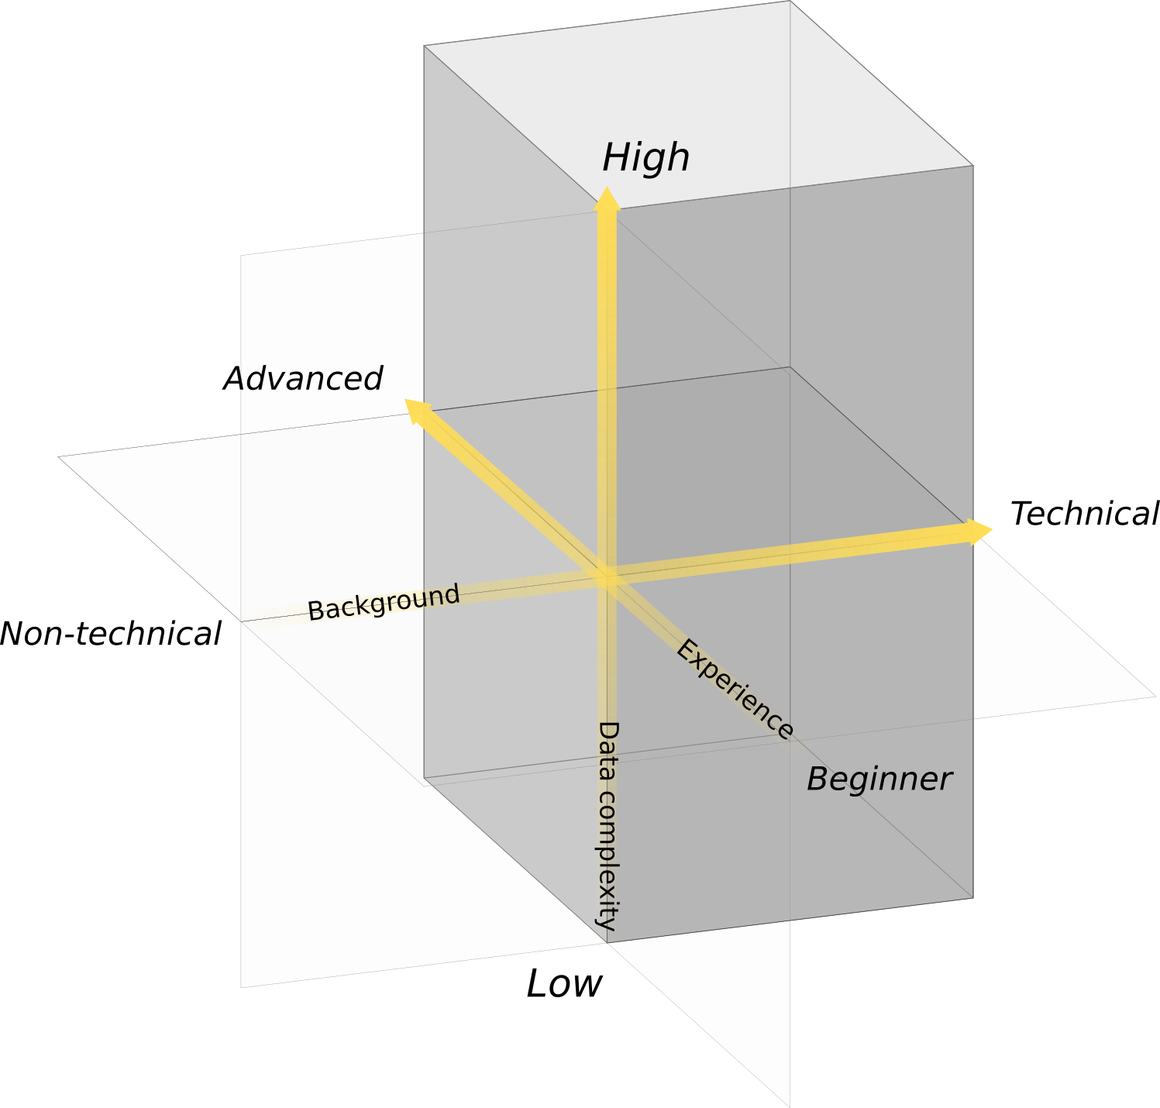
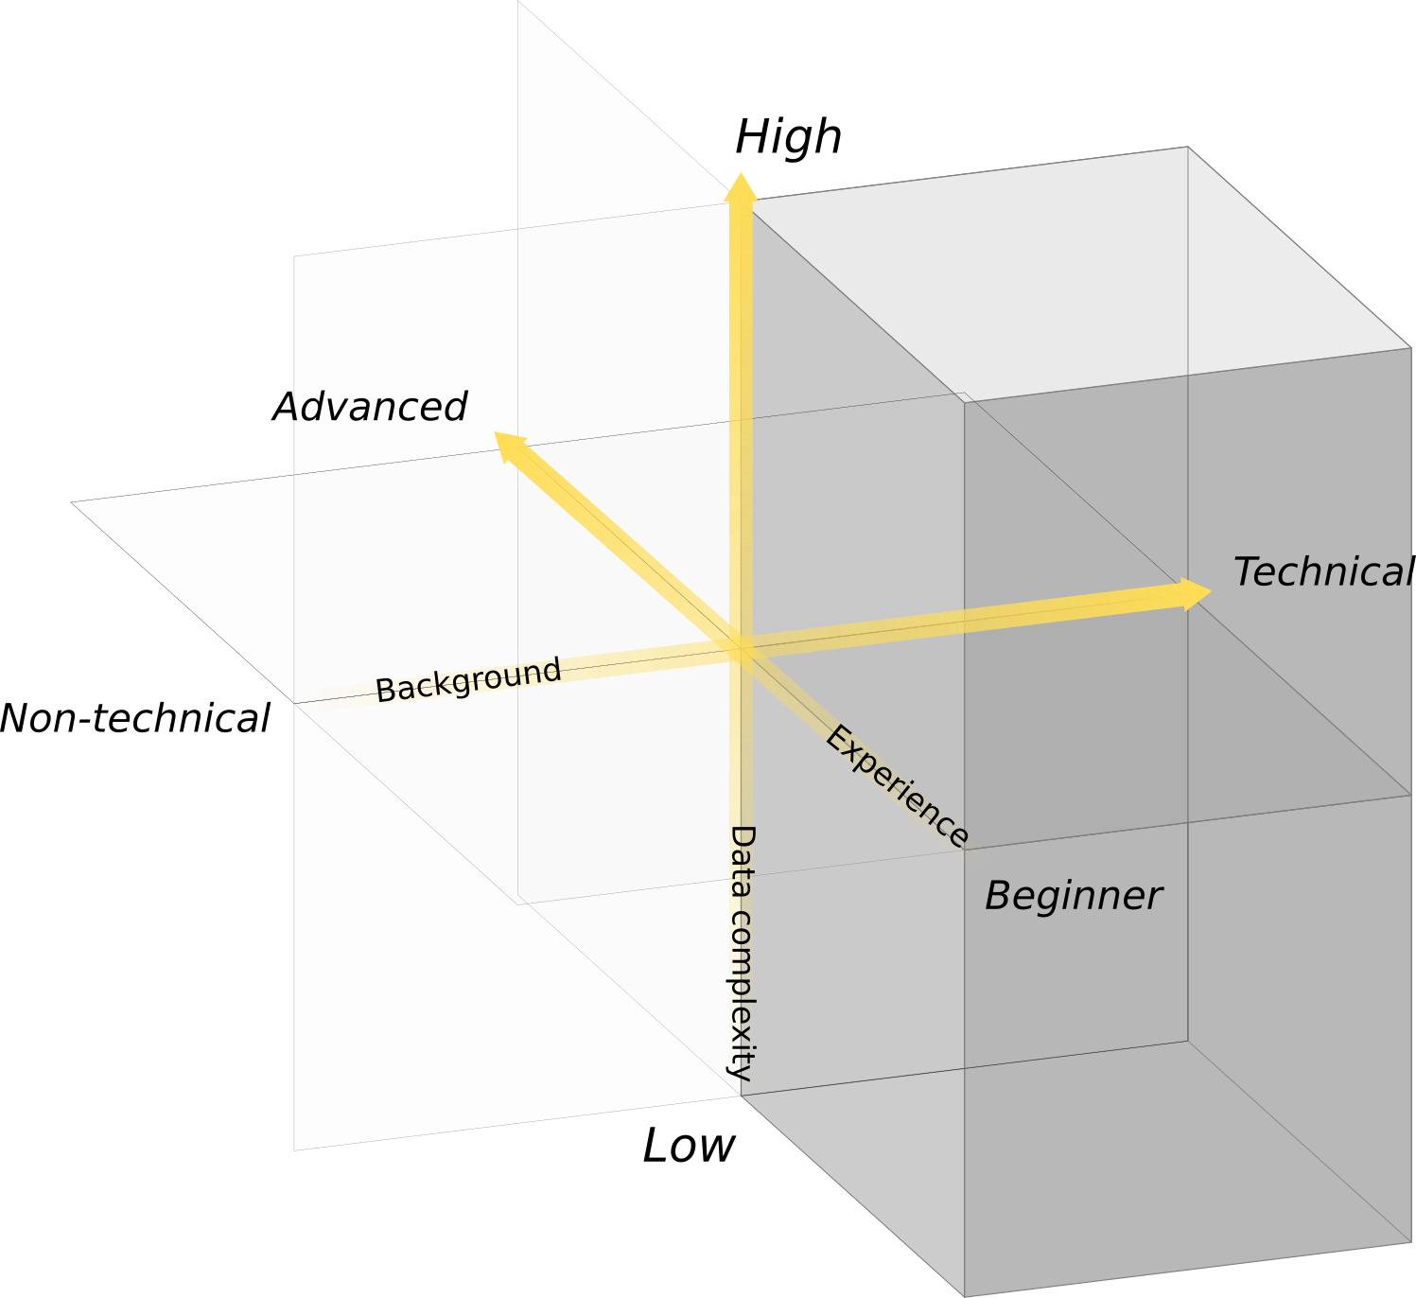
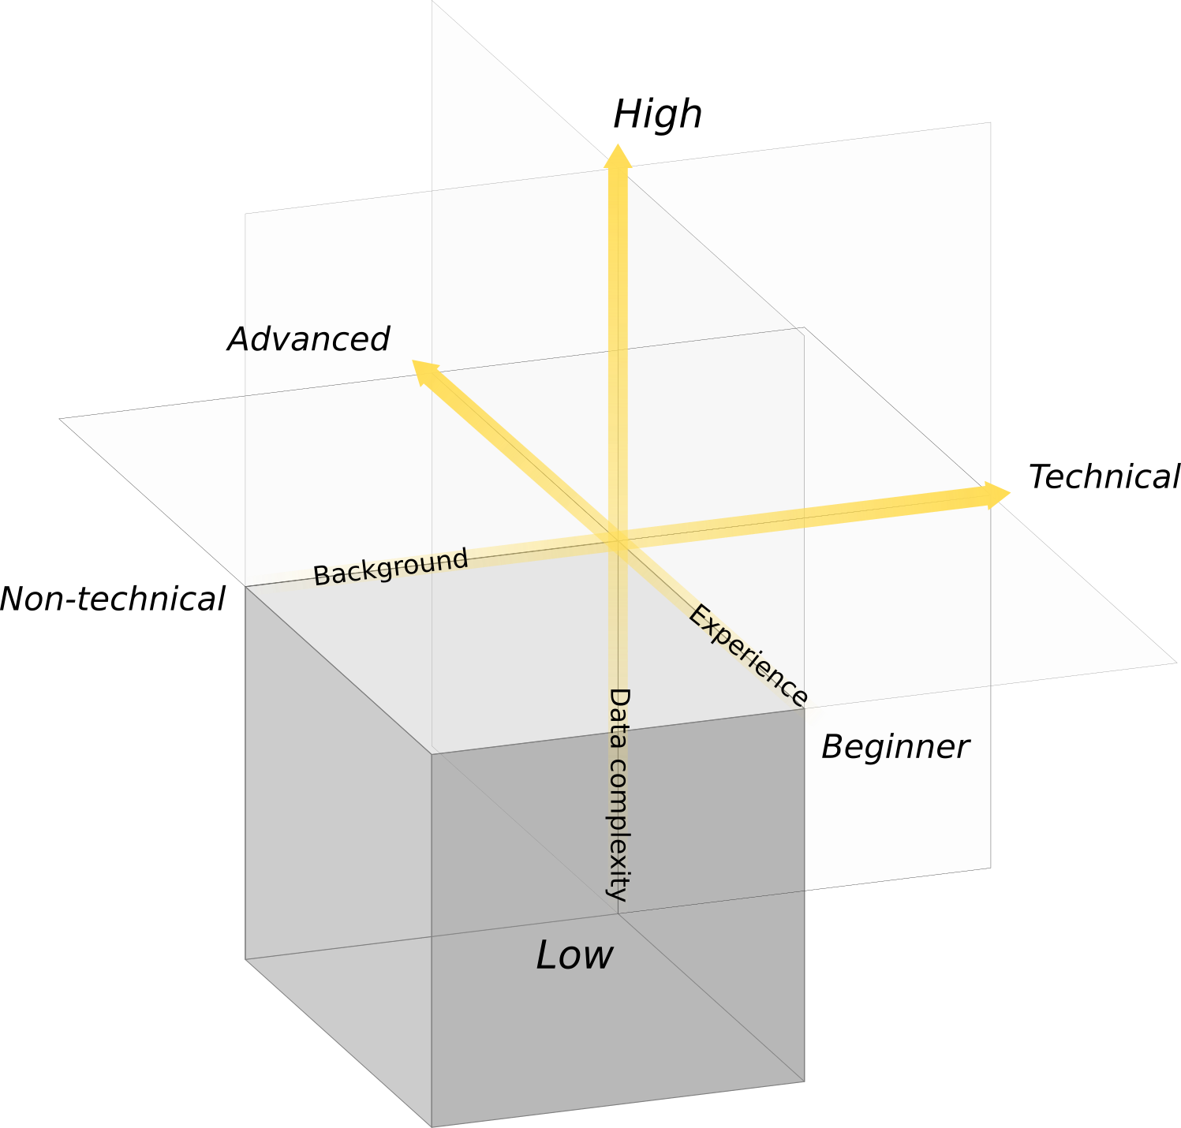
Data evaluation fitness of users - Characterization
Beamline scientist
Early stage PhD student
Cultural heritage users
Serving people with different background and needs is a great challenge

Slide 10
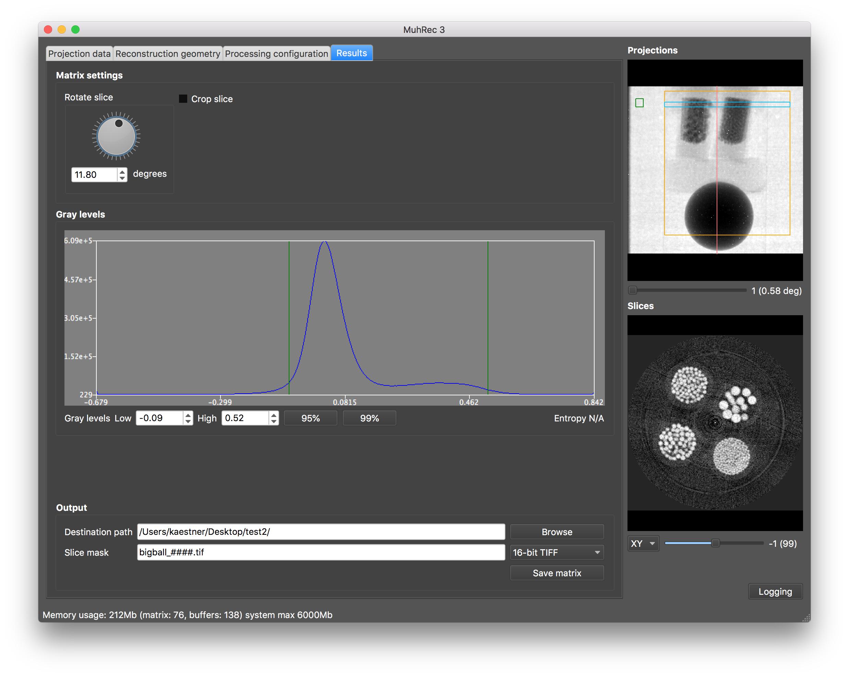
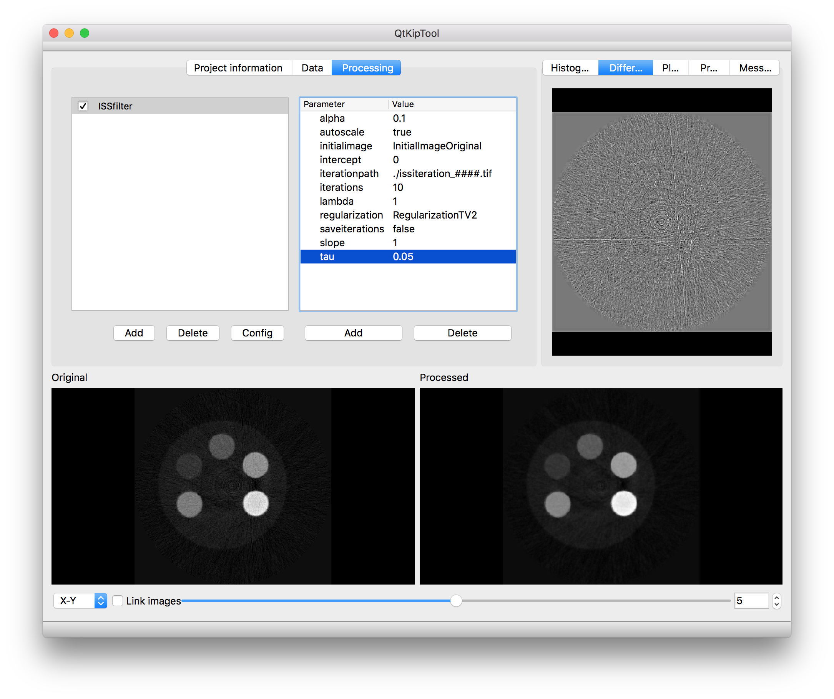
Applications developed at PSI
MuhRec
CT reconstruction tool
Configurable processing chain
KipTool
General processing tool 3D images
Converter tools
NIQA tool
Analysis of IAEA QA samples
nGI tool
Reduction of phase stepping scans

Slide 11
Energy resolved imaging
New neutron sources with pulsed beam …
… Reveal new information about the sample → New science (Many WCNR11 Contributions)
  Bragg edge analysis
  Diffraction imaging
  Modulation techniques
  Challenges on the development
  Produce large data
  Adds new dimensions to the data
  Workflow flexibility
User interface
Guiding algorithms
Core

Slide 12
Modern software development
Agile development
  Iterative development
  Collaboration
Using repositories
  New issues in repository branches
  Maintain stable master through merge reviews
Issue tracking (New features, Improvements, Fixing bugs)
Frequent releases (2 x year)
Automated testing and builds
Online documentation

Slide 13



Some technical details about the development
Main coding language
GUI Library
Planned binding
The PSI way
In particular: C++11
XCode (Mac)
MSVC15 (Windows)
g++ (Linux)
Version: 5.9 LTS
Cross platform
Qmake
QTest
Python 3
Embedded scripting
Call libs from python
Tutorials
Typical work flows
Repository: GitHub
https://github.com/neutronimaging
Development history
Issue tracking
Documentation (Wiki)
Build server: Jenkins
Automated builds
Planned:
Nightly build installers
Automatic unit testing

Slide 14
Going open source
Why open source?
Its free → Thus serves a wide community
Insight in used methods → Reproducibility and traceability
Promotes interoperability and collaboration
A requirement from funding agencies

Slide 15
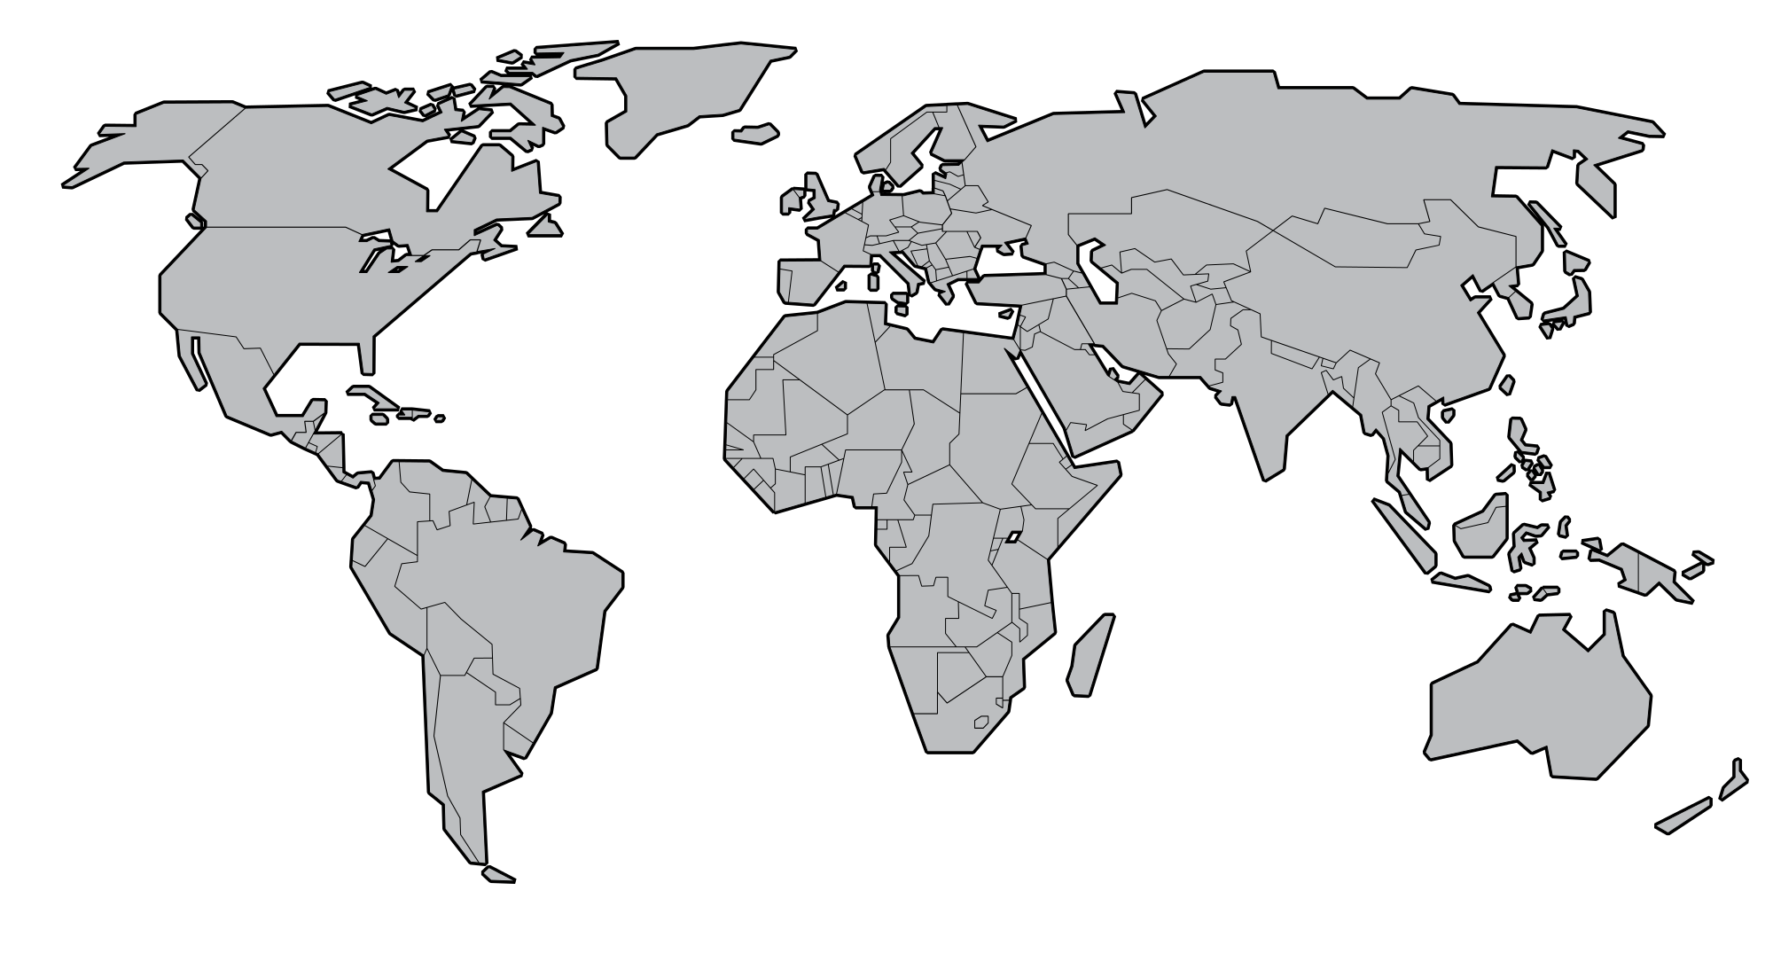
Collaboration Network
PSI
ESS ERIC
TUM
SNS
ISIS
J-PARC
Contributors
Observers

Slide 16
Do you want to contribute?
  Using and promoting open source analysis tools
  Give feedback (report issues, request new features)
  Promote interoperability between different sites
As user
There are different ways to contribute
  Contribute to existing code base in ongoing projects
  Contribute with your own projects
As developer
  Identify use cases
  Define requirements
  Monitoring
  Testing and verification
As stakeholder

Slide 17
Wir schaffen Wissen – heute für morgen
The analysis of imaging
data should be …
… done in a reproducible way.
  … open source to promote collaboration.
  … developed with modern techniques.
  We welcome new partners to join.

Slide 18
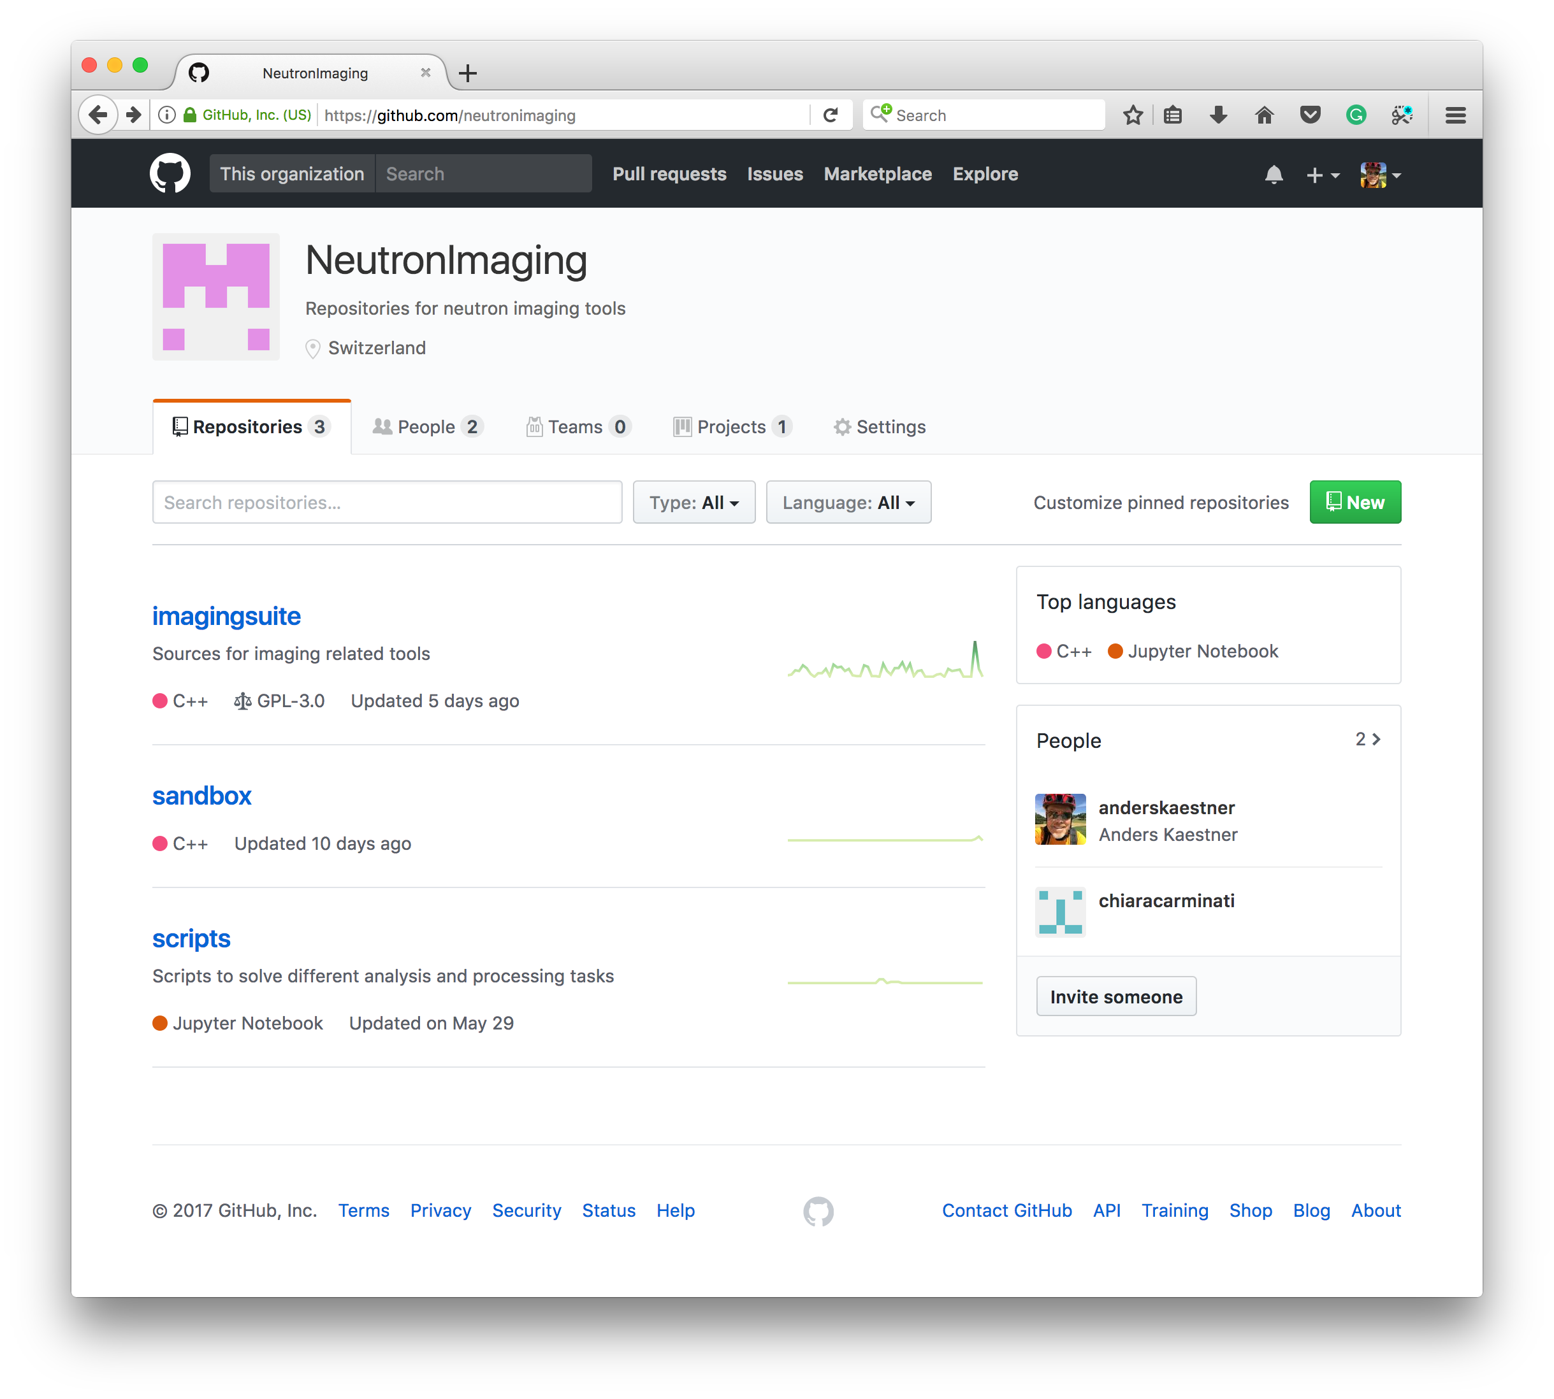
Open source and distribution - Repository
All developed code shall be open source
Done
Most of the code is transferred
License GPL 3.0
Issue tracking (GitHub)
Submit issue link in apps
Transfer remaining code
Prepare build scripts
Partly done
Setup automated build @ DMSC
Prepare build instructions
Update files with license header
Source repository https://github.com/neutronimaging

Slide 19
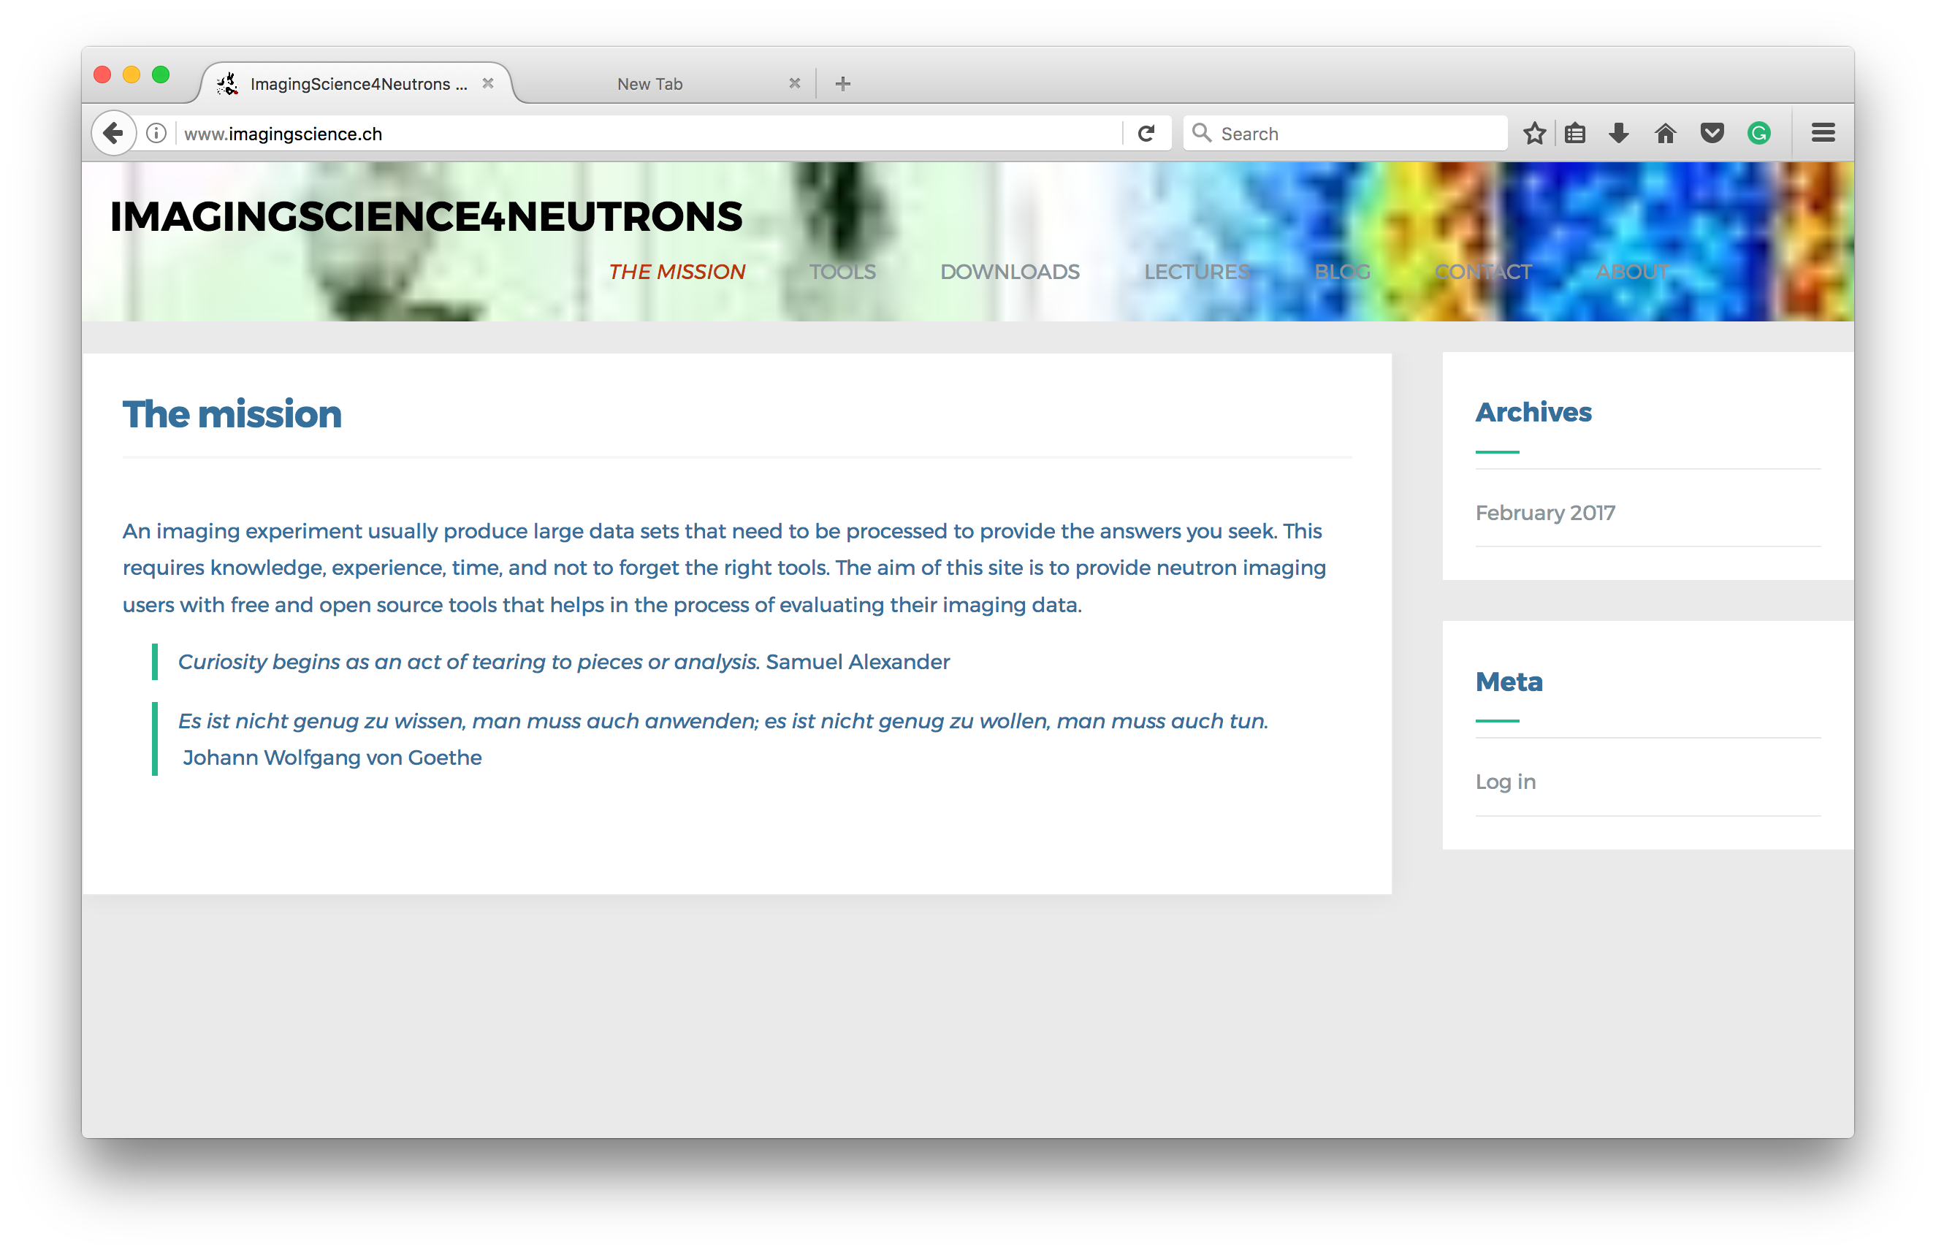
Open source and distribution – Binaries
Status
Web page using WordPress CMS
News letter mailing lists
  14 subscribers
Download counters
  Lectures > 600 downloads
  MuhRec 250 downloads
  KipTool 250 downloads
Releases ~ 6 months interval
Pending
Add more descriptions
Design a logo
Downloads @ http://www.imagingscience.ch

Slide 20
Design – Strict separation per purpose
Core
Basic functionality
Algorithms
I/O
Frameworks
Controls central processes
Configuration
GUI
Bind core and framework to GUI
Additional widgets
Applications
MuhRec
KipTool
ImageViewer

Slide 21

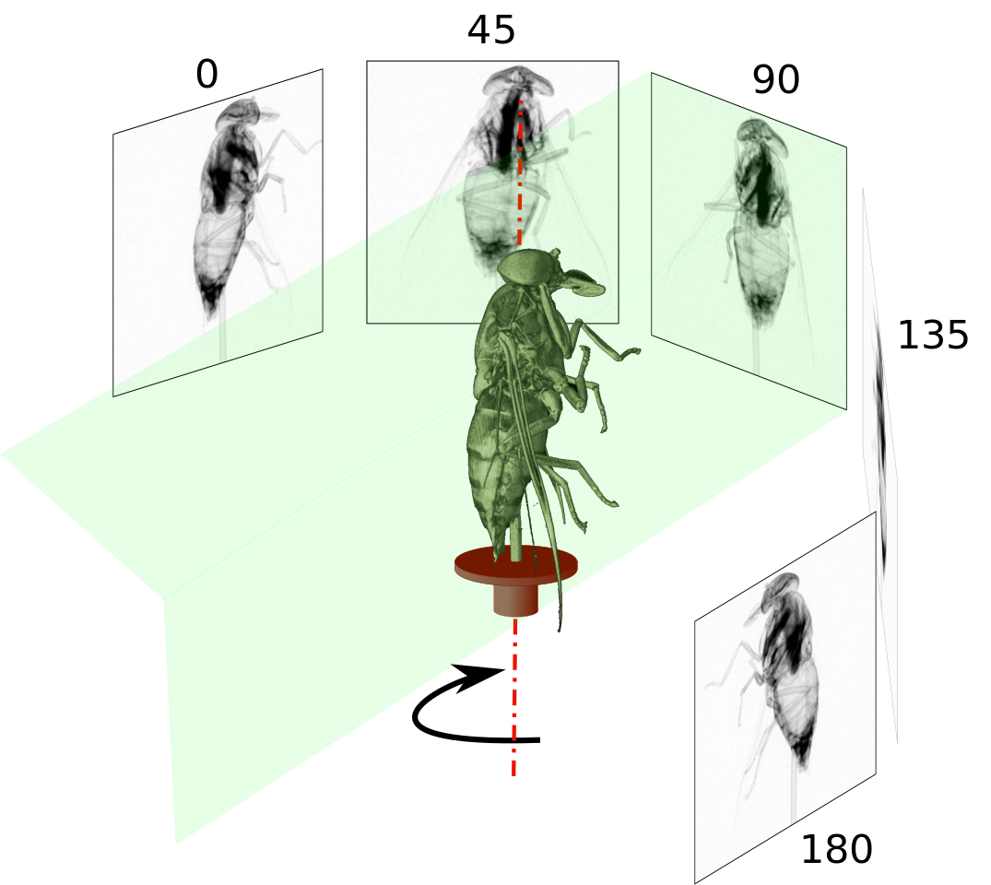
NI as data science process
Exploratory
Data
Analysis
Data collected
Data
is Processed
Clean
Data set
Models &
Algorithms
Data
product
Communicate
Visualize
Report
Make
Decisions
Reality/Experiment

