Slide 1
Imaging at the Spallation Neutron Source: Opportunities and Challenges
Jean Bilheux (*), Hassina Bilheux(**), Gian Song, Qingge Xie, Yuxuan Zhang, Jiao Lin, Ke An, Michael Kirka, Ryan Dehoff, Ducu Stoica, Sarma Gorti, Balasubramaniam (Rad) Radhakrishnan, Lou Santodonato
Oak Ridge National Laboratory
11th World Conference on Neutron Radiography
September 2-7, 2018
(*) bilheuxjm@ornl.gov
(**) bilheuxhn@ornl.gov

Slide 2
Advanced neutron imaging techniques at ORNL
At the Spallation Neutron Source:
  Bragg-edge imaging (this talk)
  Resonance imaging (Yuxuan Zhang)
At the High Flux Isotope Reactor CG-1D Imaging Beamline:
  Polarized imaging (Tianhao Wang)
  Spin Echo SANS (Fankang Li, proof-of-concept done in June at CG-1D)
  Grating interferometry (Les Butler @LSU, available Summer 2019 at CG-1D)
  Laminography (ongoing)
At both facilities:
  Advanced reconstruction and visualization (ongoing)
  Machine learning/artificial intelligence (statistical techniques to “teach” computers to learn, within reach but available when?)
Notes:
The neutron imaging program at ORNL continues to grow along with development activities with several collaborators at ORNL and LSU

Slide 3
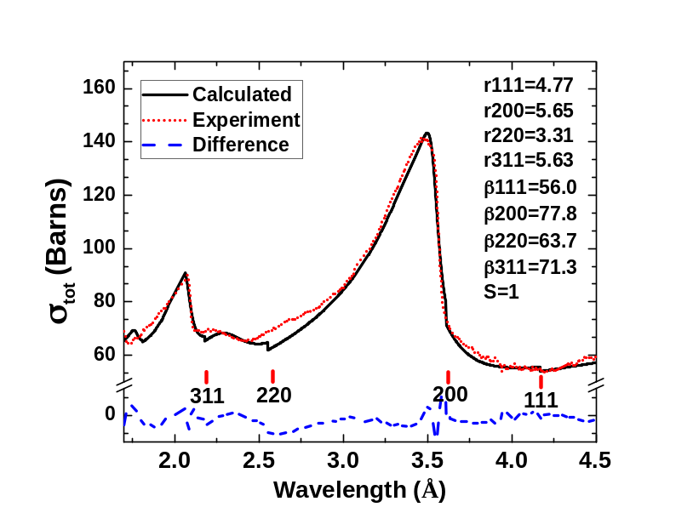
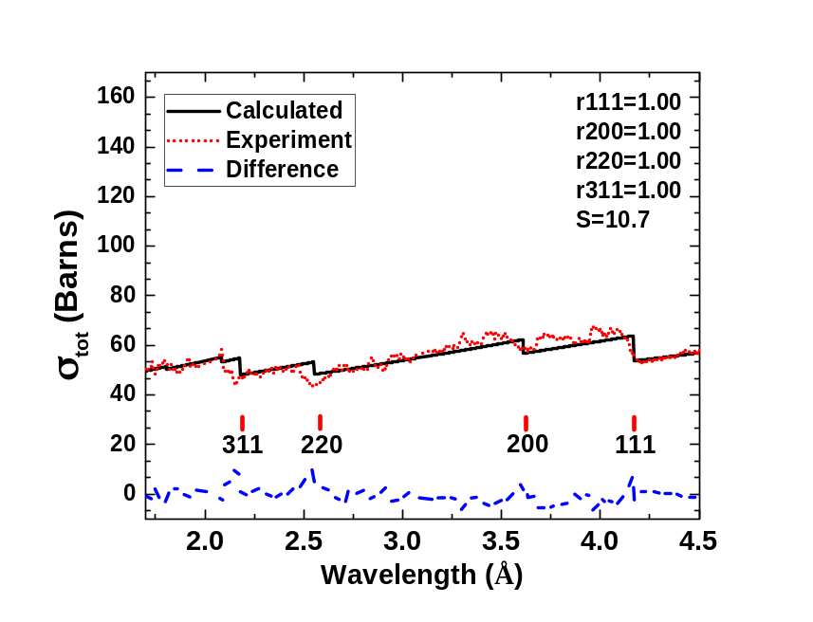
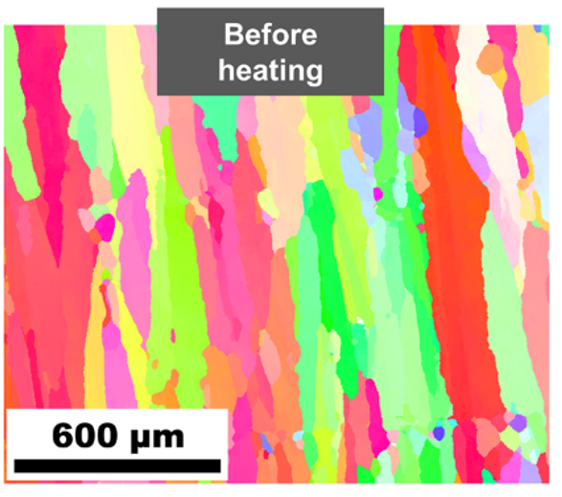
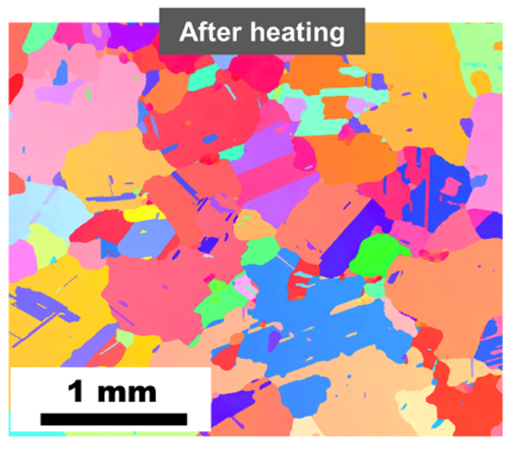
We have been actively developing TOF imaging
SNAP and VULCAN utilized for VENUS development
  generation of useful TOF data while VENUS in design and under construction
ORNL investments developing software tools and procedures
  Significant advances in data analysis and model fitting
TOF imaging techniques provide unique data:
    Wavelength-dependent imaging (or Bragg edge imaging): quantitative interpretation of total cross-section provides crystalline structure characterization at a spatial resolution of ~ 150 microns (we’ve developed a model for fitting the data for interpretation)
    Resonance imaging – isotopic-sensitive spatially-resolved spectroscopy technique
Quantitative analysis via Bragg-edge modeling of in-situ heated Additively Manufactured Inconel 718
²³⁸U resonance peaks
As-measured U238 peaks at the SNAP beamline compared to the database developed at SNS.
Notes:
SNAP is being upgraded to accommodate neutron imaging users while VENUS is being built. Please contact Hassina if you would like to measure in our next run cycle (Jan to May 2019). Proposals are due September 18th.
We can perform both Bragg edge and resonance imaging (we are developing our own fitting software for resonances). That’s because the established SAMMY software is only available to US citizens and green card holders.
Left: an example of microstructure evolution in Inconel 718 (Ni superalloy, 55% Ni) using Bragg edge (to be discussed during this presentation). We start with a columnar sample, we heat up to 1500 K and cool back down and obtain an equiaxed microstructure with larger grains.
Right: Resonances of U 238 as measured (dots) and simulated. We are evaluating the discrepancy between simulations (based on amount of material in the beam) and experiments. We think this might be due to background and gamma sensitivity of the detector.

Slide 4
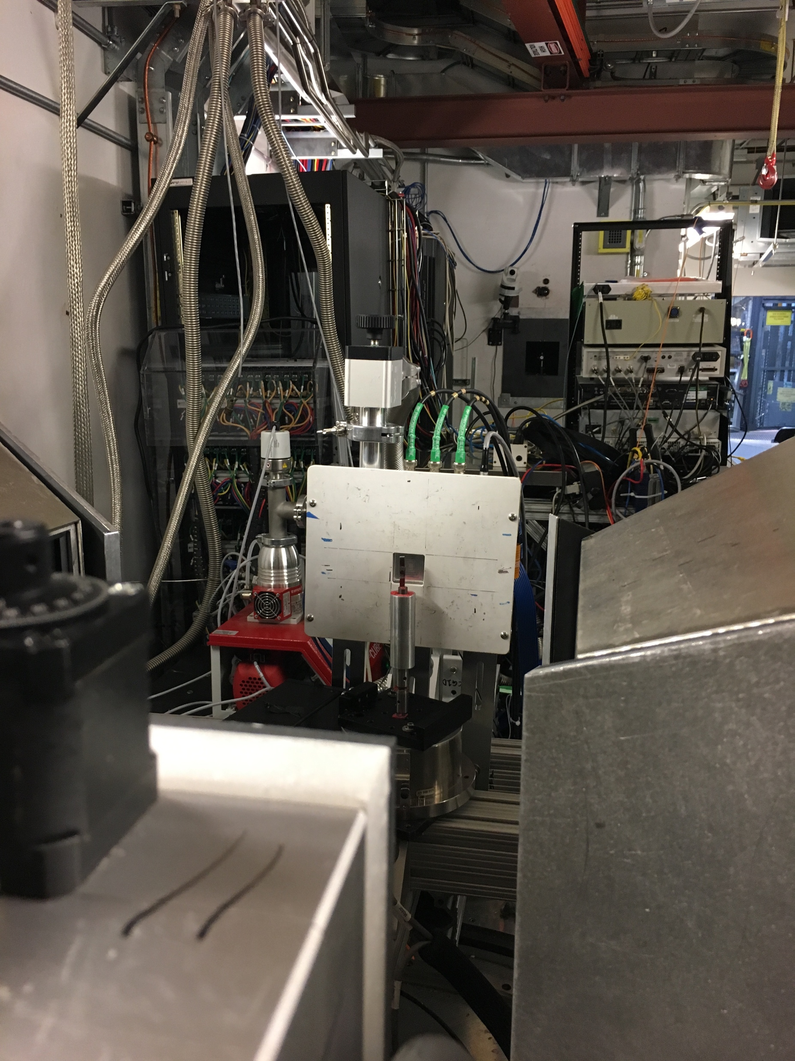
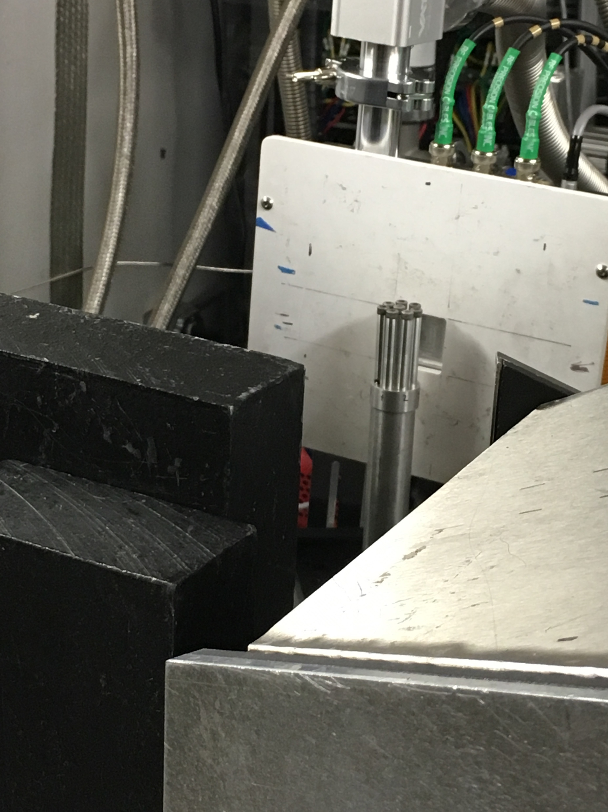
SNS SNAP Imaging (“Temporary” capability available to users)
Notes:
Setup at SNAP is being upgraded to accept imaging users. A photo of the current set up at 16 m (position of MCP). 15 m is where the diffraction sample sits. We add lead shielding to reduce the interactions of the fast neutrons and gammas with the MCP electronics (when too much radiation, the MCP freezes or has lines superimposed with data, so we have to power cycle it). Sample in the photo are nuclear TRISO SPHERES (3 mm diameter, U235/U238, Gd)
Right side: spectrum at SNAP
Green: T0 not phased properly and is letting gammas from the source through
Blue: T0 is phased properly and a sample is in place, which is shown by the decrease of flux around 1.25 to 2.5 Angs.

Slide 5
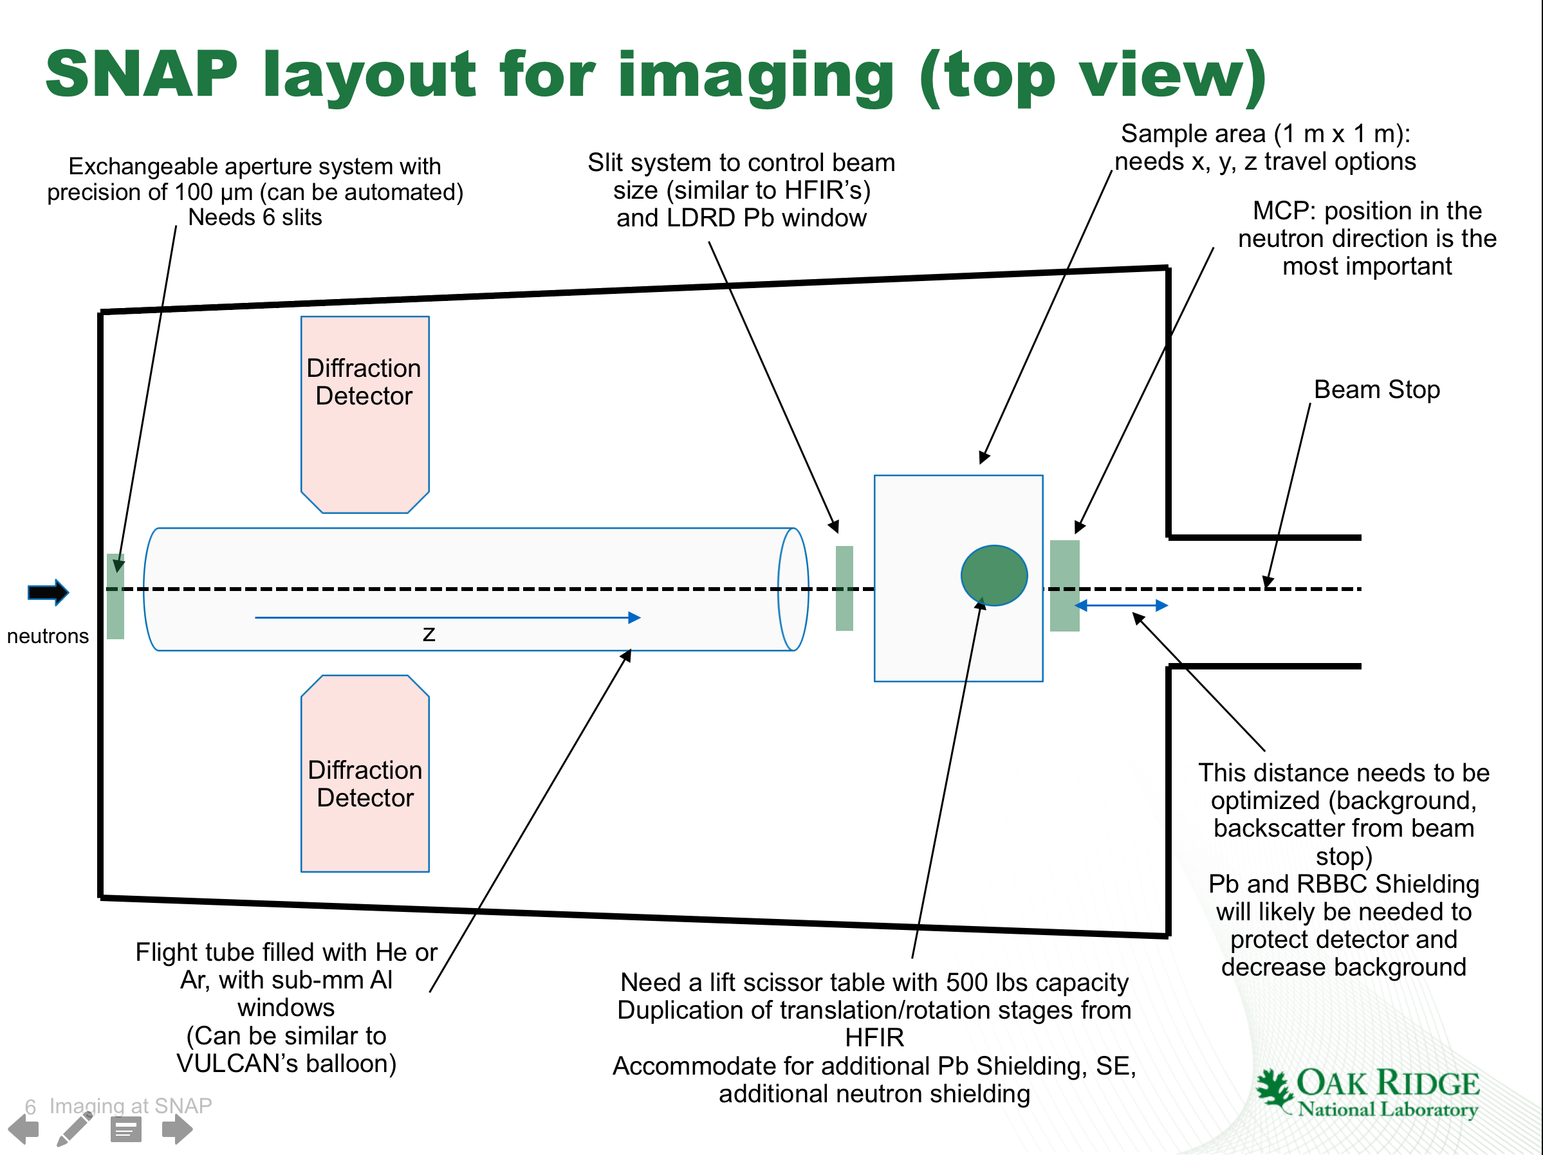

Slide 6
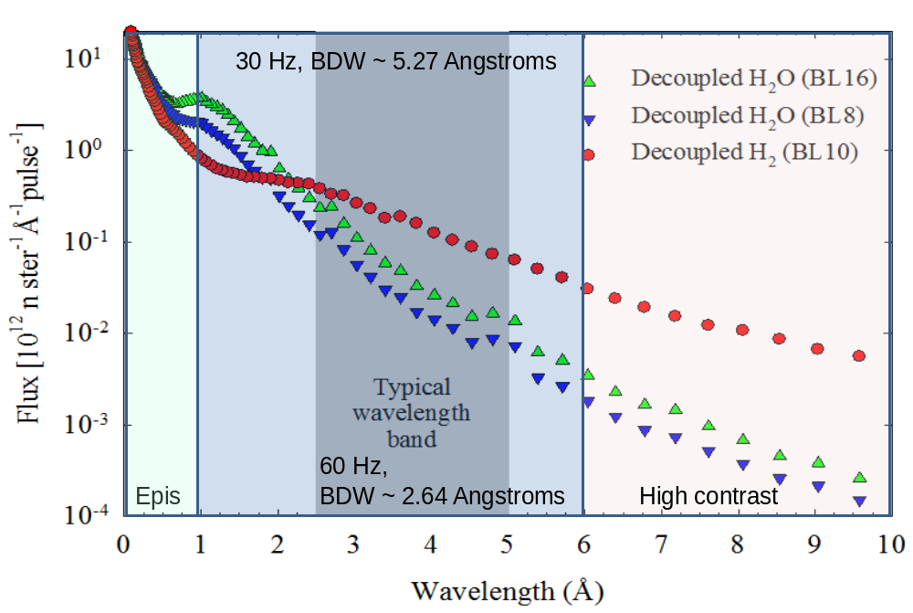
SNS VENUS (Future) Dedicated SNS Imaging Beamline
Beamline | Optimized for | Completion date | L/D | Max FOV (cm2) | Maximum Wavelength or BDW (Å) | Time resolution | Spatial resolution | Flux (n/cm2/s)
VENUS, ORNL (20 to 60 Hz, 1.4 MW) (20 and 25 m) | Imaging | TBD (3.5 years from October 1st 2018) | Up to 2000 | 28 x 28 | Up to 20 2.4 BDW (25 m) | Δλ/λ=0.15% (at 1 Å) | < 15 microns | 1 x 10^8 (L/D = 400)
Notes:
Flux is integrated over the bandwidth
T0, 1 single disk bandwidth chopper, one double disk bandwidth chopper, one single disk bandwidth chopper.
Thermal/cold aperture L/D = 400 to 2000
Epithermal aperture (1 m of steel)
Can run at 30 Hz and 60 Hz (even 20 Hz)

Slide 7
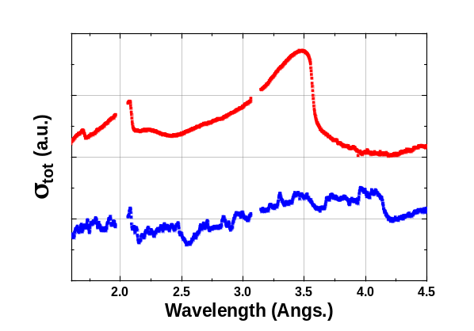
Neutron radiography and data reduction at a pulsed source
Two-dimensional TOF neutron radiograph
Field of view: 2.8 *2.8 cm²
Best option for data reduction but sometimes sample occupies whole detector area
Pixel size: 55*55 μm²
Sample
Empty place (Open Beam: OB)
Transmitted neutron (I₁)
Transmitted neutron (I₂)
Sample
Second best option is to use a beam monitor
Incident pulsed neutron beam
MCP detector
Region of interest
Incident neutron (I₀)
SNS energy distribution varies as a function of beam power
Cannot measure as a function of time but need to measure as a function of protons on target
Gamma discrimination is extremely important for resonance imaging
Bragg-edges
Slit system
Extract crystallographic information from the Bragg-edge spectrum
In-situ measurements (load frame or furnace)
Notes:
Beam is collimated with JJXray slits (Boron Nitride based slits) Sample sits close to MCP (28 mm x 28 mm).
We leave an area of the detector open to the beam for normalization because we realized the spectrum of the source can shit through time (within 12 hrs). It is a known fact but most beamlines measure bulk materials
Ideally, we need a beam monitor and protons on target (we don’t measure based on time at the SNS).

Slide 8
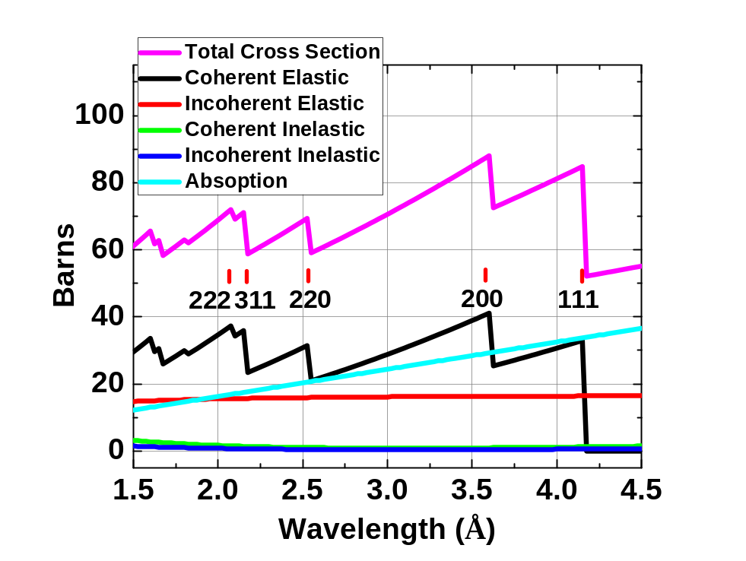
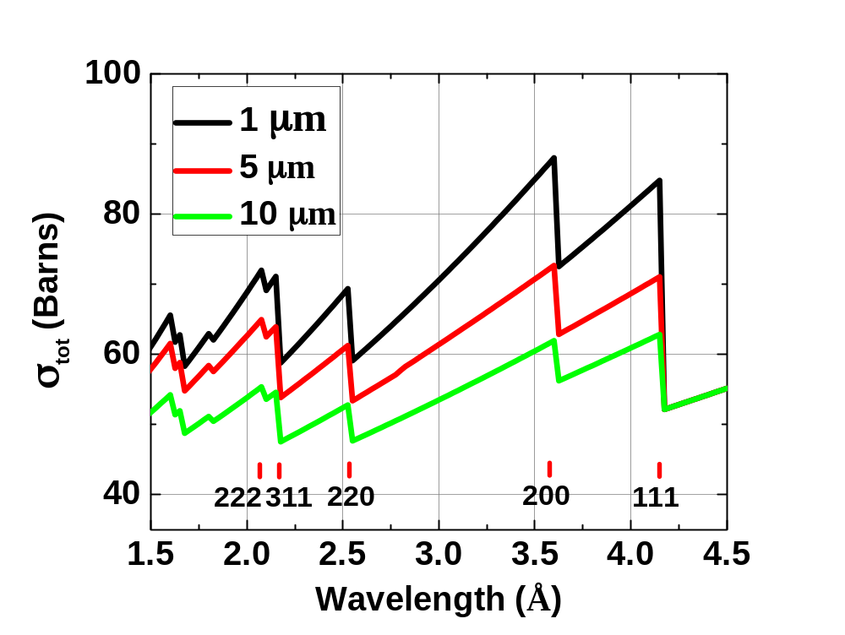
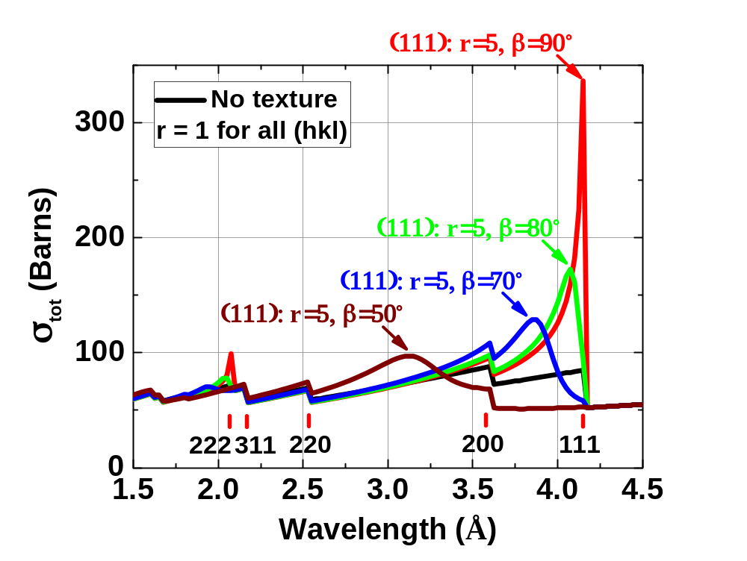
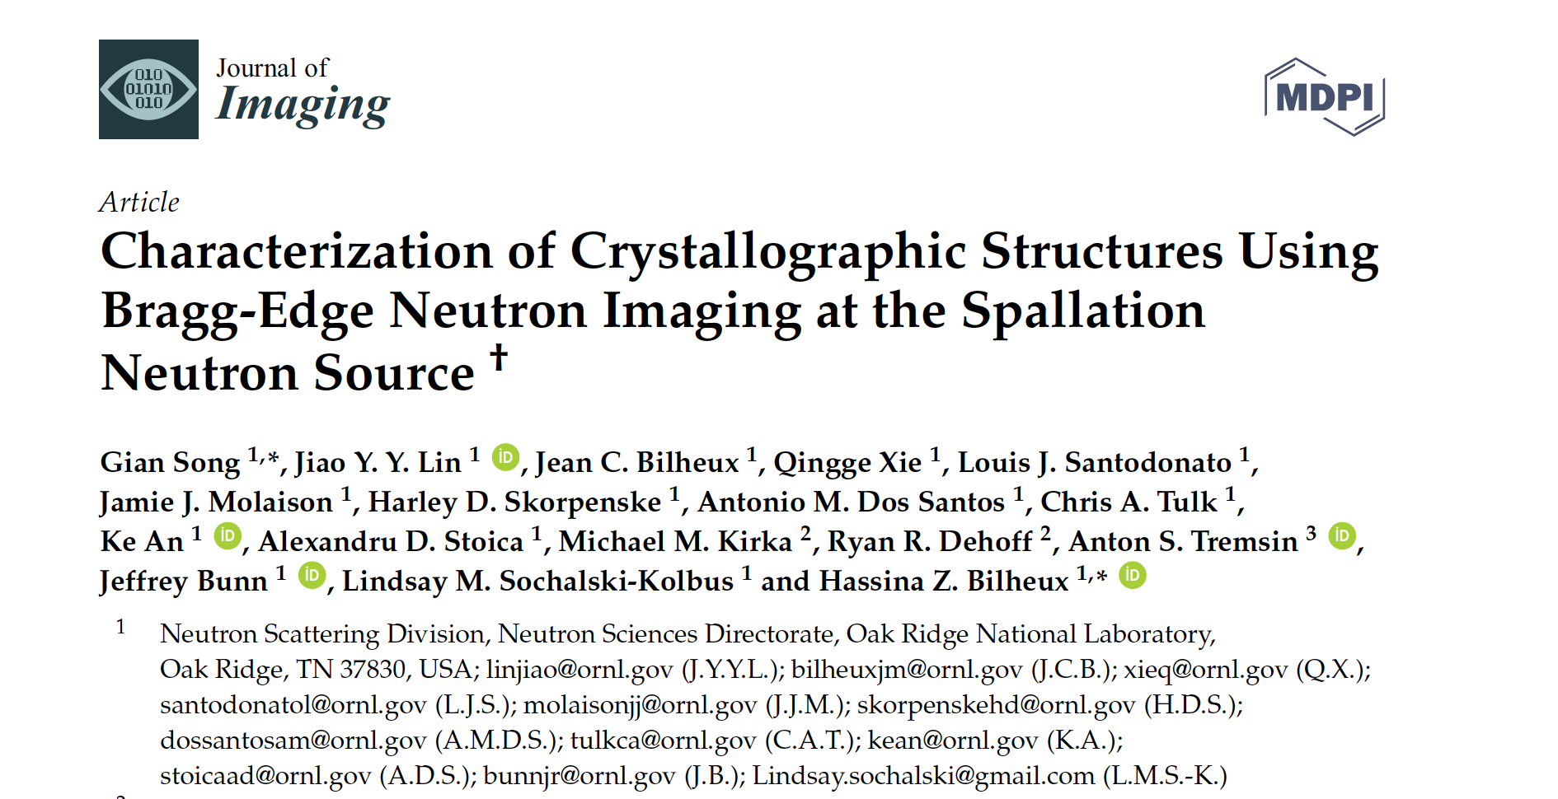
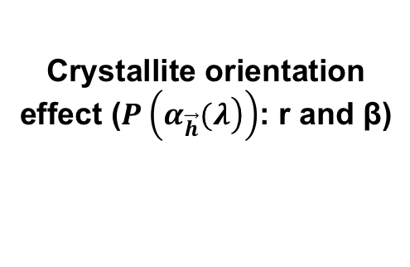
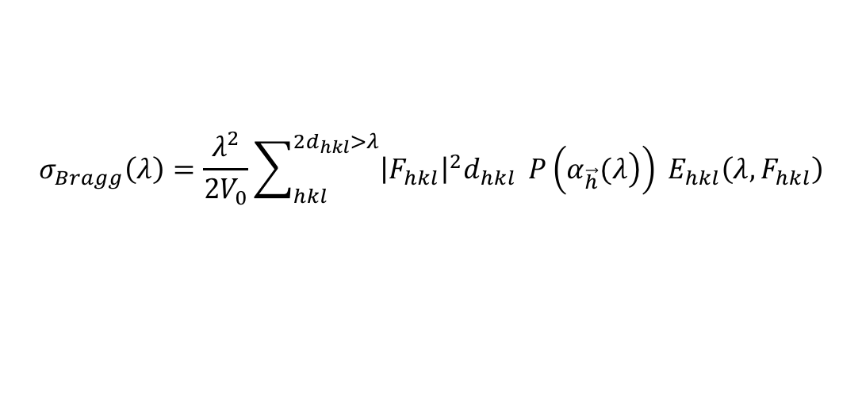
Crystallite orientation effect ($P\left(\left.α_{\vec{h}}(λ\right)\right)$: r and β)
Total cross section for Inconel 718
Crystallite size effect
(E_{hkl})
r_{hkl}: crystallite anisotropy
β_{hkl}: most probable angle
Granada, J. R. Zeitschrift für Naturforschung A 39, 1160 (1984).
2. Binder, K. physica status solidi (b) 41, 767-779 (1970).
Sabine’s primary extinction model
𝜆: wavelength
𝑉₀: volume of unit cell
F_{hkl}: Structure factor including Debye-Waller factor
d_{hkl}: plane spacing
$$σ_{Bragg}\left(λ\right)=\frac{λ^{2}}{{2V}_{0}}\sum_{hkl}^{{2d}_{hkl}>λ}{{\left|F_{hkl}\right|}^{2}d_{hkl}} P\left(\left.α_{\vec{h}}(λ\right)\right) E_{hkl}\left(λ,F_{hkl}\right)$$
March-Dollase model
Vogel, S. PhD thesis, Christian-Albrechts Universität Kiel, (2000).
Sabine, T. Acta Crystallographica Section A. 44, 368-374 (1988).
Song, et al., “Thermally-Induced Dynamic Evolution of Additively Manufactured Metal Microstructures”, J. of Imaging, 2017.
Notes:
We started with the established March-Dollase method developed years ago. We implemented the algorithm in Python notebooks
ALL THESE ARE SIMULATIONS
Top left: bragg’s cross section = coherent elastic cross-section. It is the cross-section responsible for Bragg edges we see.
The plot shows all cross-sections for Inconel 718 powder, perfect case with sharp edges
Middle: Effect of the crystallite size (based on Sabine’s primary extinction function). S is not the crystallite size but is representative of it.
When the crystallite size increases, the bragg edges decreases.
Right: All hkl are kept with no preferred orientation but <111>. They all have an r = 1 (which means random grain orientation). The only textured hkl is 111. We vary the orientation of the 111 grains and the 111 grains start contributing to hkls that happen that shorter wavelengths, making Bragg edge interpretation difficult.
This means it is important to know the microstructure of the sample (i.e. grain orientation).

Slide 9
Fitting and interpretation of the data
(200)
(111)
r_{hkl} = 1, random grain orientation
r_{hkl} ≠ 1, fiber or plate-shaped distribution (i.e. here columnar)
S (in microns) increases as a function of temperature, from 1 to 2.6, and finally reaching 10.7, indicating grain size growth
Notes:
From left to right, heating and cooling of a 5 mm thick block of Inconel 718. Starts with a strong preferred 200 orientation (columnar grains), then the 200 peak starts to go down with heating due to Debbye Waller effect (vibration of atoms in material). Sample is cooled down and the Bragg edges are not recovered. The sample looks like a power sample after being cooled (last image at 478K).
All r values go to 1 (random grain orientation) and the S factor (indicative of crystallite size) has gone up, indicating crystal growth.
This results shows grain growth and reorientation of 3D printed Inconel.

Slide 10
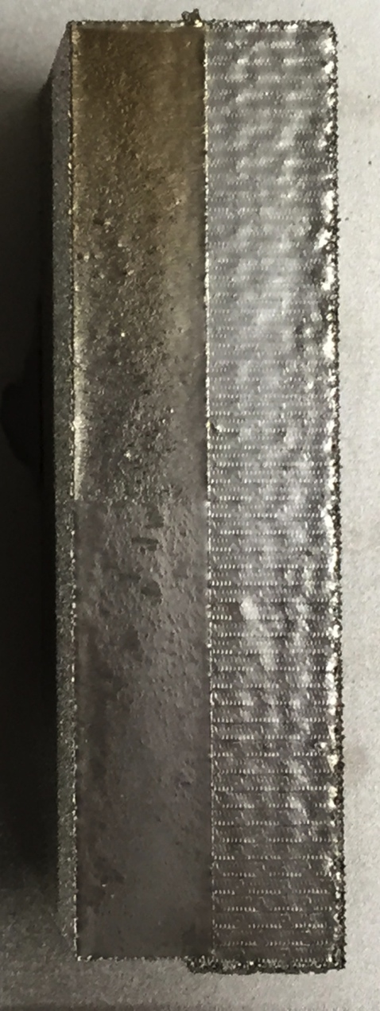
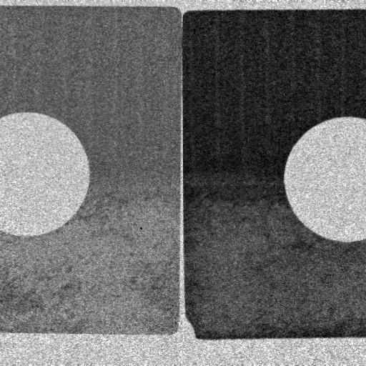
In-situ mechanical testing on interface behavior using wavelength neutron radiography
Standard Melt
Modified Melt
Thin Specimen
Thick Specimen
Modified Melt
Standard Melt
[001]
10mm
Notes:
Left: 3D printed Inconel 718 with two different melt protocols, resulting in different preferred grain orientation. These new hybrid metals have unique mechanical properties that are not well understood, especially at the interface.
Right: 5 mm (left) and 10 mm (right) dog bone samples showing preferred grain orientation with Bragg edge imaging. These measurements were acquired over a time period of 1hr.

Slide 11
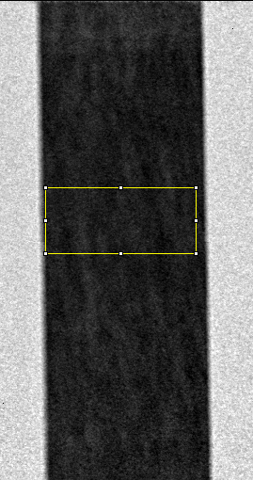
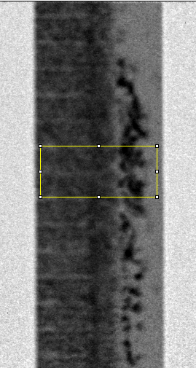
Single Columnar Structure
Dual Columnar Structure
(200)
(200)
15 MPa (before straining)
3.30
Position y (mm)
15 MPa (before straining)
3.30
0.00
Position y (mm)
200 MPa
3.30
0.00
Position y (mm)
400 MPa
3.30
Position y (mm)
0.00
400 MPa
3.30
0.00
550 MPa
Position y (mm)
3.30
Position y (mm)
0.00
(200)
(200)
0.00
550 MPa
3.30
0.00
1.65
3.30
4.95
6.60
8.80
Position y (mm)
Position x (mm)
0.00
0.00
1.65
3.30
4.95
6.60
8.80
Fitting curves
Fitting curves
Position x (mm)
(a)
(b)
Notes:
10 x 10 pixels square

Slide 12
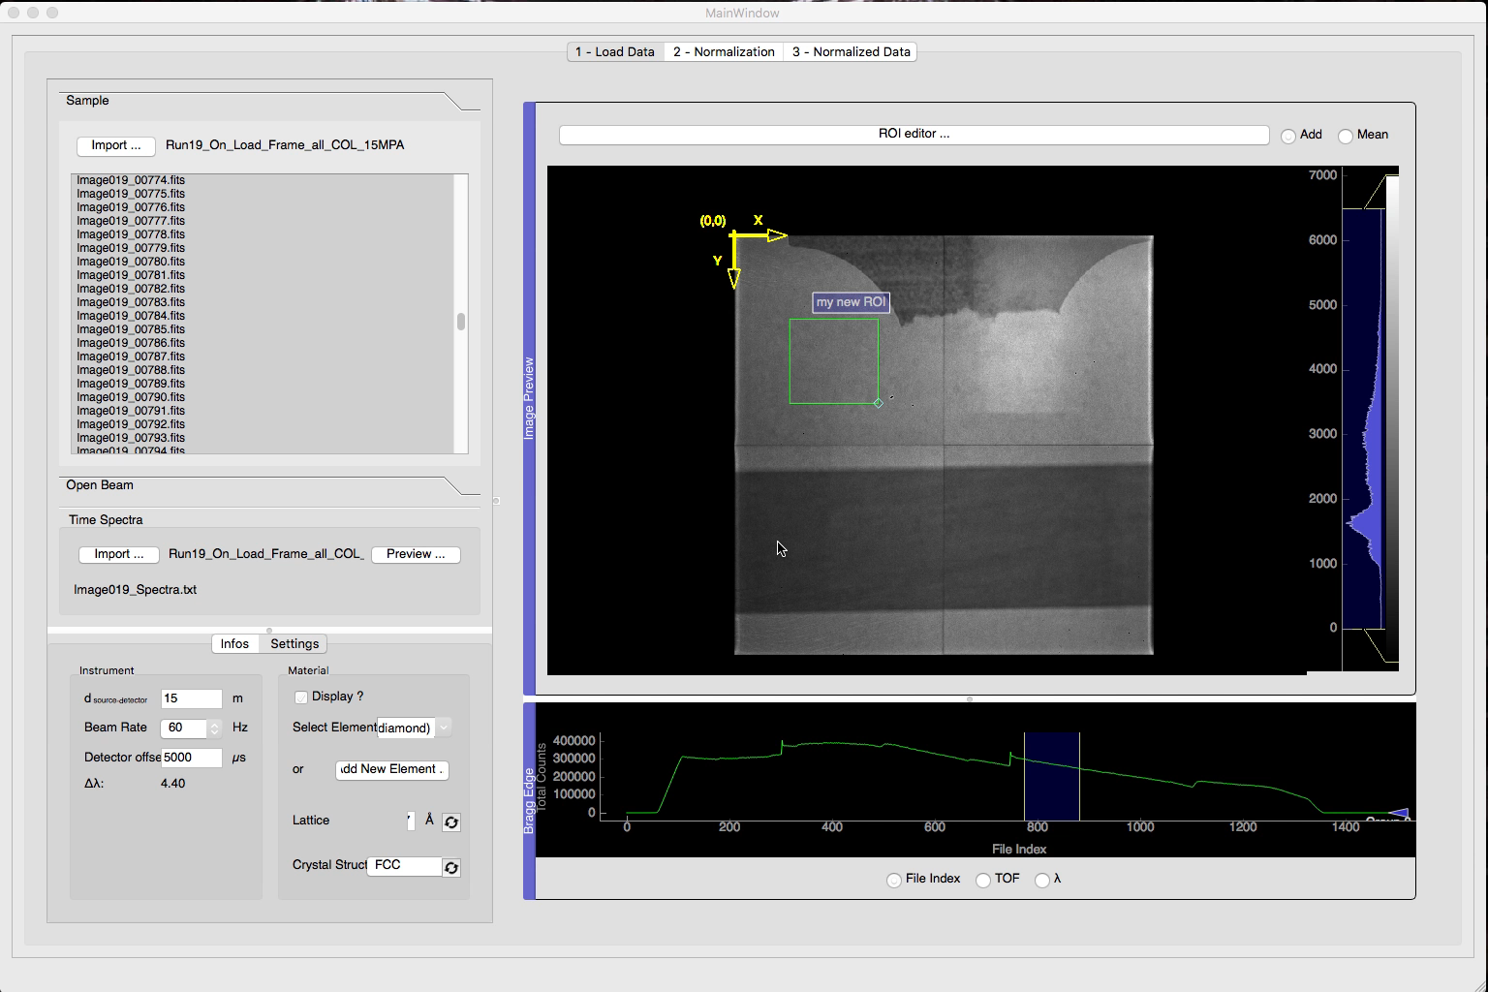
Software: a required tool for accurate and fast processing of wavelength-dependent neutron radiography: iBeatles

Slide 13
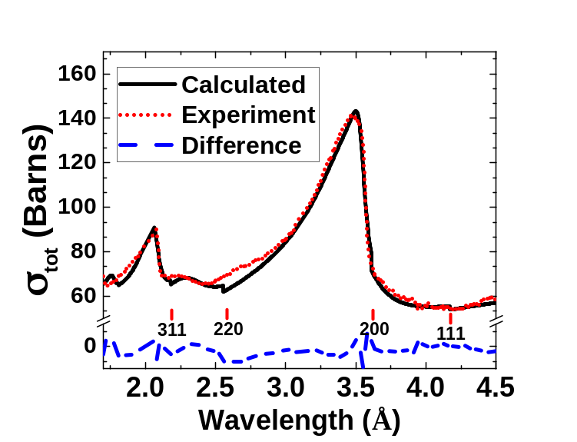
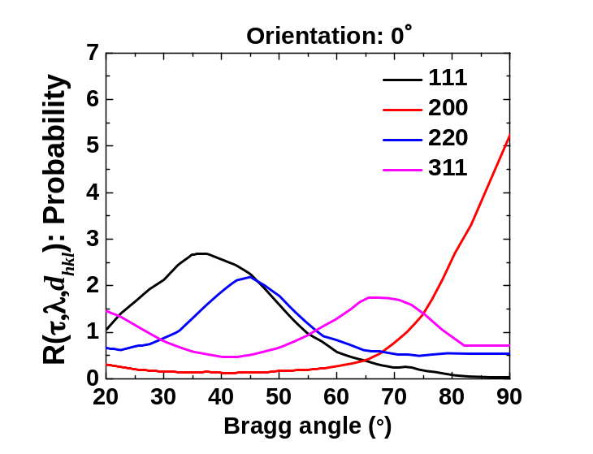
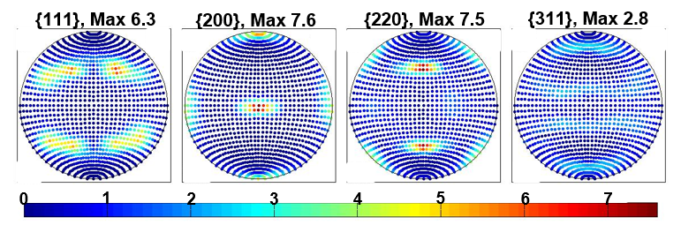
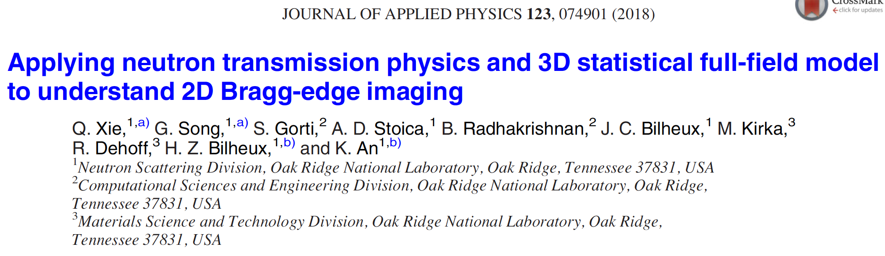
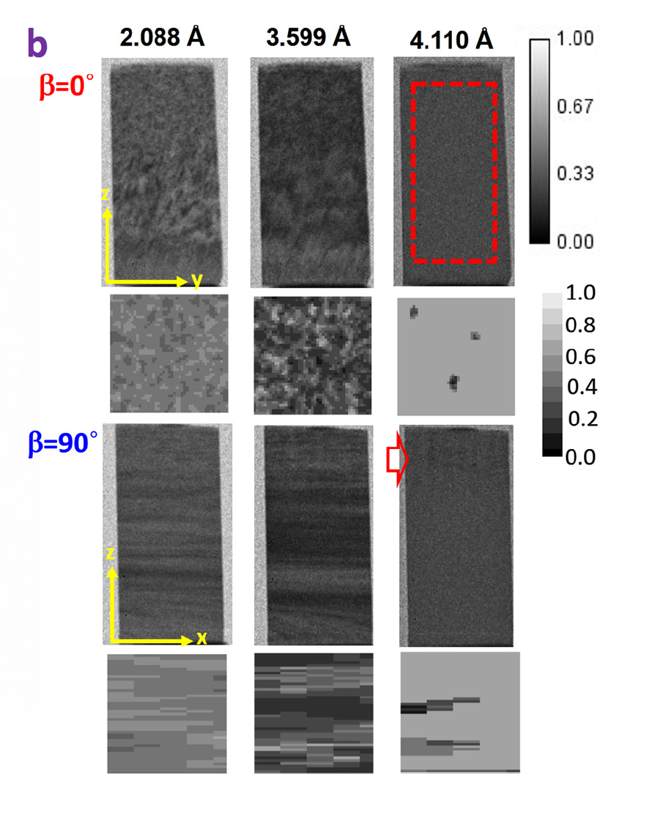
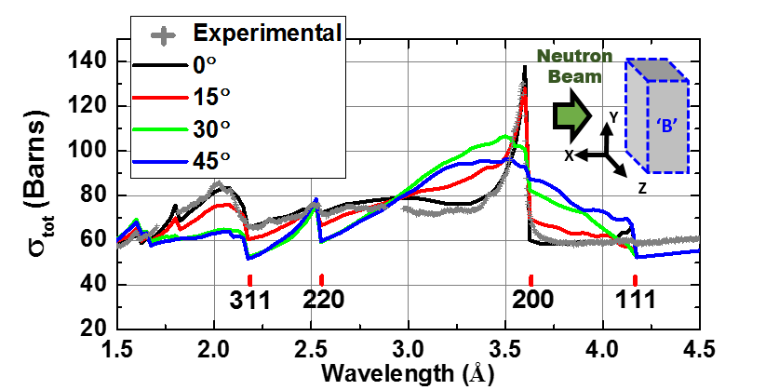
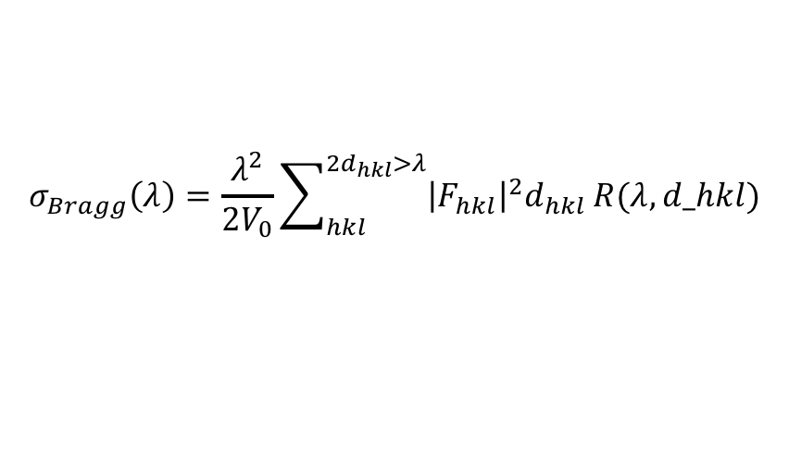
Validation of Bragg-edge imaging results using neutron diffraction
Bragg edge CT at SNS SNAP
Texture measurements at SNS VULCAN
$$σ_{Bragg}\left(λ\right)=\frac{λ^{2}}{{2V}_{0}}\sum_{hkl}^{{2d}_{hkl}>λ}{{\left|F_{hkl}\right|}^{2}d_{hkl}}R(λ,d_hkl)$$
Bunge, H.-J. Texture analysis in materials science: mathematical methods. (Elsevier, 2013)
Notes:
We developed a new way to combine diffraction and imaging data to predict Bragg edges at different angles the sample has with the beam, imitating the change in orientation of the grains.
Top left: Example of one data set: In black, modeled with our new method, experiment and difference between the two.
Top middle: Pole figures of our sample from VULCAN are used to replace the March-Dollase model and Sabine’s equation by the R factor, which depends on the neutron wavelength and the dspacing (dhkl).
Top right: R factor as a function of Bragg angle (betha).
Bottom left: Experimental data at different orientations of the sample with the beam.
Bottom middle: comparison between march dollase and our new approach: Our new approach is capable of mapping nuances in the experimental Bragg edge data (see 111)
Bottom right: we can not only predict the bragg edges as a function of orientation of the grains, we can predict what the images will look like.
We are converting the fortran + matlab codes into Python to make it available to the user community

Slide 14
Acknowledgments
Research sponsored by the Laboratory Directed Research and Development Program of Oak Ridge National Laboratory, managed by UT-Battelle LLC, for DOE.
Resources at the High Flux Isotope Reactor (HFIR) and Spallation Neutron Source (SNS), U.S. DOE Office of Science User Facilities operated by ORNL, were used in this research.
Research at Manufacturing Demonstration Facility (MDF) was sponsored by the U.S. Department of Energy, Office of Energy Efficiency and Renewable Energy, Advanced Manufacturing Office, under contract DE-AC05- 00OR22725 with UT-Battelle, LLC.
Thanks to J. Molaison, M. Frost and H. Skorpenske for setting up the detector and furnace at the SNS beamlines.

Slide 15
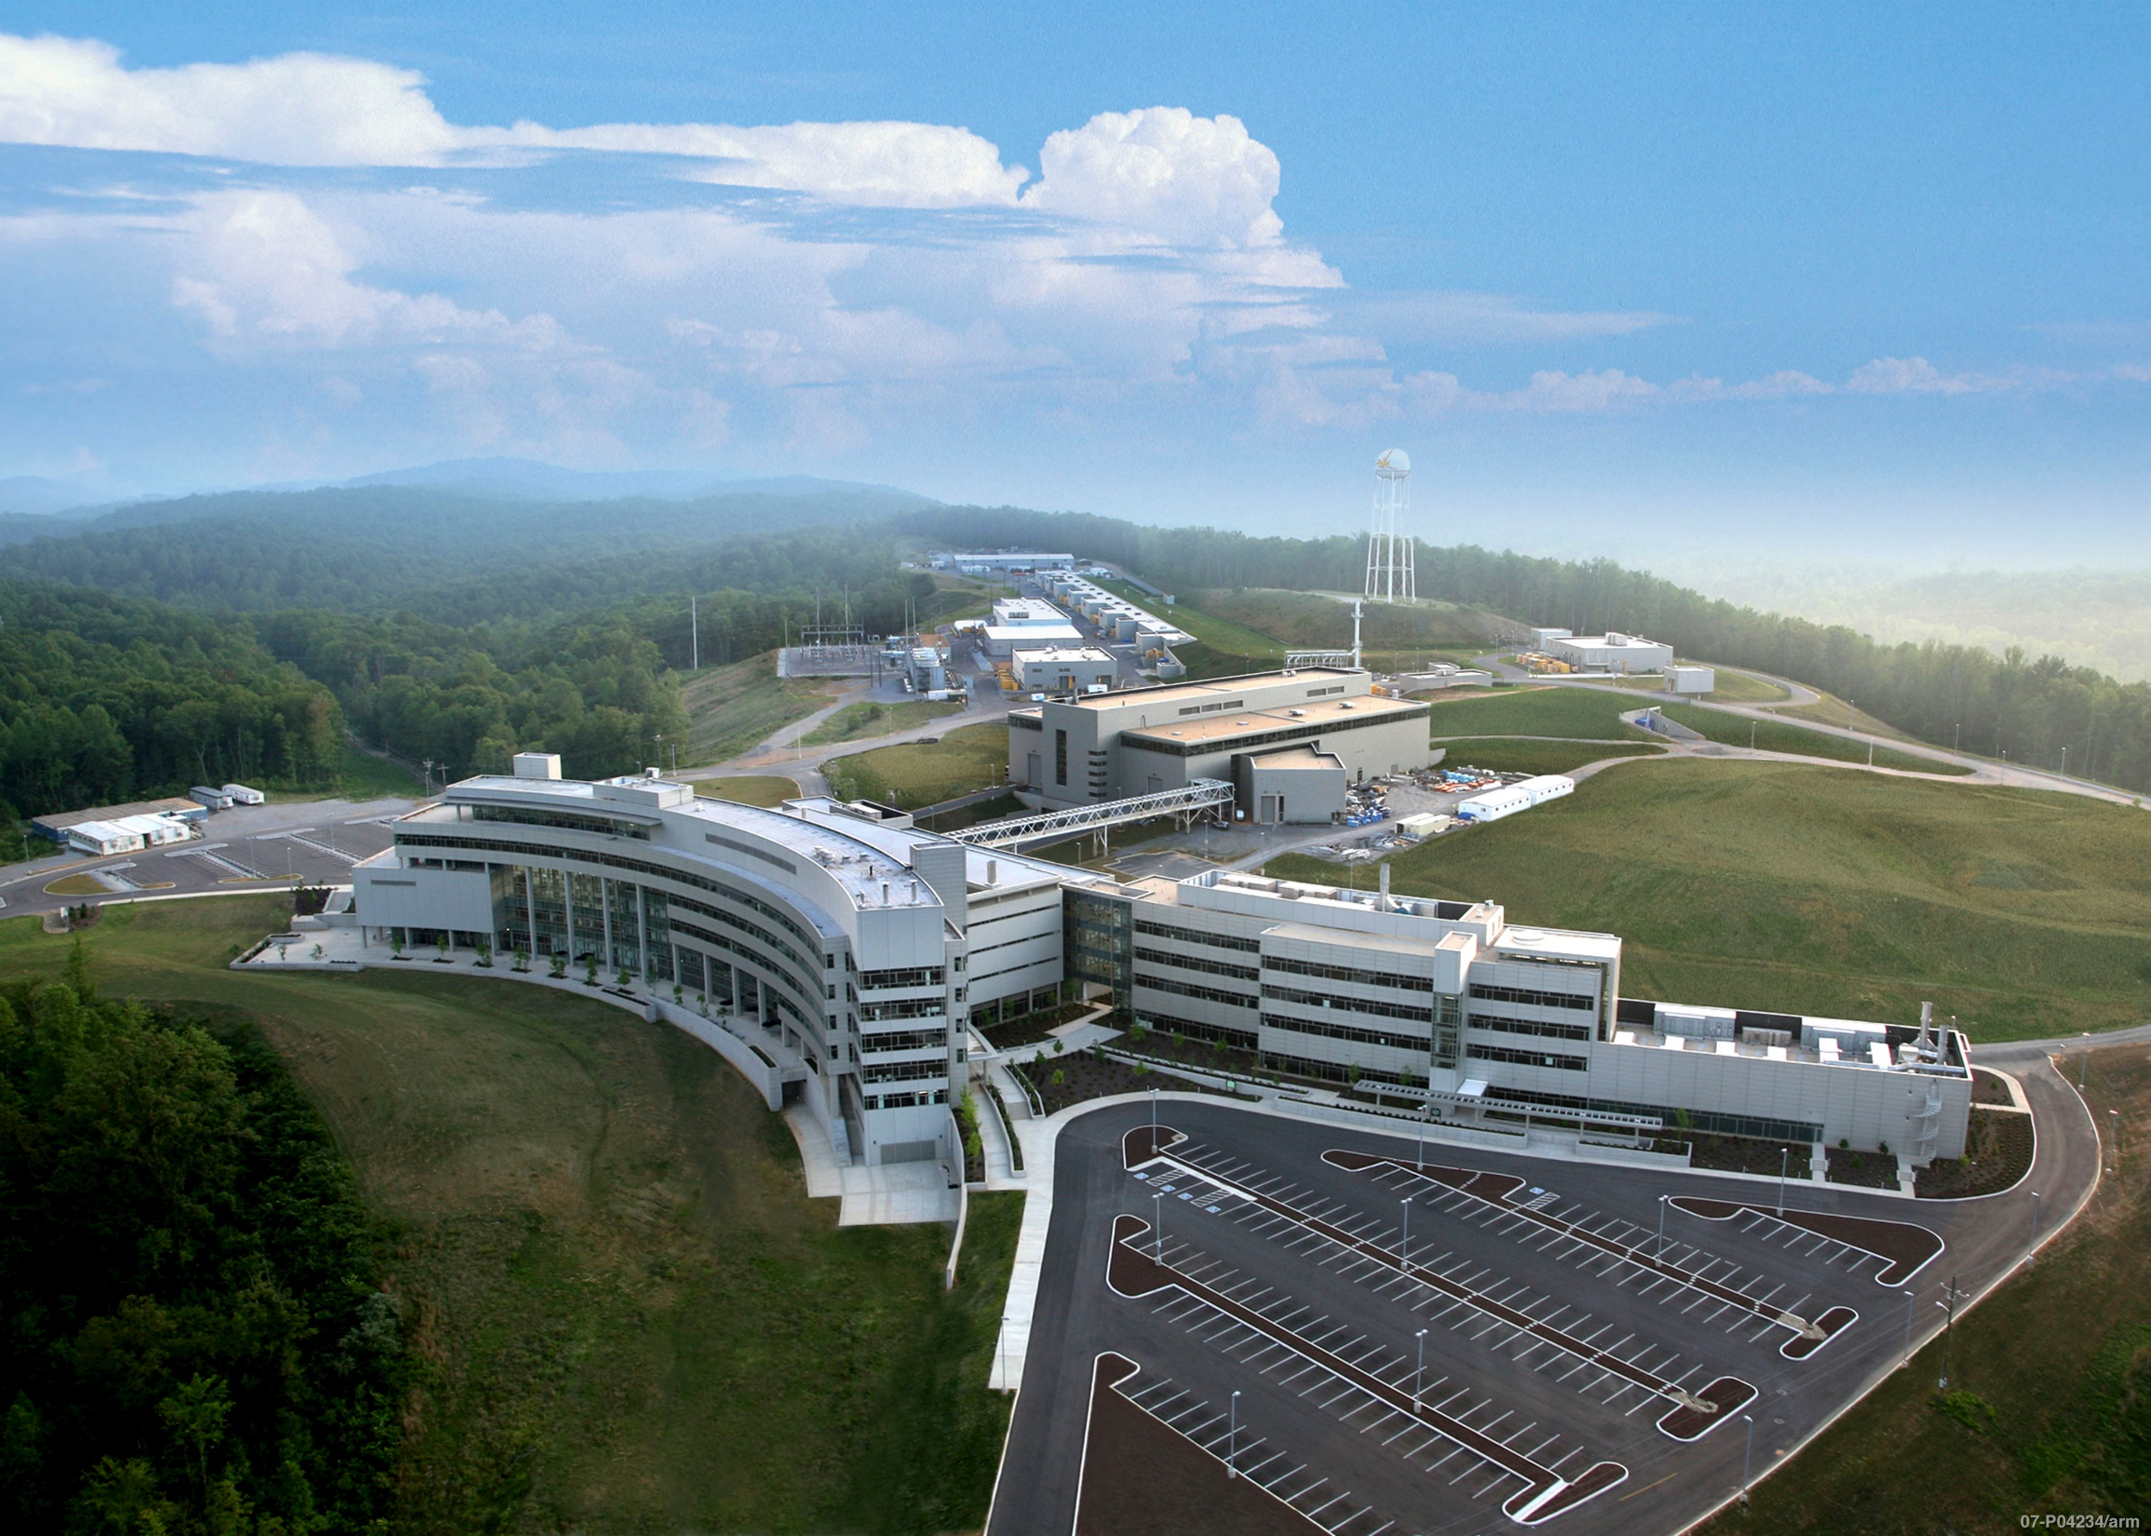
Thank you
neutrons.ornl.gov/
neutronimaging.pages.ornl.gov
The Spallation Neutron Source

Slide 16
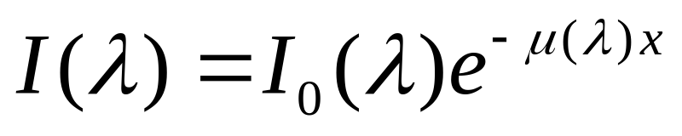
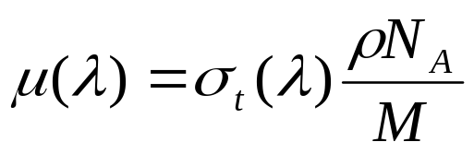
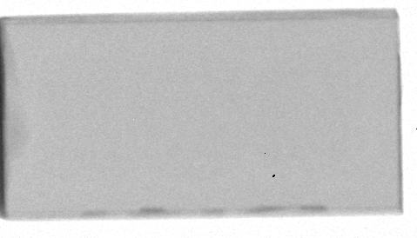
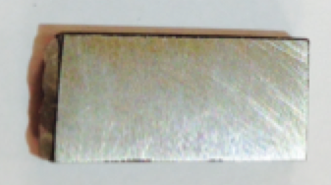
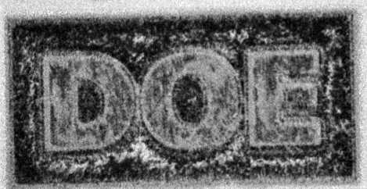
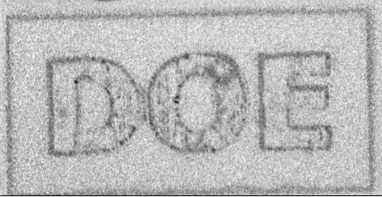
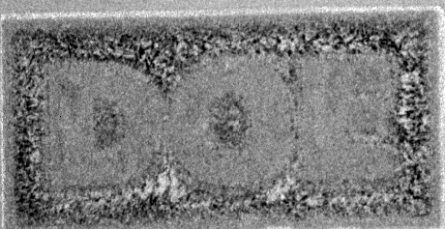
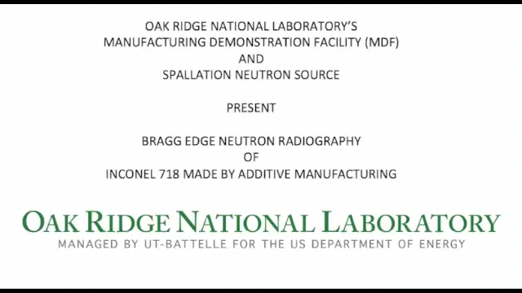
Principle of wavelength-dependent neutron radiography (or Bragg edge imaging)
Spallation neutron sources discriminate neutron wavelength (or energy) by using the time-of-flight (TOF) technique
Wavelength-dependent (or TOF) neutron radiographs
(Discrete neutron wavelengths)
White-beam (or reactor-based) neutron radiograph:
sums over all neutron wavelengths
One radiograph
t₁ or λ₁
t₂or λ₂
t_{n}or λ_{n}
Thousands of radiographs
2.0 cm

Slide 17
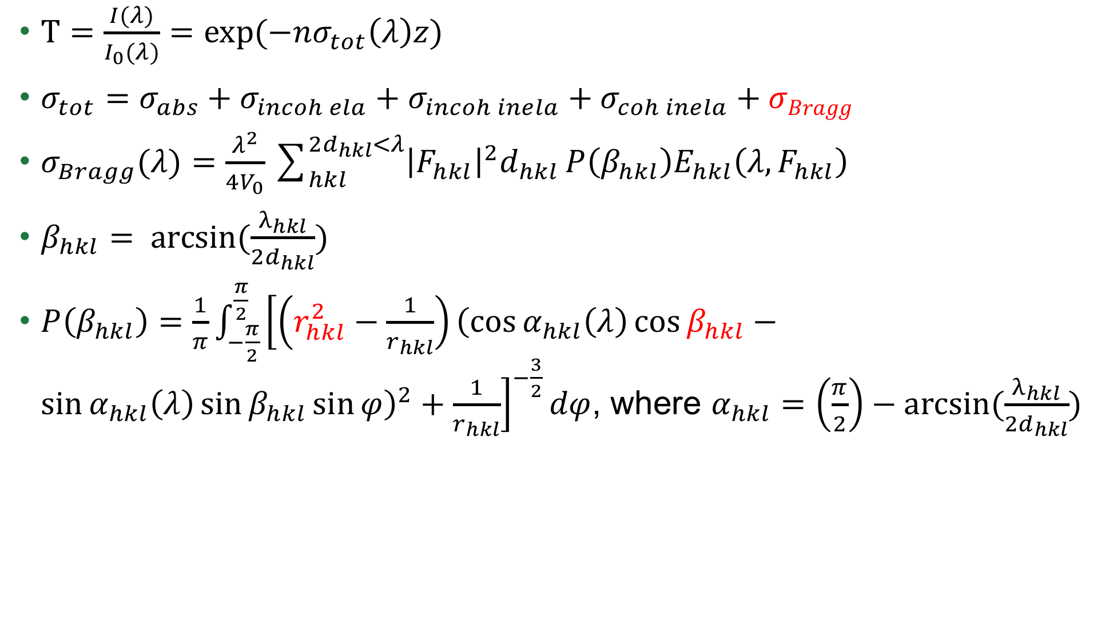
Theory of wavelength-dependent neutron radiography
$T=\frac{I(λ)}{I_{0}(λ)}=exp(−nσ_{tot}\left(λ\right)z)$
$σ_{tot}=σ_{abs}+σ_{incoh ela}+σ_{incoh inela}+σ_{coh inela}+σBragg$
$σ_{Bragg}(λ)=\frac{λ^{2}}{{4V}_{0}}\sum_{hkl}^{{2d}_{hkl}<λ}{{\left|F_{hkl}\right|}^{2}d_{hkl}}P\left(β_{hkl}\right)E_{hkl}\left(λ,F_{hkl}\right)$
$β_{hkl}= arcsin(\frac{λ_{hkl}}{{2d}_{hkl}})$
$P\left(β_{hkl}\right)=\frac{1}{π}\int_{−\frac{π}{2}}^{\frac{π}{2}}{{\left[\left(r_{hkl}^{2}−\frac{1}{r_{hkl}}\right){\left(\cos{α_{hkl}\left(λ\right)}\cos{β_{hkl}}−\sin{α_{hkl}\left(λ\right)}\sin{β_{hkl}}\sin{φ}\right)}^{2}+\frac{1}{r_{hkl}}\right]}^{−\frac{3}{2}}dφ}$, where $α_{hkl}=\left(\frac{π}{2}\right)−arcsin(\frac{λ_{hkl}}{{2d}_{hkl}})$
Depends on the crystallite size along the beam direction
Most probable angle of preferred grain orientation
Degree of crystalline anisotropy
E. Fermi, W. Sturm, R. Sachs. The transmission of slow neutrons through microcrystalline materials, Physical Review 71 (1947) 589.

Slide 18
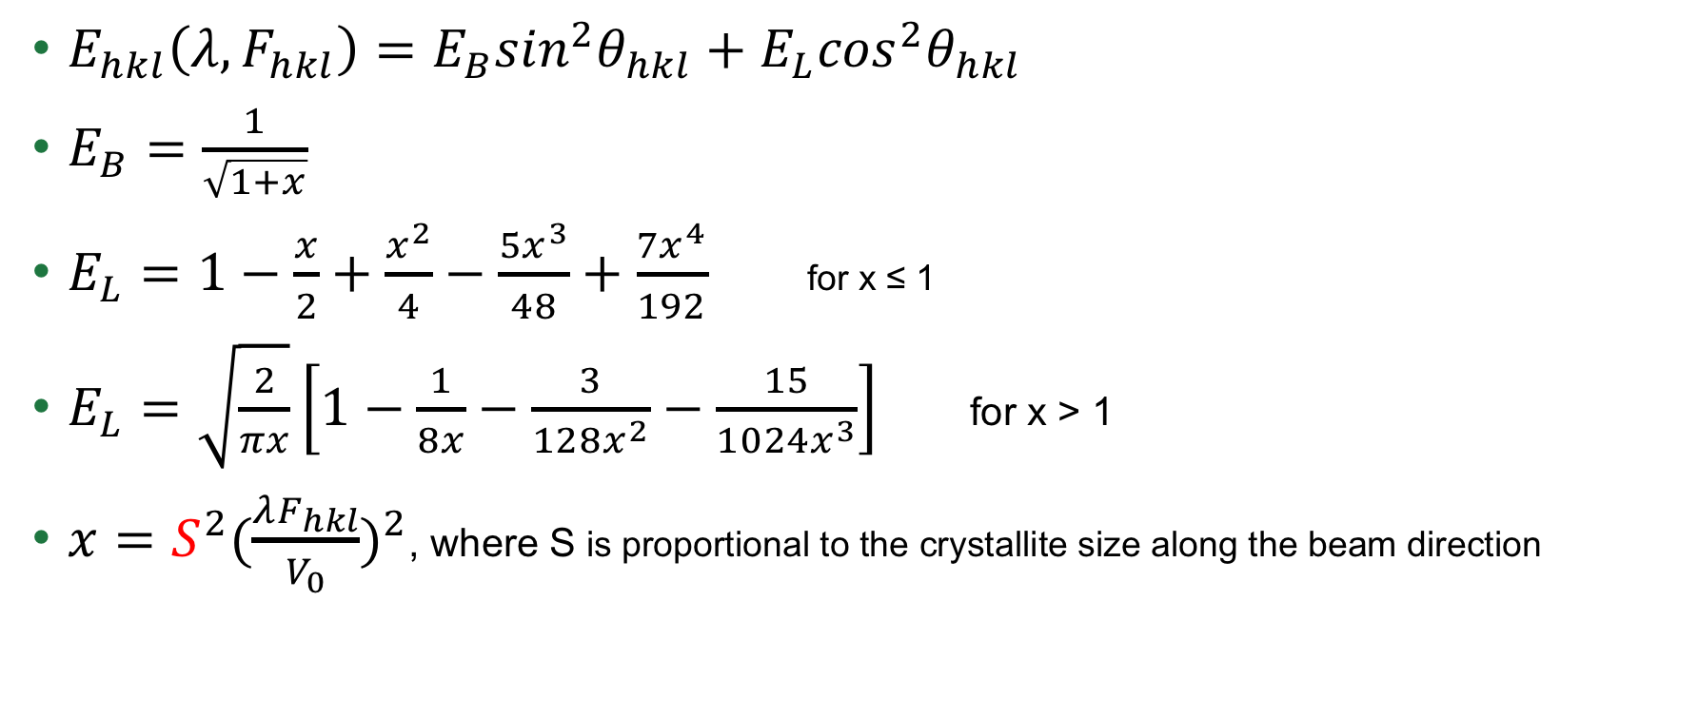
Theory of wavelength-dependent neutron radiography (cont’d)
Back-scatter and Laue (forward-scatter) contributions
$E_{hkl}\left(λ,F_{hkl}\right)=E_{B}\sin^{2}θ_{hkl}+E_{L}\cos^{2}θ_{hkl}$
$E_{B}=\frac{1}{\sqrt{1+x}}$
$E_{L}=1−\frac{x}{2}+\frac{x^{2}}{4}−\frac{5x^{3}}{48}+\frac{7x^{4}}{192}$ for x ≤ 1
$E_{L}=\sqrt{\frac{2}{πx}}\left[1−\frac{1}{8x}−\frac{3}{128x^{2}}−\frac{15}{1024x^{3}}\right]$ for x > 1
$x=S^{2}{(\frac{λF_{hkl}}{V_{0}})}^{2}$, where S is proportional to the crystallite size along the beam direction
T.M. Sabine, R.B. Von Dreele, J.-E. Jorgensen. Extinction in time-of-flight neutron powder diffractometry, Acta Crystallographica Section A 44 (1988) 374-379.
T. Sabine. A reconciliation of extinction theories, Acta Crystallographica Section A: Foundations of Crystallography 44 (1988) 368-374.

Slide 19
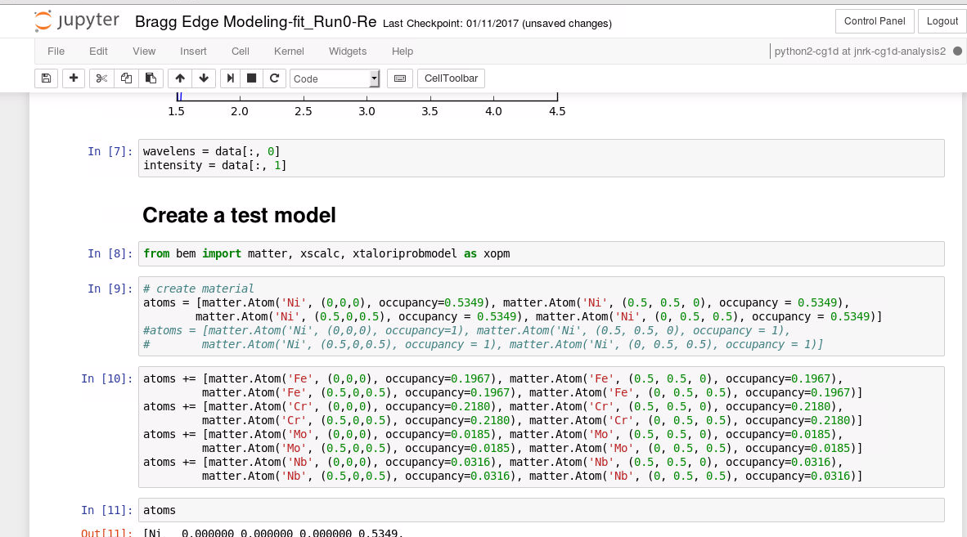
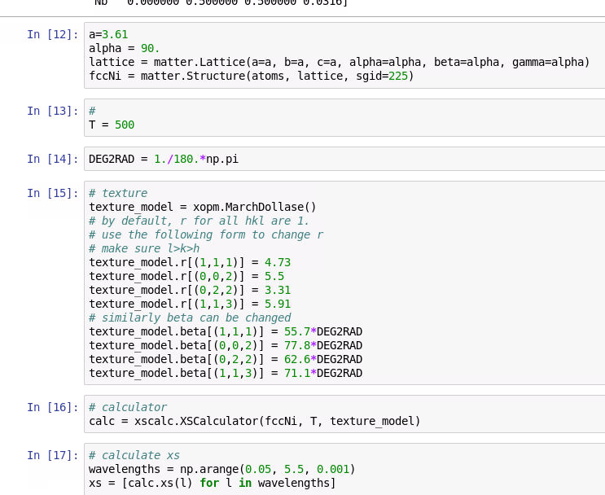
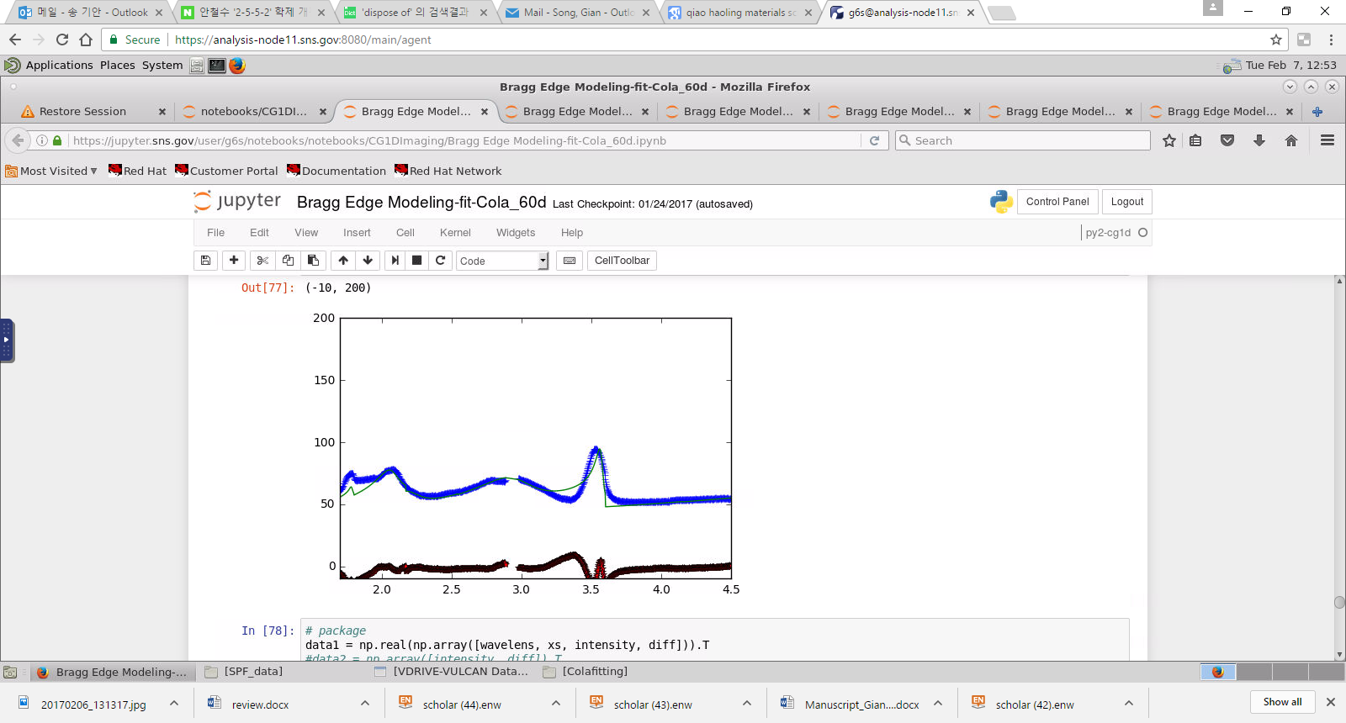
Bragg edge fitting with Jupyter Notebooks

Slide 20
Application of Bragg edge imaging to Additive Manufacturing
Additive Manufacturing metal components microstructure NDE needed for modeling purposes, and eventually validation of parts
Neutrons have the capability to penetrate deep into metals:
  Diffraction
  Neutron wavelength-dependent radiography
  Computed tomography
Our research focused on AM Inconel 718 samples (coupons and dog bones geometries) with different treatment (heat, tension, compression)
Techniques apply to other crystalline structures

Slide 21
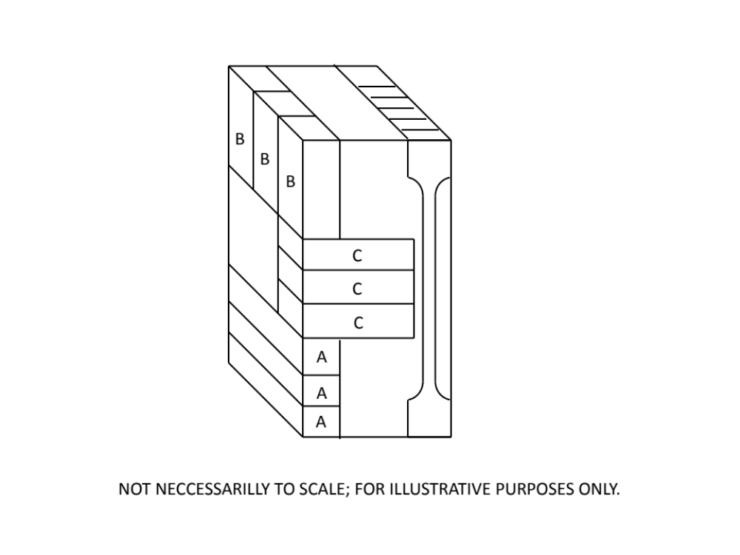
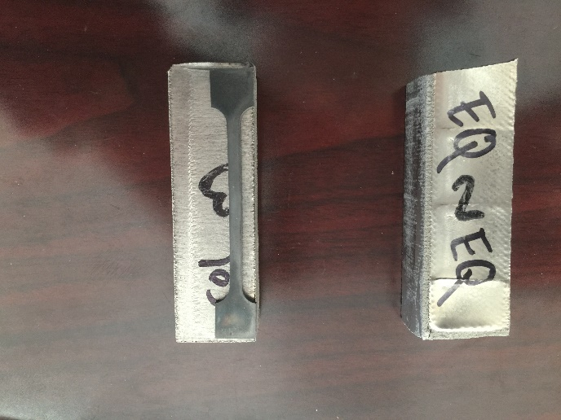
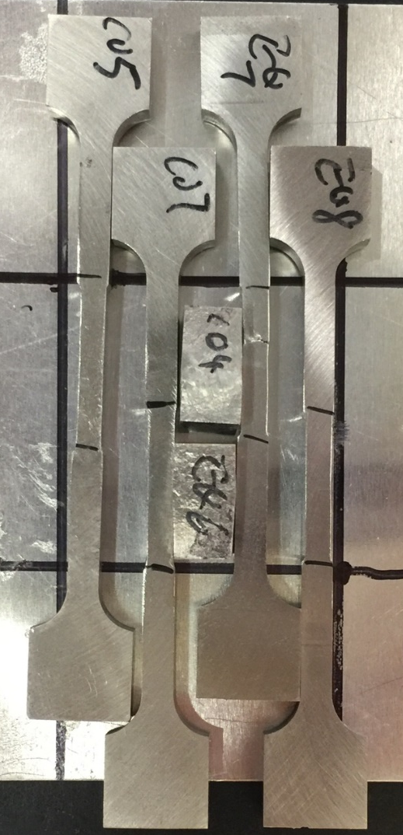
Many samples prepared using two Inconel 718 blocks with different crystallite structures
Modified Melt
Standard Melt
Compression samples
(~ 12 x 5 x 5 mm³)
Tensile samples
(~ 30 x 5 x 5 mm³)

Slide 22
In-situ heating of AM Columnar Inconel 718 coupon
Comparison
Before heating: two dominant microstructure orientations (200) and (311)
As temperature increases, Bragg edge shifts toward higher λ, as expected during thermal expansion
Bragg edges decrease with increased temperature due to Debye Waller effect (grain vibrations)
During cooling, decrease of (200) and presence of (111) grains
Final microstructure close to powder sample data (i.e. random grain orientation)
Data arbitrarily shifted along y-axis to show the different plots

Slide 23


Slide 24

neutronimaging.pages.ornl.gov
Step-by-step tutorials with animated demonstrations
Something you want to see on our user website? Contact Jean Bilheux
bilheuxjm@ornl.gov

Slide 25
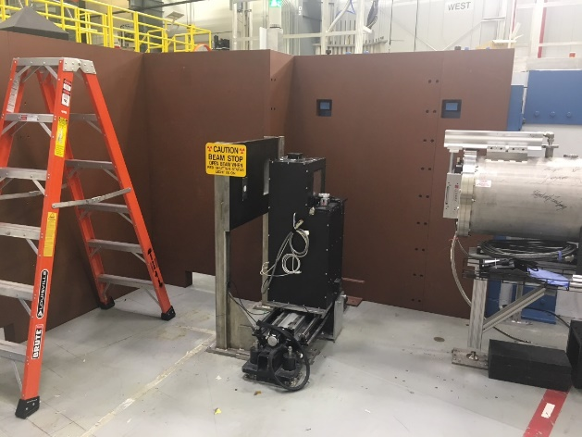
CG-1D: Cold Neutron Imaging Beamline
The CG-1D neutron imaging beamline is designed to probe structural features of length scales between ~ 25-100 µm and a few mm and kinetic changes on time scales between a few µs (repetitive motion events) to hours across a wide variety of subjects (e.g., batteries, engineering components, geological systems, biological systems, archeology and condensed matter).

Slide 26
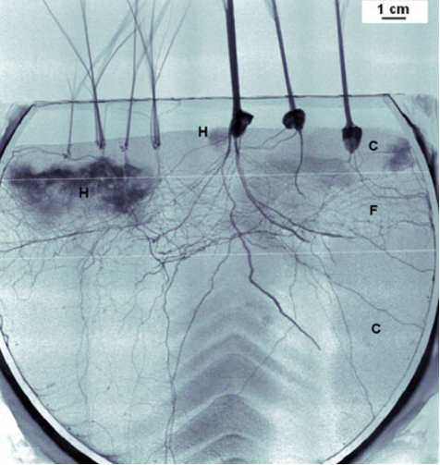
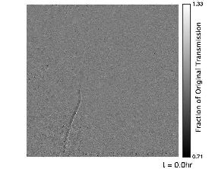
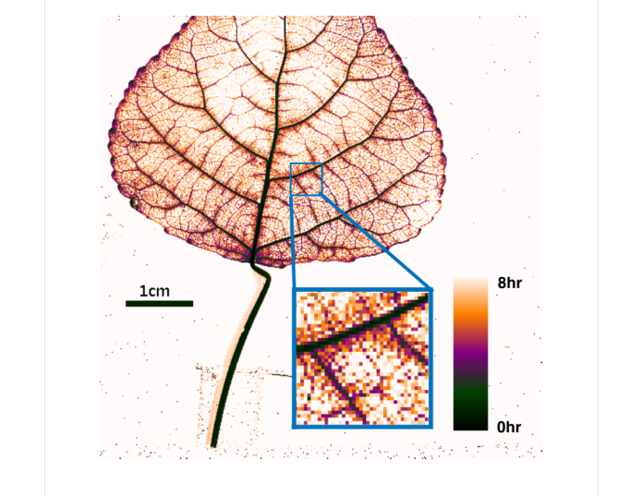
Investigating novel contrast agents for biological applications
Observation of water fluxes in soil/root surrounded with fungi is challenging due to lack of contrast between fungi and water
  Unlike heavy water (D₂O) which provides a lesser image contrast, the use of Gd compounds as tracers provide a strong neutron attenuation (i.e. contrast) that can be followed as a function of time in a plant system.
  Gd-compounds are good candidates to serve as tracers for solid movements – possible use as a tracer for nutrients (e.g. phosphorus, nitrogen).
  Gd-based MRI contrast agents prepared as a liquid solution (0.25-1M concentration) were hydroponically fed to plants prior to conducting the imaging experiments.
  Toxicity of Gd compounds will need to be evaluated through time.
Dark areas (H) around the switchgrass root systems and in several locations near maize roots likely arbuscular mycorrhizal or saprotrophic fungal hyphal masses
Courtesy of DeCarlo K., Jacobson S., Bilheux, (2017).
Warren et al., Plant and Soil 366 (2013) 683-693.

Slide 27
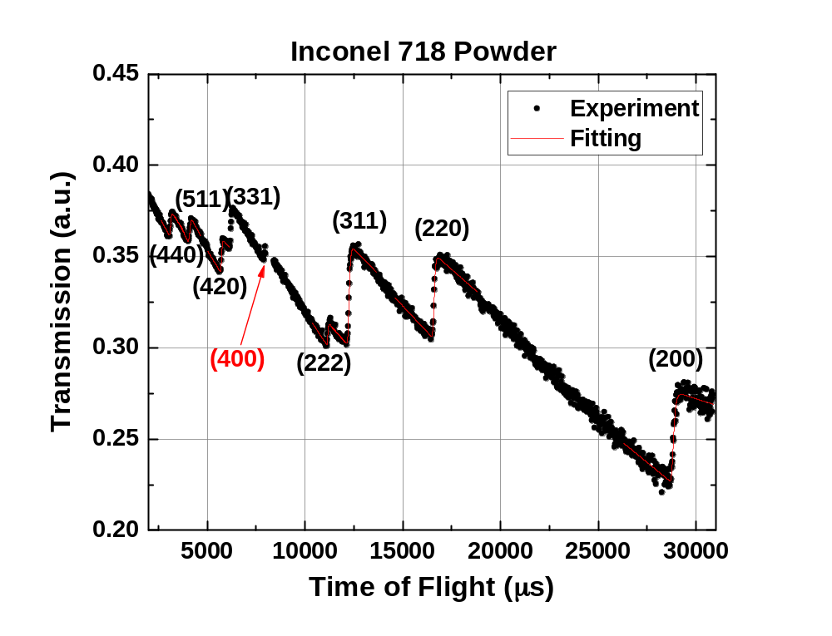
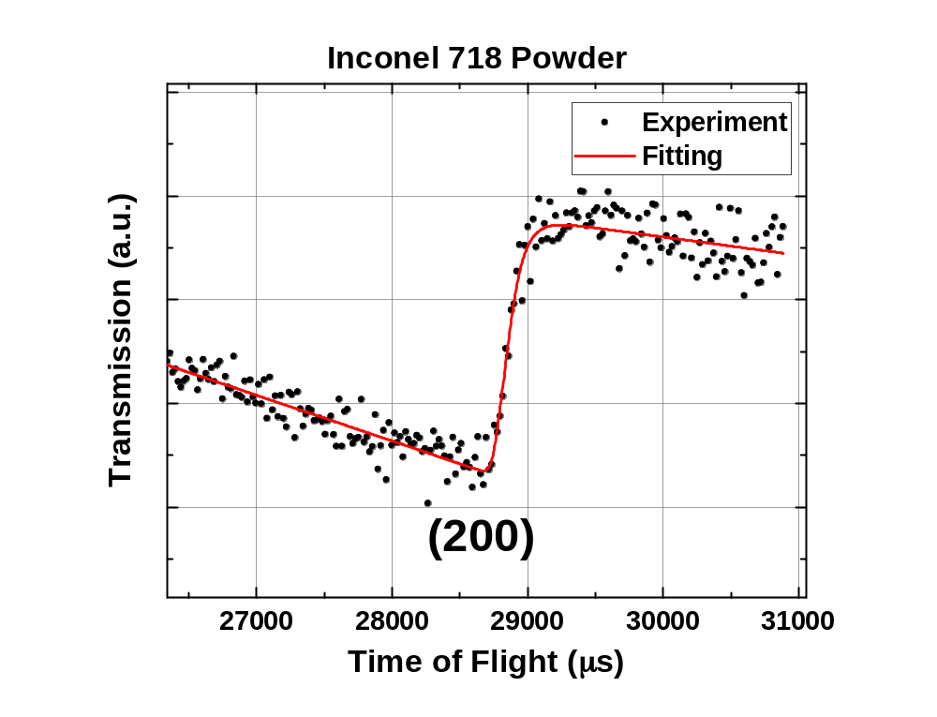

Fitting results for Inconel 718 powder
Model refinement function
$$y(t)=A_{1}+A_{2}\left(t−A_{6}\right)+\frac{\left(A_{5}−A_{2}\right)}{2}∗(t−A_{6})∗\left\{Erf\left(−\left(\frac{t−t_{0}}{σ\sqrt{2}}\right)\right)−e^{−\left(\frac{\left(t−t_{0}\right)}{α}+\left(\frac{σ^{2}}{2α^{2}}\right)\right)}∗\left[Erf\left(−\left(\frac{\left(t−t_{0}\right)}{σ\sqrt{2}}+\frac{σ}{α}\right)\right)\right]\right\}$$
t_{o}: edge position
σ: Gaussian broadening (sample and instrumental setup)
α: Decay constant, characteristic property of the moderator (geometry and temperature).
A1,A2,A5,A6: Linear function constants
Steuwer, A., et al. (2001). Phys. Stat. Sol.(a) 185(2): 221-230.

Slide 28

Total cross section spectra acquired by the best-fitting of the pole-figure rotation results
Angular distribution of the $P_{hkl}$ factors multiplied by Sabine’s primary extinction effect [$E_{hkl}\left(λ,F_{hkl}\right)$] of the (111), (200), (220) and (311) planes with an inset of the inverse pole figure for the crystal planes oriented normal to the incident beam

