Slide 1
Novel scintillation screen with significantly improved radiation hardness and very high light output
B. Walfort
Ch. Grünzweig, P. Trtik, M. Morgano, E. Lehmann, M. Strobl
WCNR11 2018, Sydney (Australia), 03. September 2018

Slide 2
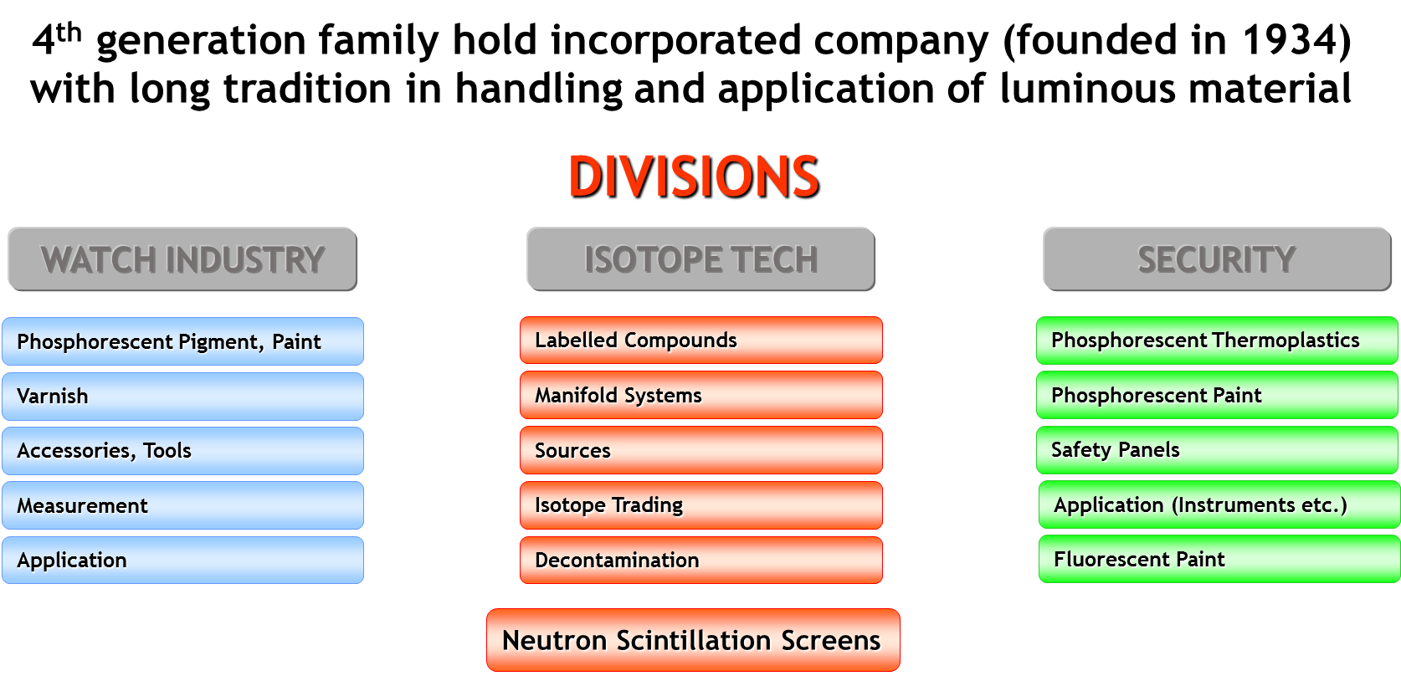
Introduction / Overview

Slide 3
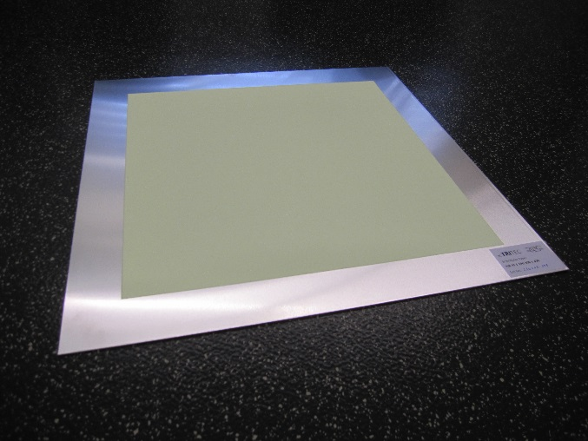
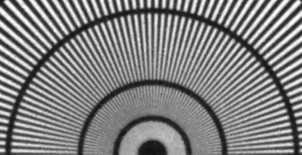
Introduction / Overview
In 2005-2006 development of thin (50 – 100 micrometer) neutron sensitive scintillation screens on the basis of ⁶LiF/ZnS for the PSI
After success in 2006 sales of this kind of screens to the market
Since 2014 distribution of scintillation screens on the basis of Gd₂O₂S:Tb and Gd₂O₂S:Tb/⁶LiF for high resolution measurements
Since 2016/17 sales of PP/ZnS-scintillation screens for imaging with fast neutrons (see different presentations within WCNR-11 Malgorzata / Robert Zboray / …) (Thank you James Hunter for initiation!!!)
And from now: We will see within this presentation…
Neutron Szintillation Screens

Slide 4
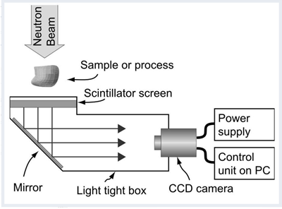
General theory behind
Neutron Scintillation Screens
Typical digital camera system:
Scintillation Screen (two step mechanism):
Core reaction with ions of high capture cross section (^{155/157}Gd, ⁶Li or ¹⁰B) to create a secondary radiation.
Excitation of a luminous material showing a fluorescence emission in the optimal range of the detection system.
Scintillation Screen

Slide 5
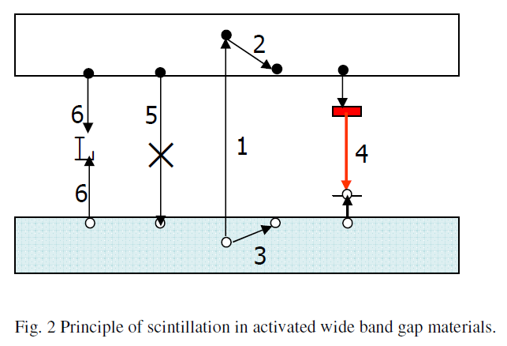
General theory behind
The fluorescence mechanism:
Excitation creating a hole in the valence band and an excited electron in the conduction band
Relaxation of the excited electron to the ground level of the conduction band
Relaxation of the created hole to the top of the valence band
Fluorescence emission via an «impurity ion»
non emittive recombination of the electron and hole
Like 5) but via an impurity (defect center or impurity ion)

Slide 6
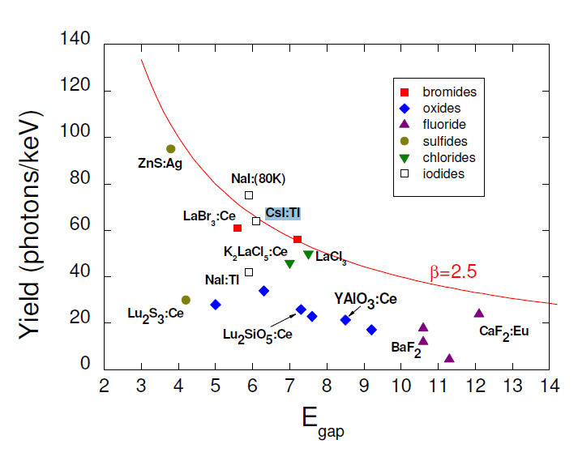
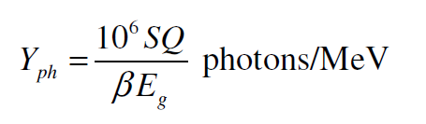
General theory behind
Light yield:
Y_{ph} = number of photons emitted by the scintillator per unit of energy absorbed
β = constant that appears approximately 2.5
E_{g} = band gap energy
S = transfer efficiency
Q = quantum efficiency
For the ideal situation S and Q are 100%
Red solid line represents the maximum light yield

Slide 7
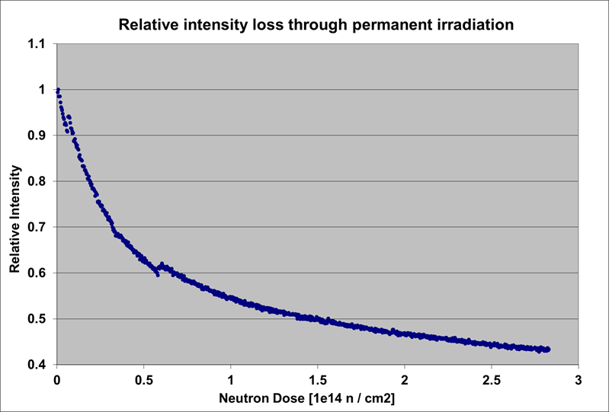
Starting situation
Degradation of ZnS:Cu/⁶LiF scintillation screen during irradiation:
From Sept. 2015 to Sept. 2017:
CTI funded development project with PSI
Reason for degradation?
Binder?
Converter?
Phosphor?
Environment?
Fitting of the curve show a two fold exponentional decay

Slide 8
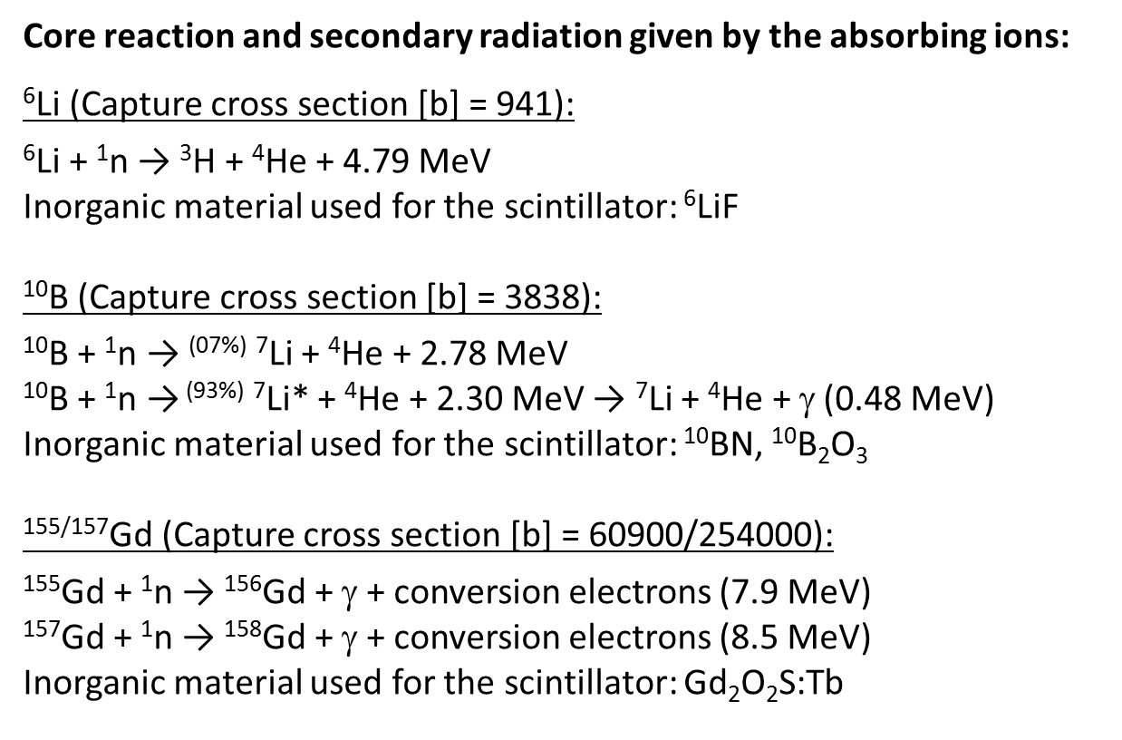
The “Absorber”

Slide 9
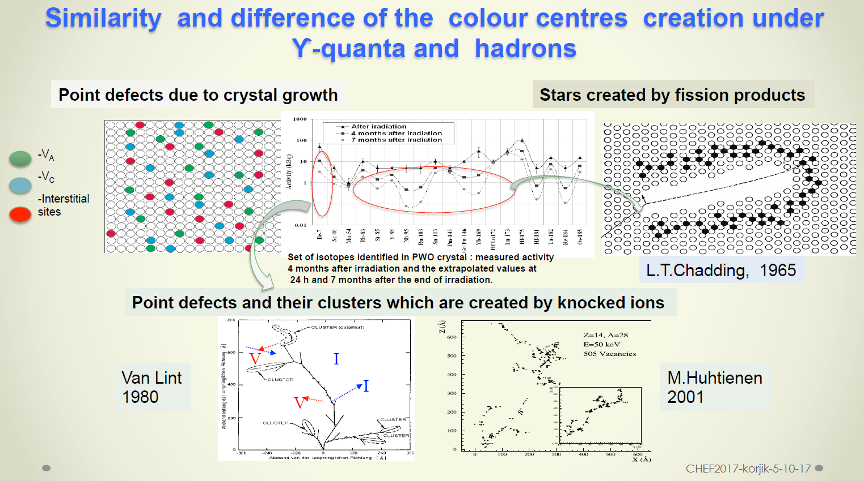
The “Phosphor”
Slide presented at SCINT 2017 conference in Chamonix by Korjik

Slide 10
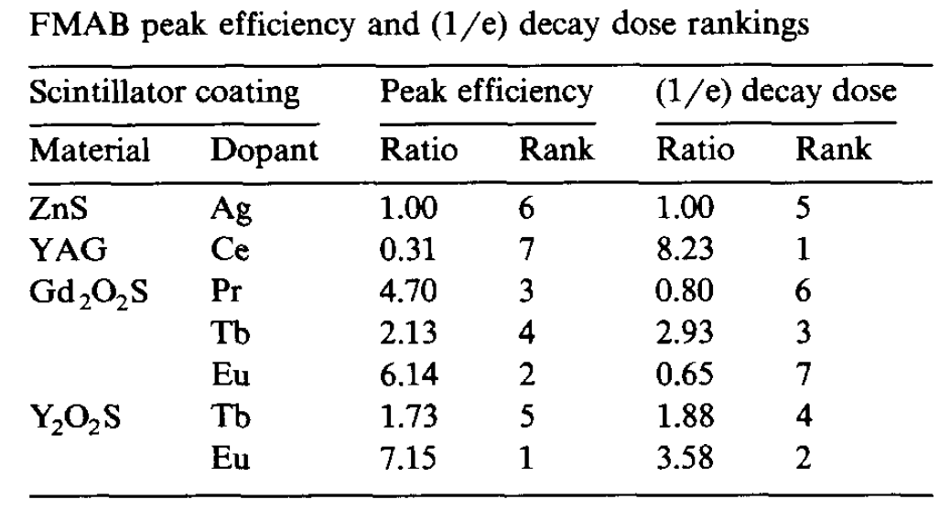
The “Phosphor”
Different phosphors show different radiation hardness:
L.R. Holland, GM. Jenkins, J.H. Fisher, W.A. Hollerman, G.A. Shelby Nuclear Instruments and Methods in Physics Research B56/57 (1991) 1239-1241

Slide 11
Degradation
Two main effects are responsible for the degradation:
I)
High energy irradiation or ions create a high density of disorder / vacancies in the crystal
Effect by the disorder / vacancies / traps:
a) Vacancies / disorder: increase of radiationless decay
b) New traps: long decay
c) Change in the surrounding of the emission center: Change in quantum efficiency
II)
High energy irradiation force a high reactivity of the surface with the environment (O₂)
Change of surface chemistry destroys the luminous mechanism (radiationless decay)
The presence of oxygen in the ZnS matrix increase the migration of Cu

Slide 12
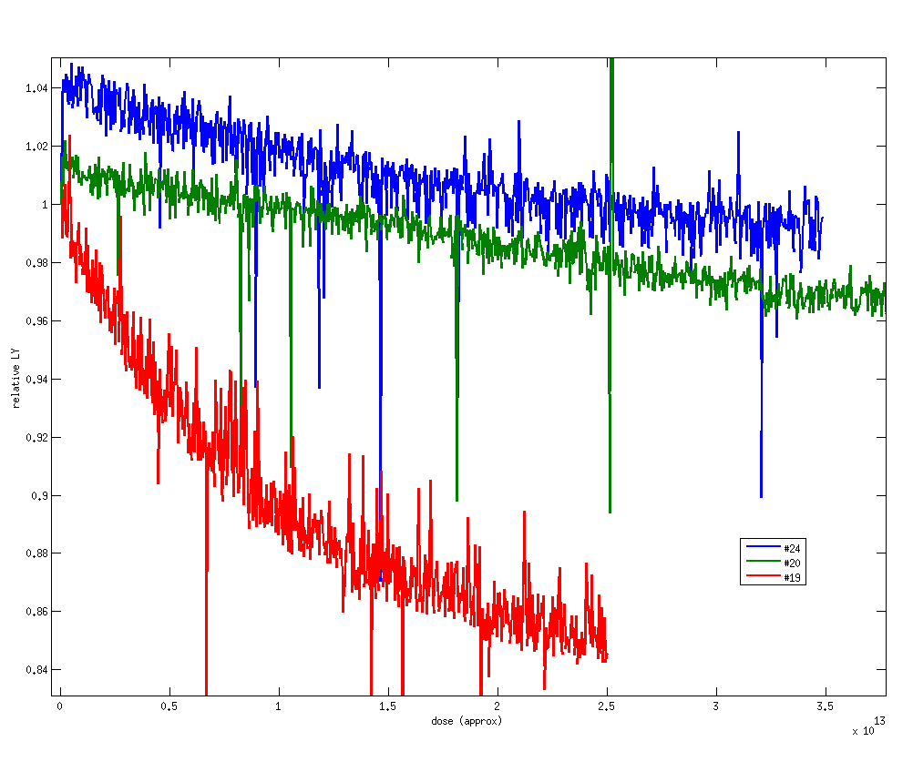
Degradation
Different secondary irradiations / protection by varnish:
#19 → Standard mixture with ⁶LiF/ZnS
Relative I(0): 100%
#20 → Mixture with ¹⁰B₂O₃
Relative I(0): 18%
#24 → Standard ⁶LiF/ZnS mixture with high quantity of varnish
Relative I(0): 35%

Slide 13
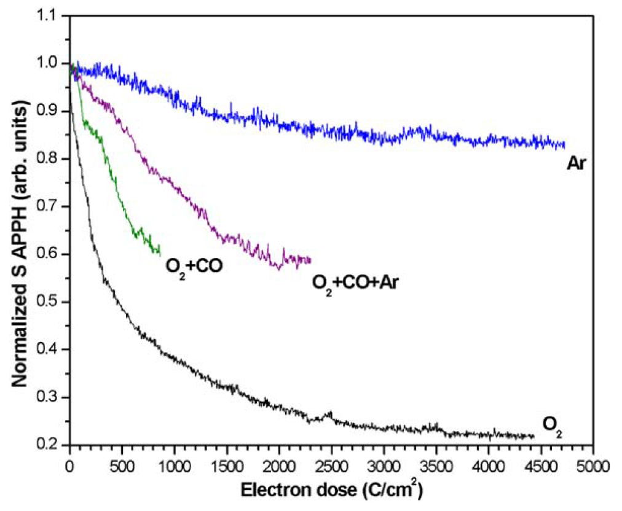
Degradation
Avoid oxygen:
Degradation of ZnS-phosphor by electron beam in different gas media
Argon does not stop complete degradation but fast component (oxidation process of the surface)
S.H. Chen et al. / Journal of Luminescence 109 (2004) 93–102
N.E. Brese et al. / Solid State Ionics 123 (1999) 19 –24

Slide 14
Degradation
Sum of above and further things to do to improve:
Reduction of mechanism 1:
Use scintillator with wider band gap (but intrinsically reduced light yield)
Use emission center emitting in the orange / red region
Use phosphor with lowest possible impurities and disorder (high crystallinity)
Change from Li-6 to B-10 or Gd, due to lower energetic secondary radiations (but reduced light output)
Doping with different cations to suppress damage (self repair mechanism)
Reduction of mechanism 2:
Avoid oxygen and other reactive gases to supress reaction with environment

Slide 15
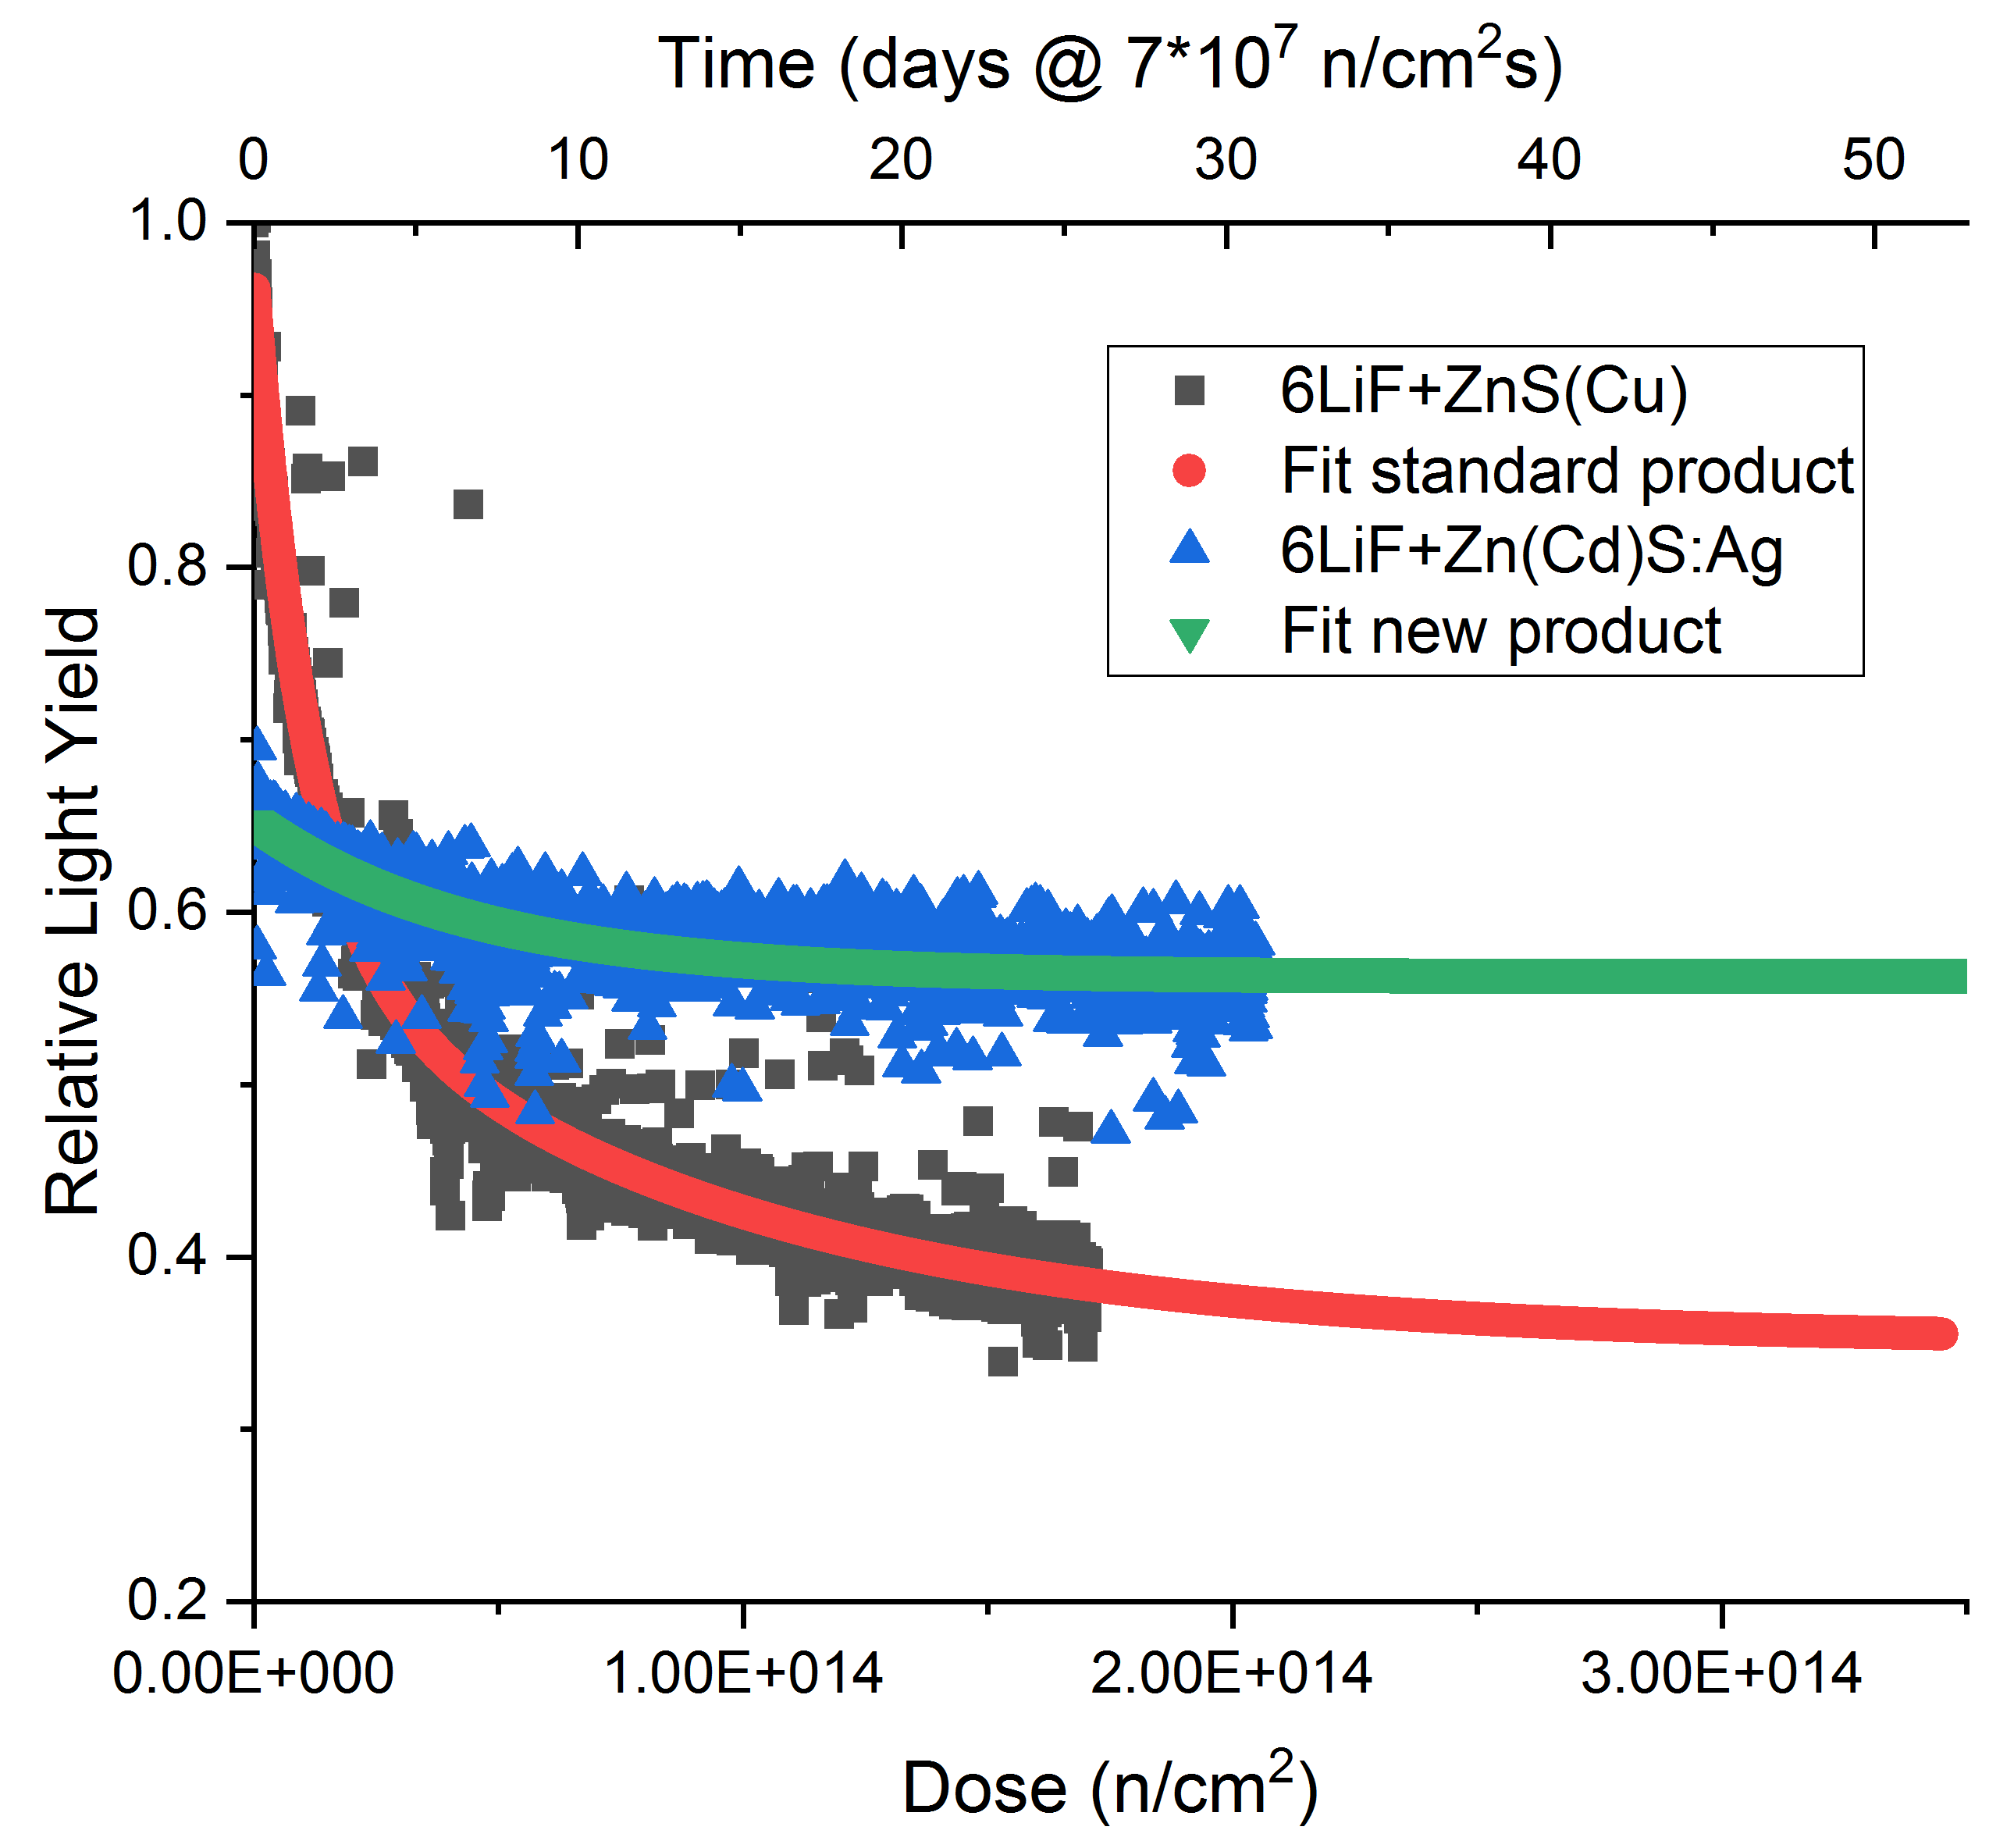
6-LiF / Zn(Cd)S-Scintillation screens
Main Reasons for higher radiation hardness:
Red emission shows in general higher radiation hardness and
Red emission is more efficient with standard CCD camera system
¹¹³Cd is generating conversion electrons, which are less destructive than triton and alpha particles from ⁶Li
Protection against air (oxygen) by use of higher varnish quantity
Use of less ⁶LiF in the mixture (Reduction of penetration of the phosphor by alpha particles)

Slide 16
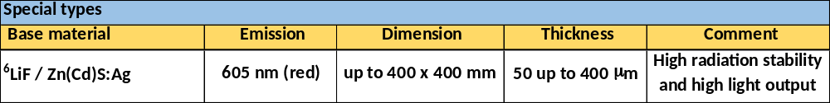
6-LiF / Zn(Cd)S-Scintillation screens
Main features:
After some time of irradiation 50% higher light output!
Similar resolution in comparison to the ZnS:Cu/⁶LiF scintillation screen
Better neutron statistics due to Cd-absorption. ¹¹³Cd (~13% abundancy) has neutron cross section of 20’000
Fluorescence lifetime is strongly reduced (see next slide)
But:
CdS is in the SVHC list (Reach, Cd causes cancer), Special precautions are required!

Slide 17
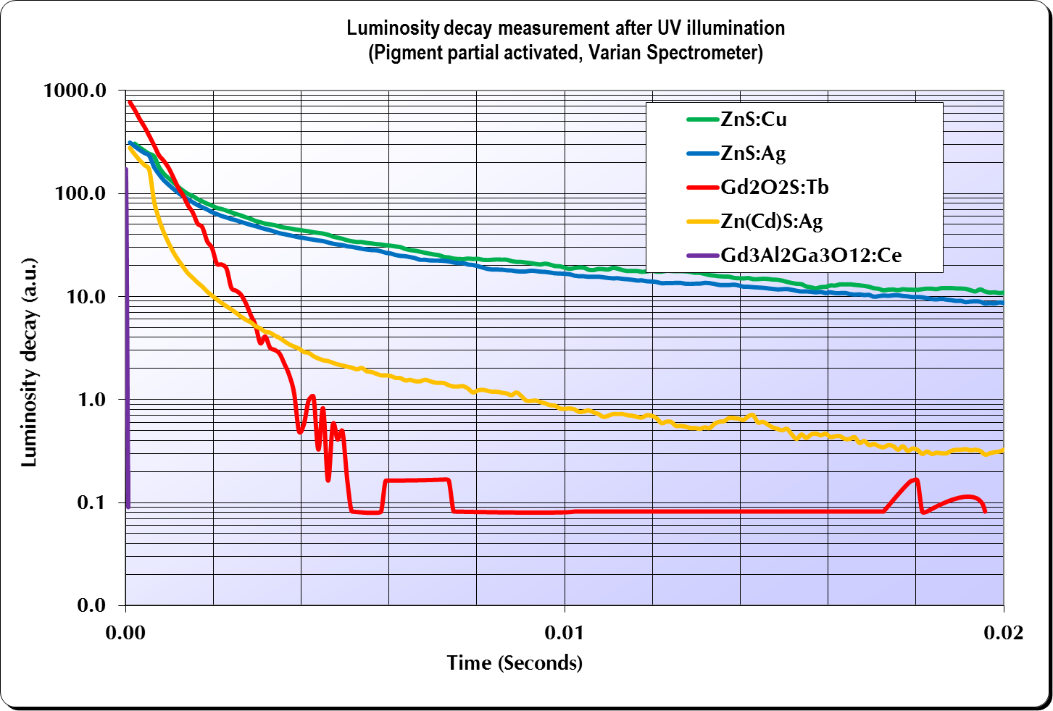
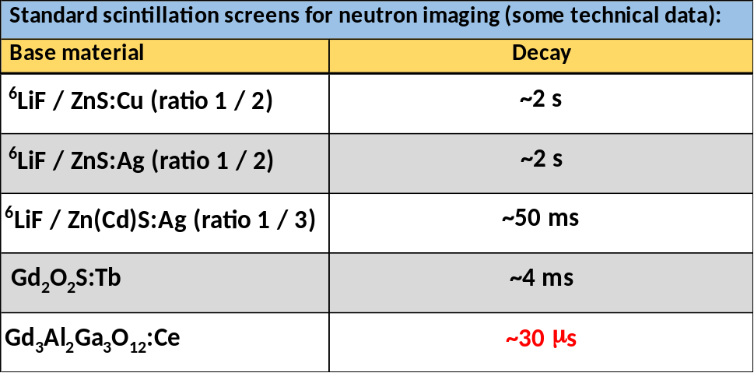
Fluorescence Lifetime

Slide 18
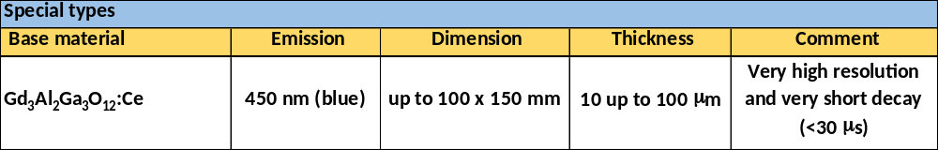
Very short fluorescence lifetime
Special types:
Gd₃Al₂Ga₃O₁₂:Ce → Very high resolution / very short fluorescence lifetime and response!

Slide 19
We are open to help you in your developments
for new types of scintillation screen!
Thank you very much for your attention
and we are looking forward to a further or new long and strong collaboration!

Slide 20
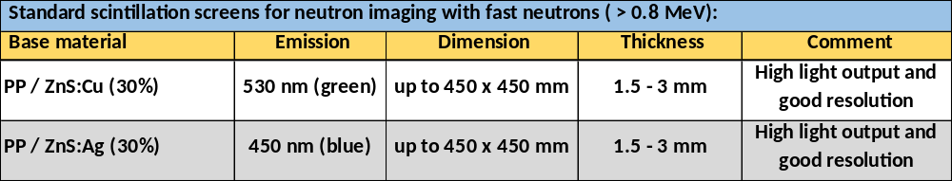
Fast Neutrons
For imaging with fast neutrons a polypropylen plate filled with a ZnS-phosphor is used. The scintillation is also a two step process. First neutrons interact with the hydrogen atoms of the polypropylene plate to build up recoiled protons. Those excite the ZnS to give the corresponding detectable light.
For information on light output / gamma sensitivity / resolution please have a look
on the poster from Malgorzata G. Makowska
or presentation by Robert Zboray
or have a look into J. Imaging 2017, 3(4), 60

Slide 21
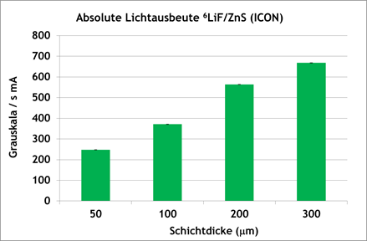
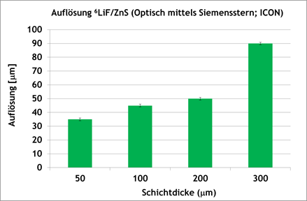
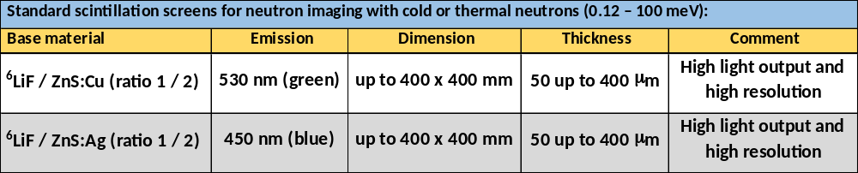
⁶LiF / ZnS-Scintillation screens
⁶LiF / ZnS-Scintillation screens (green emitting)
Thickness / Intensity / Resolution
With higher thickness we get higher light output
With lower thickness we get a better resolution
At NEUTRA with different setup we have a 10 times higher light output…

Slide 22
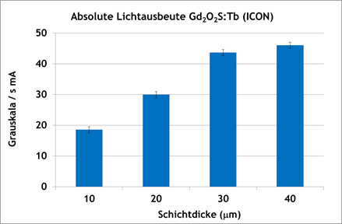
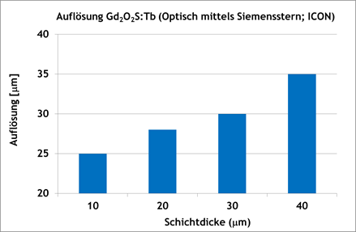
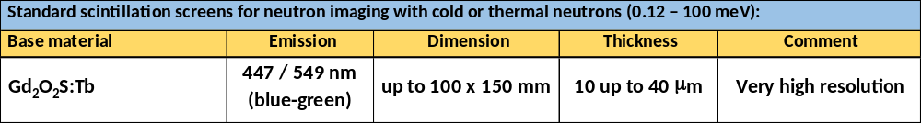
Gd₂O₂S:Tb-Scintillation screens
Thickness / Intensity / Resolution
With higher thickness we get higher light intensity
With lower thickness we get a better resolution
Saturation in light output at ~30-40 μm. Absolute intensity ~1/10 of ZnS/LiF screen, but better resolution…

Slide 23
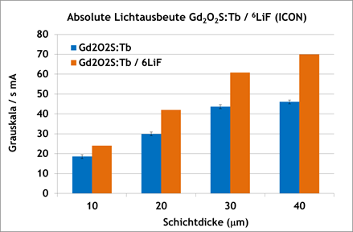
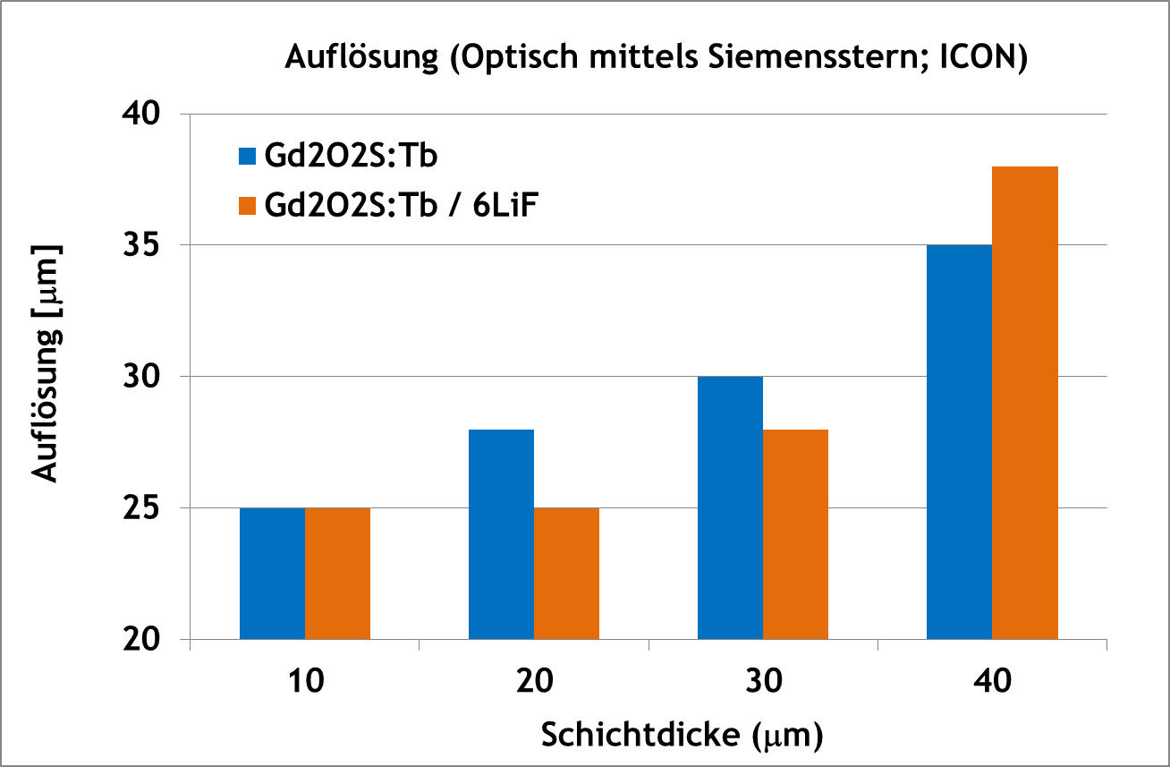
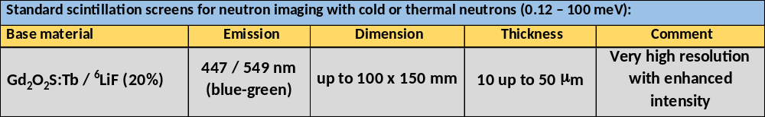
⁶LiF / Gd₂O₂S:Tb-Scintillation screens
Thickness / Intensity / Resolution
Addition of ⁶LiF give 30-50% higher brightness with same resolution!!!

