Slide 1
Development of kfps bright flash neutron imaging for rapid, transient processes
R. Zboray, Ch. Lani, A. Portanova
Department of Mechanical and Nuclear Engineering, The Pennsylvania State University, University Park, PA, 16802, USA
11th World Conference on Neutron Radiography, 2-7 September 2018, Sydney, Australia

Slide 2

High frame rate neutron radiography for rapid transient processes
Frame rate is usually limited by the available neutron flux of the beam lines even at the strongest, large-scale neutron sources (1e7-1e8 n/cm²/s).
Phase-lock, ensemble averaging techniques work for cyclic/periodic processes
Rapid, transient processes require very high fps to avoid motion blur
Examples: multi-phase flows in heat exchanger (nuclear fuel bundles, boilers), dynamic, wavy films flows on surfaces, water hammer in piping, flows in sprays nozzles, impacting flows, steam explosions (liquid-metal/water), fast mixing processes
Might easily need few kfps
Short t_{exp} (sub ms for kfps range) -> very high flux needed

Slide 3
Bright flash thermal neutron radiography
Nuclear reactor pulses might bring remedy!
TRIGA research reactor type can be pulsed to produce bright flashes of high instantaneous power and flux of a few GW (at typical steady power of only a few MW)
Pulse are typically only 20-30 ms long (FWHM)
This high flux surge at the beam line could be utilized for high speed imaging of rapid transient processes of the above time scale/constants
Physics of TRIGA pulsing:
Special Fuel: Zirconium (91%)+U(8%, 20% U-235)+H(1%mass=50 atom %)
due to the H content the fuel elements contribute directly to the moderation of neutrons -> strong negative feedback to power
to induce a neutron flash, one control rod is rapidly withdrawn from the reactor core. The reactor is made prompt super critical with its power increasing to up to 1000x of the steady-state value.
The strong negative feedback brings back the reactor to zero power

Slide 4
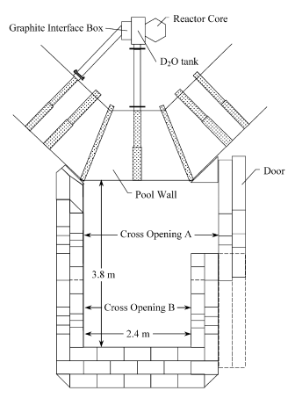

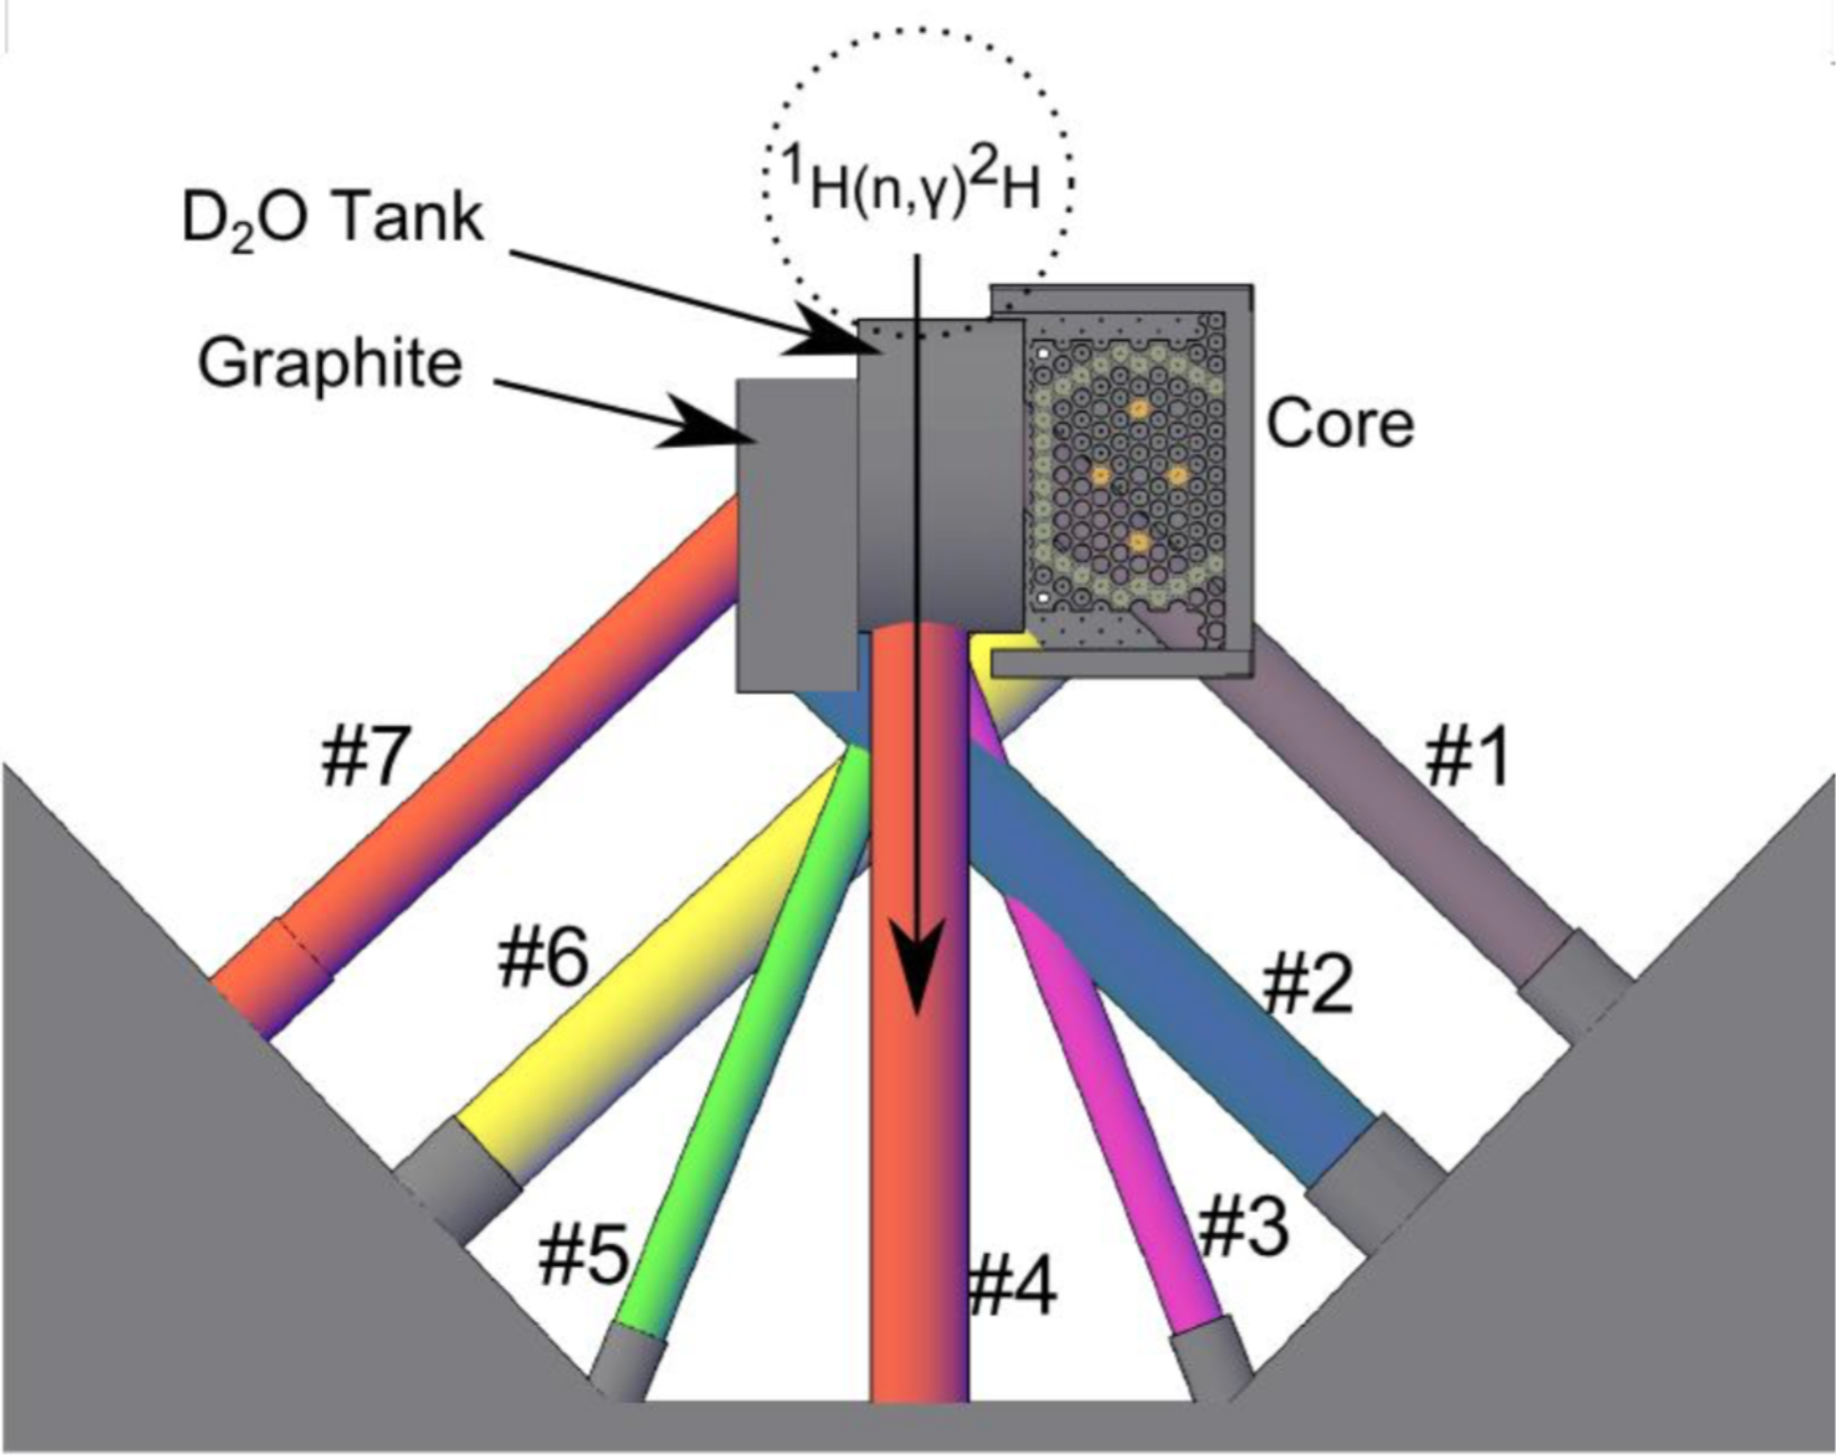
The Penn State Breazeale 1 MW TRIGA Reactor imaging beam line
Neutron beam lines at present:
Neutron imaging beam line
Thermal flux 1.7e7 n/cm²/s at 1MW
L/D ≈150
Cd ratio (Au foils) ≈ 5
Beam cave

Slide 5
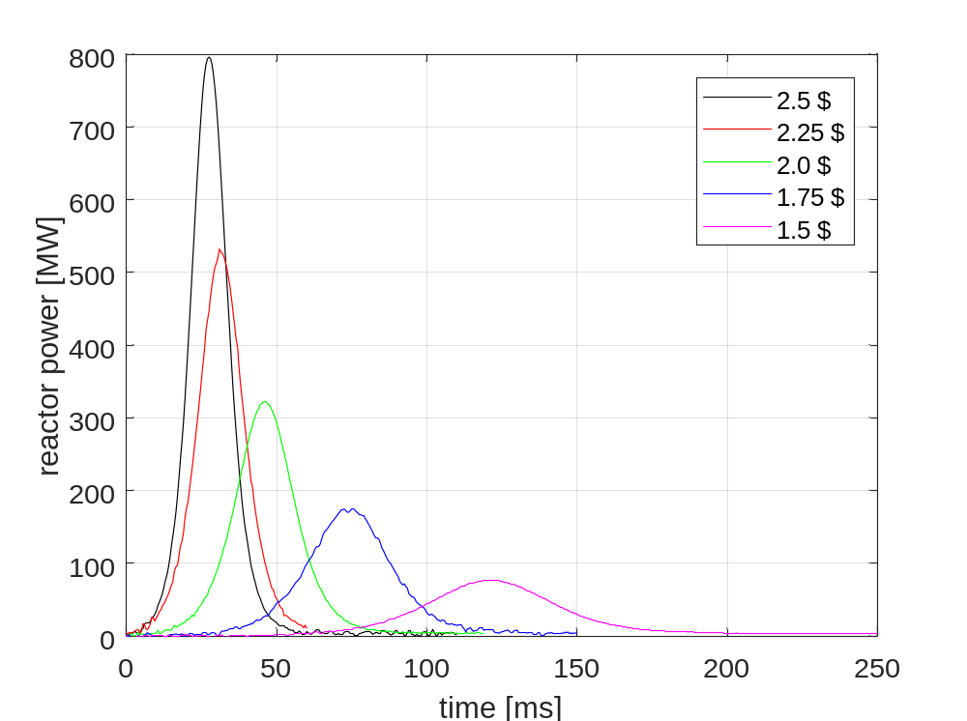
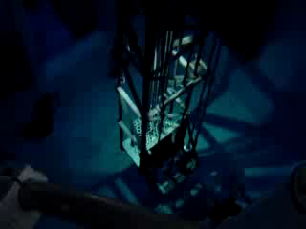
Pulsing the Penn State TRIGA reactor
We utilized 2$ and 2.5$ pulses for the present work.
Pulse repetition time is typically 12-15 mins.
Typical pulse heights: 761±12 MW (2.5$) and 284±6 MW (2$)
Peak flux values at beam line: 1.3e10 n/cm²/s (2.5$) and 4.8e9 n/cm²/s (2$)
Typical pulse widths: 15.4±0.3 msec (2.5$) and 24.5±2.6 msec (2$)
Pulses are perfectly repeatable, small variations
Breazeale reactor of Penn State University, source: https://www.youtube.com/watch?v=6I3JKYdGWTE

Slide 6
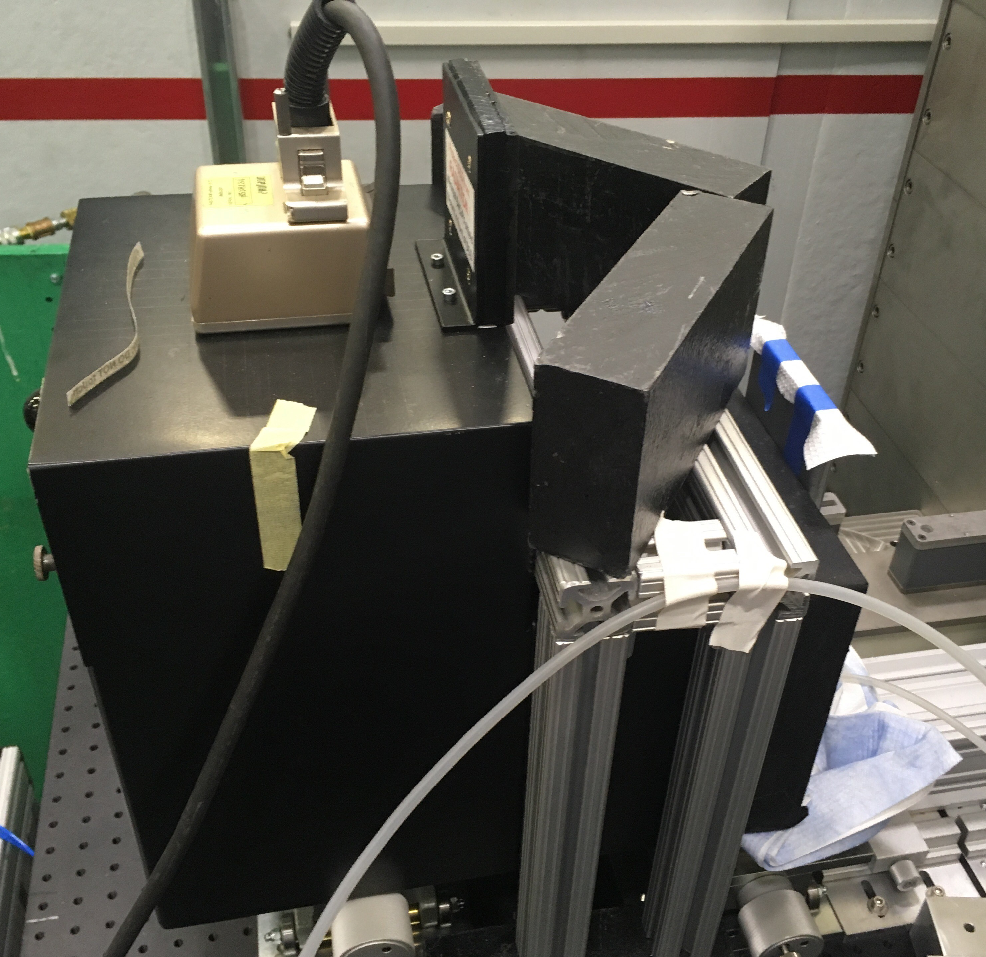
The high speed imaging detector
Typical scintillation screen+mirror+camera type detector with some special features:
High-speed CMOS camera (legacy)
Special high brightness optics
400 um ultra-thick LiF/Zns(Cu) scintillator screen from Scintacor for maximizing the detection efficiency (let’s debate about useful thickness vs. transparency ☺)
Afterglow/decay time of ZnS should be still acceptable at a few kfps (another discussion point)
we compromise on the spatial resolution: ≈0.6 mm (due to combination of thick scintillator and special optics)
FOV: 70 mm x70 mm
Pixel size: 0.13 mm
Camera head
Shielding
Scinti screen
Ligth tight box

Slide 7
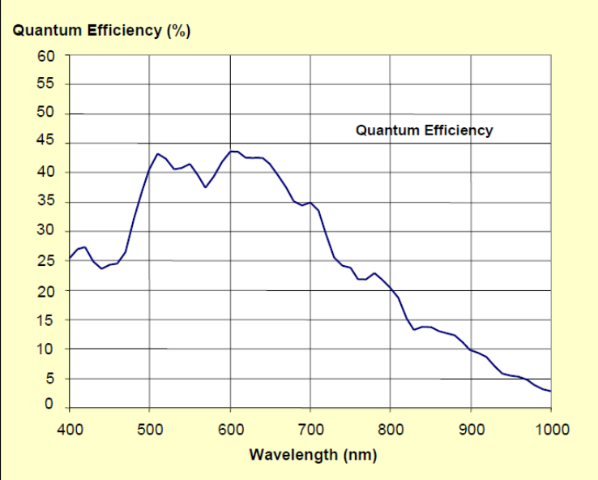
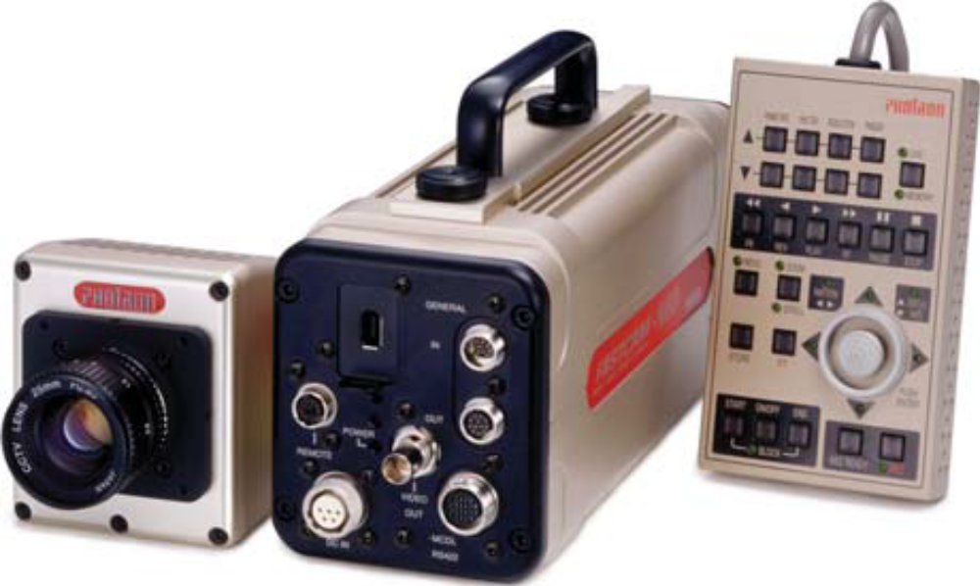
Photron FASTCAM-Ultima 512 high speed camera
Native resolution 512x512 pixels x 10bits
Variable internal gains: x1, x2 , x4, x8
Sped at full resolution read out: up 2 kfps
Speed at partial chip readout: up to 32 kfps
On board memory: max. 2048 full frame images
C lens mount
Global shutter

Slide 8
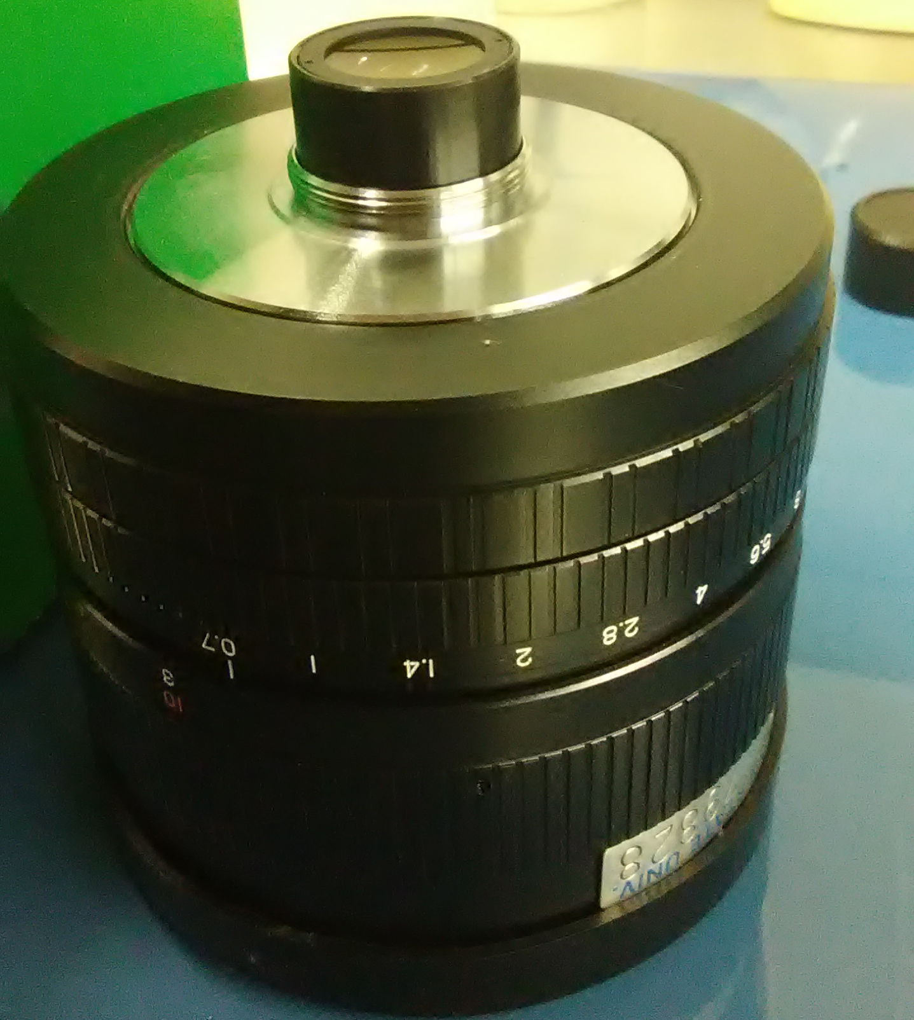
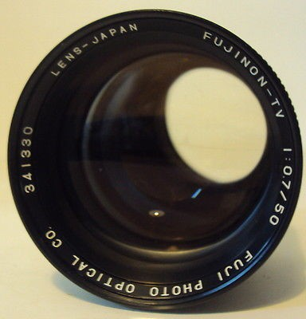
Fujinon f=50 mm/0.7 CC-TV lens
Predates digital CCD/CMOS cameras (difficulty to focus on the chip with C-mounts)
Native MFD=3m
Use C-mount extension rings/tubes to enable focusing closer -> increases effective f#
With a 2-mm extension ring, we could have a reasonably good optical focusing and the lens still outperforms modern f#=1.2 or 1.4 lenses w.r.t. light collection efficiency

Slide 9
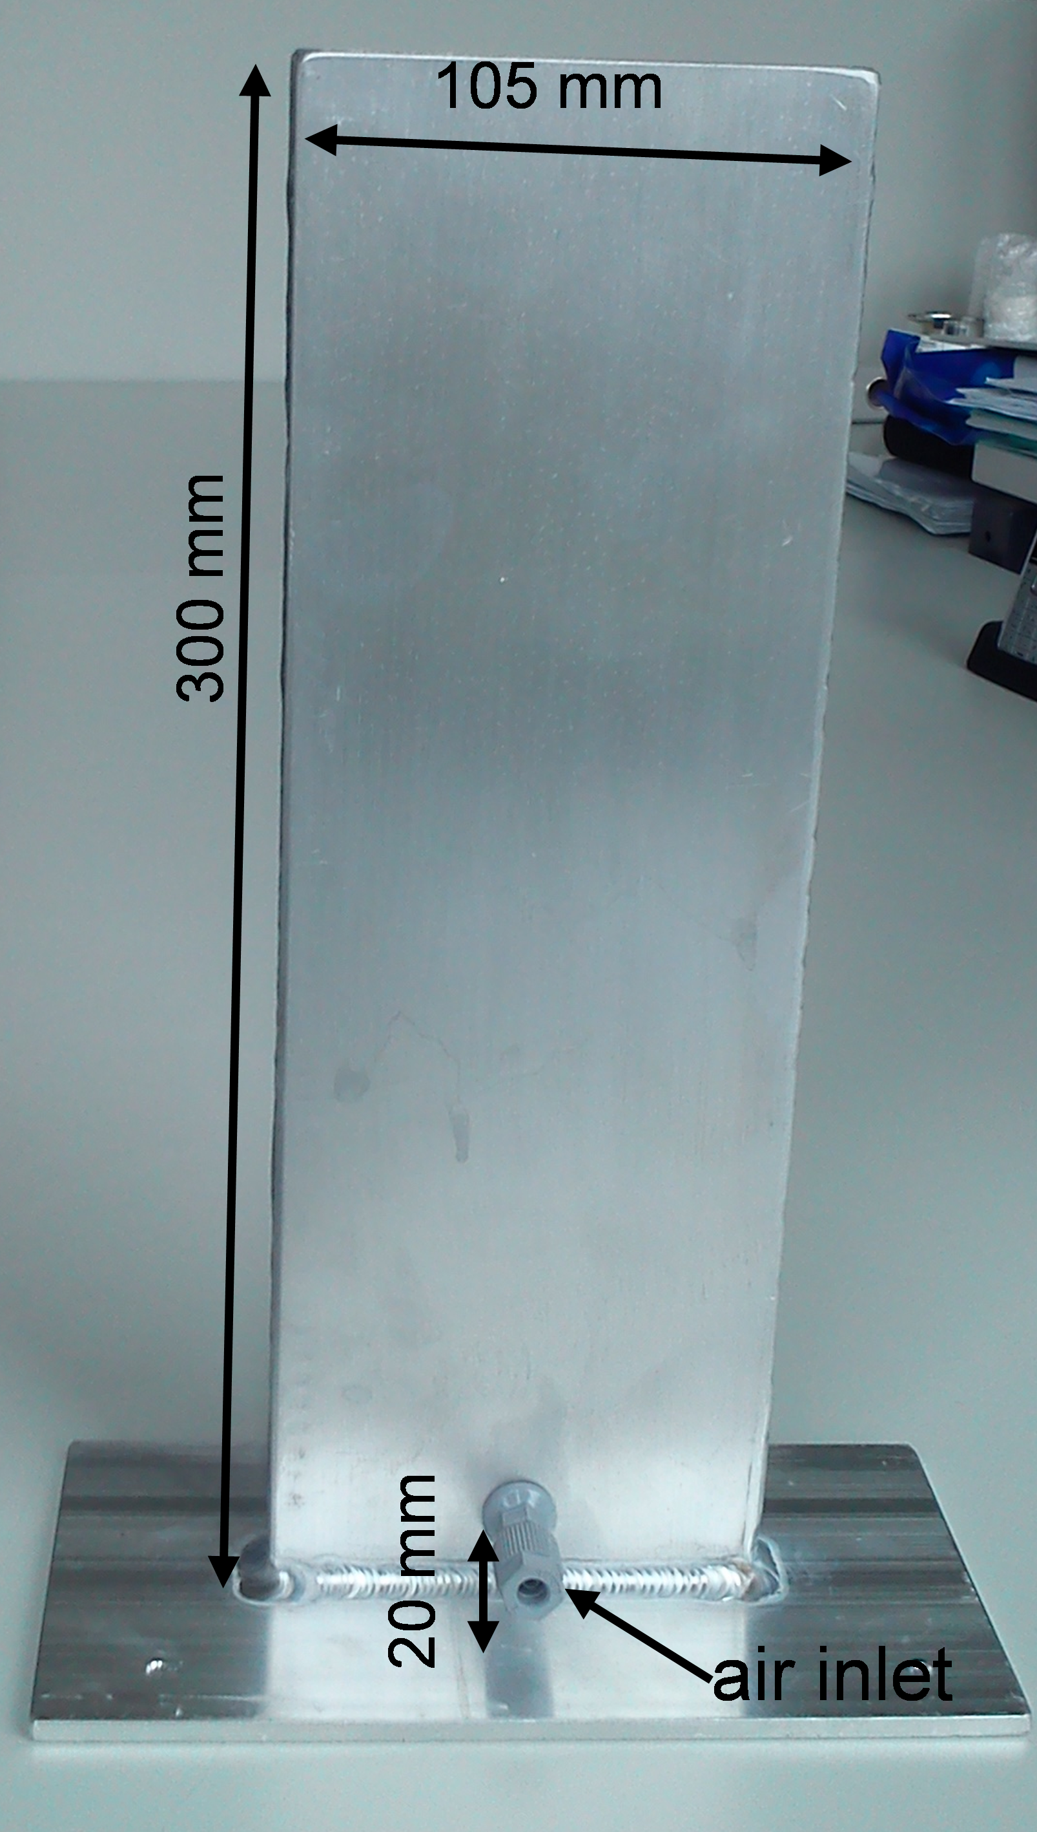



Results 1.
Bubbly 2phase flow in a simple air bubbler is used for demonstrating the technique:
Raw images:
2000 fps for a 2.5$ pulse
2000 fps for a 2$ pulse
4000 fps for a 2.5$ pulse
Partial FOV is due to manual synchronization with pulse, will be solved in future!
Gray scale is arbitrary

Slide 10
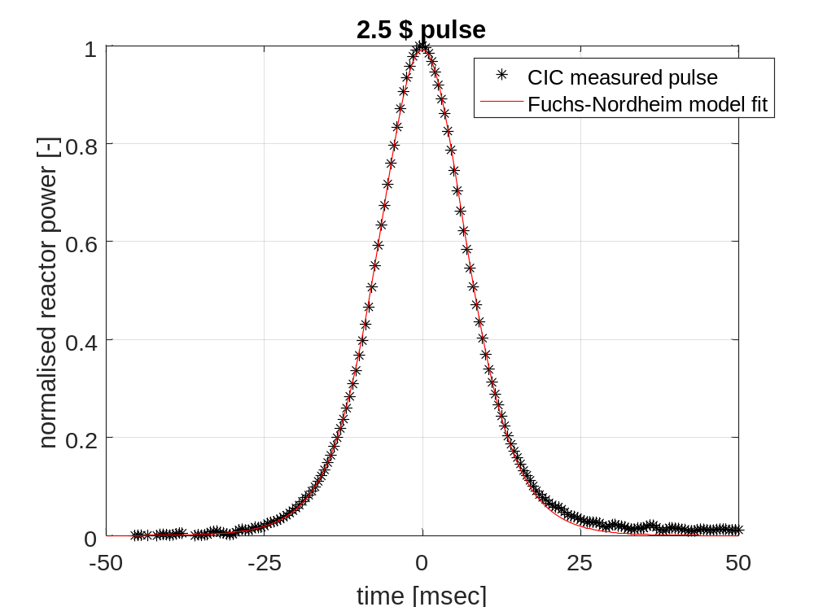
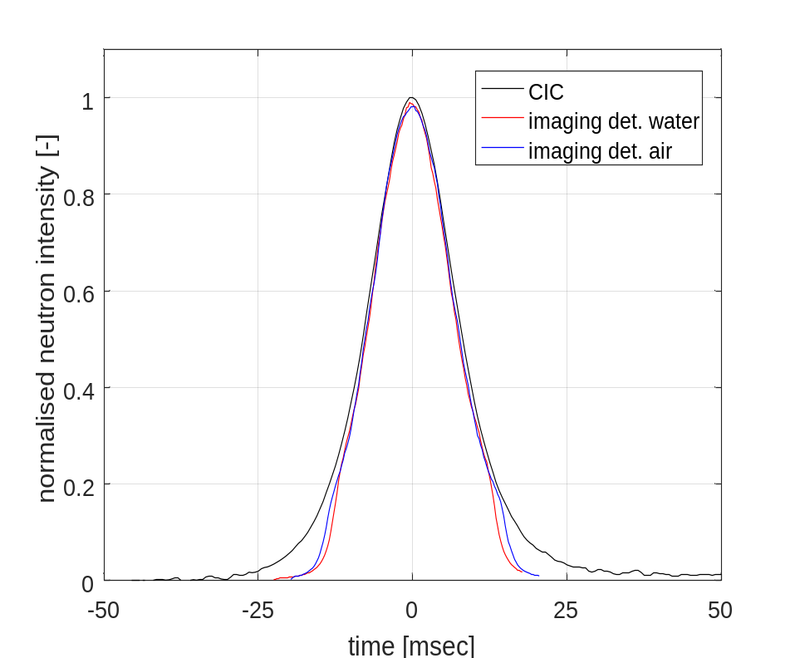
Results 2.
Cross checking imaging detector results with that of a compensated ionization chamber (CIC) neutron detector placed adjacent the core and a theoretical model for a 2.5$ pulse:
Imaging detector reading has been averaged over the whole FOV.

Slide 11
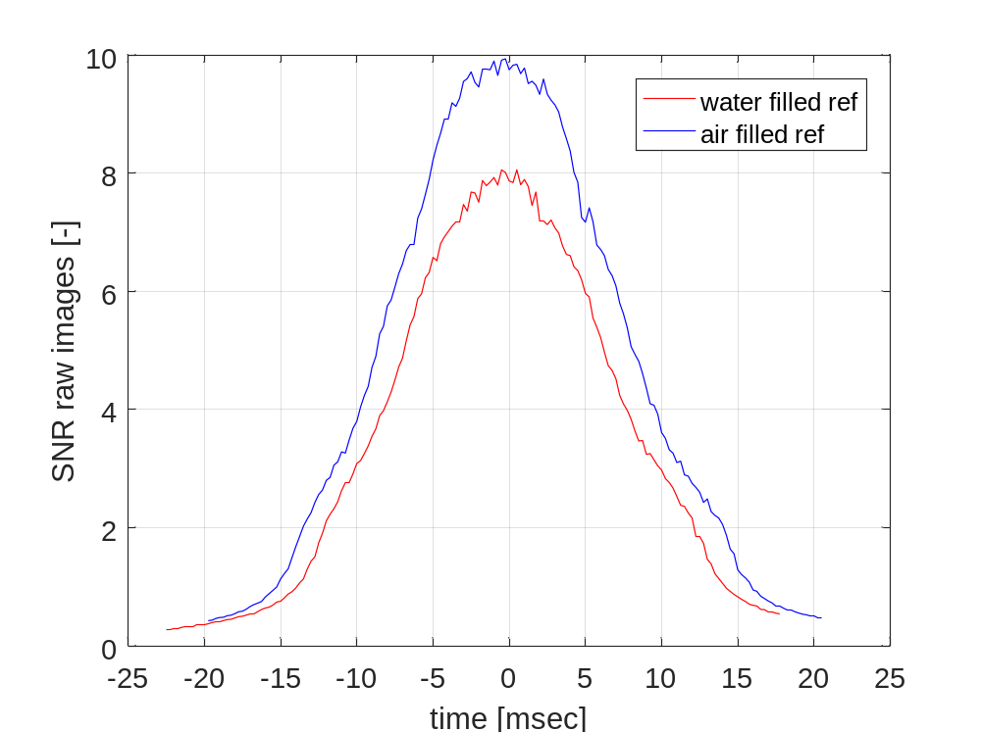
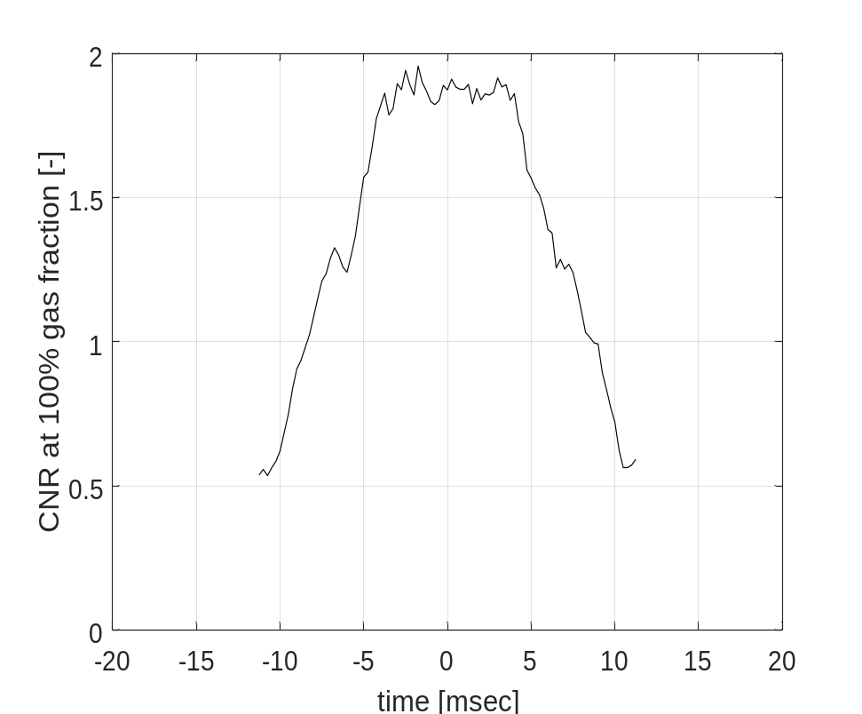
Results 3.
Signal-to-noise ratio (SNR) and Contrast-to-noise ratio (CNR) for the frames during a 2.5 $ pulse:
Imaging detector reading has been averaged over the whole FOV.

Slide 12
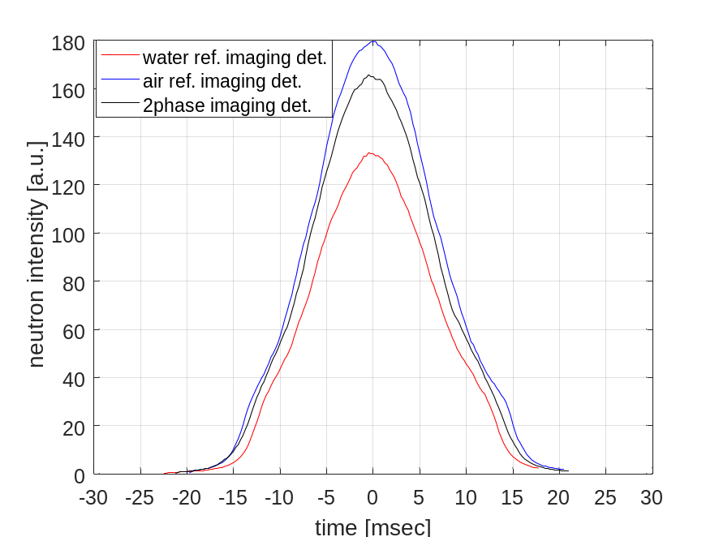
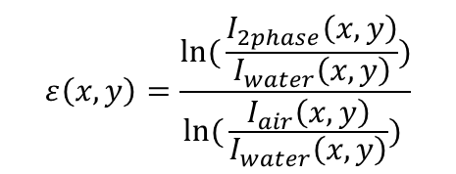
Results 4.
Quantitative results: normalization using reference images (flat fields) to obtain the pixel-wise, instantaneous chord-averaged gas fraction distribution:
Different normalization strategies:
Alignment of actual and reference measurement pulses around their peaks and normalize the 2phase image with its instantaneous counterpart
Use always the peak value image of the air and water
reference series and account for the intensity
modulation in the 2phase measurement during the
pulse -> better statistics
Average demodulated 10-20 instantaneous reference
images before/after the peak and use that for
normalization –> even better statistics
We found no significant differences between 1. and 2.!
$$ε\left(x,y\right)=\frac{\ln{(}\frac{I_{2phase}\left(x,y\right)}{I_{water}\left(x,y\right)})}{\ln{(}\frac{I_{air}\left(x,y\right)}{I_{water}\left(x,y\right)}) }$$

Slide 13



Results 5.
Normalized images of the instantaneous gas fraction distribution. Some bias is found in the results (values >1 and <0)
2000 fps for a 2.5$ pulse
2000 fps for a 2$ pulse
4000 fps for a 2.5$ pulse

Slide 14
Conclusions and Outlook
We have developed bright flash neutron radiography up to 4 fkps imaging rates for rapid transient processes
We have demonstrated the performance and the capabilities of the technique by imaging two-phase flow in a simple bubbler
Higher image rates at full FOV are possible using higher $ values pulses and electronic synchronization with the pulses
Accordingly we will elaborate on the two above points in the future
Applications: very rapid transients where one can leverage the penetrating power of neutrons, however: slower dynamic processes where few 100 fps rate would suffice can also benefit from higher image quality due to high peak flux

Slide 15
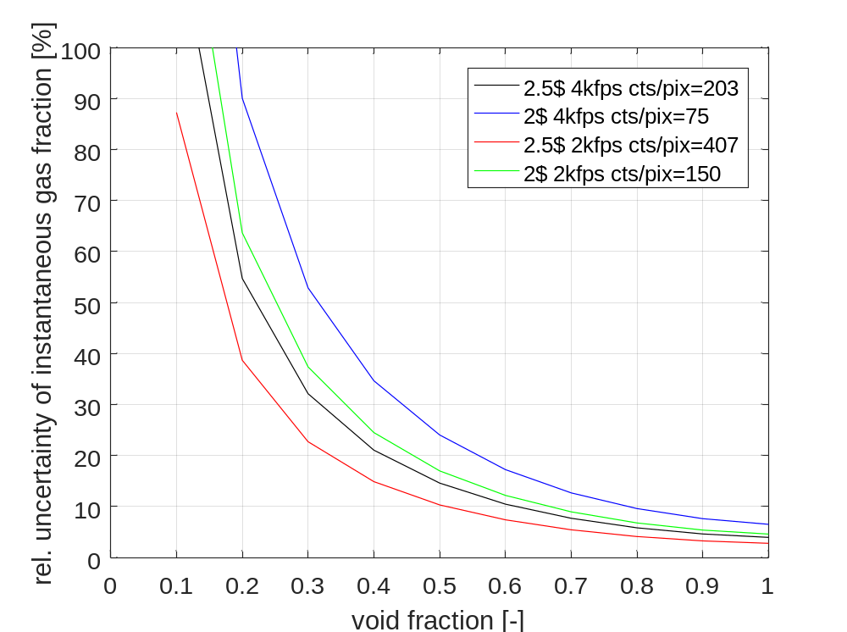
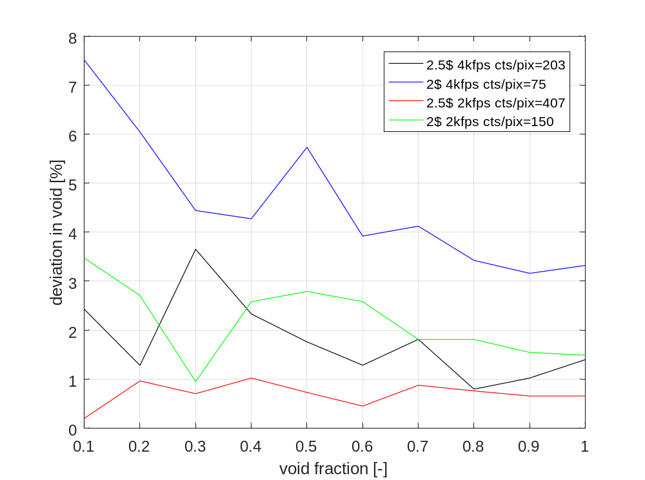
Results 6.
Statistical uncertainty in instantaneous gas fraction:
Low count bias (non-linearity of Lambert-
Beer):

Slide 16
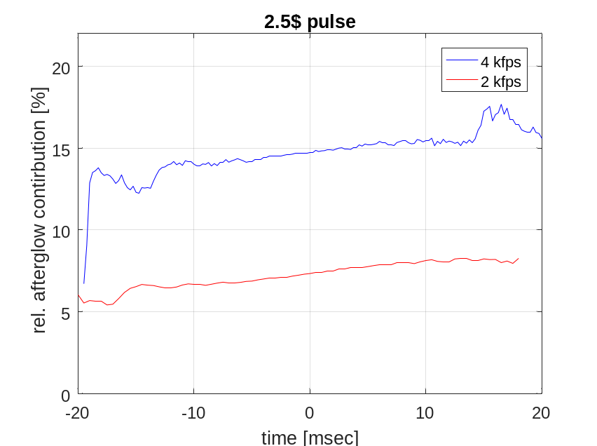
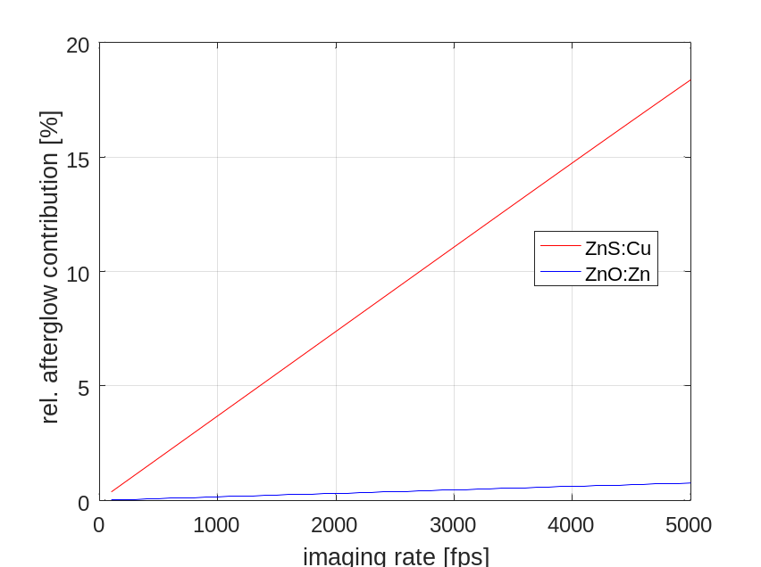
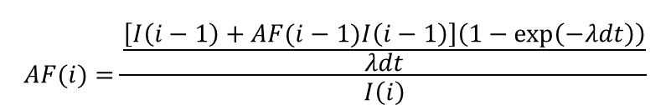
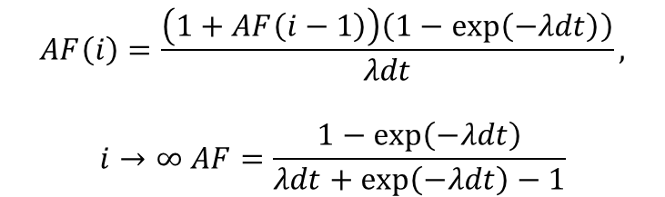
Afterglow effect of LiF/ZnS:Cu screen
ZnS decays to 10% 85us (long component) -> λ=2.71e4 /s, the relative afterglow fraction at image i, AF(i)
For bright flash:
$$AF(i)=\frac{\frac{\left[I\left(i−1\right)+AF(i−1)I\left(i−1\right)\right]\left(1−\exp\left(−λdt\right)\right)}{λdt}}{I\left(i\right)}$$
For constant intensity:
$$AF\left(i\right)=\frac{\left(1+AF\left(i−1\right)\right)\left(1−\exp\left(−λdt\right)\right)}{λdt},$$
$$i→∞ AF=\frac{1−\exp\left(−λdt\right)}{λdt+\exp\left(−λdt\right)−1}$$
Scintacor offer ZnO:Zn scintillator screen with a decay time of 3.5 us!
BUT: ZnO:Zn has lower scintillation efficiency and higher gamma sensitivity! ->
ZnS:Cu is still a reasonable compromise!!

