Slide 1



BEHAVIOR OF POROUS ROCK STUDIED WITH NEUTRON TOMOGRAPHY
Maddi Etxegarai
E. Tudisco, A. Tengattini, S. Hall, G. Viggiani

Slide 2
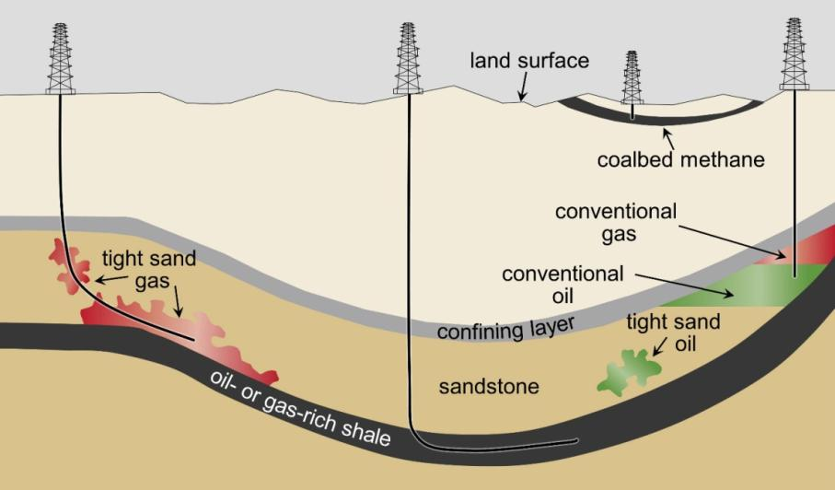
CONTEXT | OBJECTIVE | TEST | IMAGE ANALYSIS | RESULTS | SUMMARY
Context
Changes in the fluid flow due to the deformations during subsurface resource engineering operations are of great interest yet poorly understood.
There is a clear need for experimental characterization and modelling of how deformation modifies fluid flow in rocks

Slide 3
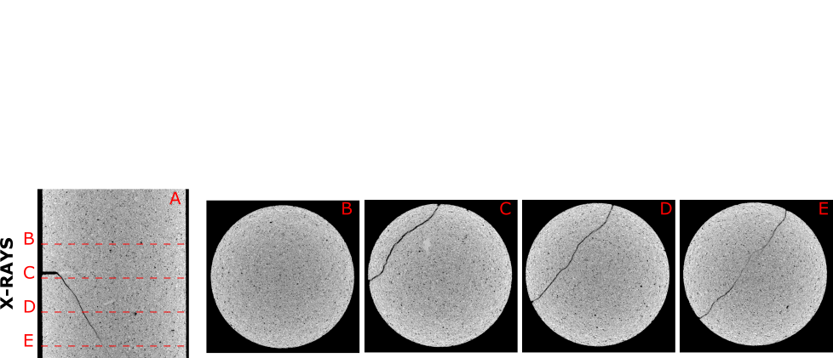
CONTEXT | OBJECTIVE | TEST | IMAGE ANALYSIS | RESULTS | SUMMARY
Context: X-rays
X-rays allow high spatial and temporal resolution.
BENTHEIM SAMPLE
Notes:
But we want to analyze the hydrolical aspects

Slide 4
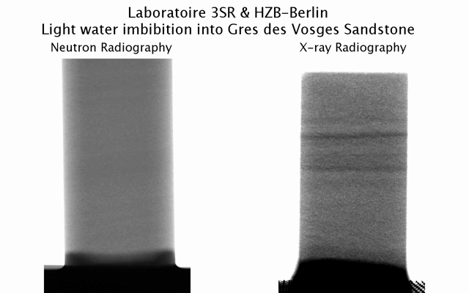
CONTEXT | OBJECTIVE | TEST | IMAGE ANALYSIS | RESULTS | SUMMARY
Context: Neutrons
Neutrons are highly sensitive to hydrogen.
Different interaction with each isotope.
Low interaction with metals.
Edward Andò
Notes:
Contrast , D2O, H2O
Cell

Slide 5
CONTEXT | OBJECTIVE | TEST | IMAGE ANALYSIS | RESULTS | SUMMARY
Objective
Perform an experimental campaign to measure the full field fluid speed evolution in rocks at different triaxial loading stages.
High speed neutron tomographies are acquired in order to track the 3D fluid front.
Medium resolution x-ray tomographies have also been acquired to obtain the strain field by means of Digital Volume Correlation
→ AIM: TO QUANTIFY COUPLED HYDROMECHANICAL PROCESSES
Notes:
What do we need to get that

Slide 6



CONTEXT | OBJECTIVE | TEST | IMAGE ANALYSIS | RESULTS | SUMMARY
Objective: structure of the experimental campaign
A0
A1
A2
A3
Sandstone sample
X-Ray tomography
Triaxial loading
X-Ray tomography
DIGITAL VOLUME CORRELATION
A1 - X_RAY TOMOGRAPHY
A3 - X_RAY TOMOGRAPHY
A2 - TRIAXIAL LOADING
A0 – SANDSTONE SAMPLE
3D VOLUMETRIC STRAIN FIELD
3D MAXIMUM SHEAR STRAIN FIELD
Local discontinuities
3D reconstruction
3D reconstruction

Slide 7
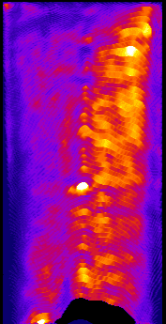
CONTEXT | OBJECTIVE | TEST | IMAGE ANALYSIS | RESULTS | SUMMARY
Objective: structure of the experimental campaign
B0
B1
Saturated sample
Neutron high speed tomography
B1 – SATURATED SAMPLE
05 – NEUTRON HIGH SPEED TOMOGRAPHY
IN-HOUSE CODE
3D
SPEED MAP
D₂O
3D reconstructions
H₂O
7

Slide 8
CONTEXT | OBJECTIVE | TEST | IMAGE ANALYSIS | RESULTS | SUMMARY
Test: Triaxial loading
4 Vosges samples were deformed at different levels + 1 intact
Confinement pressure: 30 MPa
Confinement pressure: 40 MPa

Slide 9
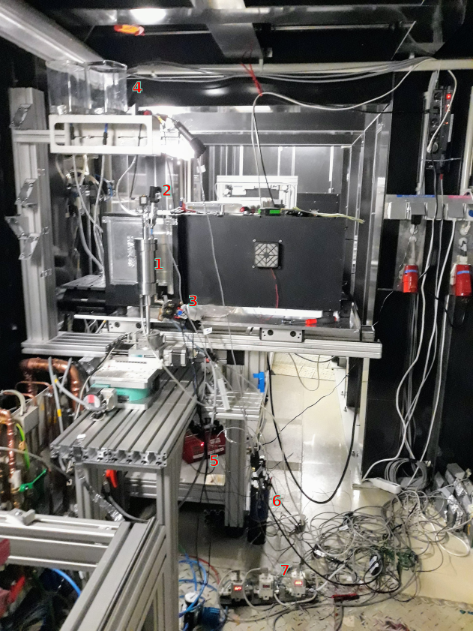
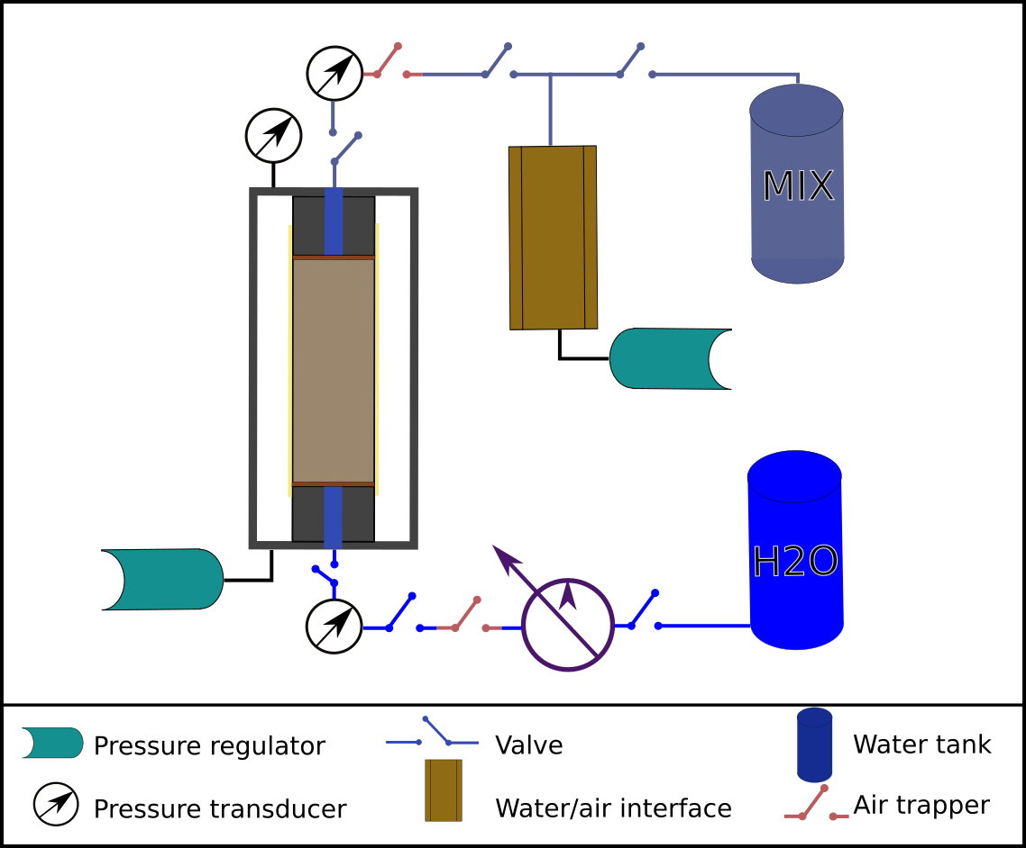

CONTEXT | OBJECTIVE | TEST | IMAGE ANALYSIS | RESULTS | SUMMARY
Test: Neutron setup
The samples were previously saturated with heavy water.
Light water was pushed through the sample while the flow rate and the pressure were controlled.

Slide 10
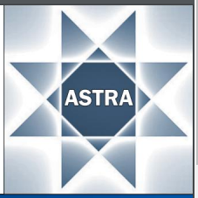
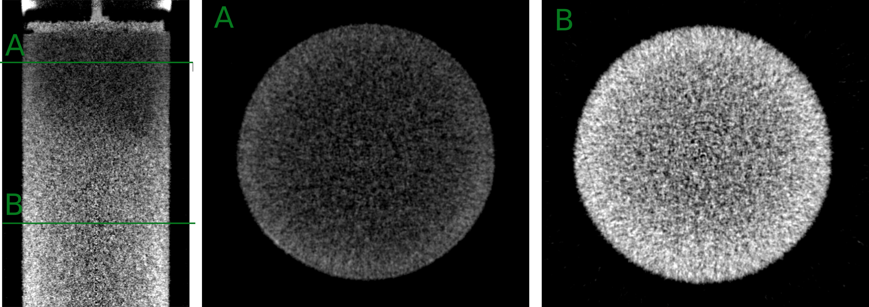
CONTEXT | OBJECTIVE | TEST | IMAGE ANALYSIS | RESULTS | SUMMARY
Image analysis: Reconstruction
D₂O
One minute fast tomography
                -Radiography exposure time: 0.2 s
                -Pixel size: 220 µm
Beam hardening effect
Not a strong contrast between the gray scale of both waters
H₂O

Slide 11
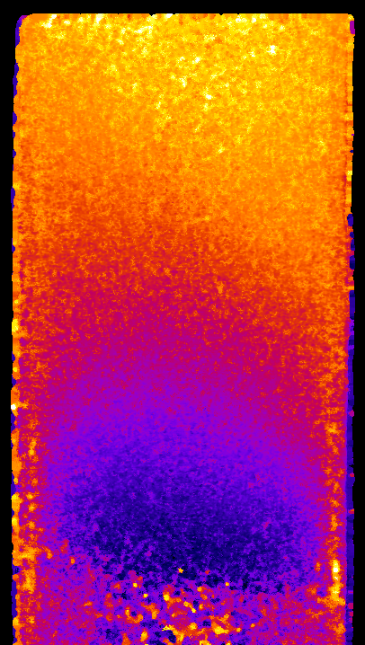
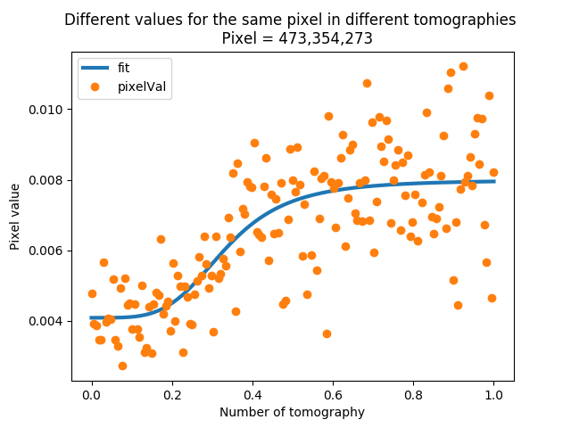


CONTEXT | OBJECTIVE | TEST | IMAGE ANALYSIS | RESULTS | SUMMARY
Image analysis: Time map
SIGMOIDAL FITTING
The gray scale of a pixel is plotted for all the tomographies and a sigmoidal function is fitted to the trend
The C parameter gives the arrival time
WATER FRONT TIME MAP
C
0
min
412

Slide 12
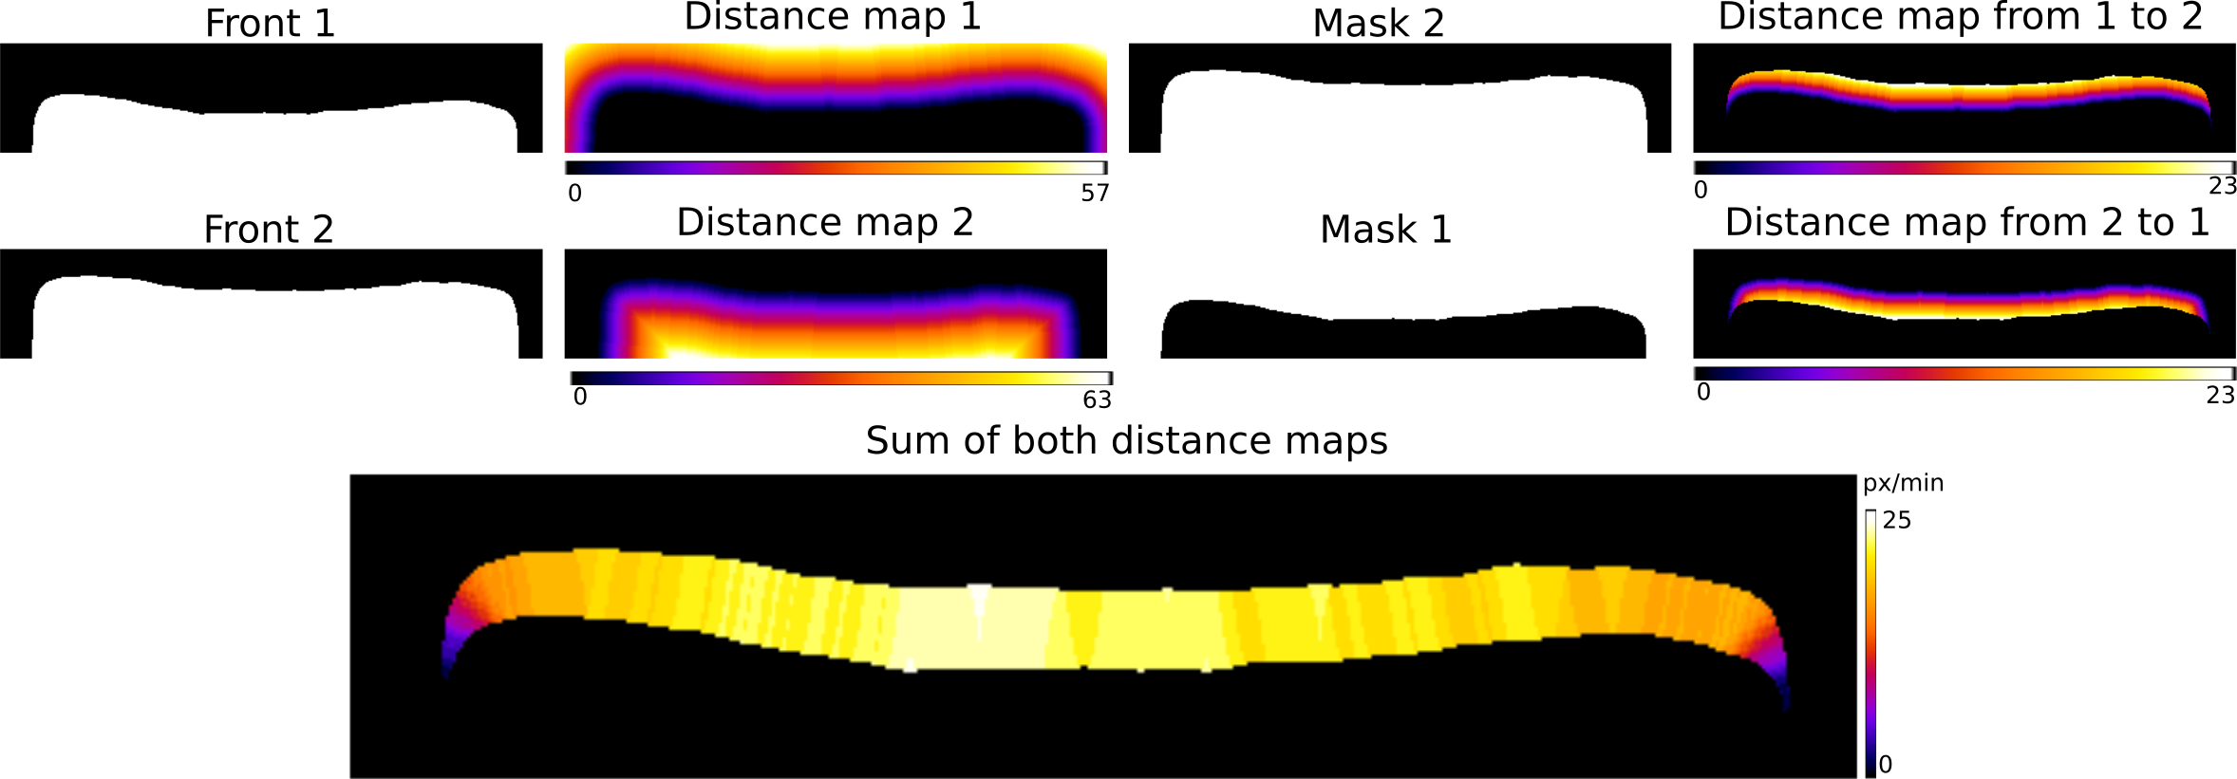
CONTEXT | OBJECTIVE | TEST | IMAGE ANALYSIS | RESULTS | SUMMARY
Image analysis: Water front speed
Binarize the reconstructed volume to get the two consecutive fronts.
Calculate the distance maps in the space between both fronts.
Sum both distance maps

Slide 13
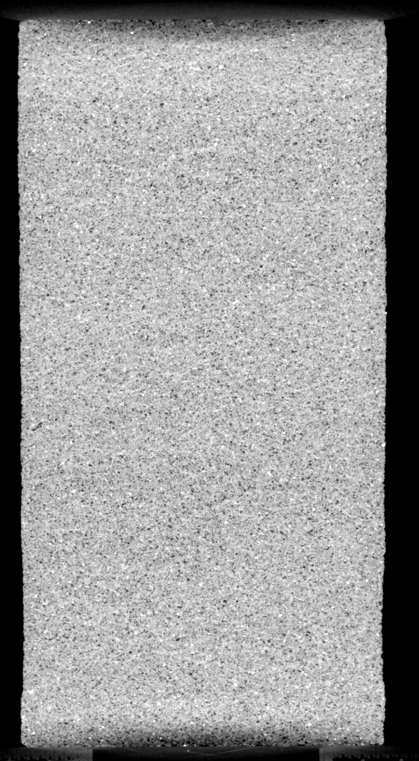
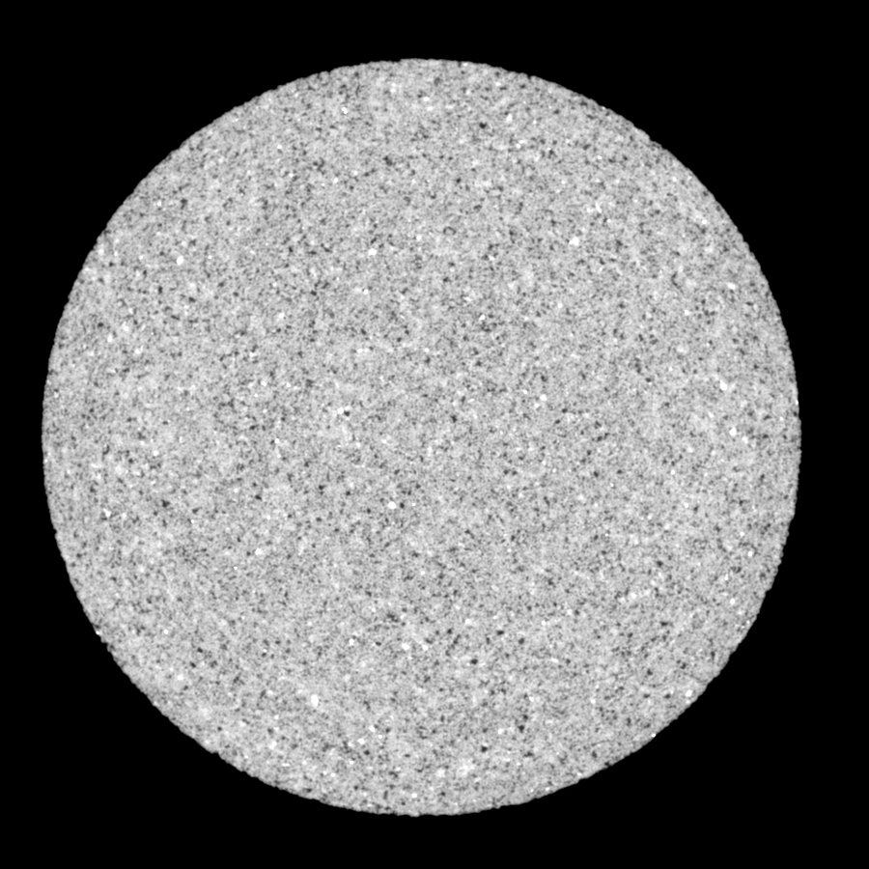
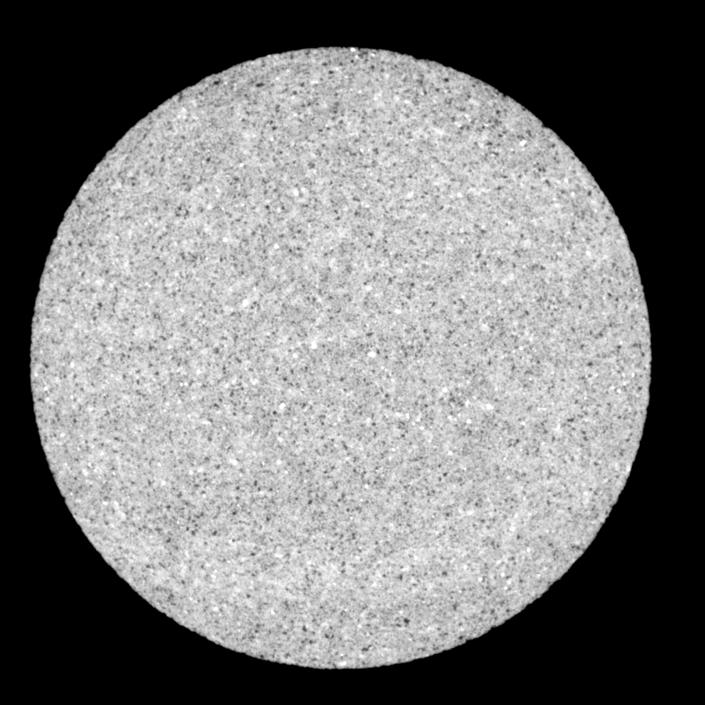
CONTEXT | OBJECTIVE | TEST | IMAGE ANALYSIS | RESULTS | SUMMARY
Results: VO01ME
Intact sample
The water was flushed at 4 ml/h: Front speed of 0.253 mm/min
X-RAY TOMOGRAPHY
Vertical
Horizontal
Attenuation

Slide 14
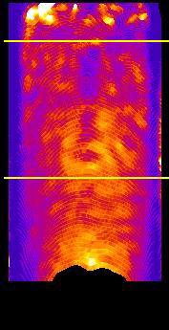
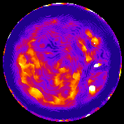
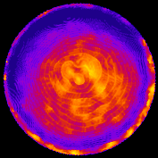
CONTEXT | OBJECTIVE | TEST | IMAGE ANALYSIS | RESULTS | SUMMARY
Results: VO01ME
Intact sample
The water was flushed at 4 ml/h: Front speed of 0.253 mm/min
X-RAY TOMOGRAPHY
WATER FRONT SPEED
Vertical
Horizontal
Vertical
Horizontal
0
mm/min
0.34
Attenuation

Slide 15







CONTEXT | OBJECTIVE | TEST | IMAGE ANALYSIS | RESULTS | SUMMARY
Results: VO02ME
Sample deformed at 30 MPa confinement, in the beginning of the plateau in the stress/strain response
The water was flushed 8 ml/h:
Front speed of 0.506 mm/min
VOLUMETRIC STRAIN
SHEAR STRAIN
Vertical
Horizontal
Vertical
Horizontal
-0.1
0.1
0.01
0.22

Slide 16
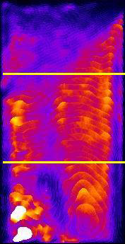
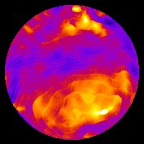
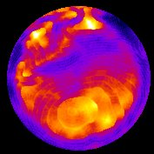
CONTEXT | OBJECTIVE | TEST | IMAGE ANALYSIS | RESULTS | SUMMARY
Results: VO02ME
Sample deformed at 30 MPa confinement, in the beginning of the plateau in the stress/strain response
The water was flushed 8 ml/h:
Front speed of 0.506 mm/min
WATER FRONT SPEED
Vertical
Horizontal
VOLUMETRIC STRAIN
SHEAR STRAIN
Vertical
Horizontal
Vertical
Horizontal
-0.1
0.1
0.01
0.22
0.04
mm/min
0.59

Slide 17






CONTEXT | OBJECTIVE | TEST | IMAGE ANALYSIS | RESULTS | SUMMARY
Results:VO03ME
Sample deformed at 30 MPa confinement, close to the stress peak
The water was flushed at 4 ml/h
Front speed of 0.253 mm/min
VOLUMETRIC STRAIN
SHEAR STRAIN
Vertical
Horizontal
Vertical
Horizontal
-0.015
0.015
0.006
0.02

Slide 18
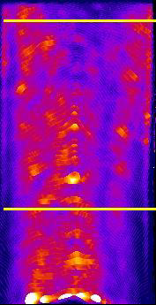
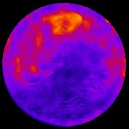
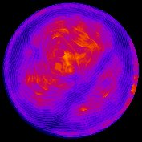
CONTEXT | OBJECTIVE | TEST | IMAGE ANALYSIS | RESULTS | SUMMARY
Results:VO03ME
Sample deformed at 30 MPa confinement, close to the stress peak
The water was flushed at 4 ml/h
Front speed of 0.253 mm/min
WATER FRONT SPEED
Vertical
Horizontal
VOLUMETRIC STRAIN
SHEAR STRAIN
Vertical
Horizontal
Vertical
Horizontal
-0.015
0.015
0.006
0.02
0.19
mm/min
0.50

Slide 19






CONTEXT | OBJECTIVE | TEST | IMAGE ANALYSIS | RESULTS | SUMMARY
Results: VO04ME
Sample deformed at 40 MPa confinement, in the beginning of the plateau in the stress/strain response
The water was flushed at 3 ml/h
Front speed of 0.19 mm/min
VOLUMETRIC STRAIN
SHEAR STRAIN
Vertical
Horizontal
Vertical
Horizontal
-0.035
0.035
0
0.1

Slide 20
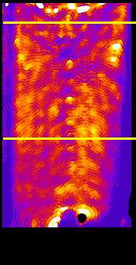
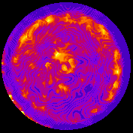
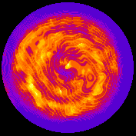
CONTEXT | OBJECTIVE | TEST | IMAGE ANALYSIS | RESULTS | SUMMARY
Results: VO04ME
Sample deformed at 40 MPa confinement, in the beginning of the plateau in the stress/strain response
The water was flushed at 3 ml/h
Front speed of 0.19 mm/min
WATER FRONT SPEED
Vertical
Horizontal
VOLUMETRIC STRAIN
SHEAR STRAIN
Vertical
Horizontal
Vertical
Horizontal
-0.035
0.035
0
0.1
0
mm/min
0.25

Slide 21






CONTEXT | OBJECTIVE | TEST | IMAGE ANALYSIS | RESULTS | SUMMARY
Results: VO05ME
Sample deformed at 40 MPa confinement, close to the stress peak
The water was flushed at flushed at 4 ml/h
Front speed of 0.253 mm/min
VOLUMETRIC STRAIN
SHEAR STRAIN
Vertical
Horizontal
Vertical
Horizontal
-0.02
0.02
0.01
0.2

Slide 22
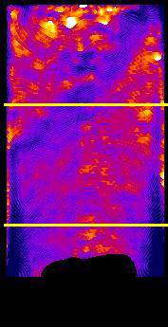
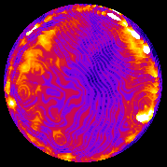
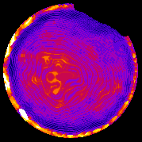
CONTEXT | OBJECTIVE | TEST | IMAGE ANALYSIS | RESULTS | SUMMARY
Results: VO05ME
Sample deformed at 40 MPa confinement, close to the stress peak
The water was flushed at flushed at 4 ml/h
Front speed of 0.253 mm/min
WATER FRONT SPEED
Vertical
Horizontal
VOLUMETRIC STRAIN
SHEAR STRAIN
Vertical
Horizontal
Vertical
Horizontal
-0.02
0.02
0.01
0.2
0.1
mm/min
22
0.49

Slide 23
CONTEXT | OBJECTIVE | TEST | IMAGE ANALYSIS | RESULTS | SUMMARY
Summary
Objective
Investigation of coupled hydro-mechanical properties with neutrons.
Conclusions
Good control of the water front The 3D water front can be tracked in saturated samples. We are able to get the 3D flow speed map of a hydraulic process. The speed of the front is reduced in the band on a saturated sample.
Future work
Improve the resolution of the tomographies. In-situ hydro-mechanical test in neutrons. Upgrade of the setup for high pressure tests.

