Slide 1

12th World Conference on
Neutron Radiography (WCNR 12)
February, 2022
Proposal to Organise by
Indian Society for Non-Destructive Testing (ISNT)
In association with ISNR
Theme
Neutron Imaging in the Service of Mankind

Slide 2
Structure of the Presentation
Genesis of Neutron Radiography in India
NR Activities at BARC, SHAR, IGCAR
Proposal for 12th WCNR 2022
Venue – location, accessibility, facilities, accommodation
Scientific aspects
Registration accommodation

Slide 3
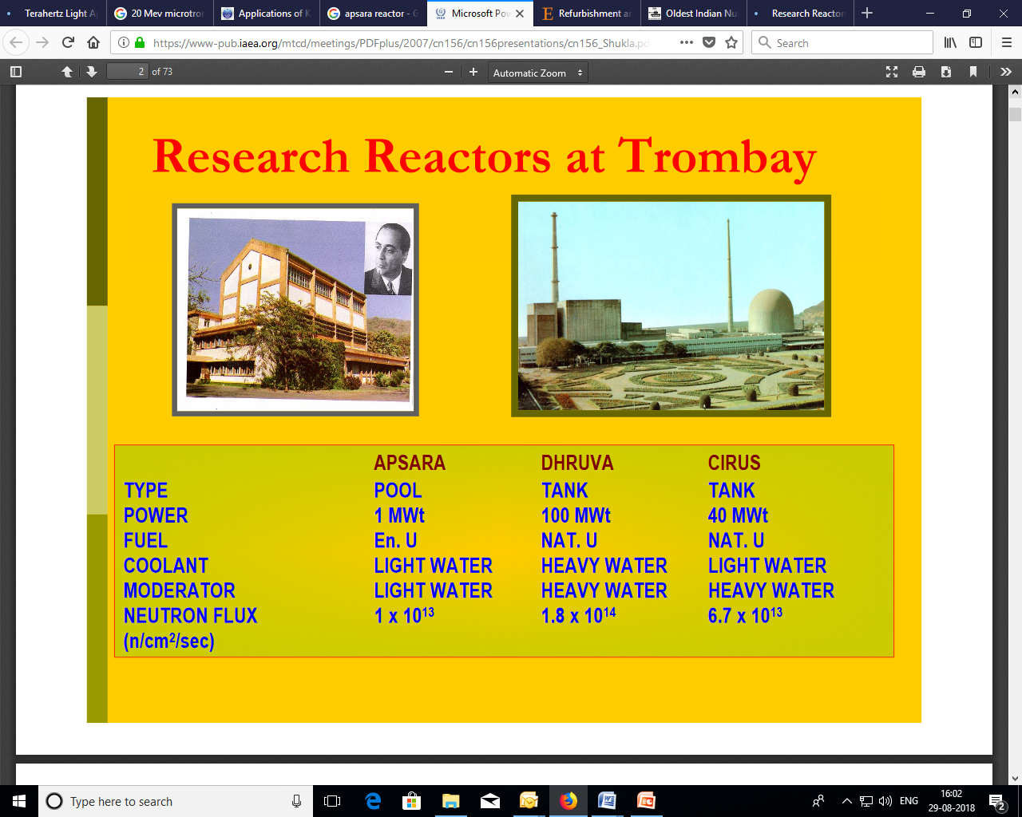
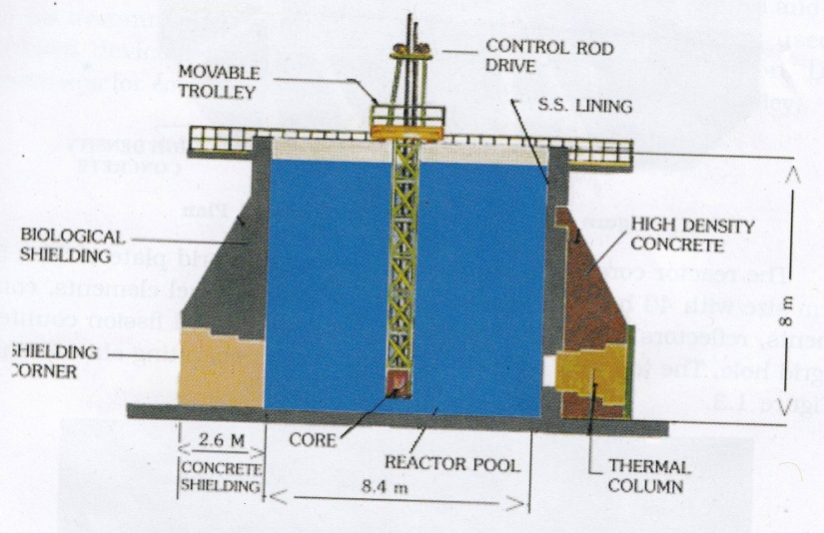
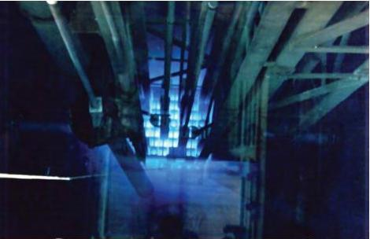
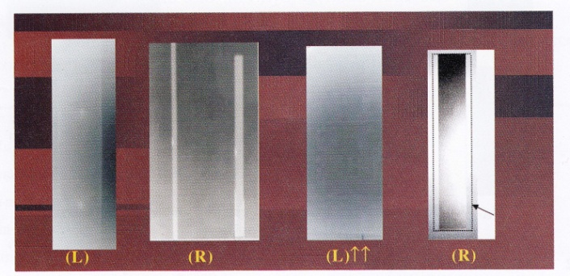
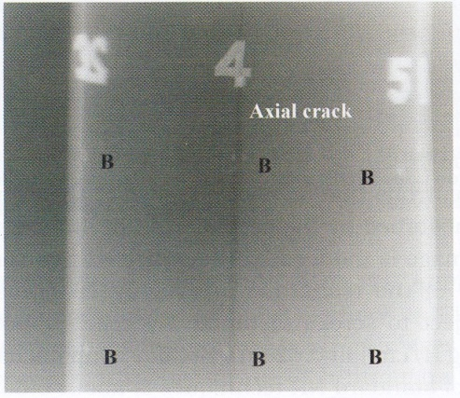
NR started at Bhabha Atomic Research Centre, Trombay
APSARA FIRST REACTOR USED FOR NEUTRON RADIOGRAPHY 1980s
DHRUVA
CIRUS
Zr- 2.5 % Nb Pressure tube price
Hydrogen Blister

Slide 4
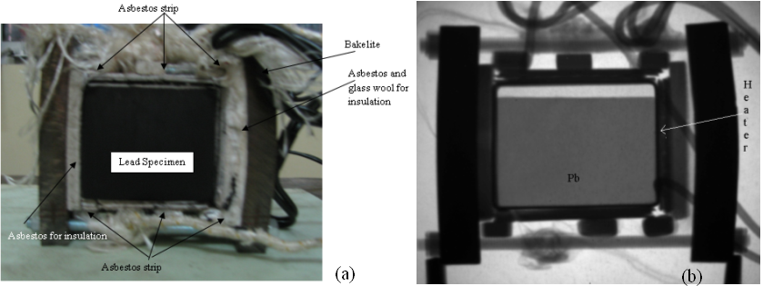
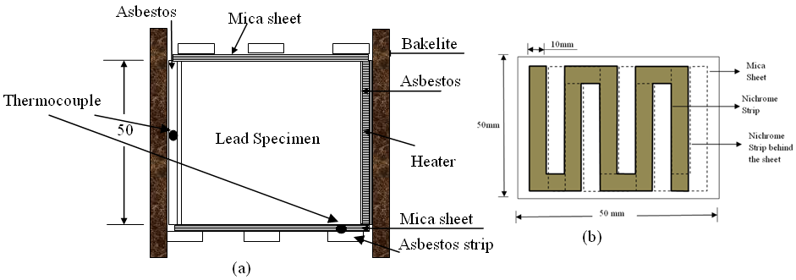
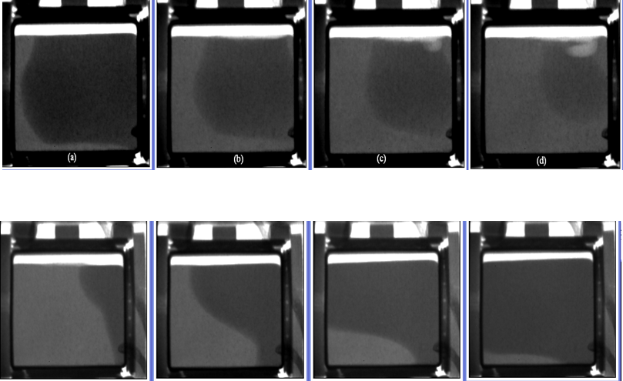
Real-time Imaging for study on melting & solidification of lead
To study the effect of impurities on melting & solidification behaviour of lead under accidental fire for applications in lead casks used for transporting radioactive material
Schematic of heating chamber
Photograph
Neutron radiograph
Melting of lead
Solidification of lead
CIRUS Reactor (2010)

Slide 5
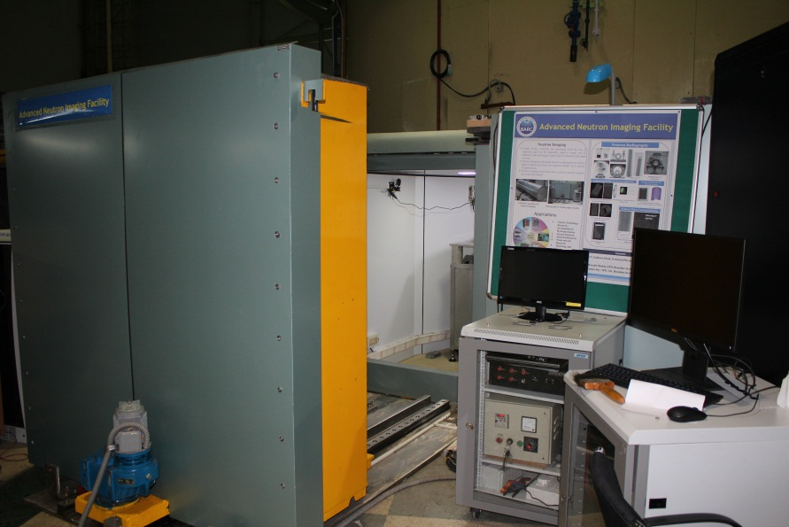
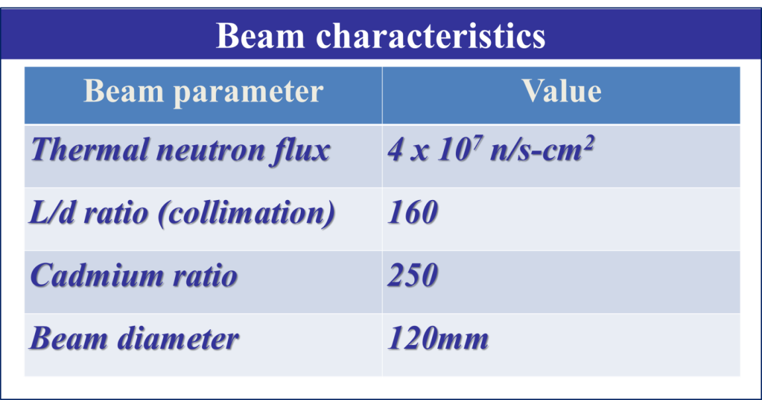
Present Activities - Neutron Imaging Facility at DHRUVA Reactor
Imaging Techniques currently implemented:
Neutron Radiography & Tomography
Neutron Phase Contrast Imaging
Real time imaging for transient events
Imaging Techniques (planned)
Neutron Bragg-edge Imaging
Neutron Laminography
Residual Stress Measurement

Slide 6
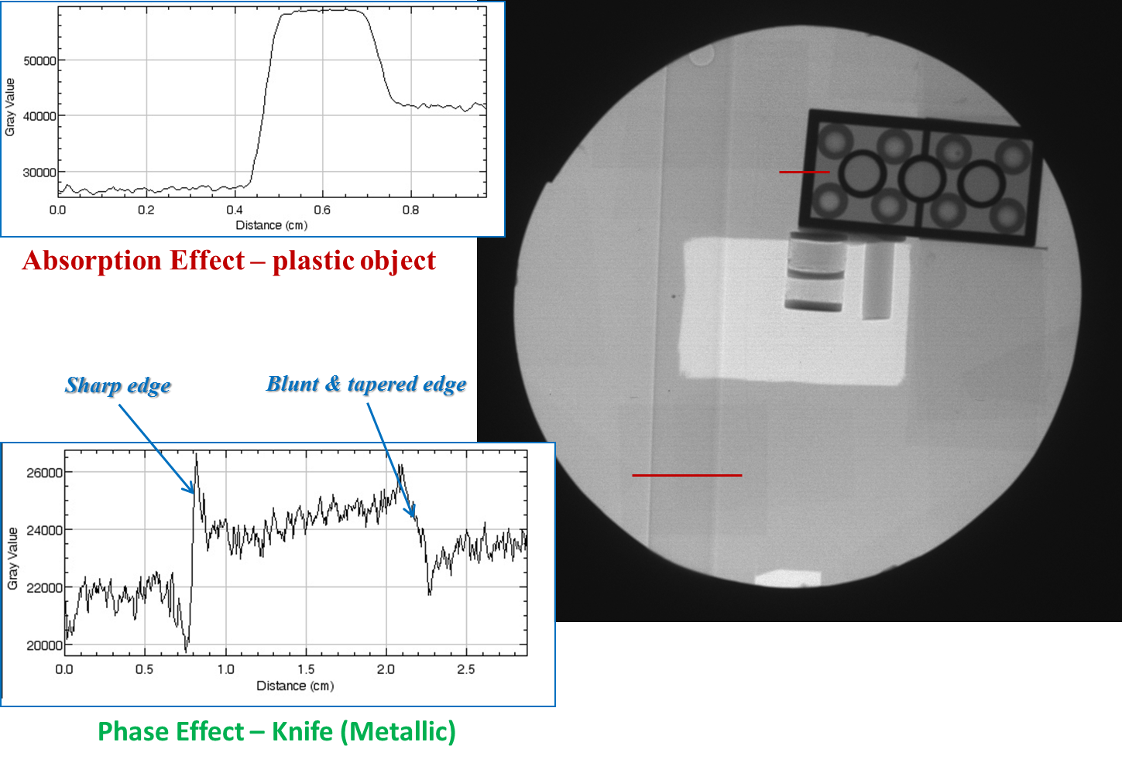
Neutron Phase Contrast Imaging
Conventional neutron radiography is based on only attenuation (removal) of neutrons in the beam path while phase sensitive techniques is based on detecting neutrons through ultra-small angles due to refraction or diffraction of coherent neutron wavefield.
For a large class of materials Phase shift term dominates over the absorption term and hence the techniques which can reveal/retrieve the phase would help in increasing the sensitivity of conventional neutron imaging.
DHRUVA Reactor (2016 onwards)

Slide 7
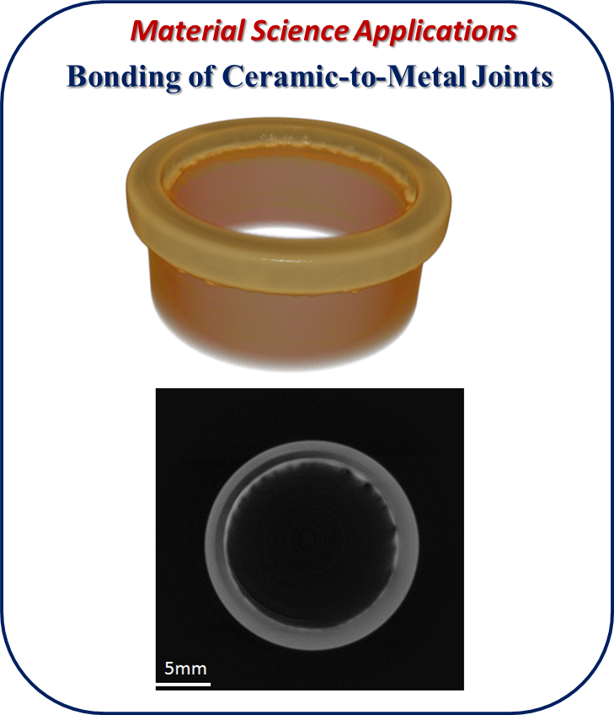
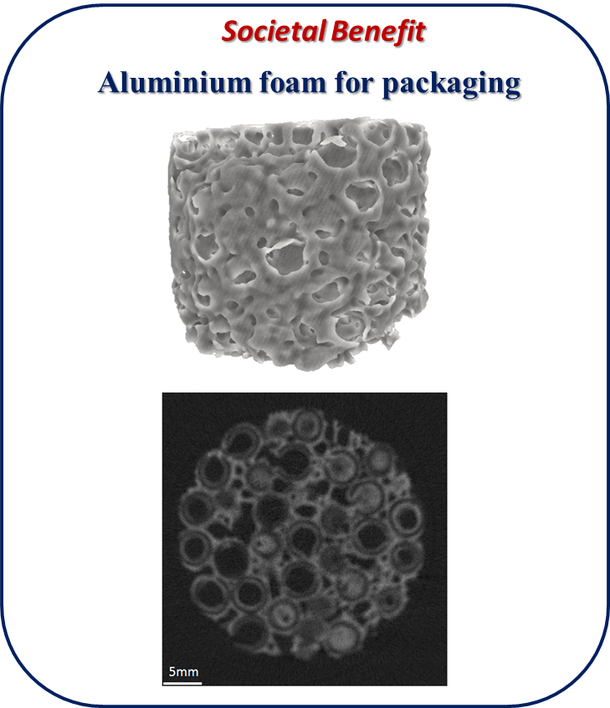
Applications of Neutron Tomography
DHRUVA Reactor (2016 onwards)

Slide 8
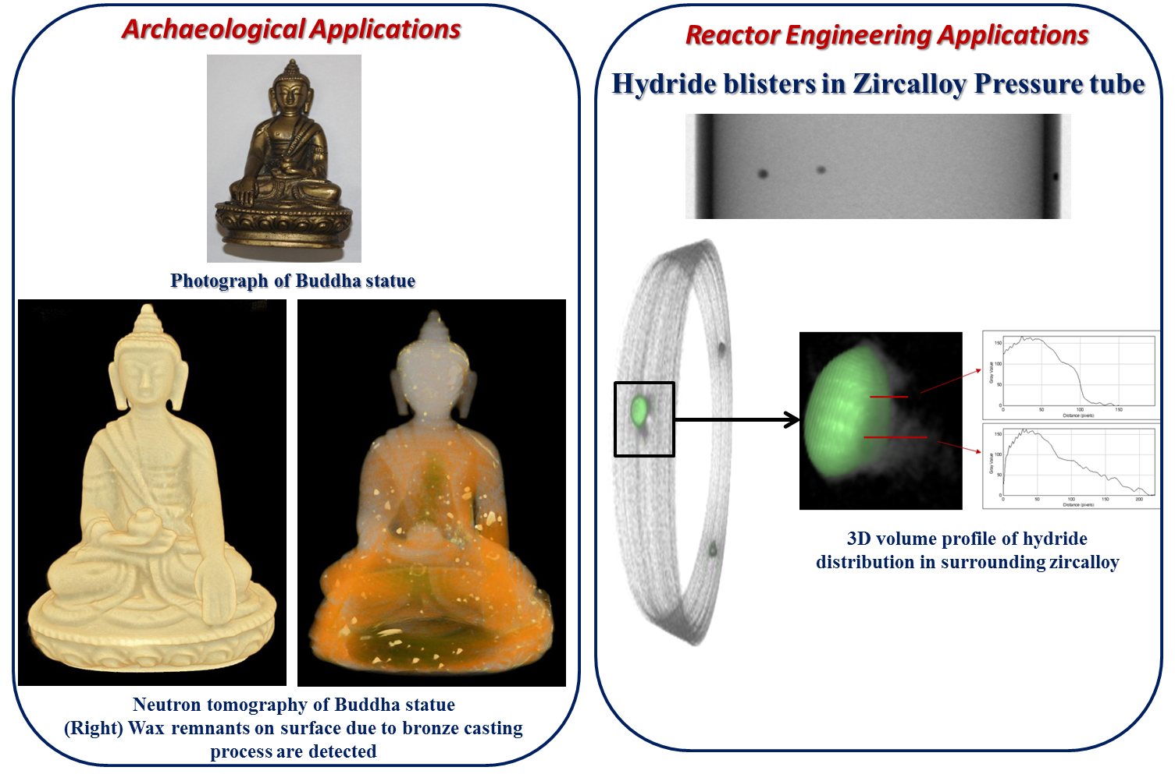
Applications of Neutron Tomography
DHRUVA Reactor (2016 onwards)

Slide 9
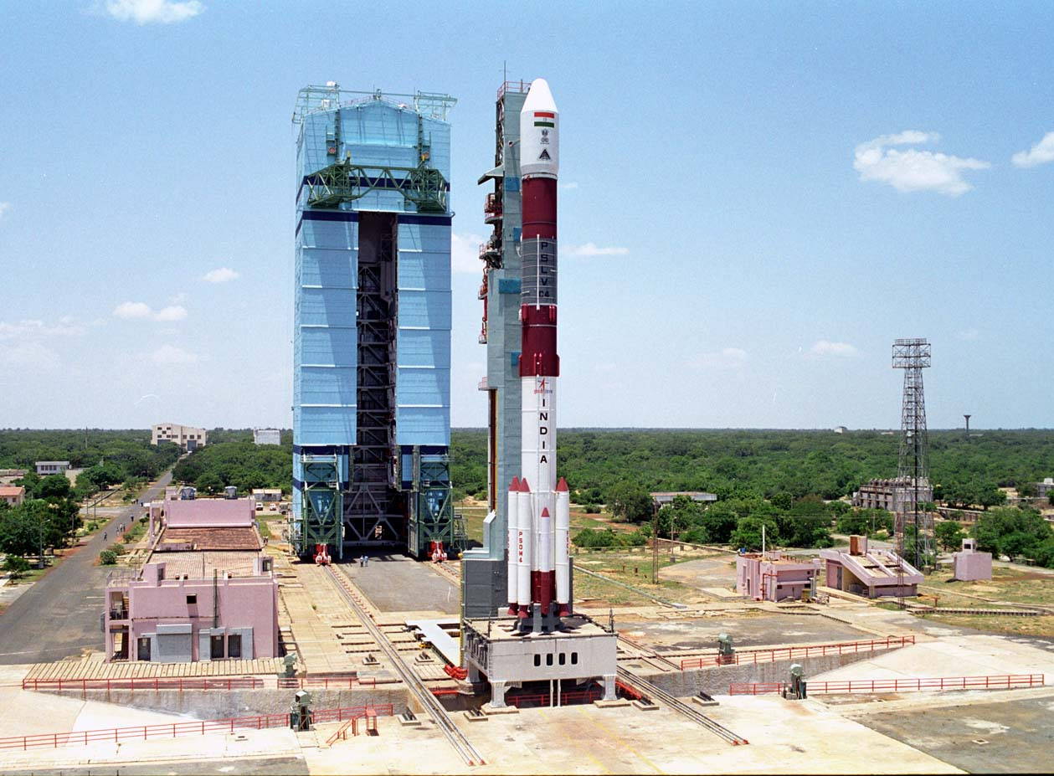
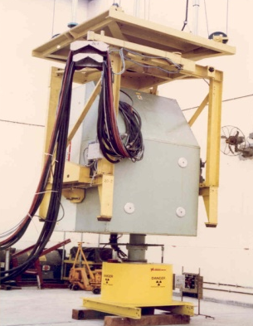
SHAR, Sriharikota
15 MeV Linear accelerator (6000 rads/min)
Neutron Radiography Facility Established by K.Viswanathan & Team
in 1980.

Slide 10
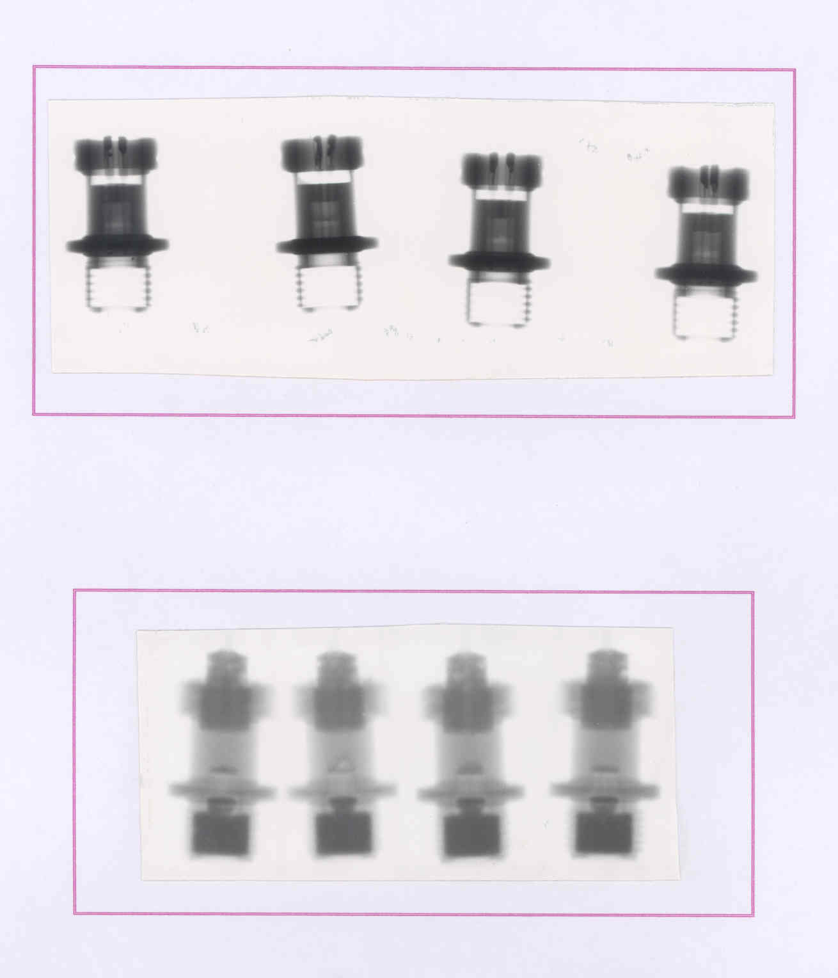
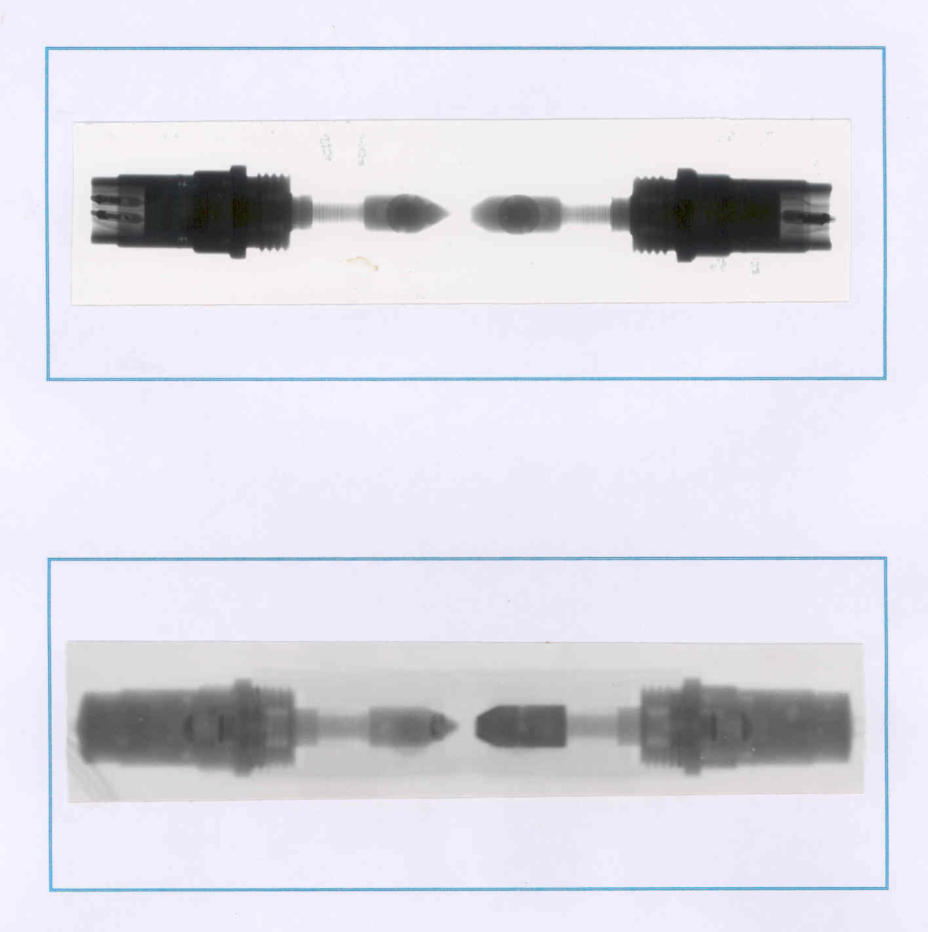
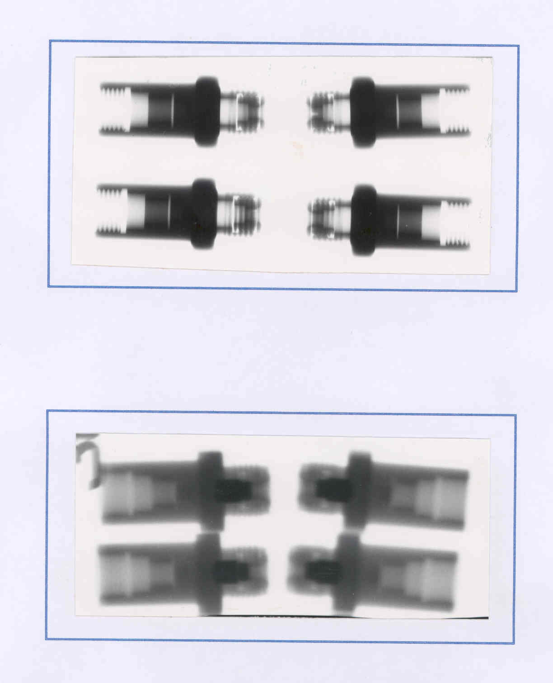
Typical NR and X-ray images of Pyrodevices
X-Ray
Cartridge
Blot Cutter
NR
X-Ray- TBI
NR- TBI

Slide 11
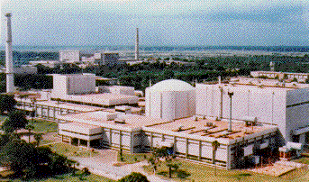
Stage – II : Fast Breeder Test Reactor (FBTR)
Sodium technology
(Pumps, Liquid Na)
Reactor Safety
demonstrated
80% indigenous
component
Cradle for
development
of HRD
40 MWt/
13.2 MWe
Criticality
Oct. 1985
Successful operation for 29 years
Unique (U,Pu)C fuel
[first time in world]
157 GWd/tonne burnup
without single fuel
pin failure in entire core
Reprocessing of
carbide fuel established
155 GWd/t fuel
reprocessed
in May 2005
FBTR Success story-IGCAR embarks on a 500 MW(e) FBR

Slide 12
Neturon Radiography at IGCAR – A peep into history
Kalpakkam Mini Reactor- KAMINI is a 30KW, tank-type research reactor that burns U-233/Aluminium alloy fuel.
Criticality – Oct. 1996 : Full power operation in September 1997.
First Neutron Radiograph in 1997 (B.Venkatraman) Visit to Riso National Lab 1994 and interactions with Dr J.C.Domanus
Neutron Radiography Facilities- Direct Method and Transfer Method
Rig and Cassette Drive Mechanism
(Baldev Raj, Kasiviswanathan and B.Venkatraman)
First Neutron radiograph of Irradiated fuel pin after 25 Mwd/t burn up (B.Venkatraman)
Second National Workshop on Neutron Radiography and release of monograph compiled by Baldev Raj, B.Venkatraman and K.Viswanathan by Neutron Radiography Working Group of India – 1998.
First Neutron radiograph of pyro device from ISRO 2000 – B.Venkatraman
Since then continuous use till date for nuclear fuel, control rods and pyros.

Slide 13
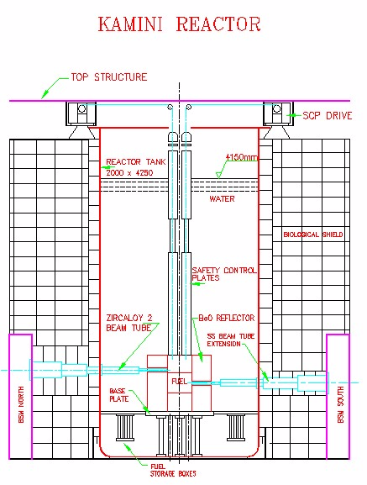
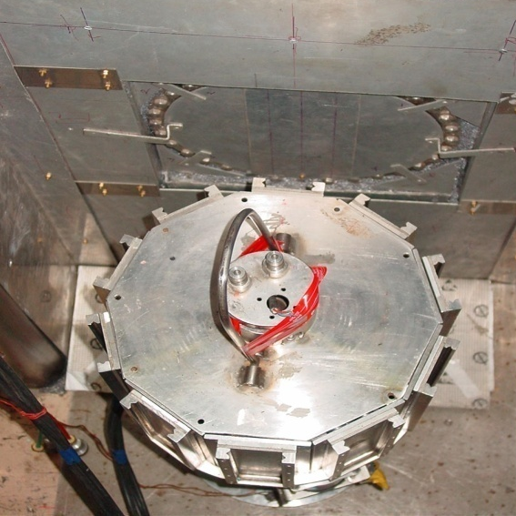
Salient features of Kamini Reactor
Item | Description
Nature of Reactor system | Tank type
Nominal power | 30 kW
Fuel | U-233 (20 Wt %) - Al alloy
Moderator/Coolant/Shield material | Demineralized water
Beam tubes | Three
Flux at outer end of beam tube | 10⁶ to 10⁷ n/ cm²/sec
Flux at irradiation sites | 10¹¹ to 10¹² n/cm²/sec
Core flux | 10¹² n/cm²/sec

Slide 14



Neutron Radiography of Highly Irradiated fuel pins (Carbide Fuel )
50,000 MWd/T
fuel pin
Pellet to Pellet gap
Plenum
Fuel column
Fuel column
Spring
N-RADIOGRAPHY OF 50 GWd/t BURNUP FUEL PINS
Observations through image processing
  Pellet-pellet gap
  Fuel pellet stack length
  Shape changes of pellets
N-RADIOGRAPHY OF 155 GWd/t BURNUP FUEL PINS
Neutron radiograph of four 155 GWd/t fuel pins showing the fuel column and the spring portion and plenum

Slide 15
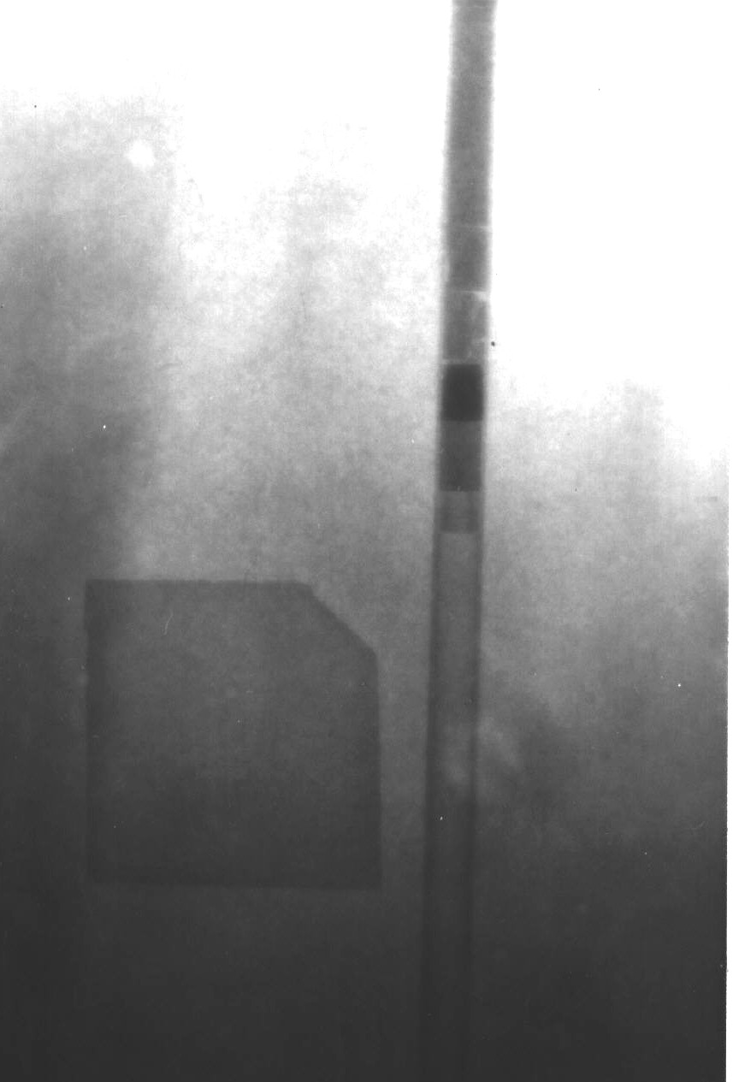
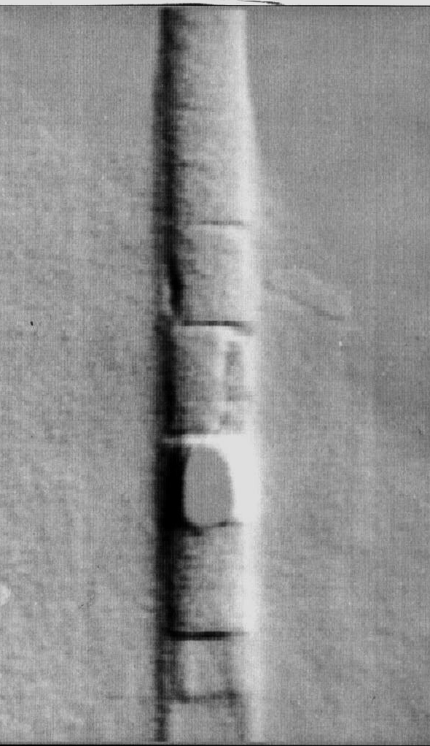
First Neutron Radiograph with KAMINI-Venkatraman
After appropriate image processing

Slide 16
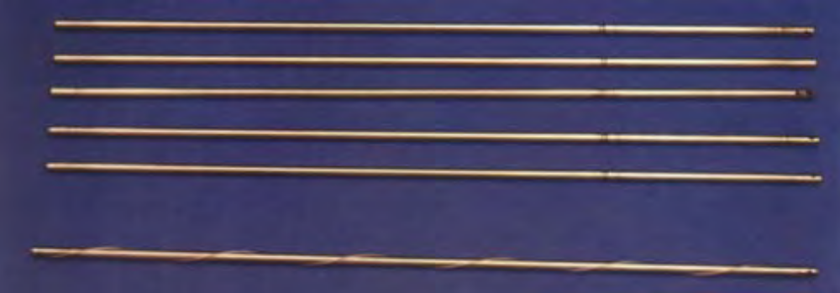
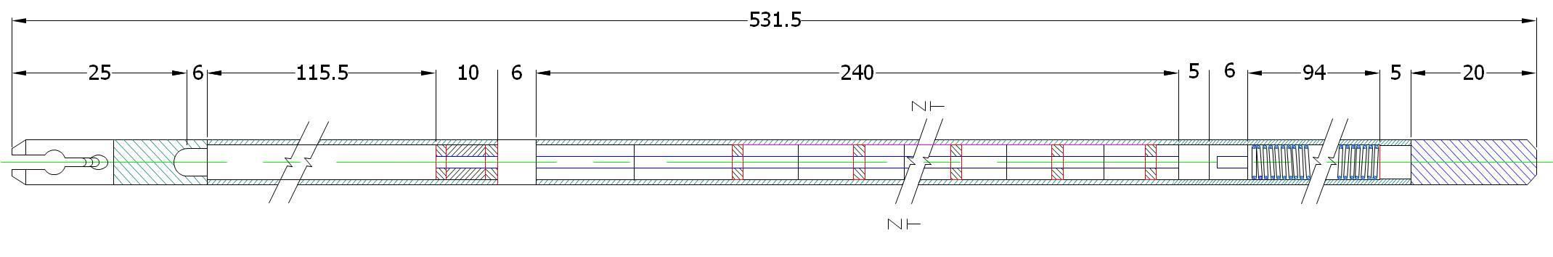

Neutron Radiography of Un-irradiated MOX fuel pin
NR Detect of Pellet to Pellet spacing and gross dimensional changes in fuel pin
As – fabricated MOX fuel pin
NR parametres (5 kW, 5 min, indium foil) chosen for Pellet integrity
Pellet dimensions & central channel (10 kW, 8 min, Dysporsium foil)
NR OF Un-irradiated MOX fuel pin used to get baseline data

Slide 17
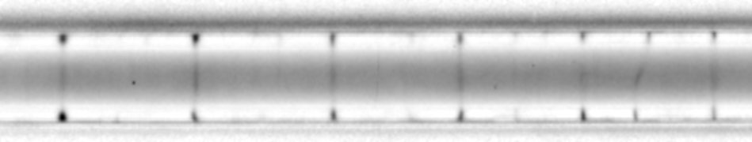
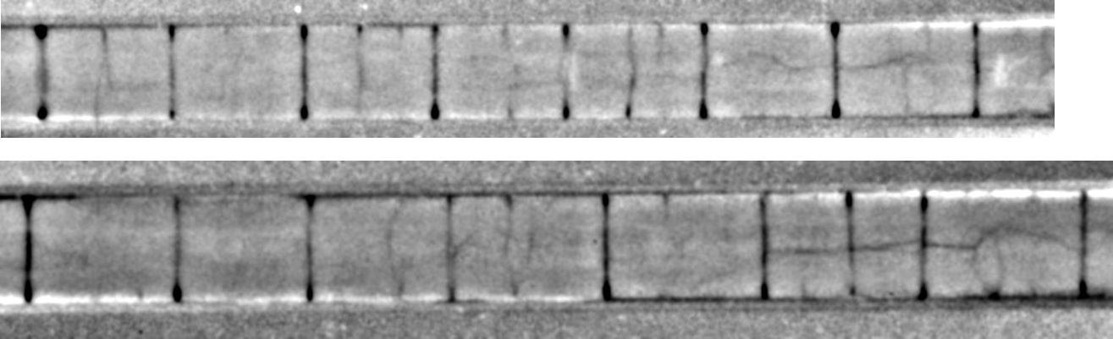
Neutron Radiography of Irradiated MOX fuel pin burn-up of 112 GWd/t
Pellet integrity from NR (10kW, 10 min, Dy foil)
Pellet integrity from NR (12 kW, 10 min, indium foil)
Pellet dimensions from NR (12 kW,15 min, indium foil)

Slide 18
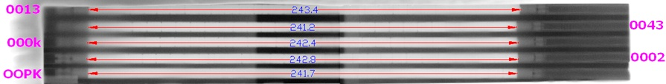
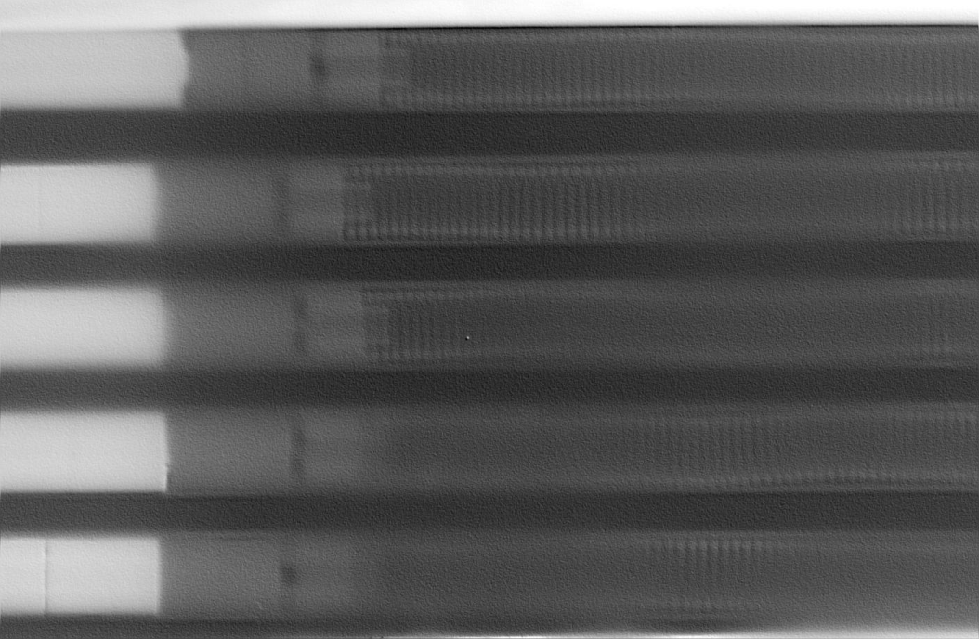
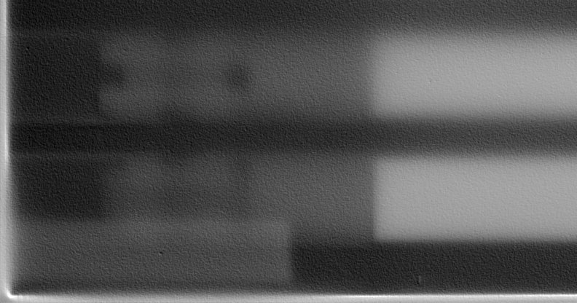

Stack length from Neutron Radiography
Neutron Radiography of Irradiated MOX fuel pin burn-up of 112 GWd/t
NR images of un-irradiated MOX Fuel Pin showing bottom crimped region and Top spring region
Stack length measurements as tabulated above
No indication of presence of chipped fuel particles or deposits in the plenum
Inter pellet gaps are clearly visible in most of the fuel pins
Inter pellet gap is not clearly delineated in one of the pins.

Slide 19
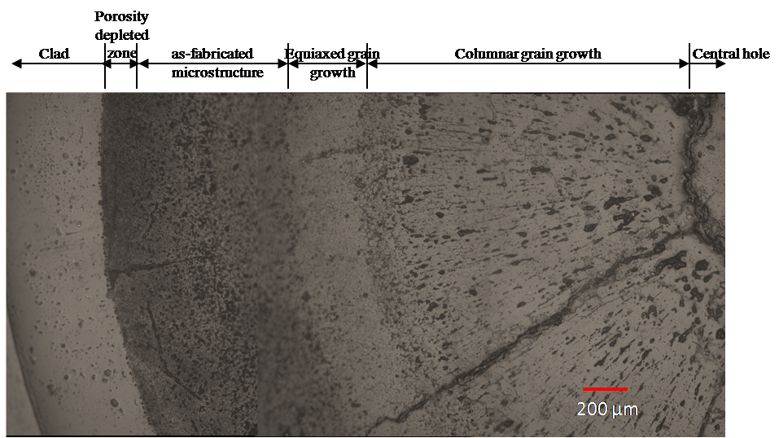
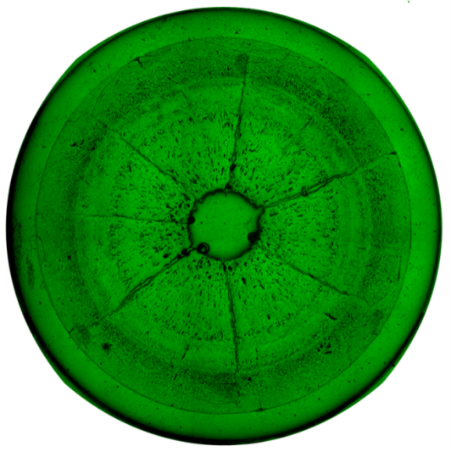
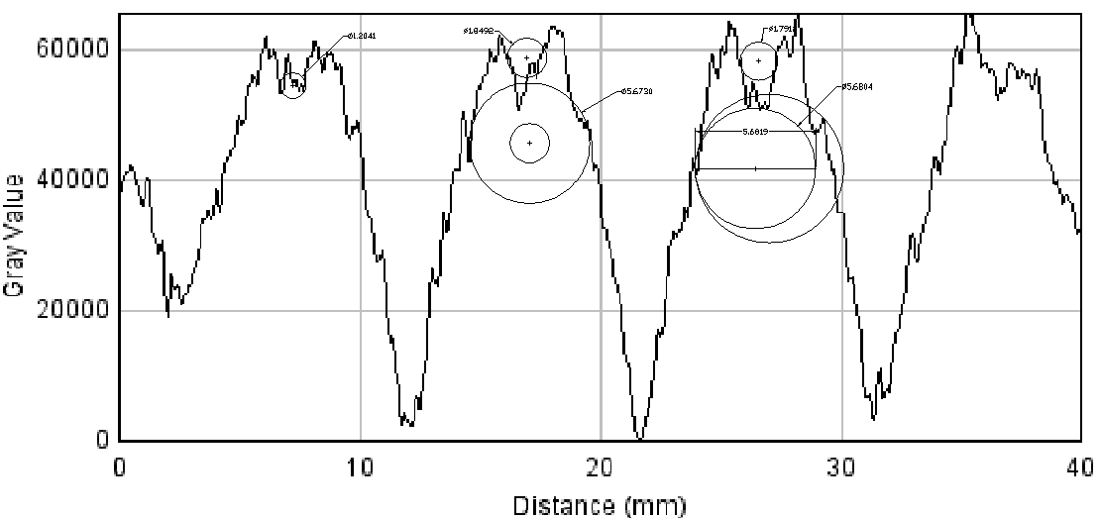
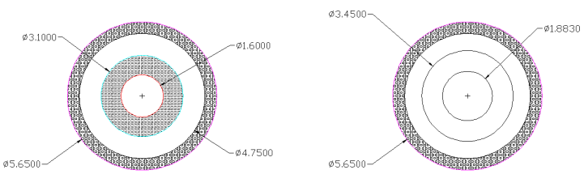
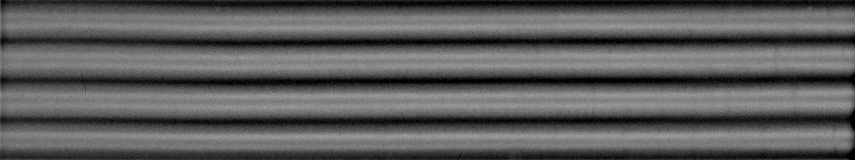
Fuel restructuring : Correlation of NR & Metallography
Microdensitometer traces of irradiated fuel pellets has indicated restructuring of fuel pellet

Slide 20

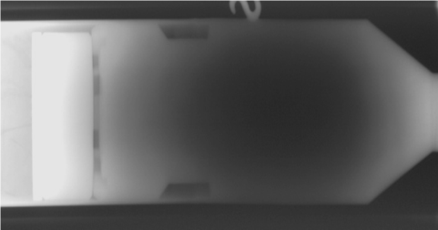
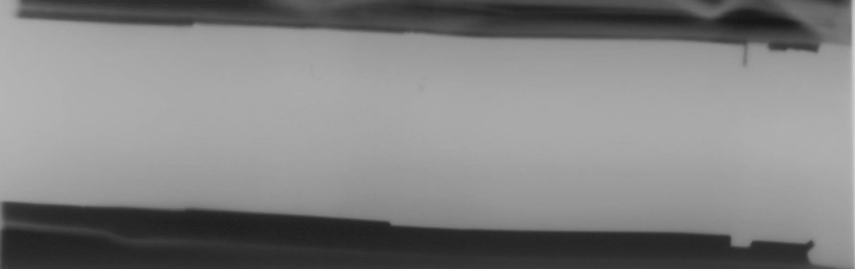
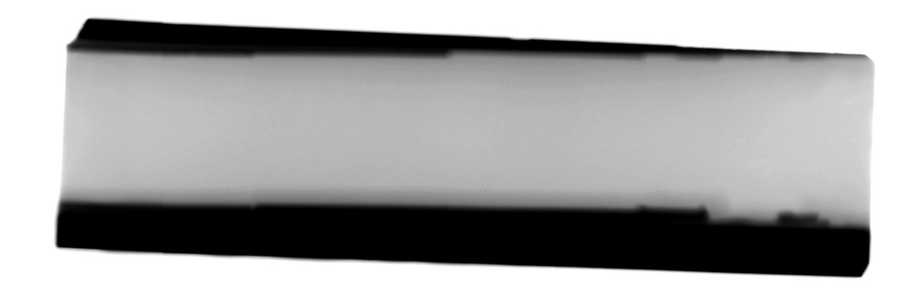
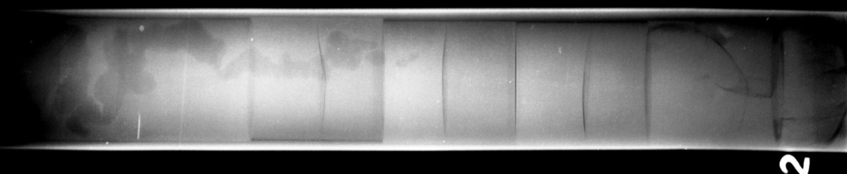
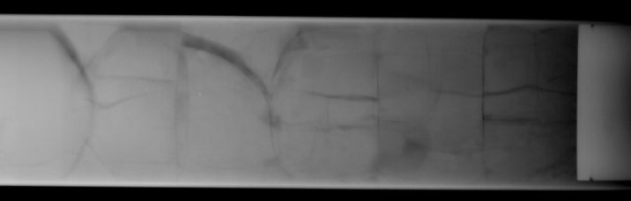
Neutron Radiography of the control rod
Cracked pellet in the foot end
Insulation pellet
Sodium filter
X-Ray shows bottom of the control rod
Neutron Radiographs of the control rod showing pellet cracking in the foot end
Neutron radiographs did not indicate any gross depletion of B¹⁰
Insulation pellet was found to be intact
Neutron radiograph of the active column at 15 kW and 20 kW showing pellet spacing
Top
Bottom
X-Radiography image of the pellet regions of the control rod top & bottom portion.

Slide 21
Neutron Radiography of Pyrodevices
Dual Pyro Valve
Cartridge 600
Detonating Cartridge

Slide 22
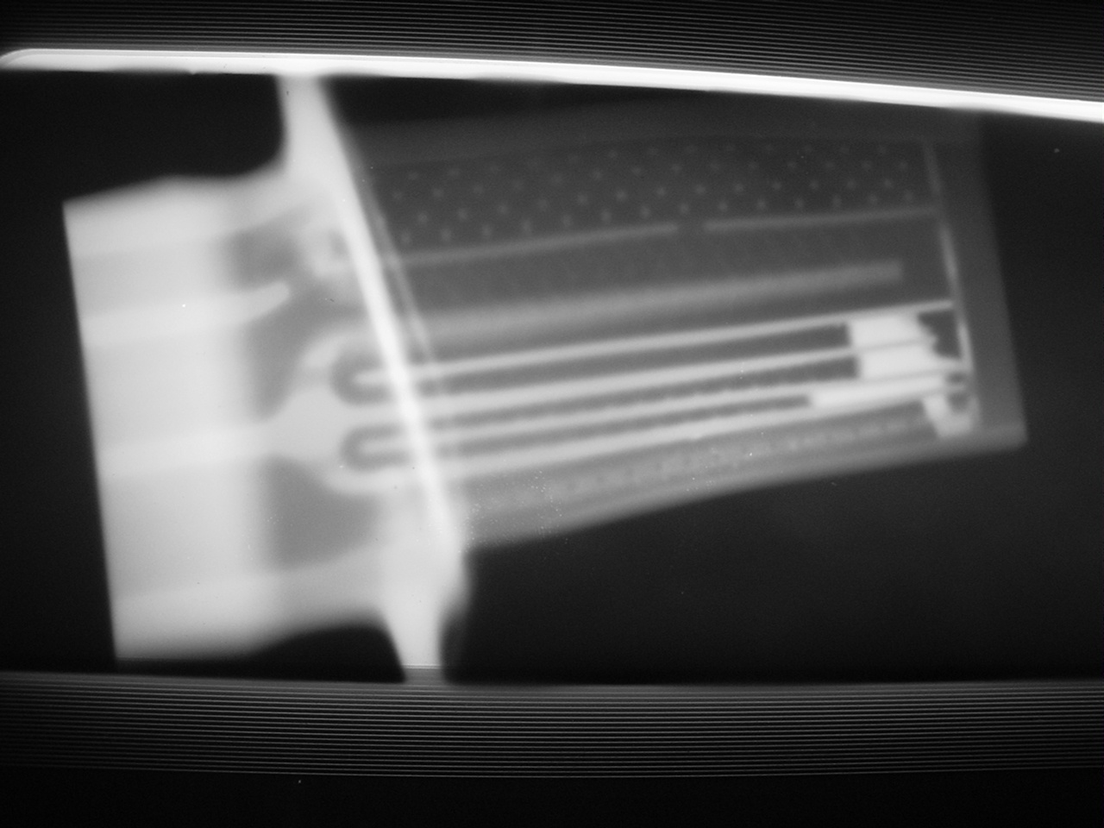
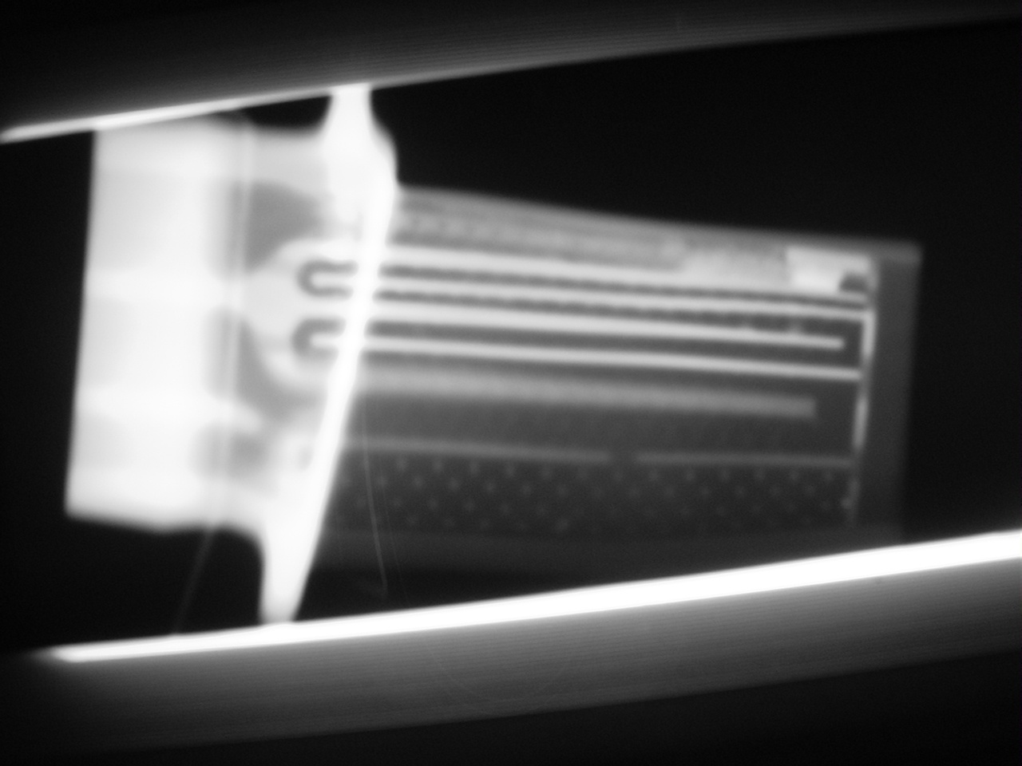
TURBINE BLADE WITH COOLING PASSAGE TRAPPED WITH CORE MATERIAL

Slide 23
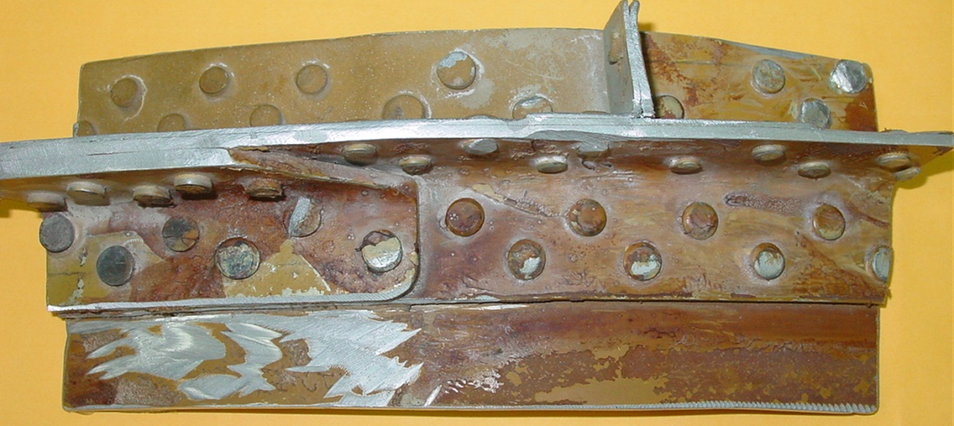
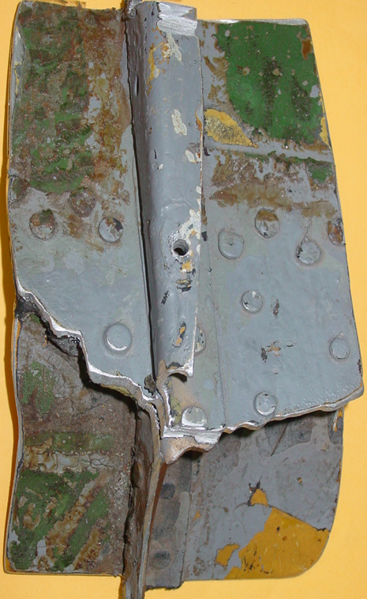
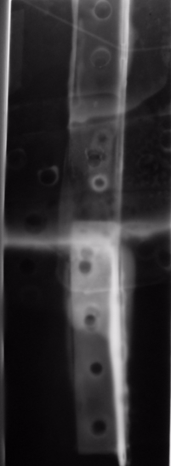
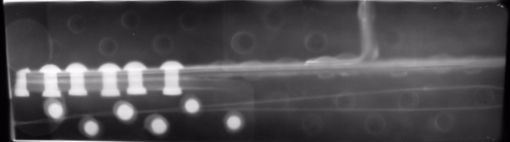
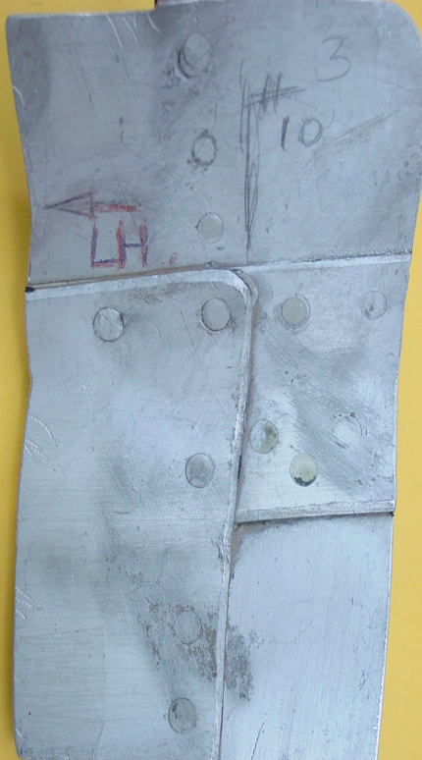
Neutron radiograph of aluminium riveted plate - corrosion studies
Corrosion damage underneath aluminium lap joint and around rivets

Slide 24
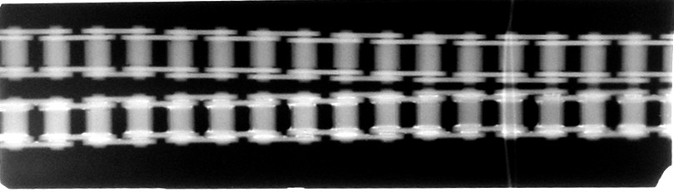
Lubricated and Unlubricated chain links

Slide 25
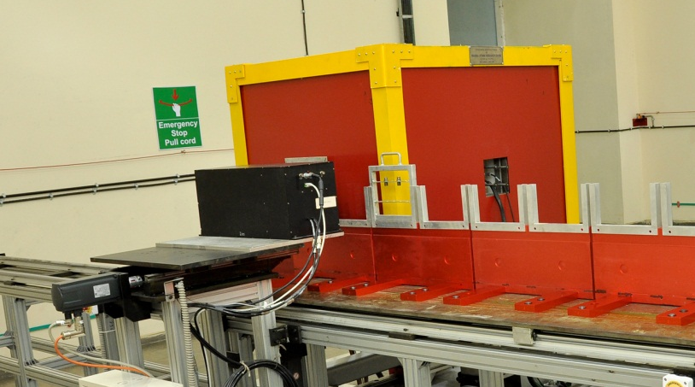



Neutron Imaging with non-reactor source
Thermal Neutron Radiography system using D-T neutron source designed by BARC and installed at Vikram Sarabhai Space Centre, ISRO for imaging of pyrotechnic devices used for space applications
Thermal Neutron Radiography Facility at VSSC, ISRO
Pyros assembled in device cassette for NR
Parameter | Value
D-T Neutron source yield | 1 x 10¹⁰ n/s
Thermal Flux (at output aperture) | 2 x 10⁴ n/(s-cm²)
Thermal Flux (at detector plane) | 1 x 10⁴ n/(s-cm²)
Cadmium Ratio | 10
L/d ratio | 25 (approx.)
Neutron Radiograph of pyrotecnic devices showing the presence of explosive charge

Slide 26



Experimental and theoretical investigations on the neutron attenuation study of polyboron materials
Neturon attenuation with Kamini south beam spectrum
Polyborn materials with
5%, 10% and 20% boron
Perspex
Am-be source
Shielding blocks
Neutron detector
Neturon attenuation with 5 Ci Am-Be source

Slide 27

Theoretical calculation for neutron attenuation in poly-boron materials was carried out using Monte Carlo N-Particle code (MCNP)
Three dimensional modeling of the actual source and geometry configuration including the shield materials and the detector
Dose rates Comparison for pure HDPE with 30% B
Thickness(cm) | Dose rate (mrem/h) |  | Relative error %
 | Using MCNP | By experiment
0 | 194 | 190 | -2.1
2.5 | 106.9 | 128.46 | 20.2
5 | 73.7 | 81.22 | 10.2
7.5 | 56.7 | 49.46 | -12.8
10 | 35.6 | 27.86 | -21.7
Dose rates Comparison for pure HDPE with 5% B
Thickness(cm) | Dose rate (mrem/h) |  | Relative error %
 | Using MCNP | By experiment
0 | 194 | 190 | -2.1
2.5 | 134 | 133.8 | -0.1
5 | 72.8 | 87.52 | 20.2
7.5 | 53.9 | 54.5 | 1.1
10 | 36.8 | 30.78 | -16.4

Slide 28
Major Labs working in India (Typical list – Not Exhaustive)
Research Institutes
  Department of Atomic Energy
    Bhabha Atomic Research Centre
    Indira Gandhi Centre for Atomic Research, Kalpakkam
  Department of Space
    Indian Space Research Organization, SHAR Centre
    Vikram Sarabhai Space Centre, Thiruvananthapuram
  Defence Research and Development Organization
    Defence Metallurgical Research Laboratory, Hyderabad
  National Aerospace Laboratories, Bengaluru
  Institute for Plasma Research, Ahmedabad
  National Metallurgical Laboratory, Jamshedpur
  Industries
    Oil and Natural Gas Corporation Limited , India – Well logging
Apsara Reactor Core (first reactor used for neutron imaging in India )
15 MeV Linear accelerator (6000 rads/min)

Slide 29
Publications from India - Typical
Venkatraman, B.; Raghu, N.; Menaka, M.; Anandraj, R , Trends in X-, gamma and neutron radiographic imaging at IGCAR Kalpakkam, Proceedings of the twenty-fifth national seminar and international exhibition on non destructive evaluation - NDE for make in India-2017, Chennai.
N. Raghu, V. Anandaraj, K. V. Kasiviswanathan, and P. Kalyanasundaram, Neutron Radiographic Inspection of Industrial Components using Kamini Neutron Source Facility, AIP Conference Proceedings 989, 202 (2008)
A. Sinha ; P.S. Sarkar ; Y. Kashyap, Applications of digital neutron imaging at BARC (India) using reactor and nonreactor sources, , IEEE Transactions on Nuclear Science ( Volume: 52, Issue: 1, Feb. 2005 )
Applications of various imaging techniques in neutron radiography at BARC, Trombay, Akhtar M. Shaikh, 18th World Conference on Nondestructive Testing, 16-20 April 2012, Durban, South Africa
M. Shukla, T. Roy, S. Bajpai, T. Patel, Y. Kashyap, P. Singh, R. Baribaddala, M. Pal, M. More, P. Adhikari, A. Sinha, S. Gadkari, Neutron Imaging Beamline for Advanced Imaging Applications at Dhruva reactor, India, , 2017-06, NDE- 2016
A. M. Shaikh and D. Shylaja, Neutron Induced Beta Radiography, , AIP Conference Proceedings 1349, 455 (2011)
Ashish Agrawal, Yogesh Kashyap, Mayank Shukla, P. S. Sarkar, and Amar Sinha, Neutron imaging experiments at E-12 beam-line of CIRUS, , AIP Conference Proceedings 1512, 482 (2013)
J.K.Ghosh, ICN.Chandrasekbaran, A.Subramanian, B.P.Patil,J.P.Panakkal and D.S.C.Purushotham, NEUTRON RADIOGRAPHY OF NUCLEAR FUEL PINS:AN ALBUM
A M SHAIKH, Development of neutron detectors and neutron radiography at Bhabha Atomic Research Centre,Pramana 71(4):663-672 · March 2009

Slide 30
12th World Conference on
Neutron Radiography (WCNR 12)
February/March, 2022
Proposed Location : Mahabalipuram, Chennai, India

Slide 31


Mahabalipuram, or Mamallapuram is a ancient town of historic significance, It was a bustling seaport during the time of Periplus (1st century CE) and Ptolemy (140 CE). By the 7th century it was a port city of dynasty of the Pallavas.
Located on the shores of Bay of Bengal, with picturesque beach, it is famous for its monolithic rock cut sculptures and reliefs and has been classified as a UNESCO World Heritage Site.
It is around 60 km south from the city of Chennai the second largest city in India a automobile and IT hub well connected internationally.

Slide 32


Conference Venue –
Radisson Blu Resort Temple Bay
Number of hotels and guest houses with prices varying from Euro 30 for students to Euro 80 -120 (subsidised) for delegates.
The Ball Room - A vast expanse of elegant architecture and contemporary technology, Spread over 10,500 sq ft, it is a combination of 3 pillar-less halls with state-of-the-art portable touch screen settings for all the equipment and lighting. It offers the finest of services and conferencing facilities. It features computer-configured and programmed patch panels that ensure sound clarity during meetings and presentations. The mobile audio-visual units allow you to plug and play while the direct Wi-Fi connection and video conferencing links you to the world. It can accommodate about 600 delegates. 3 parallel sessions can be held with a capacity of 200. Meeting rooms for other meetings with a capacity of about 30 are also available..
Ballroom – Conference hall

Slide 33



Glimpse of The Radisson Blu Resort Temple Bay

Slide 34
12th World Conference on Neutron Radiography
What it means to the Asian Community
Neutron Imaging has matured as a technology with wide and growing applications in Asian Region.
Recent international conferences in the region have been clear markers to these.
Would benefit the Asian community at large and India spur greater interest especially in Universities and institutions - students and young researchers who would now have an opportunity to meet the peers.

Slide 35
Scientific Highlights
200 Persons including international delegates
Preconference Workshop – Fundamentals of neutron imaging : blend of theory with hands on workshop
Young Researchers Forum (less than 40 years age)
Best young researchers oral and poster awards.
Technical visit to KAMINI and Fast Breeder Test Reactor, Kalpakkam
Special Session on Neutrons for diagnostic and theraphy

Slide 36
Other Details
Registration fees
  Delegates
    Early Bird : 500 US $
    Late Rate : 600 US $
    Desk Rate : 700 US $
Students : 300 US $
Benefits
  Conference kit, proceedings in usb, book of abstracts, lunch and coffee breaks, one dinner on beach front, welcome reception and cultural program.
  Specialised discounted package for room rates for delegates
  Special rates for students

Slide 37
Technical Details
Preconference Workshop
Conference + Exhibition of manufacturers / suppliers related to neutron sources and imaging.
Main conference –Technical Highlights
  Plenary talks
  Invited talks
  Oral and poster presentations
  Special Session – Young Award
  Visit to KAMINI and Fast Breeder Test Reactor, Kalpakkam

Slide 38
About ISNT
Indian Society for NDT - Sole Professional Body of NDE
Formed as NDT Society of India in 1972
> 6000 members and 18 chapters across India
Web site www.isnt.org.in to serve its members.
Internationally well recognised
Led by eminent professionals as office bearers with a blend from government and public sectors organisations, multinationals, service providers and educational institutions.
If granted WCNR 12 would be organised with Dr B.Venkatraman as President, Shri K.Viswanathan as Advisor.

Slide 39


Inaugural function of 14th Asian Pacific Conference on NDT organised by ISNT under Presidentship of Dr Venkatraman and section of audience - Nov 2013 . 800 + delegates from 26 countries participated.

Slide 40

ISNT Experience on International Events
14th WCNDT 1996 New Delhi : ~1200 delegates from about 50 countries
Indo-German Workshop BAM, Germany , IzfP Saarbrucken and ISNT
Digital Industrial Radiology 1999, 2001, 2010 India
Imaging NDE-2007 Prof. Busse , Stuttgart University, Germany,
10 countries 200 + Prof. Xavier Maldgaue , University of Laval, Canada
delegates - IGCAR Prof. Ermanno Grinzato, CNR-ITC, Italy
14th APCNDT 2013 Mumbai. 800 + delegates from 26 countries
Member of ICNDT, APFNDT and associate member of EFNDT
MESSAGE FROM PRESIDENT ISNT – Greetings from India and ISNT. We would be privileged to host WCNR 12 and would ensure that it is organised to the highest international standards and commensurate with the expectations of ISNR. Give us an opportunity to enhance Neutron radiography applications in India and Asian region.

Slide 41


