Slide 1
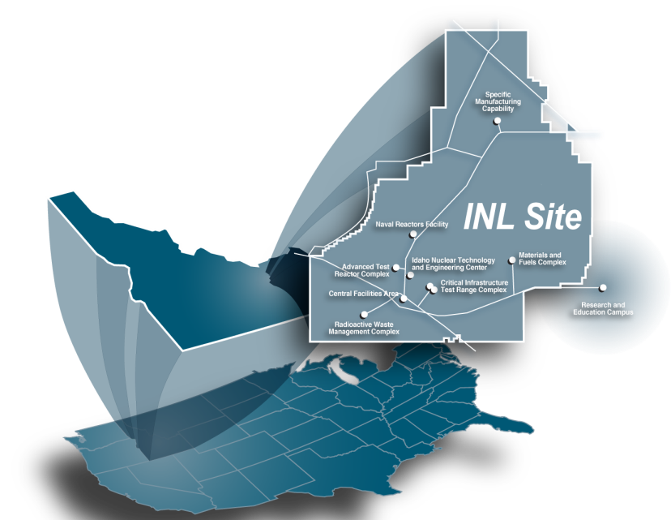
WCNR-12
Idaho National Laboratory
Aaron E. Craft, Ph.D.
Presented at WCNR-12
September, 2018

Slide 2
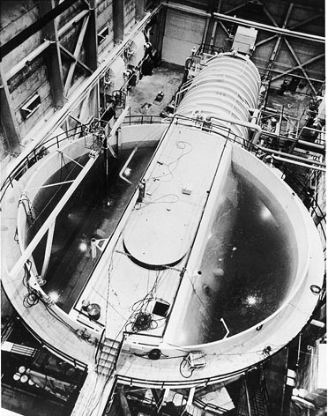
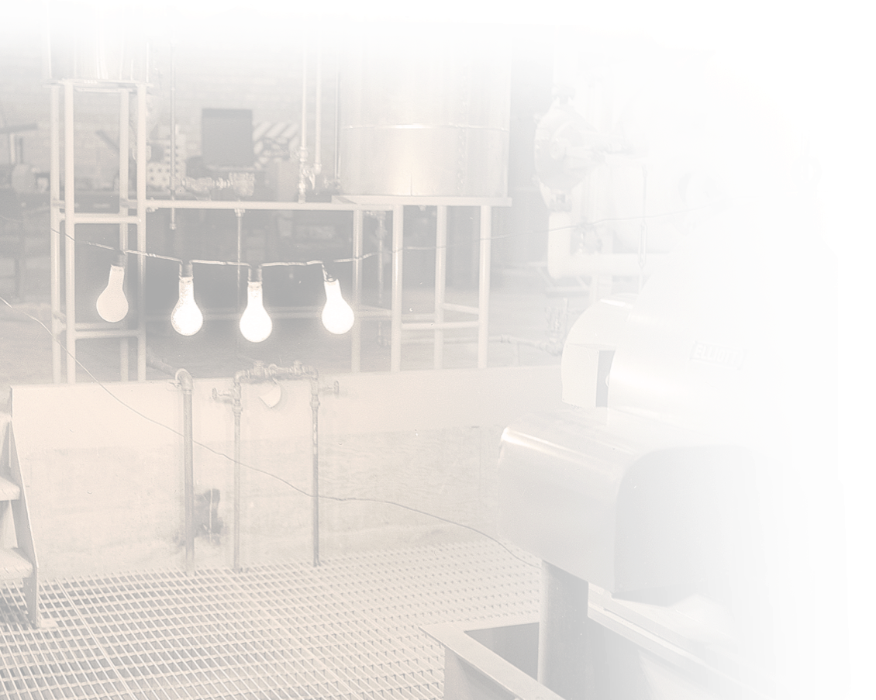
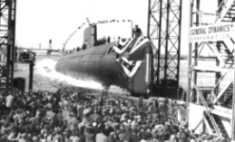
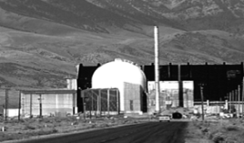
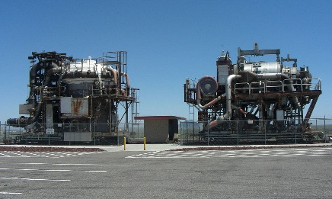
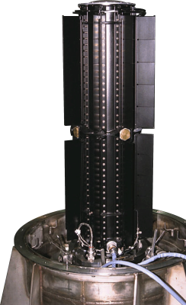
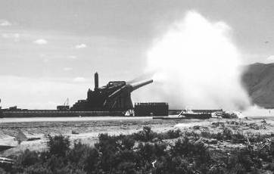
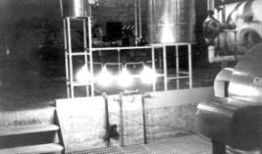
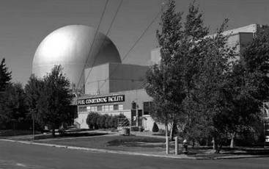
Idaho National Laboratory
Est. 1949 as the National Reactor Testing Station and Argonne-West
First nuclear power plant in 1951
Developed Navy nuclear propulsion systems
First demonstration of the breeder reactor concept
Built 52 nuclear reactors
The United States’ leading Nuclear Energy Laboratory

Slide 3
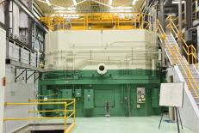
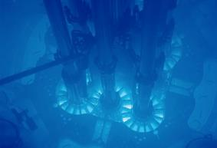
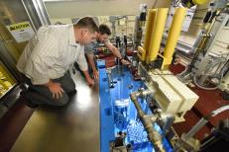
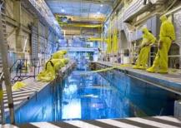
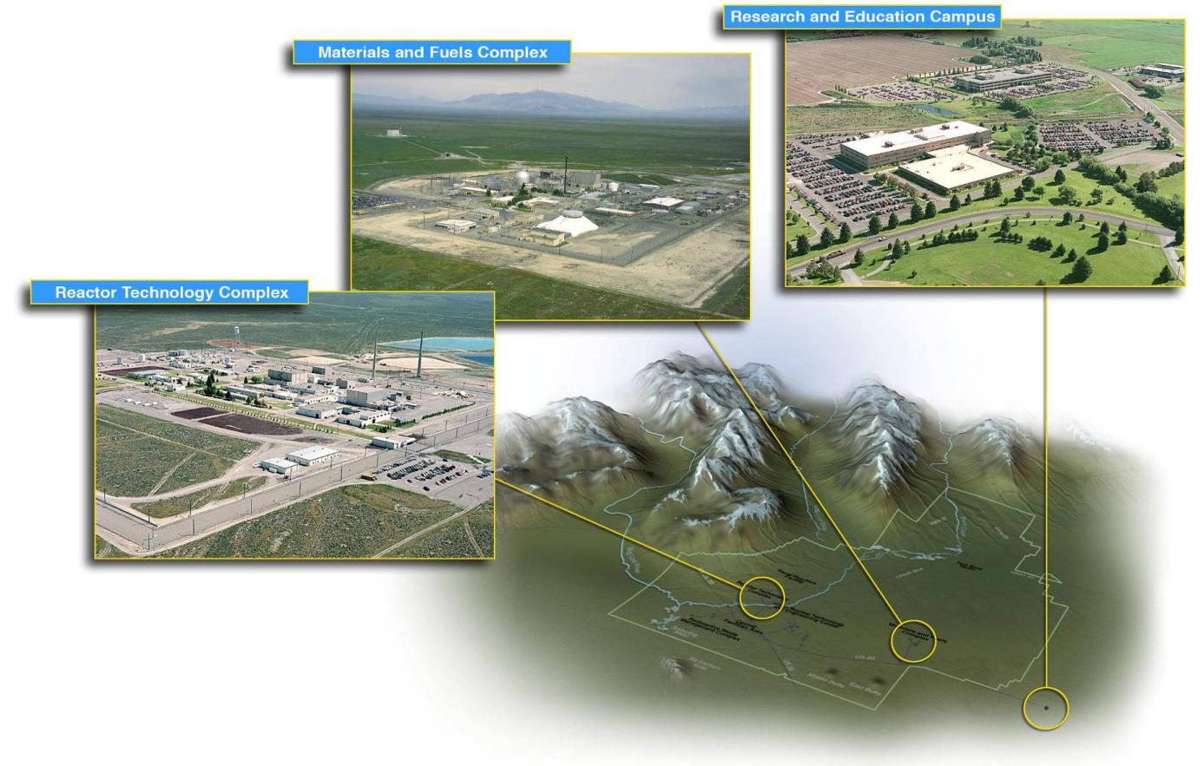
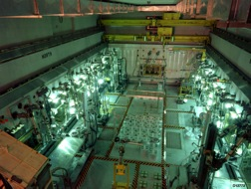
Idaho National Laboratory
2250 km² (~40Manhattan, 20Paris)
~580 buildings
300 metric tons of used fuel
~4200 employees
4 reactors
3 neutron beams for imaging
TREAT
ATR
NRAD
ATR-C

Slide 4
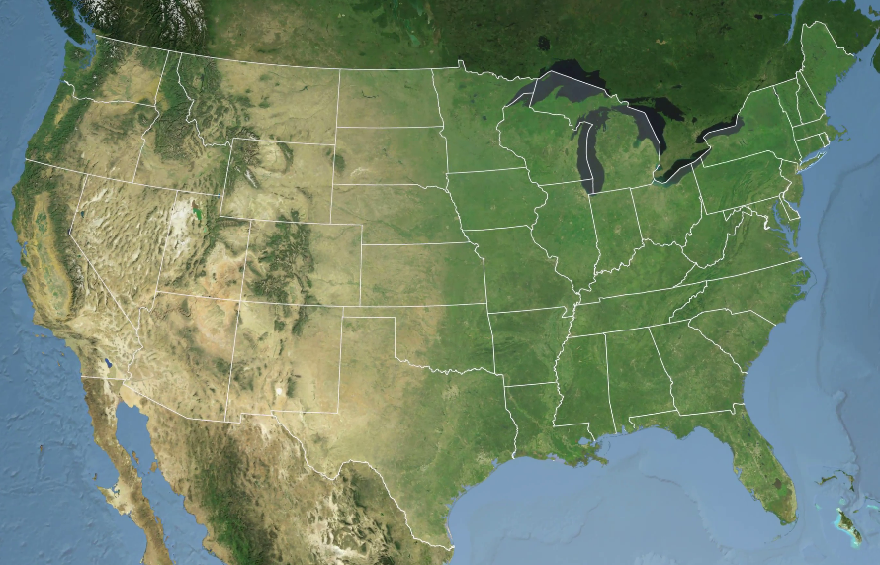
Hosting WCNR-12
Planning so far:
  Have a professional event planner
  Made budget for the event
  Surveyed several locations
  Have approvals from INL and DOE
Backup plan to host at INL
Primary plan to host in Jackson, WY
  Neutron Imaging School & Main Conference
  Snow King Conference Center
  Airport in Jackson
Tour of INL imaging facilities after general conference
  Charter a bus for transport
PICTURES…
Jackson

Slide 5
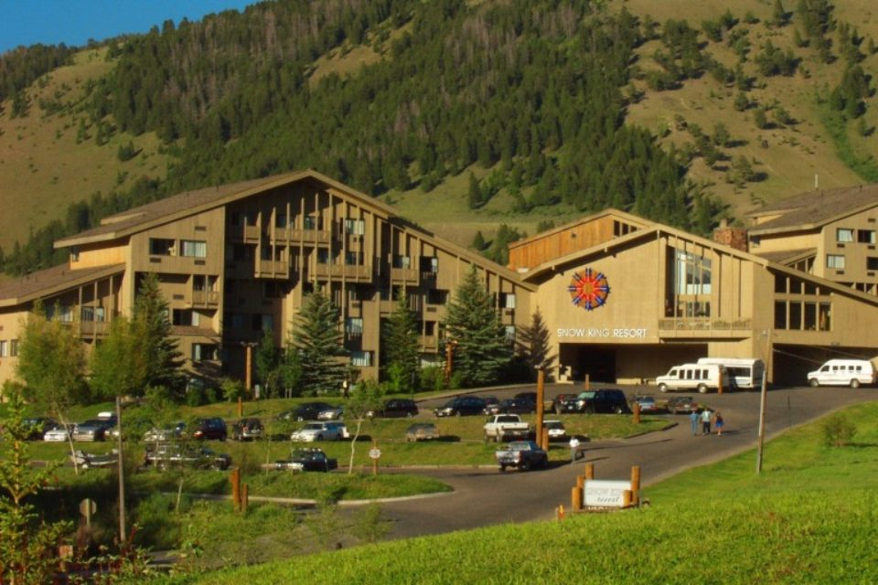
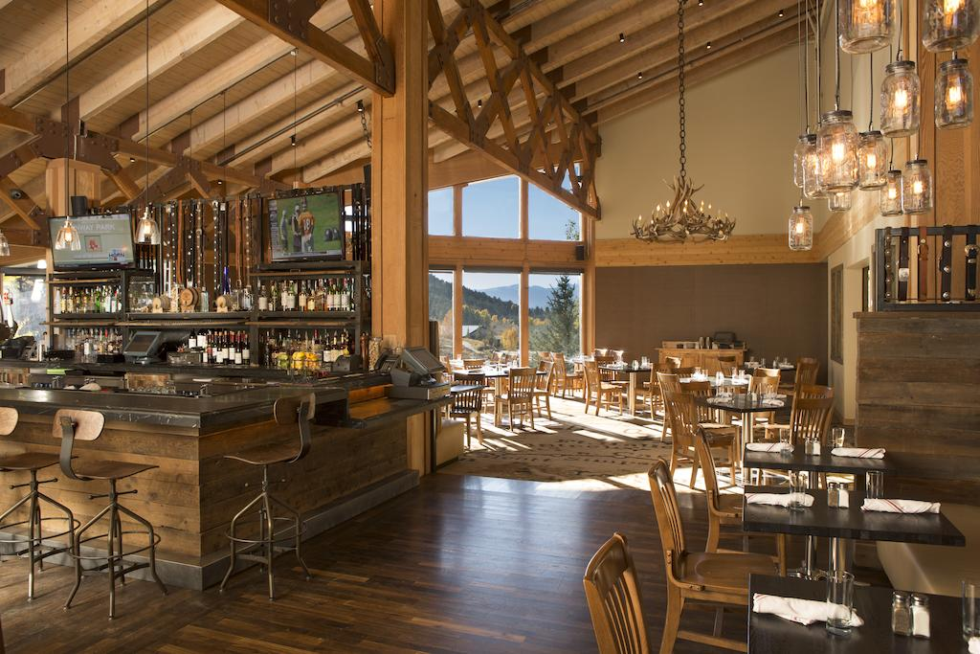
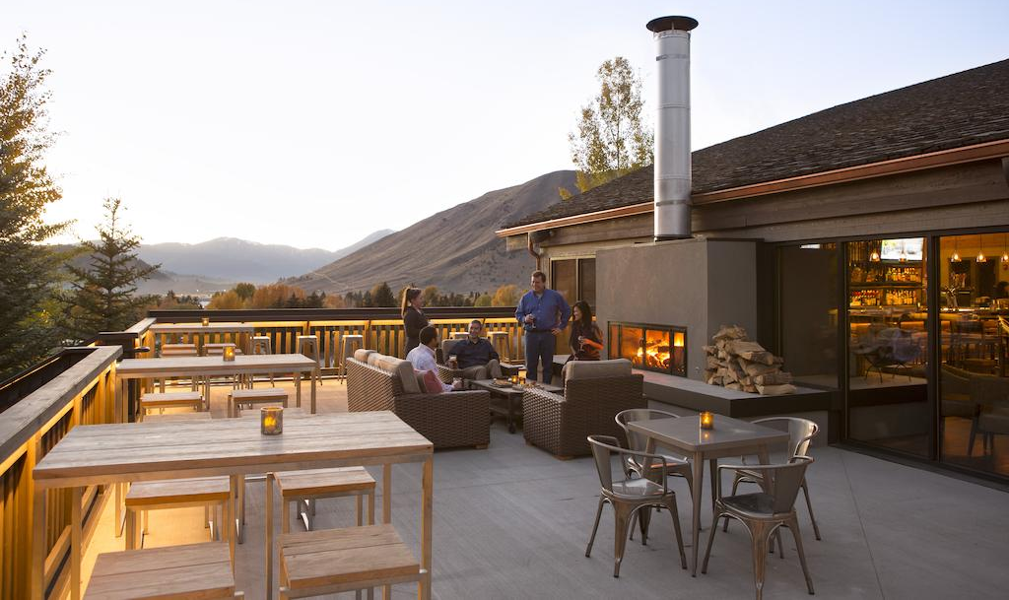
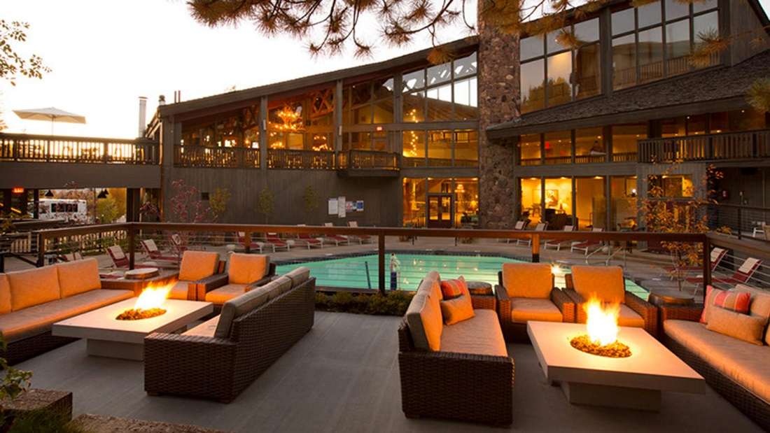
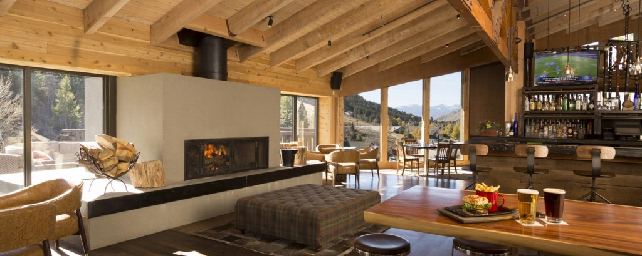
Can reserve 150 rooms at $129/night
(expected $141/night in 2022)
Hayden’s Post Restaurant at Snow King Resort

Slide 7
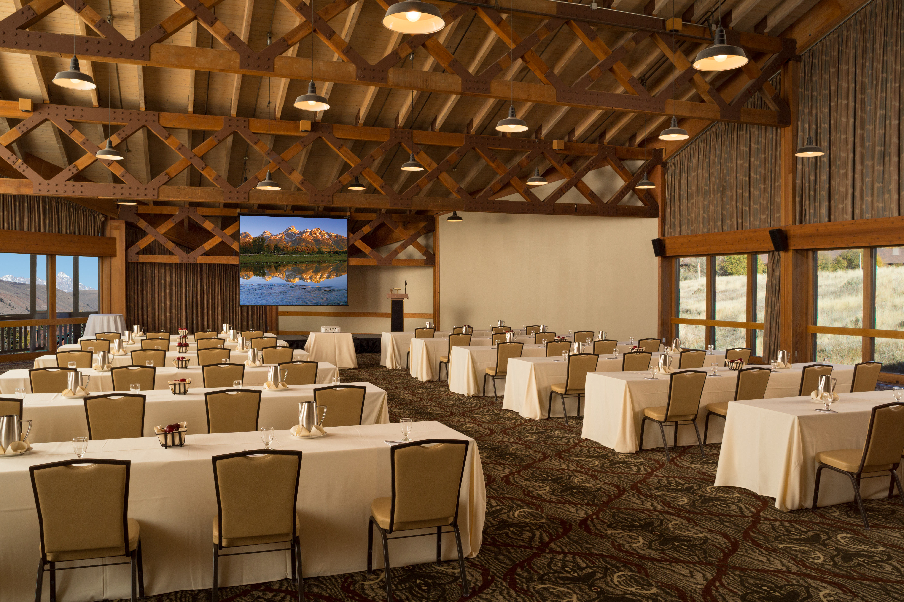

Slide 8
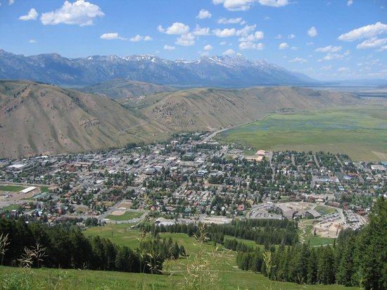
AIRPORT
Town
Center
Snow King
Resort

Slide 9
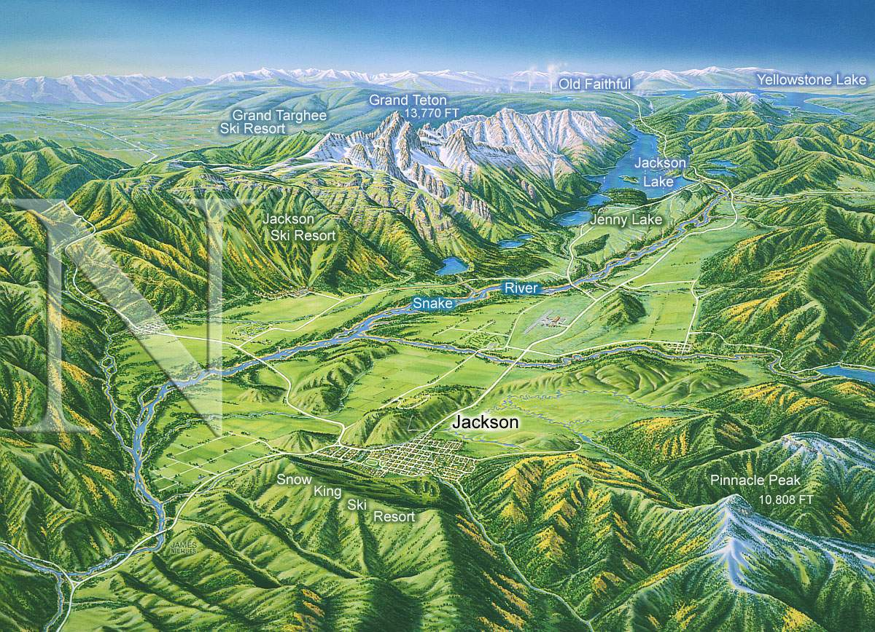
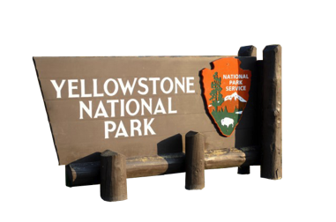
4197 m
AIRPORT
Elev. 1901 m
3294 m

Slide 10
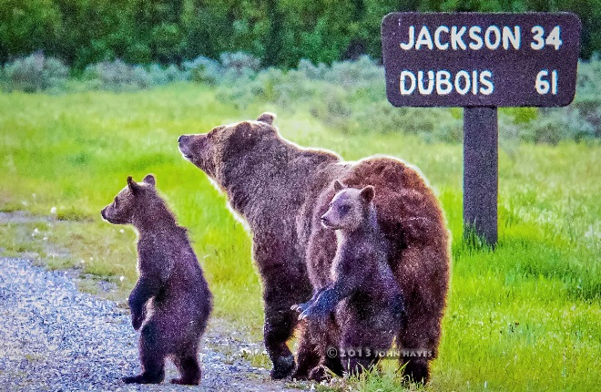
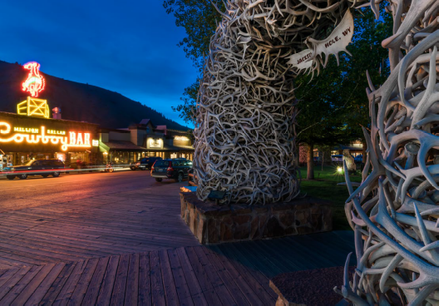
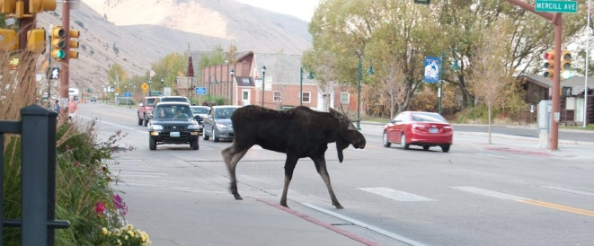
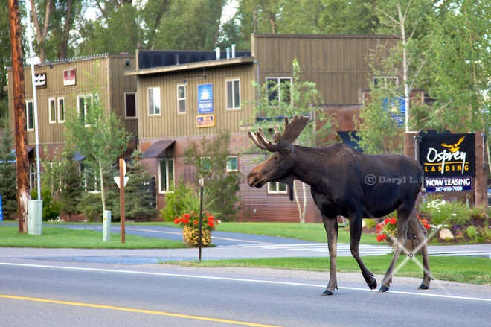
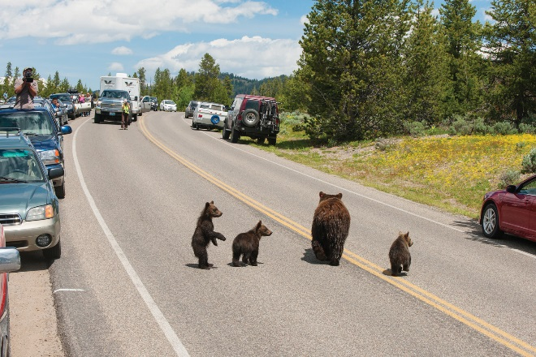
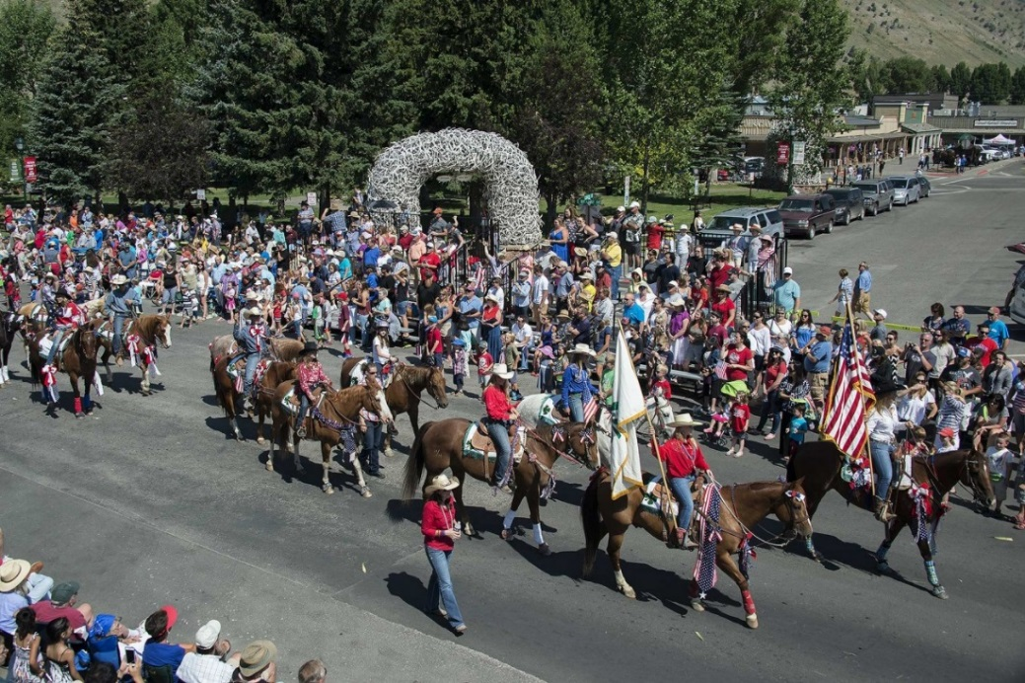
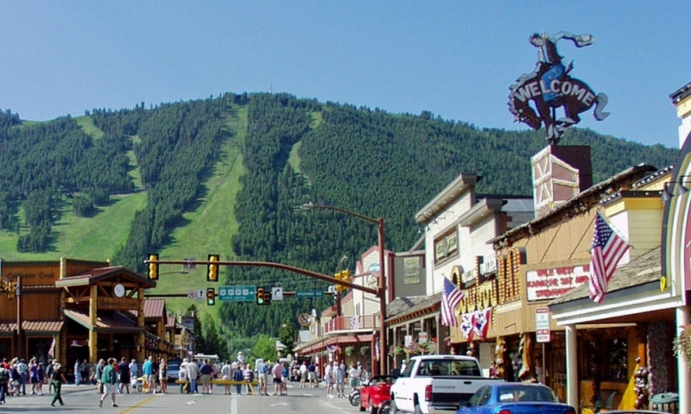
JACKSON, WY
CLASSIC WESTERN TOWN
VISITOR FRIENDLY
AIRPORT
RESTAURANTS & PUBS
SHOPPING
LUXURY RUSTIC
Town Square shootout every summer night Monday through Saturday

Slide 11
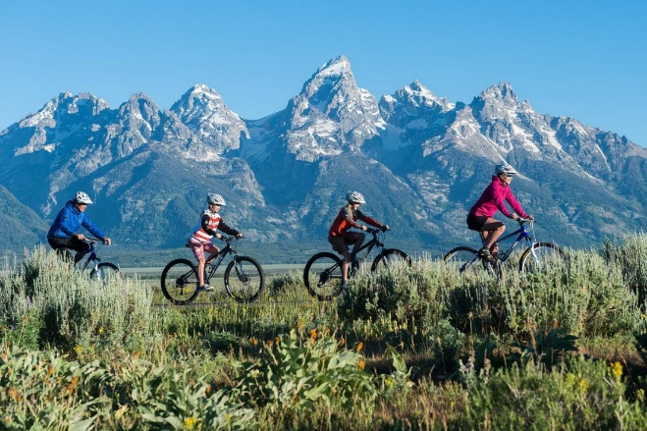

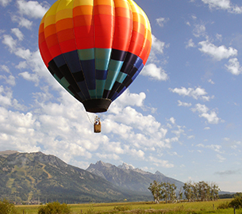
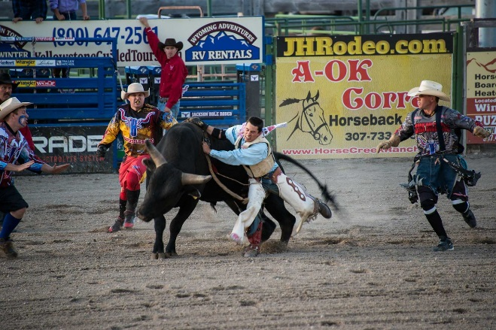
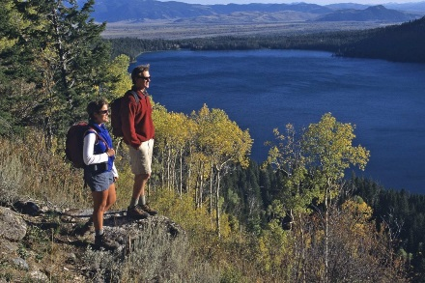
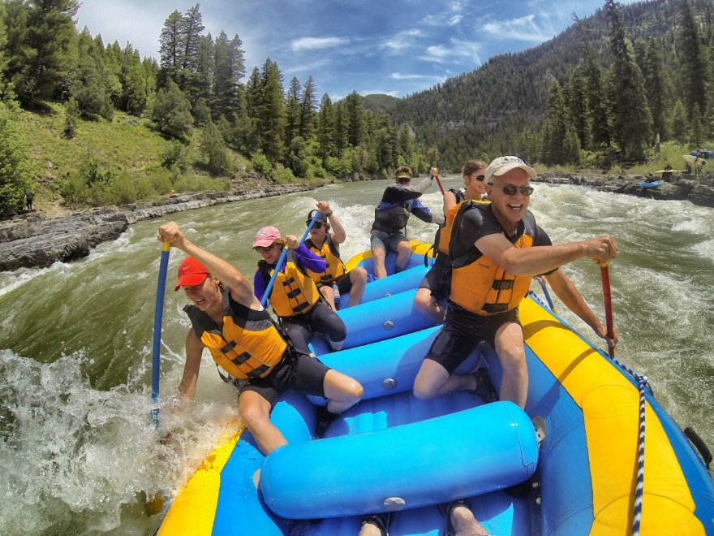
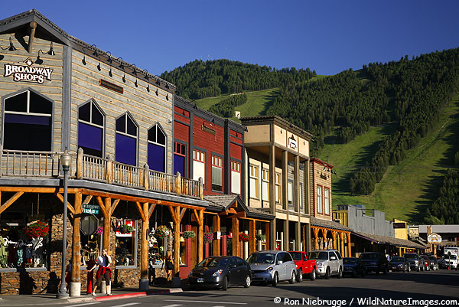
MAKE IT A VACATION

Slide 12
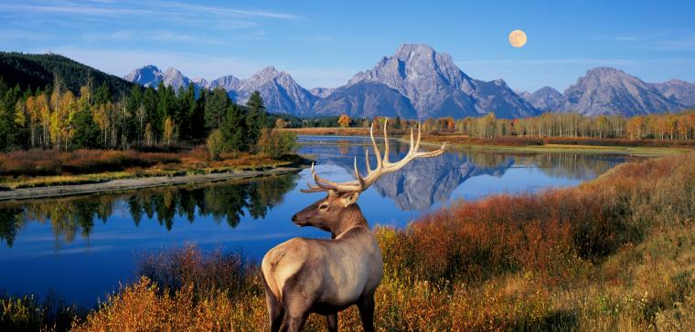
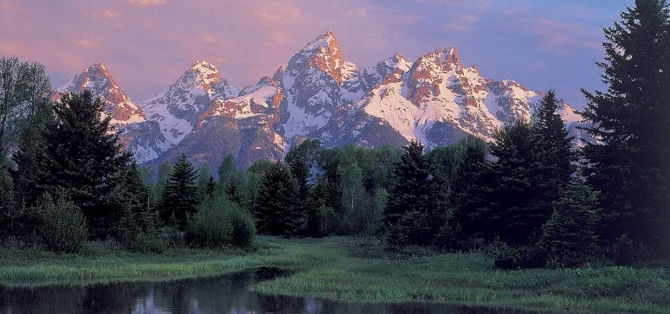
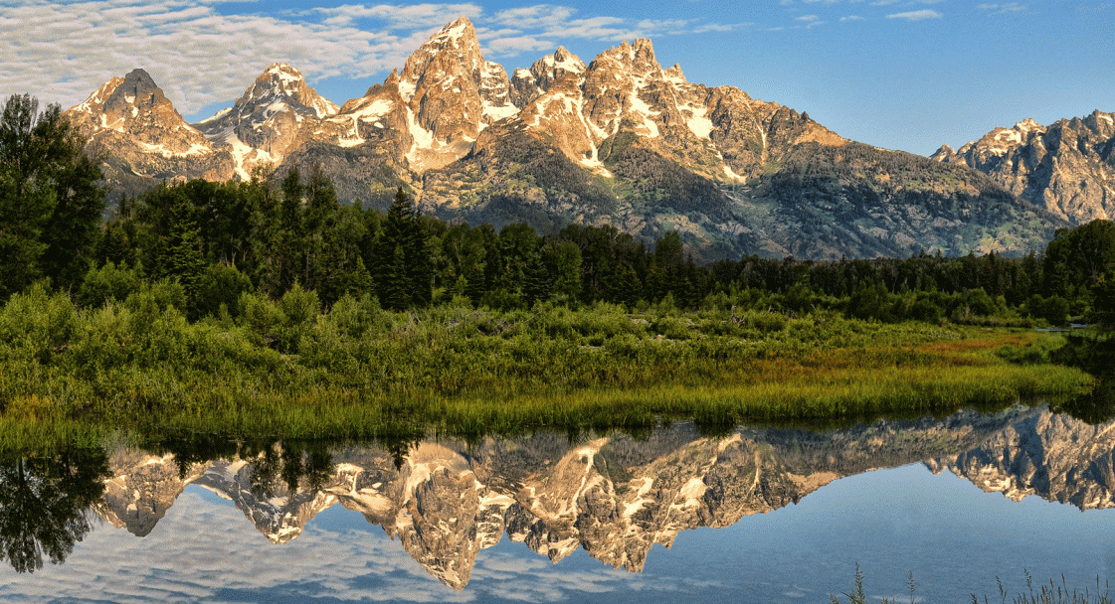
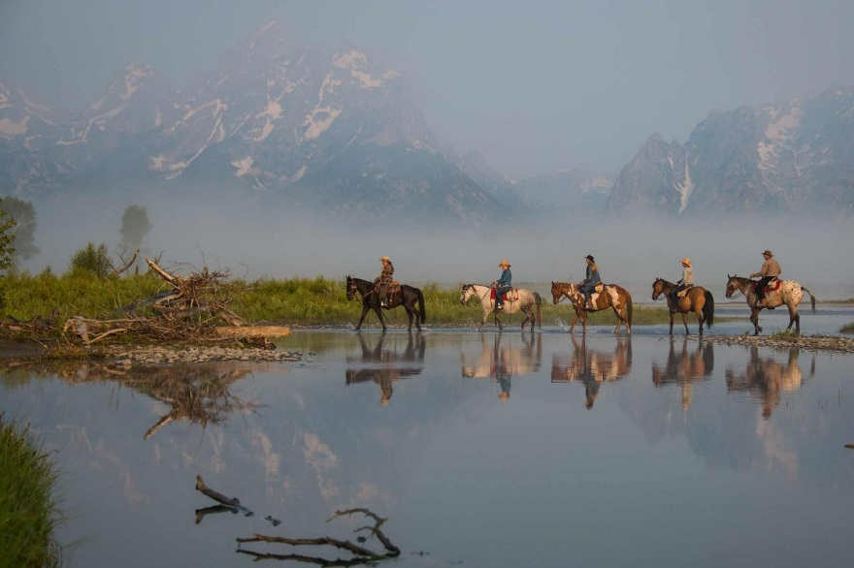
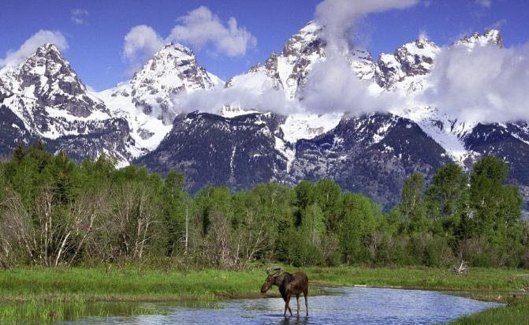
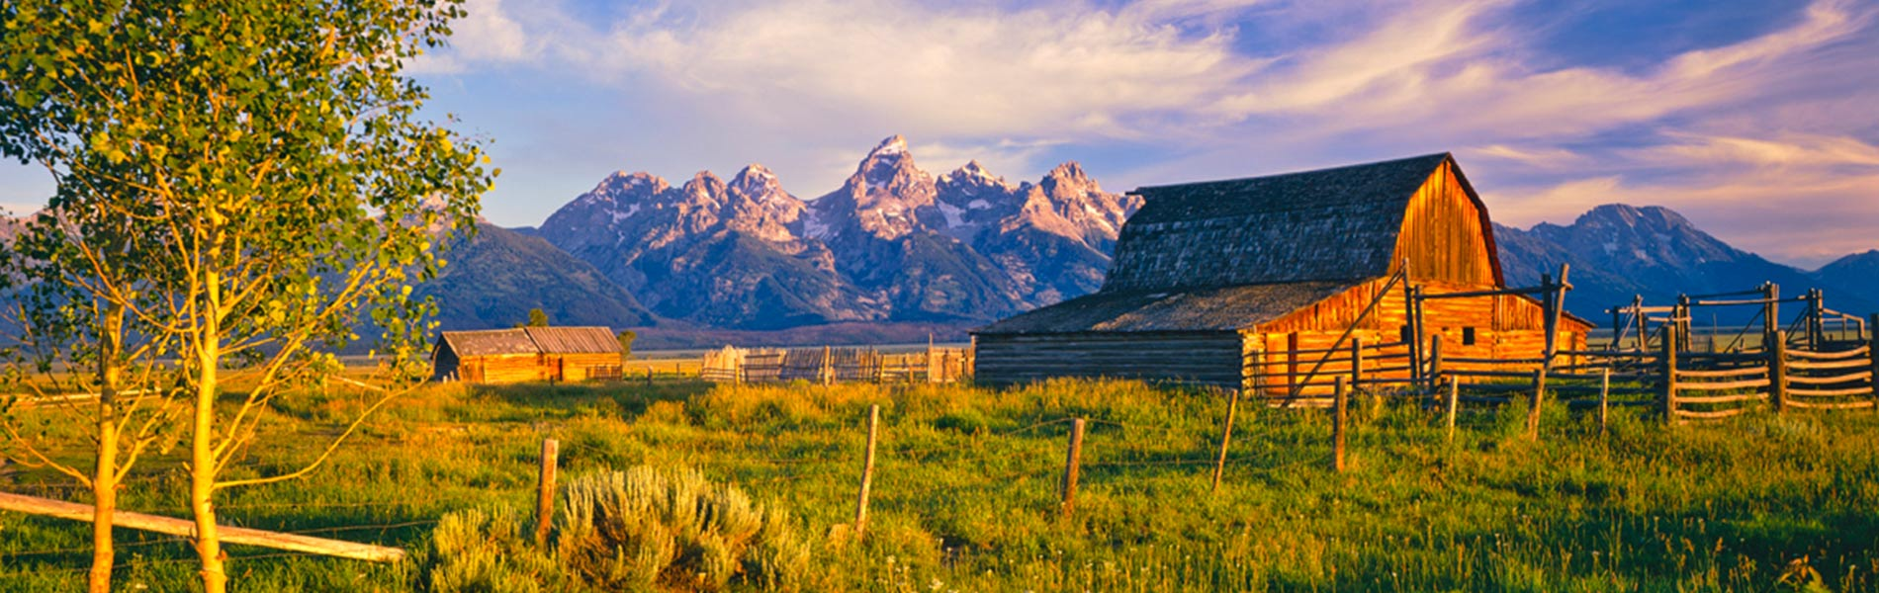
Grand Teton National Park
Adjacent to the Jackson valley
Teton mountain range and the iconic 4,200-meter Grand Teton peak
Mountaineering, hiking, backcountry camping and fishing
Adjacent to Yellowstone National Park

Slide 13
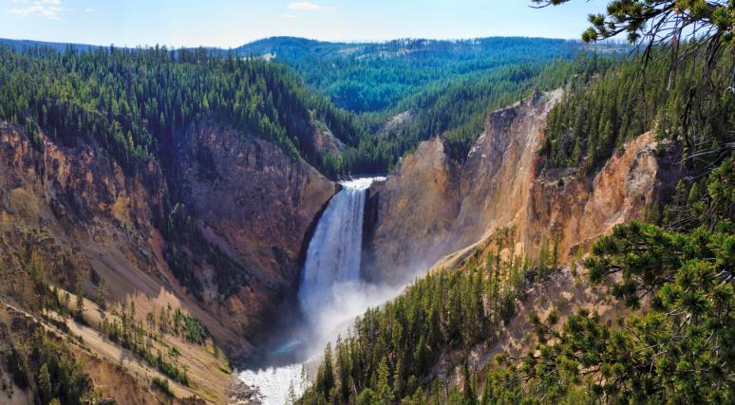
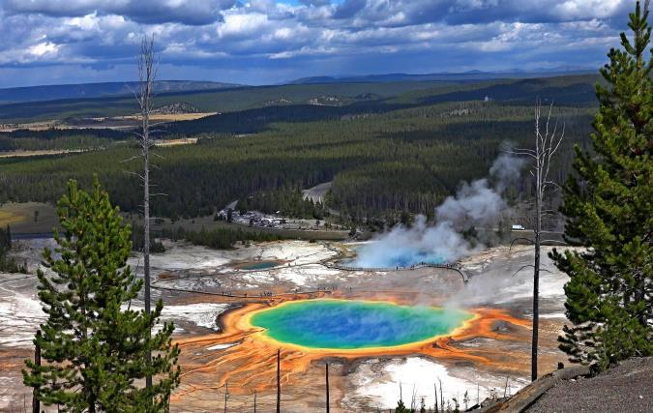
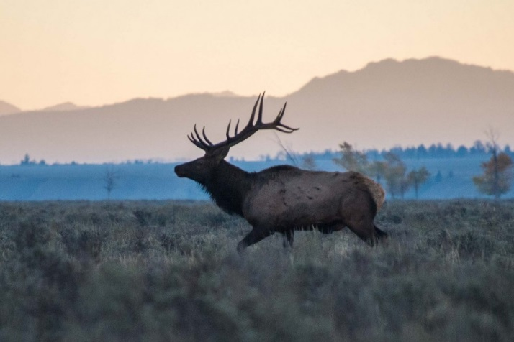
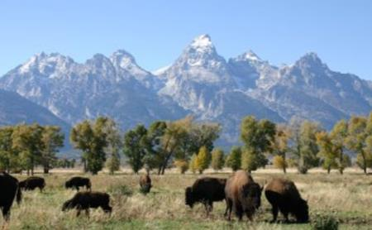
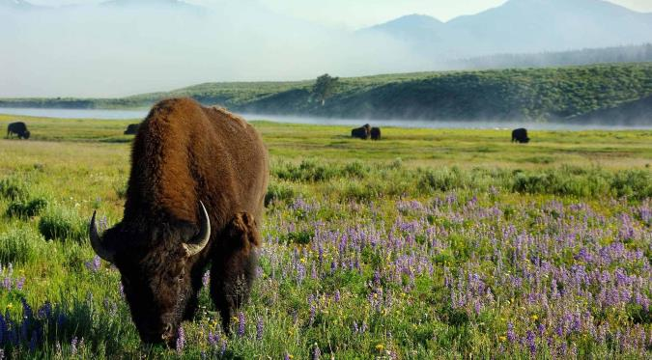


Yellowstone National Park
~1 hour from Jackson
Est. 1872, the USA’s oldest national park
>9000 km² wilderness area atop a volcanic hot spot
Dramatic canyons, alpine rivers, lush forests, hot springs and gushing geysers, including its most famous Old Faithful
Home to bears, wolves, bison, elk and moose

Slide 14
Tentative Schedule (June?)
Thurs – Fri Neutron imaging school
Saturday Delegates arrive; Board meeting
Sunday Walking discussion (Bus to Old Faithful)
Mon – Fri Main conference

Slide 15


WELCOME TO WCNR-12

