Slide 1
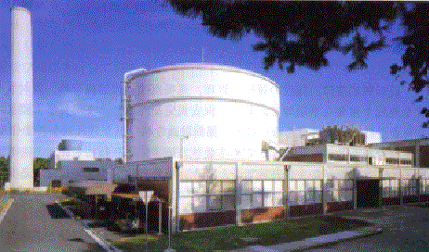
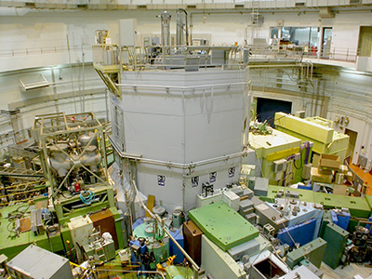
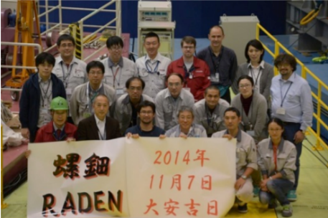
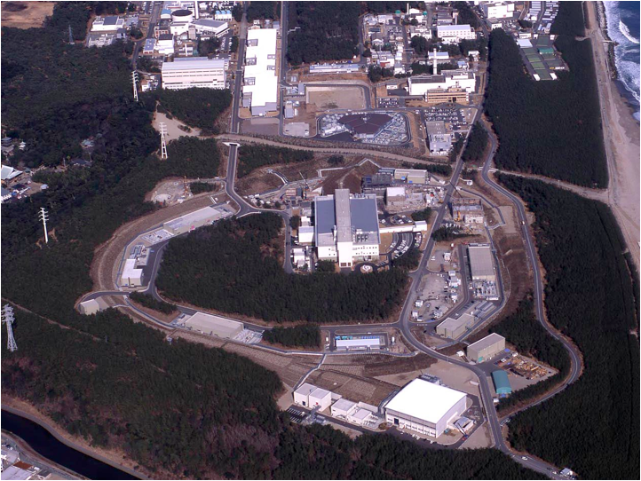
WCNR-12 Candidate: Japan
WCNR-1 1981 San Diego, USA USA
WCNR-2 1986 Paris, France EU
WCNR-3 1989 Osaka, Japan Asia
WCNR-4 1992 San Francisco, USA USA
WCNR-5 1996 Berlin, Germany EU
WCNR-6 1999 Osaka, Japan Asia
WCNR-7 2002 Rome, Italy EU
WCNR-8 2006 Gaitherburg, USA USA
WCNR-9 2010 Kwa Maritane, South Africa AF
WCNR-10 2014 Grindelwald, Switzerland EU
WCNR-11 2018 Sydney, Australia OC
1957 JRR-1(shut down)
1960 JRR-2 (shut down)
1962 JRR-3 (modified)
1964 KUR
1990 JRR-3(M)
2008 J-PARC
E-2, B-4 Two Imaging Port
TNRF, CNRF will be restarted in 2020!
2014 RADEN(BL22)

Slide 2
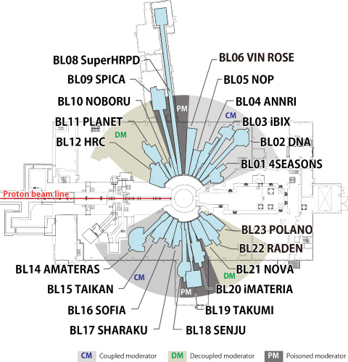
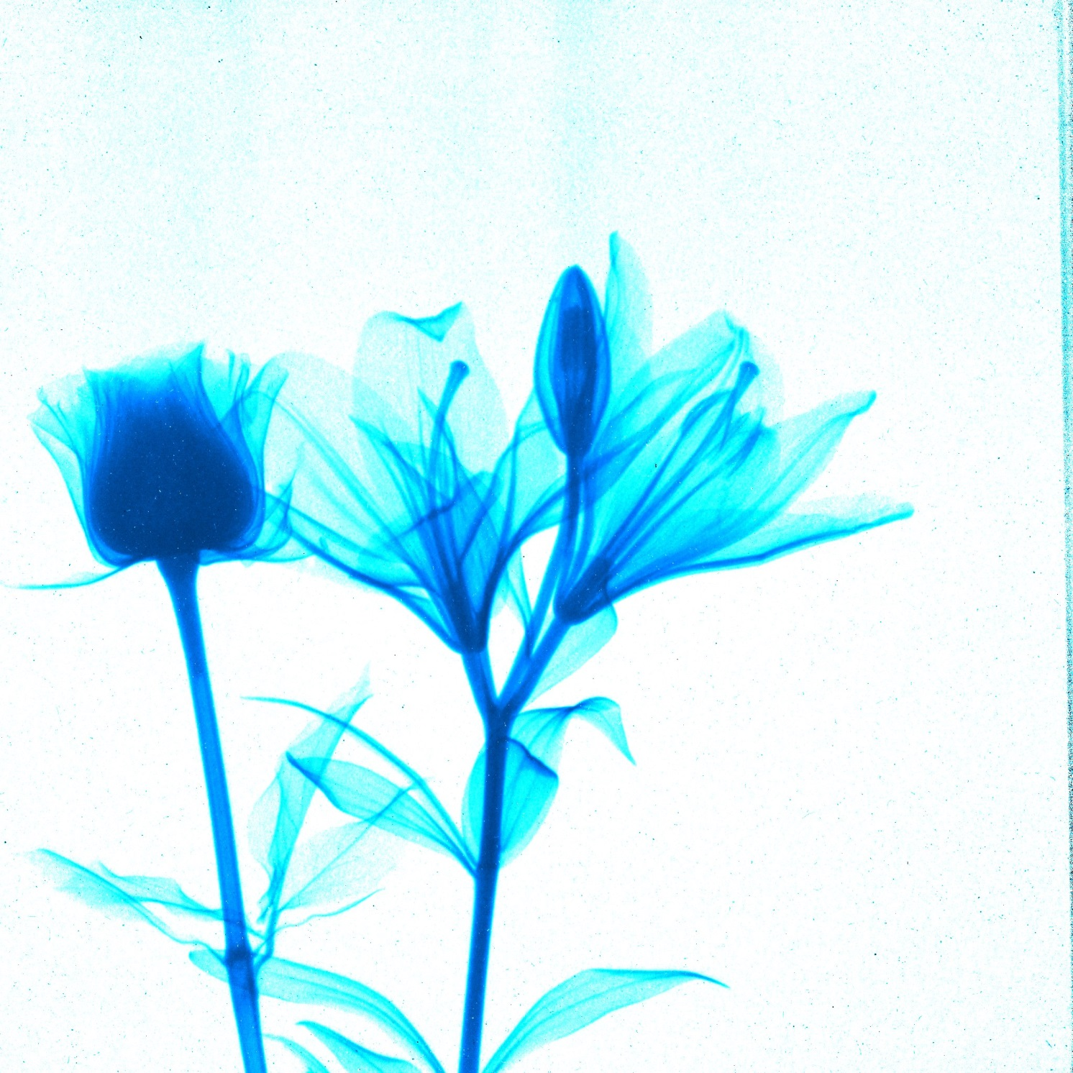
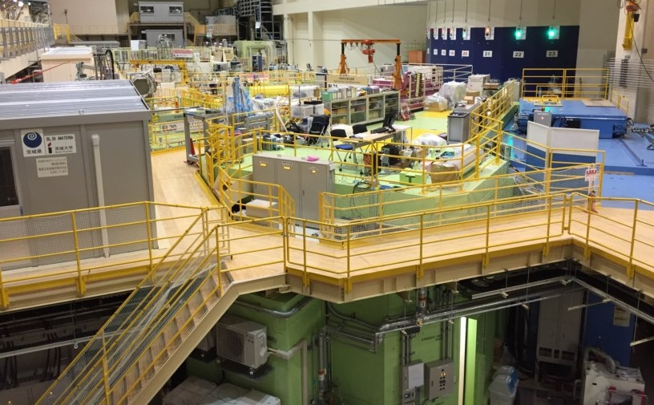
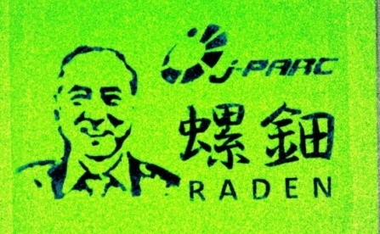
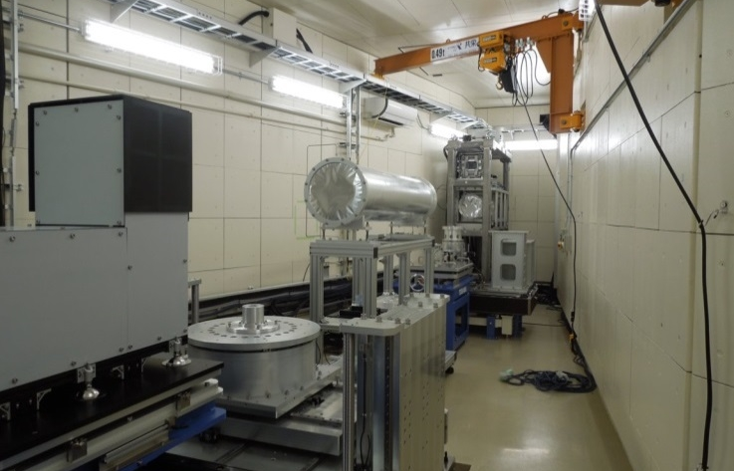

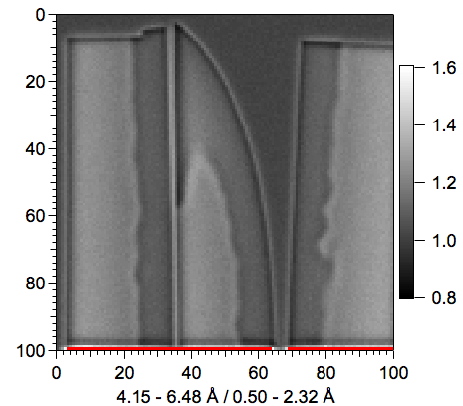
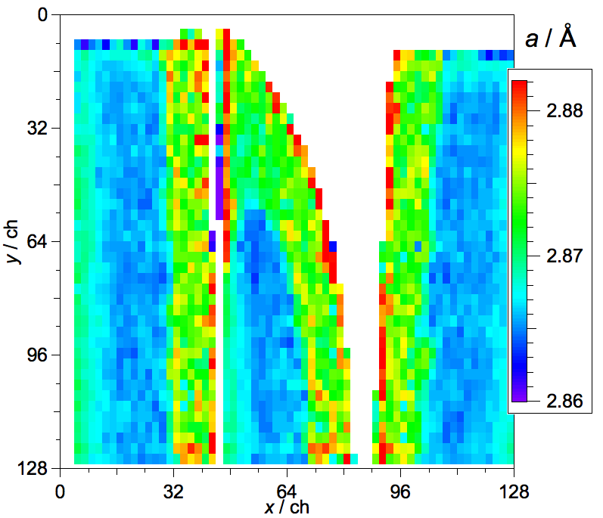
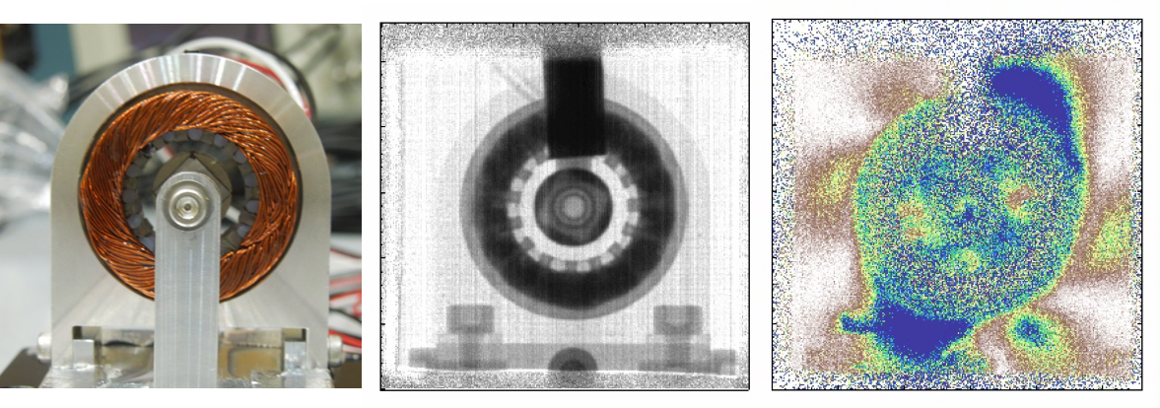
RADEN -Energy-Resolved Neutron Imaging System-
The first instrument dedicated to Energy-Resolved Neutron Imaging
First Beam in Nov. 2014
User program from JFY 2015
Bragg-Edge Imaging
Magnetic Imaging

Slide 3
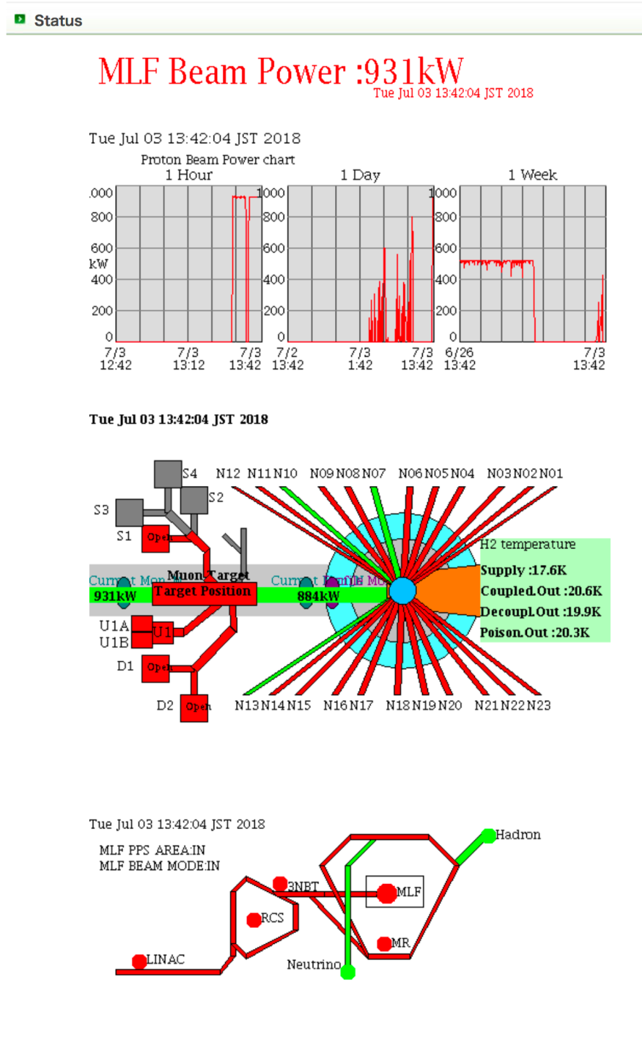
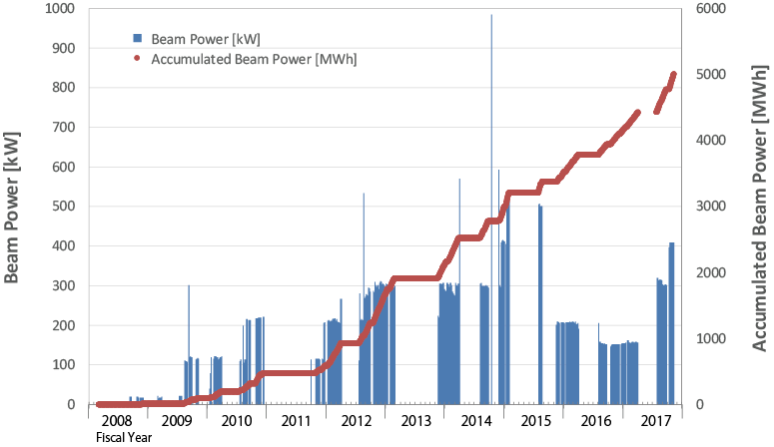


J-PARC current status and upgrade to 1MW operation
J-PARC power history at MLF
Hg Target
Trouble
500 kW operation
at present
Hadron
Accident
Earthquake
After several accidents and disaster, we are expecting full-power operation in 2020!
Succeeded in 1MW-eq. operation on July 3rd.

Slide 4
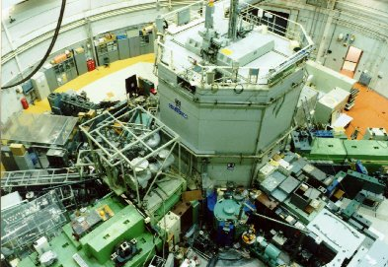

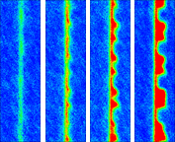

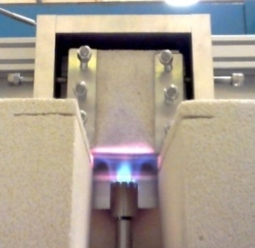
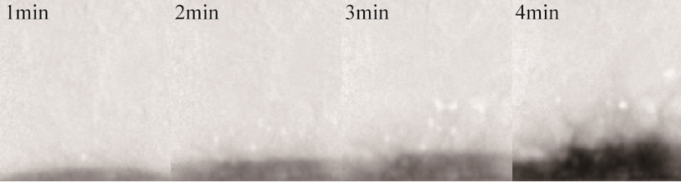
Kyoto University Research Reactor (KUR) current status
5MW thermal power reactor
Two imaging ports in KUR : E-2 &B-4
1964 First critical
2004-2007 Fuel conversion
(93% [HEU] → 20% [LEF])
2011.3.11 Fukushima Daiichi accident
2014.5.26 Suspended for new regulation
2017.8.29 Re-operation started
E-2 port
B-4 supermirror guide tube
1 cycle : 3days (Tue. – Thu.)
1 MW (45 h) + 5 MW (6 h)
B-4 port
conventional and dynamic NRG
Boiling
in a pipe
Fuel cell
Normal water (Q_{F})
Supercritical
hydrothermal
synthesis
Flux: 8.5 x 10⁷ n/cm² s
Beam size: 1cm width & 7.5cm height
E-2 port
conventional NRG and CT
1min 3min 5min 10min
Supercritical water (Q_{SCW})
Explosion of concrete
Flux: 4.8 x 10⁵ n/cm² s
Beam size: 15 cm in diameter

Slide 5
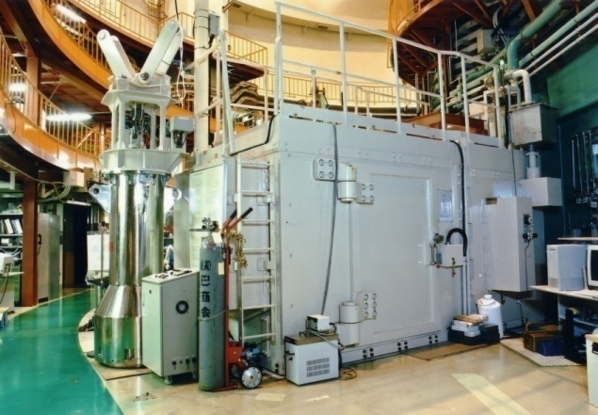
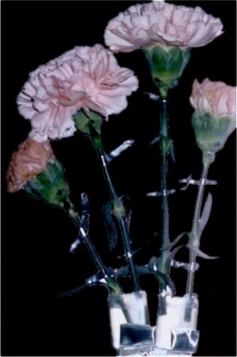
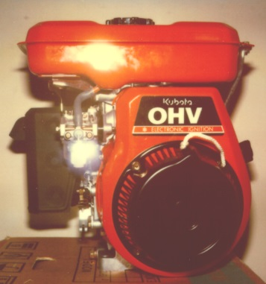
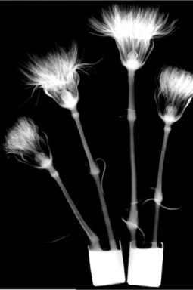
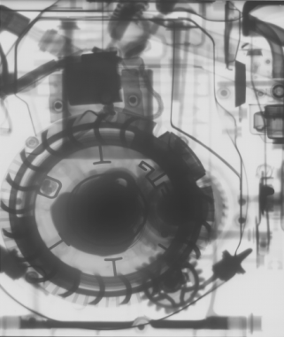
JRR-3 current status and the prospect of re-operation
Operation of JRR-3 has been suspended since November in 2010 because of the new regulatory requirement established after the accident (12 Mar. 2011) of Fukushima Daiichi nuclear power plant.
Current schedule is as below
FY2018 : design the roof reinforcement and application for the budget
FY2019 : construction
FY2020(may be fall) : re-operation
JRR-3 and its facilities are restored and ready to operation, and expected to give new imaging data in the next WCNR.

Slide 6
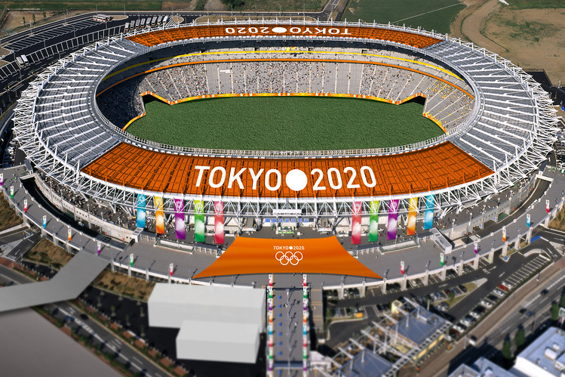
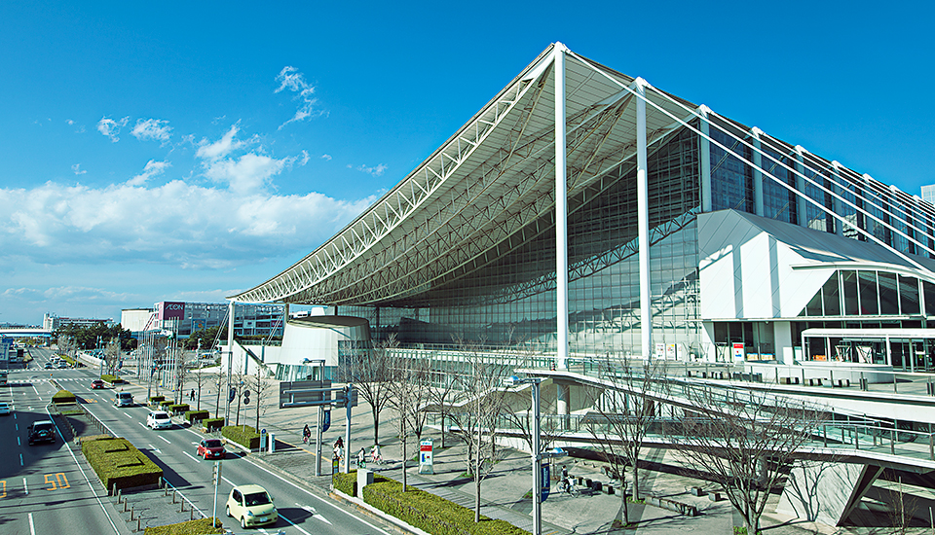
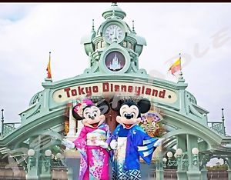
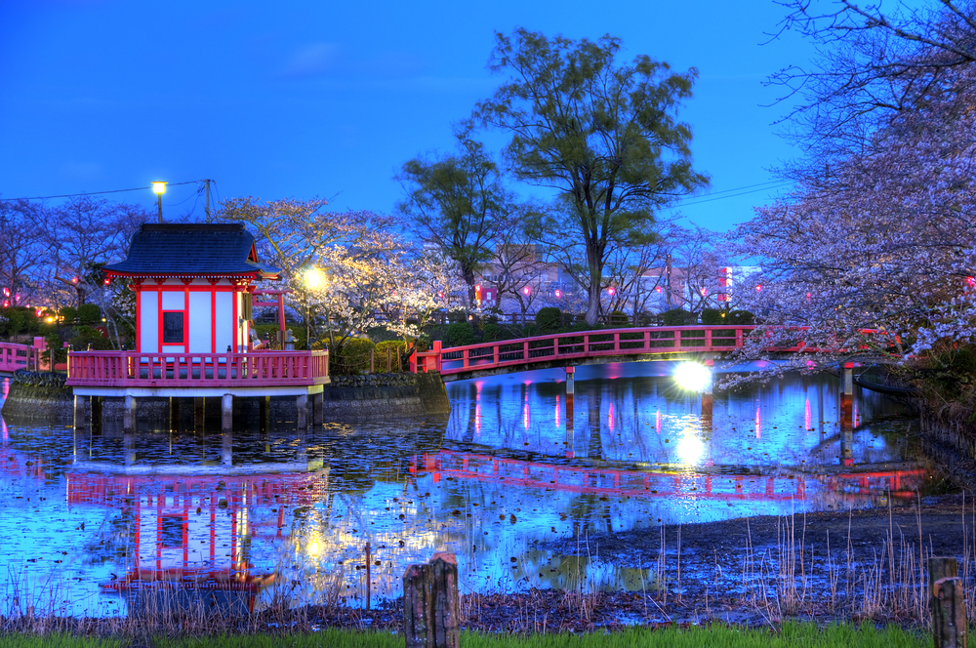

Proposed Site for WCNR-12: Tokyo (2yrs after Olympic game!)
Venue: Makuhari Messe
Technical Tour: JRR-3, J-PARC (Two hours by Bus)
Tokai
Tokyo

Slide 7
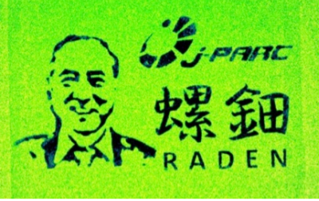



Committee Member
Honorable Chair: Prof. Y. Kiyanagi (Nagoya Univ.)
Steering Committee:
Prof. K. Mochiki (Tokyo City Univ.)
Dr. M. Matsubayashi (JAEA)
Prof. Y. Kawabata (Kyoto Univ.)
General Chair: Prof. Y. Saito (Kyoto Univ./JAEA)
Local Organizing Committee:
Chair: Dr. T. Shinohara (J-PARC)
Dr. T. Kai (J-PARC),
Dr. H. Iikura (JAEA)
Prof. M. Kanematsu (Tokyo Univ. of Science)
Prof. D. Ito (Kyoto Univ.)
Secretary: Dr. T. Sakai (JAEA)
Technical Organizing Committee:
Chair: Prof. T. Kamiyama (Hokkaido Univ.)
Prof. H. Satoh (Hokkaido Univ.)
Prof. K. Hirota (Nagoya Univ.)
Dr. A. Taketani (RIKEN)
Prof. H. Umekawa (Kansai Univ.)
Prof. H. Asano (Kobe Univ.)
Prof. U. Matsushima (Iwate Univ.)
We are waiting for you
in Tokyo!

