Slide 1
APS-U HLA Client Scripting Environment
Guobao Shen, Tom Fors, Andrew Johnson, Sinisa Veseli, Ned Arnold
Argonne National Laboratory
Nov 2018 EPICS Collaboration Meeting
2018-11-15

Slide 2
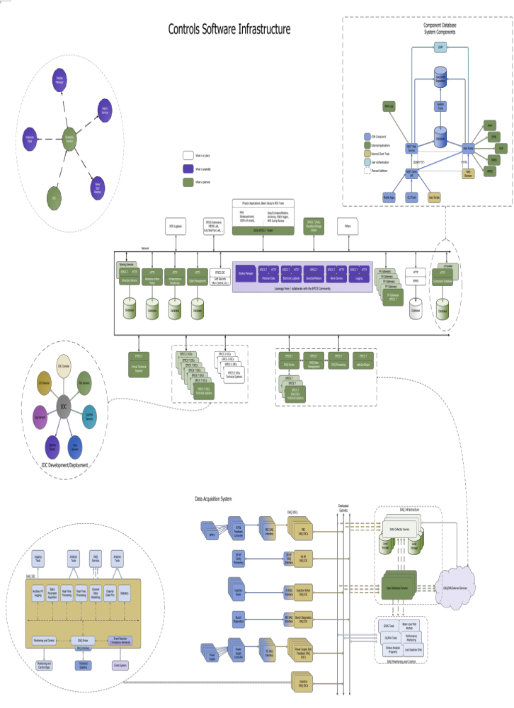
APS-U Controls Software Infrastructure

Slide 3
APS/APSU Controls Software
Current APS Status and APS-U Approach
Physics Applications, Beam Study & MCR Tools
EPICS 7 (PVA)
Waveform/Image Viewer
MCR logbook
PEM, sddsexperiment,
1000s of scripts, …
Save/Compare/Restore,
Archiving, Glitch logger,
MPS Dump Review, …
EPICS Extensions
MEDM, alh, burt,
StripTool, adt, …
SDDS-EPICS Toolkit
Others
Network
SDDS-EPICS 7 Toolkit
Naming Service
Traveler
Display Manager
EPICS 7 HTTP
Directory Service
HTTP
Infrastructure Monitoring
EPICS 7 HTTP
Component Database
HTTP
Cable Management
HTTP
IRMIS
PV Gateways
PV List
EPICS IOC
Soft Records
(run control, etc)
PV Gateways
PV Gateways
EPICS 7
EPICS 7 HTTP
Historian Data
PV Gateways
EPICS 7
Database
EPICS 7 HTTP
Electronic logbook
Database
Database
Database
Database
EPICS 7
Save/Set/Restore
EPICS 7
Virtual Technical System
EPICS 7 IOCs
Technical Systems
EPICS 7
DAQ Server
EPICS 7
DAQ Data Management
EPICS 7
DAQ Processing
EPICS 7 IOCs
Technical Systems
EPICS 7 HTTP
Alarm Service
EPICS 7 IOCs
Technical Systems
EPICS 7 IOCs
Technical Systems
EPICS 7 DAQ IOCs
Technical Systems
EPICS 7
sdds2pvObject
EPICS 7 HTTP
Logging
EPICS 7 DAQ IOCs
Technical Systems
EPICS 3 IOCs
Technical Systems
EPICS 7 DAQ IOCs
Technical Systems
EPICS 3 IOCs
Technical Systems
Leverage from / collaborate with the EPICS Community
EPICS 3 IOCs
Technical Systems
EPICS 3 IOCs
Technical Systems

Slide 4
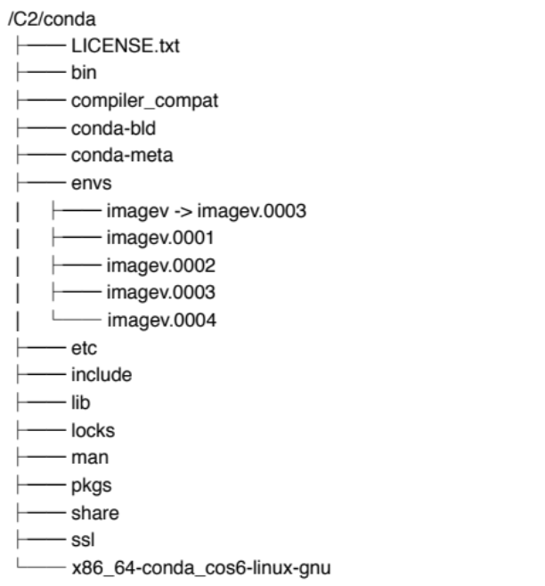
HLA Client Scripting Environment
Python Based
  Python3.6 and above
PyQt5
pvaPy
Conda as the package and environment management system
  Keep ROOT environment minimum
  Application managed by its own conda environment
Directory structure design and version control

Slide 5
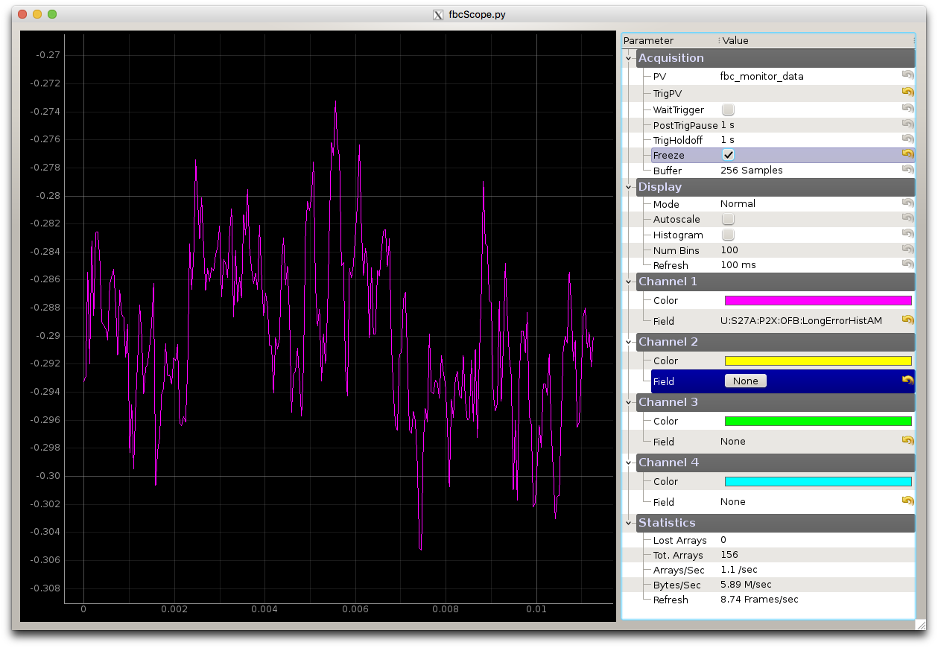
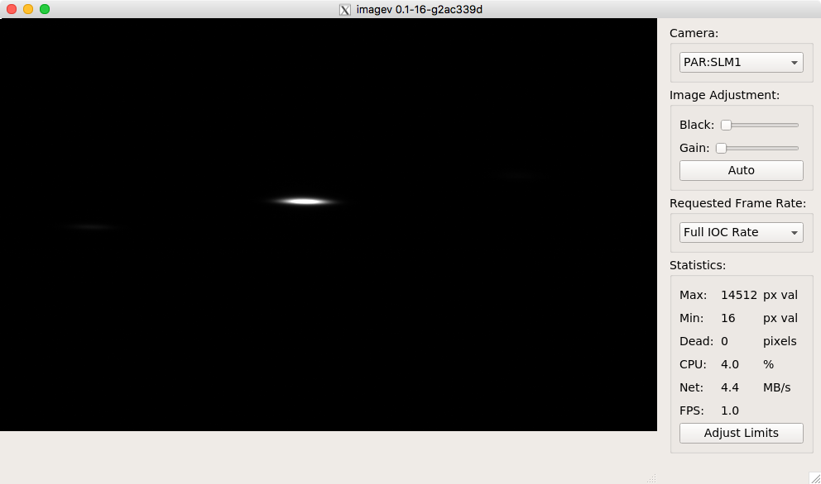
HLA Client Scripting Environment
Physics Applications, Beam Study & MCR Tools
EPICS 7 (PVA)
Waveform/Image Viewer
MCR logbook
PEM, sddsexperiment,
1000s of scripts, …
Save/Compare/Restore,
Archiving, Glitch logger,
MPS Dump Review, …
EPICS Extensions
MEDM, alh, burt,
StripTool, adt, …
SDDS-EPICS Toolkit
Others
Network
SDDS-EPICS 7 Toolkit
Naming Service
Traveler
Display Manager
EPICS 7 HTTP
Directory Service
HTTP
Infrastructure Monitoring
EPICS 7 HTTP
Component Database
HTTP
Cable Management
HTTP
IRMIS
PV Gateways
PV List
EPICS IOC
Soft Records
(run control, etc)
PV Gateways
PV Gateways
EPICS 7
EPICS 7 HTTP
Historian Data
PV Gateways
EPICS 7
Database
EPICS 7 HTTP
Electronic logbook
Database
Database
Database
Database
EPICS 7
Save/Set/Restore
EPICS 7
Virtual Technical System
EPICS 7 IOCs
Technical Systems
EPICS 7
DAQ Server
EPICS 7
DAQ Data Management
EPICS 7
DAQ Processing
EPICS 7 IOCs
Technical Systems
EPICS 7 HTTP
Alarm Service
EPICS 7 IOCs
Technical Systems
EPICS 7 IOCs
Technical Systems
EPICS 7 DAQ IOCs
Technical Systems
EPICS 7
sdds2pvObject
EPICS 7 HTTP
Logging
EPICS 7 DAQ IOCs
Technical Systems
EPICS 3 IOCs
Technical Systems
EPICS 7 DAQ IOCs
Technical Systems
EPICS 3 IOCs
Technical Systems
Leverage from / collaborate with the EPICS Community
EPICS 3 IOCs
Technical Systems
EPICS 3 IOCs
Technical Systems

