Slide 1

Michael Bree / David Beauregard / Garth Steel
Canadian Light Source
PyAcq
BioXAS Data Acquisition Platform
EPICS Collaboration Meeting - Melbourne
November 2018

Slide 2
Requirements
Acquire / Visualise / Save 1000 x 1000 point scan (~64 Gb)
Extensible to Multiple acquisition techniques:
    Rapid Bidirectional Flyscan / XAS / One Pos. / Two Pos.
GUI responsive at all times – no pauses / stalls
Dynamic visualization (e.g., change ROIs, etc)
Platform independent (Linux, Windows, Mac)
Stand-alone GUI operation (Users can take copy home)

Slide 3
Rapid Bidirectional Flyscan

Slide 4
Solution
Client / Server Architecture
Modular Implementation
No EPICS in Client
Restrict EPICS to supporting modules

Slide 5
System Overview
Python
High level EPICS
(SNL)
Low level EPICS
Client (GUI)
Server
Scan Coordinator
Rapid FlyScan
Beamline Energy
Zebra
SR570
XSP3
Scalar
Mono
Undulator
SSCAN
HARDWARE
No EPICS
Minimal EPICS

Slide 6

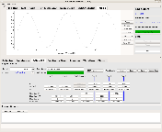
Scan
Cfg
Plugin
…
Scan
Cfg
Plugin
…
Scan
GUI
Plugin
Scan
Plot
Plugin
GUI
No SCAN logic
Client
No GUI knowledge
Scan
Engine
(Server)
TCP/IP
…
Scan CFG
(JSON)
Scan
GUI
Plugin
No EPICS
No EPICS
multiprocess
multiprocess
…
Scan
Plugin
Scan
Plugin
HDF5
Reader
HDF5
Writer
Scan
Plot
Plugin
Data
(HDF5)
SSCAN
SSCAN
Other
Standalone Client
1000 X 1000
64 GB
Positioner
Positioner
Positioner
Positioner

Slide 7
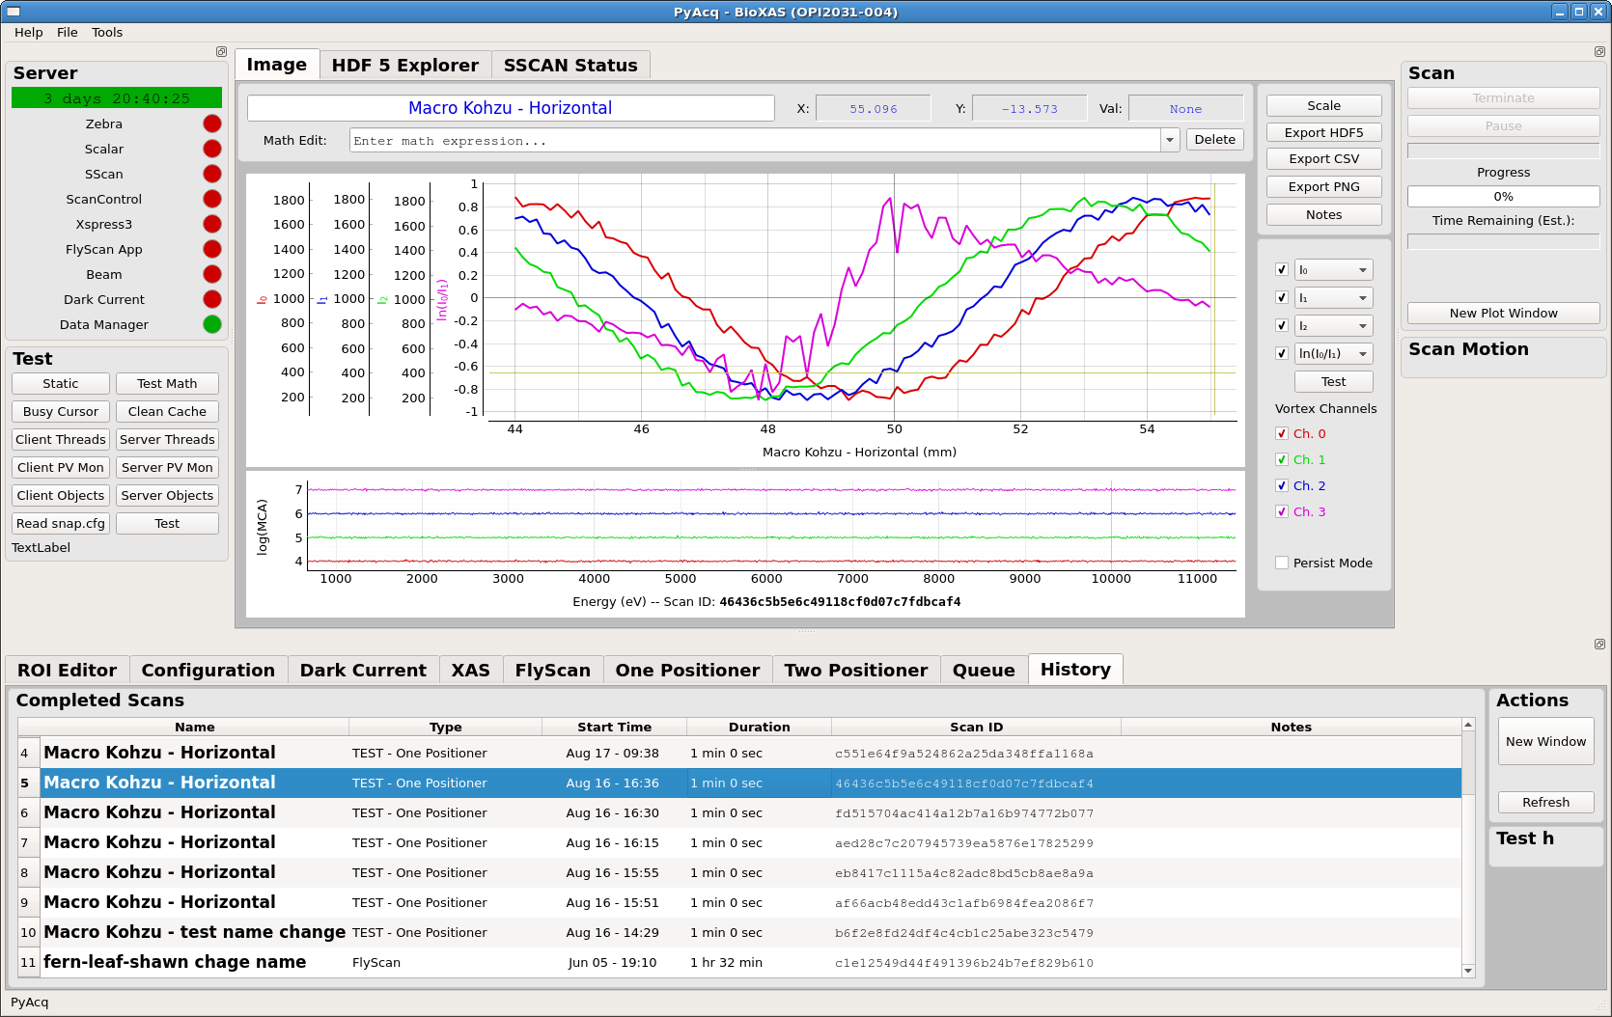

Slide 8
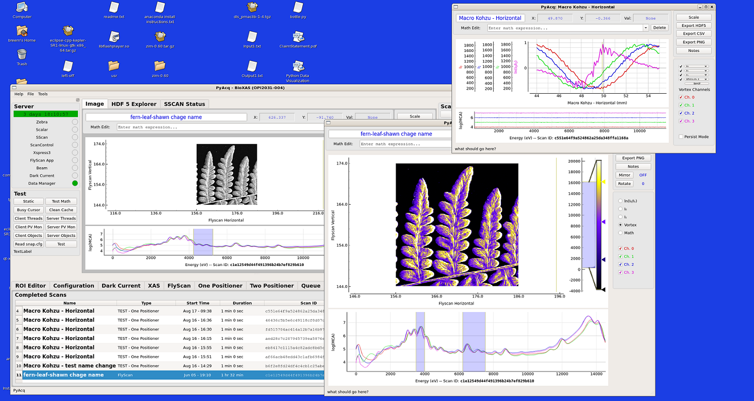

Slide 9
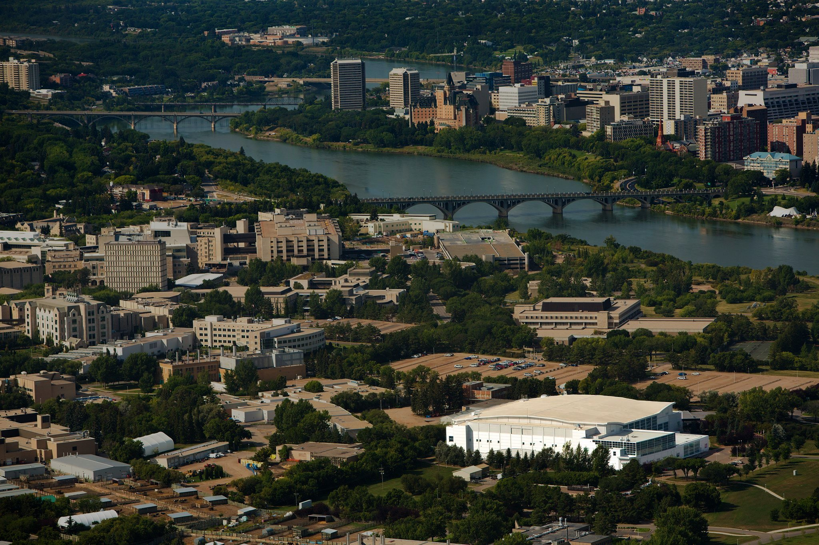
Thank You!

