Slide 1
Capillary alignment on PD
or how to make the bent and twisted look good…
Terry Cornall, ANSTO, Australian Synchrotron.

Slide 2
Overview
Powder Diffraction experiments use samples of powdered crystals packed into skinny capillaries.
All sorts of colors and different thickness capillaries, not always straight
The capillaries are mounted on a magnetic base, not always straight
The base is put on a ‘spinner’ to average out crystal orientation, not always on the spin axis
As a result, tilt and translation errors can be +/-10° and +/-5mm
This makes the sample ‘wobble’ into and out of the x-ray beam
Scientists don’t like that….
Manual spin alignment is a hard-earned skill
Automate it Terry, please?

Slide 3
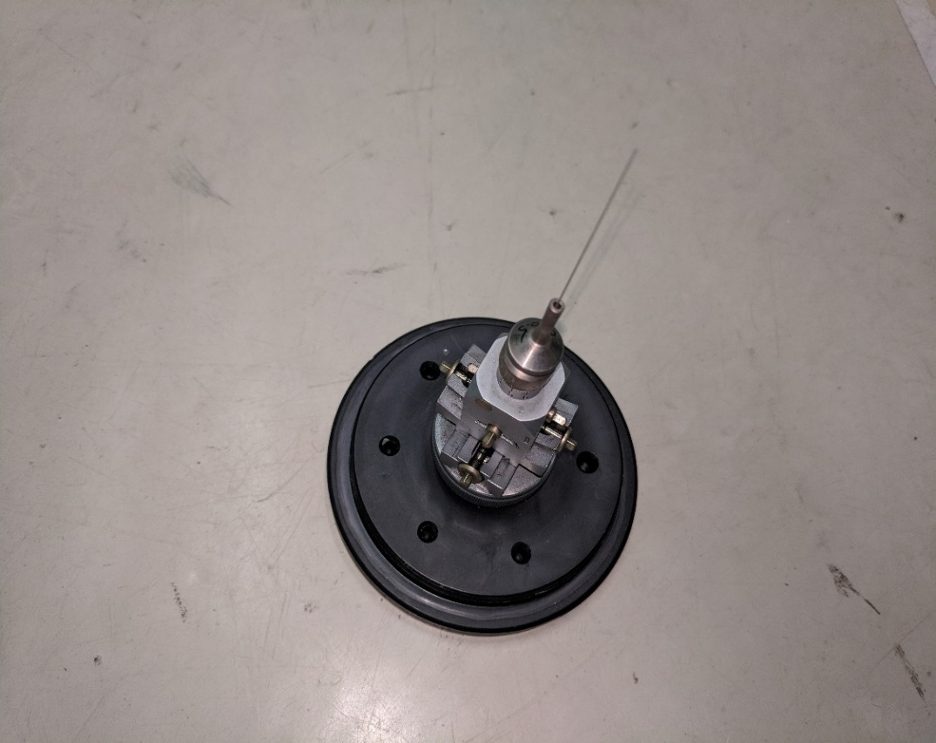
Old-school: A manual goniometer head
Small, light, reliable (This one not on a spinner yet)
Manual adjustment takes 20s (for some…)
Difficult for inexperienced user
On PD, mounted horizontally rather than vertically
Height of stack limited because of placement of the
detector diffractometer
Want ‘set and forget’ i.e. not continuous
adjustment. i.e. only the spin motor running after alignment
Want wobble less than 5 microns, i.e. about the size of a middling-large bacterium
We’re gonna need a better microscope…

Slide 4
What is wanted for autoalignment
20s for alignment
Want wobble less than 5 microns, i.e. about the size of a middling-large bacterium
We’re gonna need a better microscope…

Slide 5
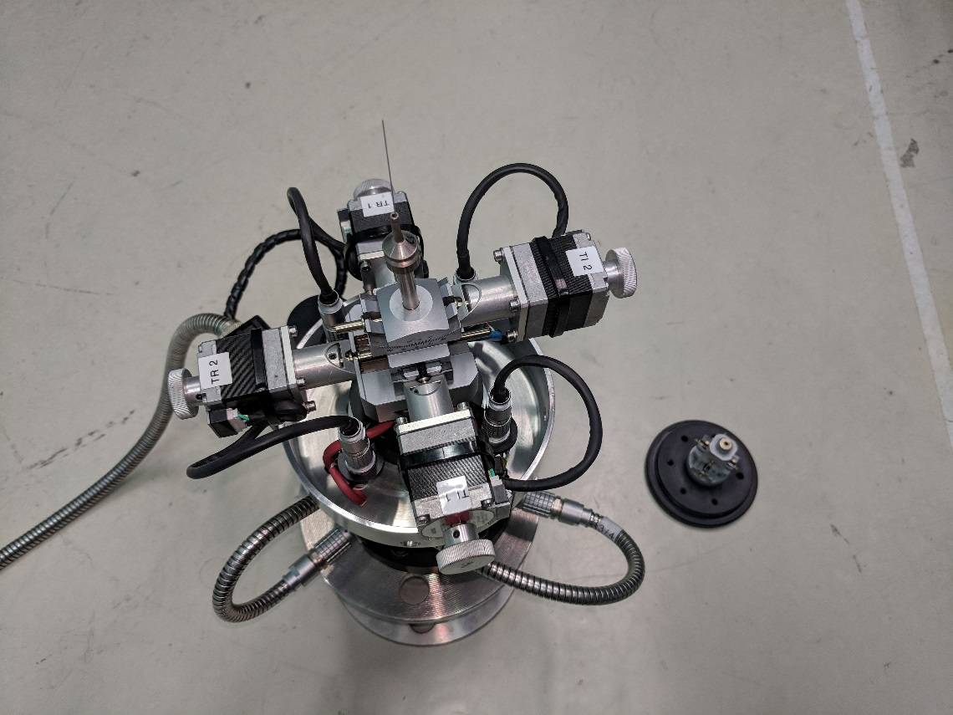
Version 1
Add tilt and translate motors connected thru a slip-ring
Use AreaDetector and a GigE camera with ‘scope
Use ambient lighting
Use IDL for image processing
Use intensity thresholding and least-squares
line fitting to measure angle
flip thru 90° to get 2 views
Apply corrections
Spin… Yay, works!
Hmm…. internal cables are breaking…
Ooh, the slip-ring is tethered by the wires!

Slide 6
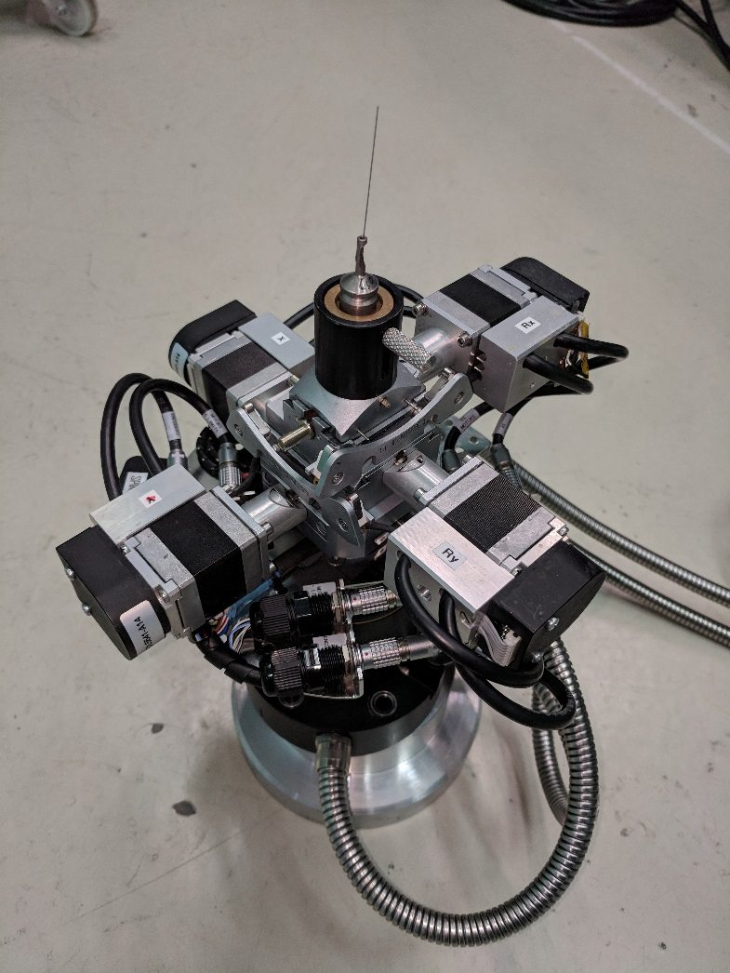
Version 2. Encoders and 2 cameras
New slip ring, properly tethered
Encoders on tilt/translate motors (really, Terry?)
Mounting points for 2 cameras.
Worked to improve alignment times,
but we couldn’t find a view for the 2nd camera that
wasn’t upset by ‘clutter’
Unfortunately, a subtle mechanical ‘tic’ on the spin
axis caused a lot of issues
A fix was found using multiple tries, but never 100%
and too slow
Deemed a failure… Sigh.

Slide 7
What not to do in version 3
Don’t take the manufacturer’s word for anything
  e.g. “Yes, this goni designed to work vertically will also work horizontally”
If there’s a problem elsewhere don’t try to fix it in software
  Sometimes you can, sometimes it’s a rabbit-hole
Make a good framework for your software first
  Use threads by all means, but can’t just launch and forget
Try not to spend all your software on how to stop things
  Build in ‘Abort’ capability to all classes
Don’t expect all subsystems to behave properly all the time
  But don’t get in a tangle trying to double-or triple check them either
  Make classes with built-in timeouts or self-monitoring and failsafes
Don’t expect all users to understand the underlying process
  If there’s a button that does something, it WILL get pressed, probably out of order

Slide 8
Things that have worked so far
Area Detector Prosilica
Pyepics for Channel Access from Python
IDL image processing (but I don’t want to use IDL anymore…)
OpenCV module for Python for image-processing
Event-driven state-machine in Python
EpicsQT (QeGui) for Operator and Engineering GUIs
Vimba/Pimba (Allied Vision libraries and Python wrappers)
Synch the camera to rotation angle

Slide 9
Stopping is harder than starting
When there are a lot of asynchronous threads, stopping things is hard.
Especially when you have to be sure that things have stopped stopping. e.g. motors.
Python threading doesn’t encourage ‘killing’ threads so they need to monitor and kill themselves.
Multiple ‘parented’ timeouts and flags help.
Putting in checks in every loop for a local ‘abort’ or a global ‘DIE_DIE_DIE’ flag worked but made coding tedious.
Will attempt to use Python decorators and lambdas to make this easier.
Using multiprocessing rather than threading may provide a ‘terminate’ method that can be called externally.

Slide 10
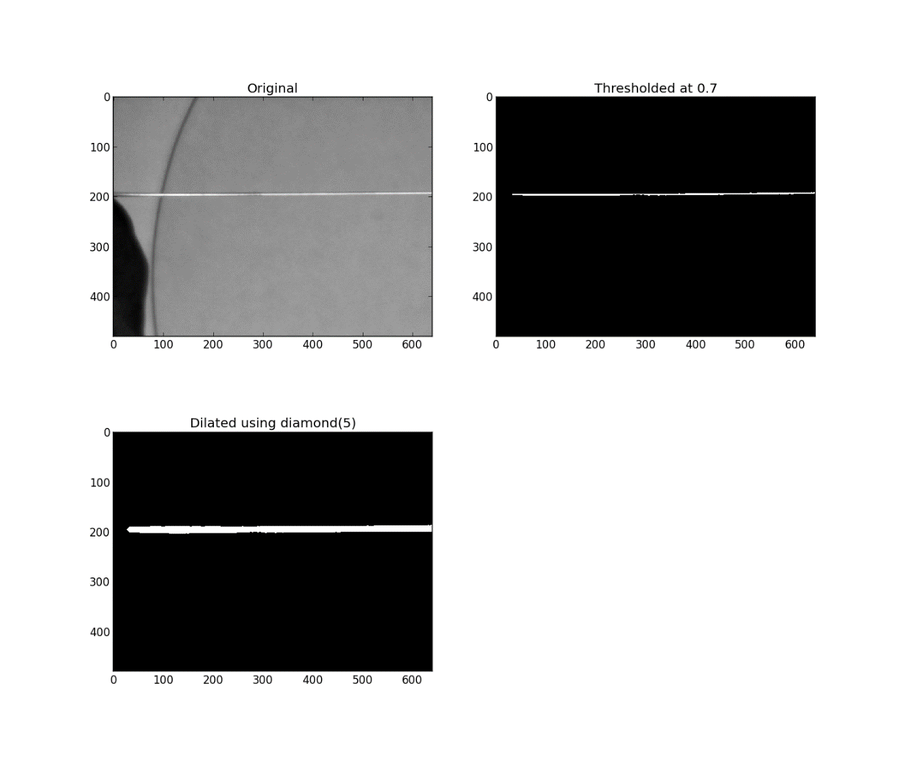
Simple image processing
(oh if it was always this easy…)
Capillary can be light or dark
Background can be clear or cluttered
Lights can be on or off
Capillary can be out of focus
Capillary can be thick or thin
Amazingly, this (mostly) worked for
version 1 using the IDL libraries
Also works (mostly) using OpenCV but
not quite as well

Slide 11
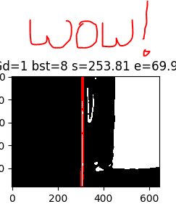
Better image processing
This example shows an experimental method that grouped
intensity-thresholded pixels into connected groups, then rejected
groups that weren’t ‘skinny’ enough. Works great, but is slow.
However, this is a particularly bad input and we can do much better using backlighting to improve the input images. Then we can use simpler methods.
Currently, the method being trialled is:
Backlight the capillary with a collimated light and use a telecentric lens.
Use Sobel or similar edge-detection filter to measure image gradient at each pixel.
Apply a ‘oriented gradient’ pre-filter to eliminate pixels with gradient too far from acceptable angles. e.g. more than 10° from vertical tilt-range.
Then threshold and clean up with morphological operators to reduce noise.
Then reject all pixels on a row that has more than 2 ‘edges’.
Apply line-fitting on the remaining points. Reject lines out of tilt-range.

Slide 12
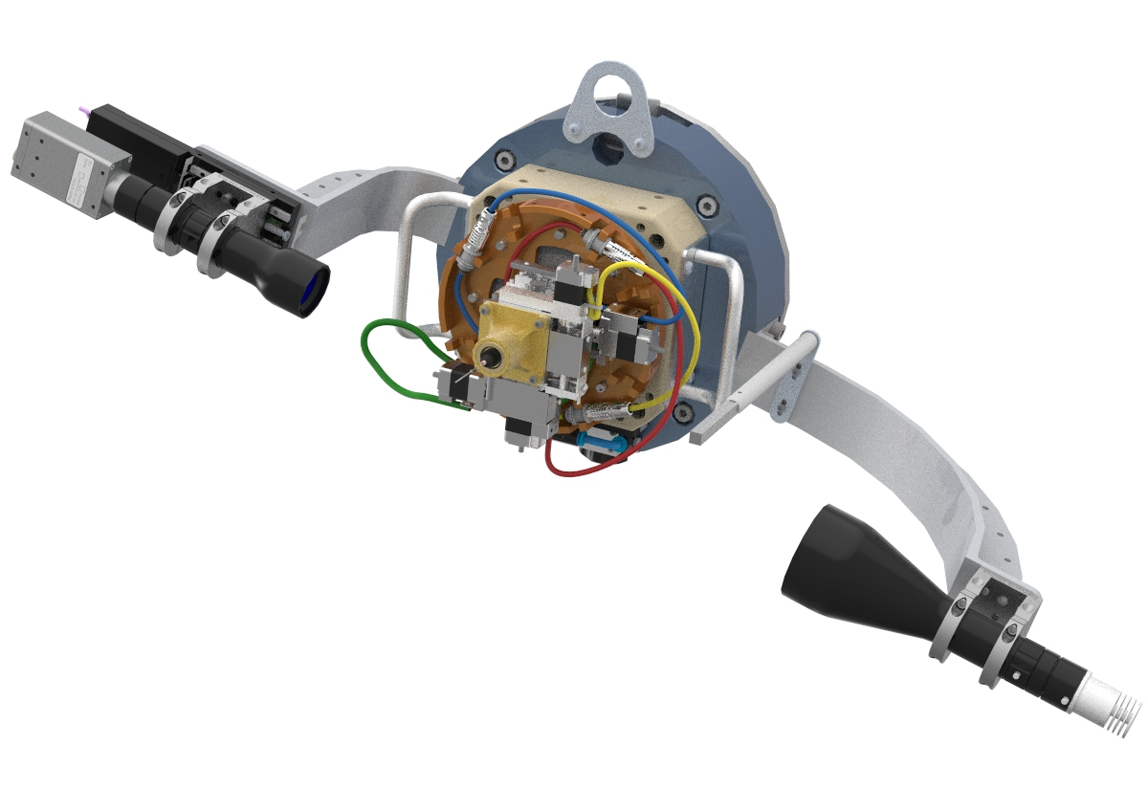
Version 3
Air-bearing for spin axis to stop ‘tic’
Slip rings for unencoded translate and tilt stepper motors
Collimated back-lighting to improve images
Telecentric lens to reduce ‘blooming’ as distance changes
Higher res camera to improve res
Image capture synchronised to 90° to allow alignment ‘on the fly’
This would also allow easy manual adjustment
A lighter, more precise tilt/translate stage
A better mounting system to help with putting it on and taking it off
Python/Pyepics/AreaDetector/OpenCV with EpicsQT GUI

Slide 13
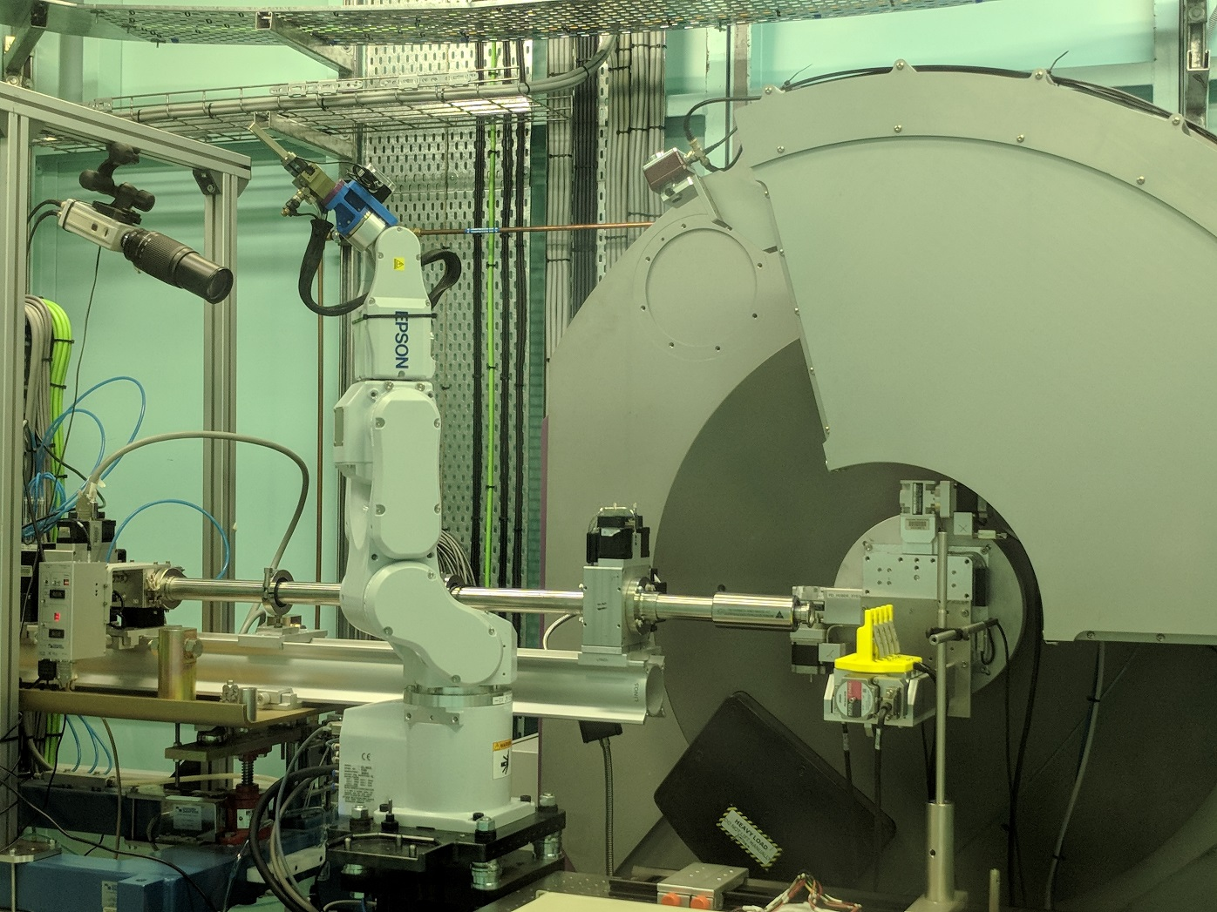
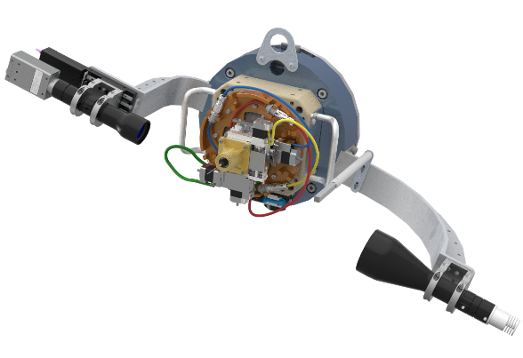
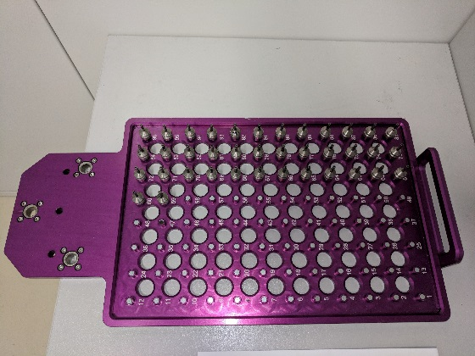
Let’s add a robot to the mix…
Actually, we’ve already done this.
Just needs a reliable and fast
autospinner…

