Slide 1
EPICS Solution for EPSON Robots
Speaker: Dr Mark Clift
Date: 12/11/2018

Slide 2
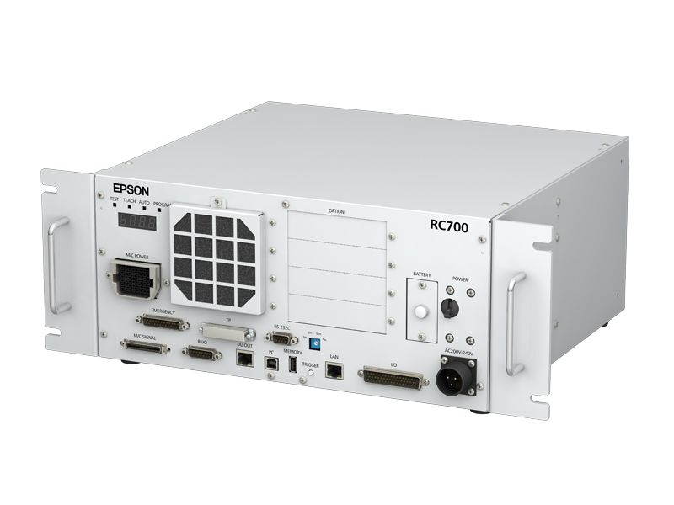
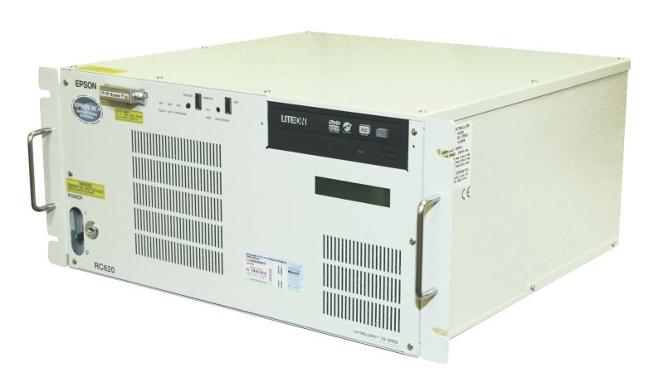
Features
EPSON robots
RC-620, RC-700 controllers
Ethernet connected

Slide 3
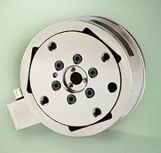
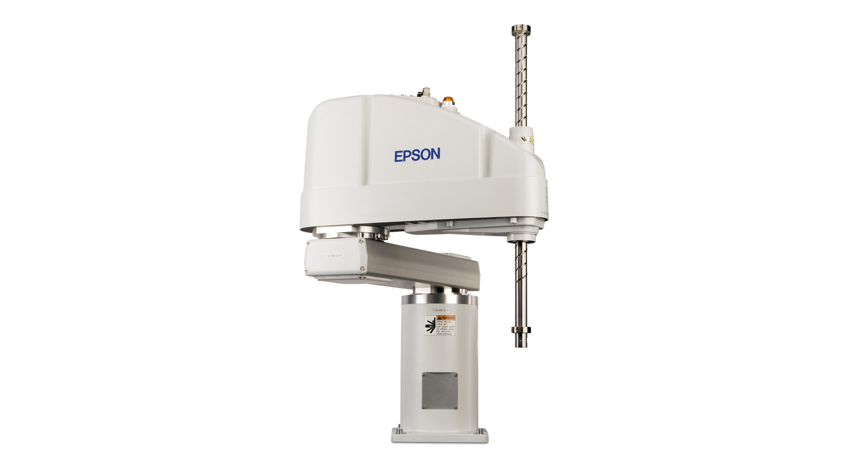
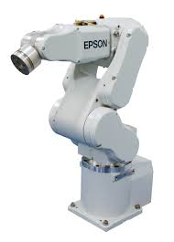

Features
EPSON 4-6 axis robots
Multiple robots per controller supported
Utilise all robot facilities (Vision, force sensing, TP)
Designed to integrate any application

Slide 4
Components
Major components:
  A network server written in the robot native language (SPEL)
    Foreground – manipulator
    Background – logic, data, IO
  Function name resolution service – DLL .NET c++
  Force sensing module – DLL .NET c++
  An EPICS database for robot operations (eg. motor on, brake on)
  Python interface to generic EPICS database
  Set of EDM screens – Engineering
Attribute | Epson | Supplied
Max sample frequency | 500 | 28000 | Hz
Sample frequency run-time adjustable | No | Yes
Averaging run-time adjustable | No | Yes
Notes:
Eiger1 not listed as formal deliverable in PMP – was a milestone and key ‘stepping stone’

Slide 5
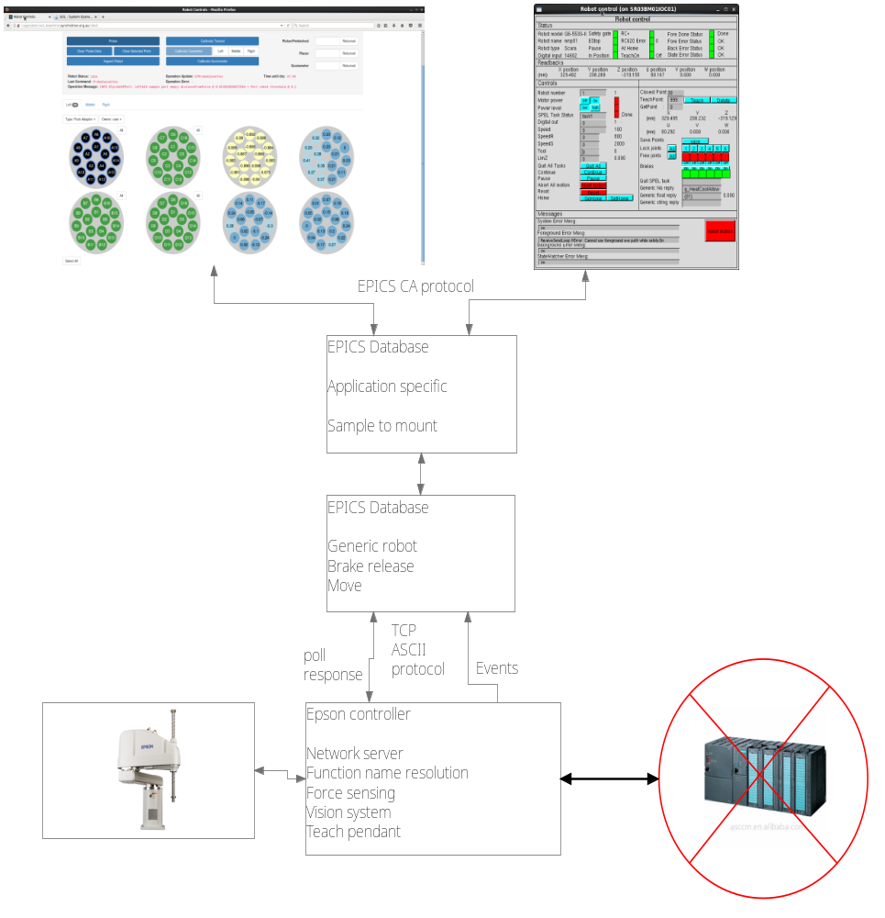
Components

Slide 6
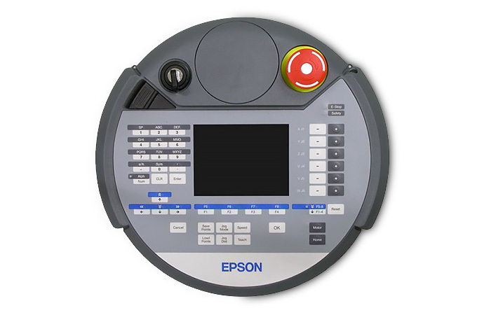
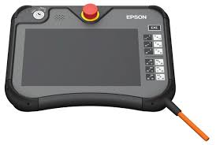
Safety
Dual redundant safety inputs
Teach mode – Teach pendant – Can be used to block user operations during robot recovery
Network server shows operators robot mode (eg. program or teach)
Robot cannot move when safety bad
  Network server can still control IO – Open grippers
  Network server can still run background tasks (eg. Send sample port status to GUI client)

Slide 7
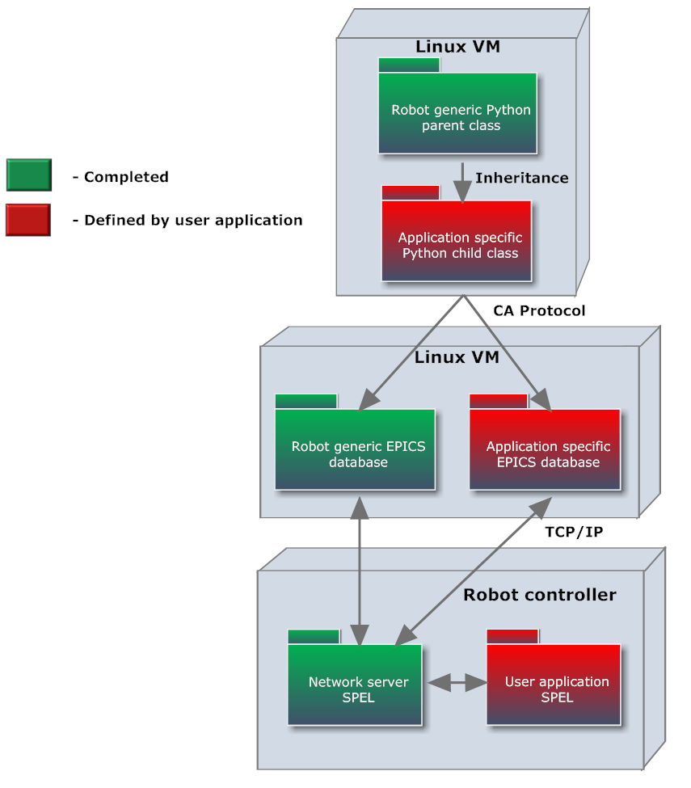
Application development
Generic robot EPICS database
  Add application specific database
  Generic python interface
    Add application python
  EDM Engineering screens
    Add application specific screens
    Robot application – in SPEL

Slide 8

Examples
MX1 sample mounting – SSRL cheetah
MX2 sample mounting – SSRL cheetah
PD sample mounting

Slide 9
Contact
To obtain the software
Email: cliftm@ansto.gov.au

