Slide 1
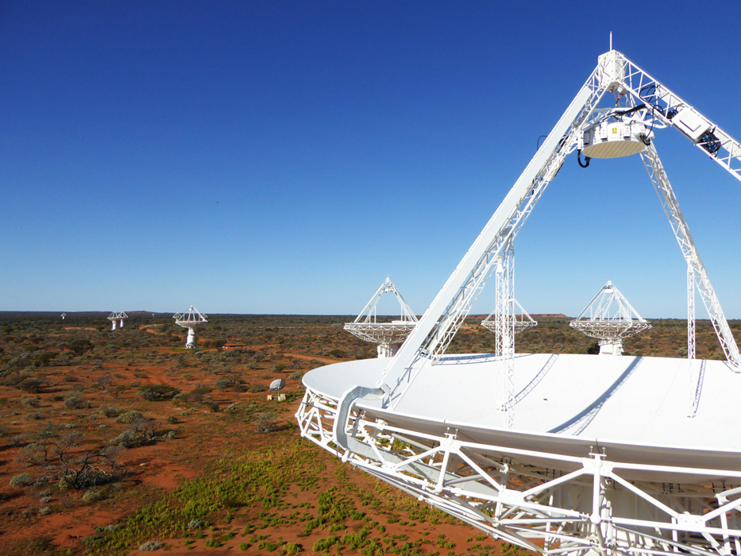
TANGO from an EPICS perspective
Astronomy AnD SPACE
Euan Troup | Developer
15 November 2018

Slide 2
TANGO – TACO Next Generation Objects
TACO – Telescope and Accelerator Control with Objects
http://tango-controls.org
OO software framework for distributed control systems
  CORBA & 0MQ network transport layer cf Channel access/PVaccess
Software ecosystem
  C++, Java, Python libraries & toolkits – others as well
  Core applications
    Astor (TANGO Manager), Jive, ATKPanel, Pogo (Class Generator), Synoptic and Jdraw, Tango Application Toolkit “ATK”, LogViewer,Qtango,Canone
  Other applications
    Archiver
    Alarm handler

Slide 3
TANGO Concepts
OO software framework for distributed control systems
  CORBA & 0MQ network transport layer
Tango device & device servers plus clients
  SQL database for configuration
    Name service
    Addressing is hierarchical
      domain/family/member
        mid_csp_cbf/bf_type1/5
        Full [protocol://][host:port/]device_name[/attribute][->property][#dbase=xx]
IDL defined software interface for clients & server including
  Defined data types
    Tango::DevBoolean,Tango::DevShort,Tango::DevLong,Tango::DevLong64,Tango::DevFloat,Tango::DevDouble,Tango::DevUChar,Tango::DevUShort,Tango::DevULong,Tango::DevULong64,Tango::DevString,Tango::DevState,Tango::DevEncoded
    Scalar, Spectrum, Image
  Commands (RPC)
    0 or 1 parameter, returns 0 or 1 parameter
  Attributes (PVs)
    Properties: Quality factor, timestamp, alarm limits
    Polling
    Change event, archive event, periodic event, data ready event
  Events
    User defined, interface change
  Defined states
    14: ON, OFF, CLOSE, OPEN, INSERT, EXTRACT, MOVING, STANDBY, FAULT, INIT, RUNNING, ALARM, DISABLE, and UNKNOWN.
    State machine coder implemented

Slide 4
More TANGO
POGO code generator
  Multi-language C++, Java, Python
  Device class & state machine
Jive Configuration Tool
  device names
  attribute names
  dynamic attributes
  attribute properties
  free properties
  stored properties

Slide 5
TANGO on its own
Documentation a bit lacking
Not enough worked examples
No example source code in TangoBox
More emphasis on coding rather than configuration
  Hundreds of devices in Jive?
How to do hierarchy
  Client code in device looks clunky
  Threading? Locking?
  cf EPICS IOC – CA server & CA client

Slide 6
Thank you
Astronomy & Space
  Euan Troup
    t +61 2 9372 4066
    e Euan.Troup@csiro.au
ASTRonomy & SPace

