Slide 1

Injection Archive System for SuperKEKB
Hiroshi Kaji (KEK)

Slide 2
Overview
Archive Objects:
EPICS PVs for SuperKEKB accelerator
System Configuration:
Standalone PC
- OS: CentOS7 linux
- CSS archiver
- PostgreSQL
VME/VxWorks IOC with EVR
- CPU: MVME5565
- EVR: VME-EVR-230RF
Retreat software:
ROOT
Archiver
Data collector

Slide 3
Archived data
Using
“data collector”
Followings are recorded in pulse-by-pulse
- Shot ID
- Injection RF-bucket#
- Bunch current before injection (for 1st injection bunch)
- Bunch current before injection (for 2nd injection bunch)
- Bunch current after injection (for 1st injection bunch)
- Bunch current after injection (for 2nd injection bunch)
- 1st bunch current at the end of beam transport
- 2nd bunch current at the end of beam transport
Followings are record when they are processed
- Injection septum angle
- RF phase of main ring
- etc ...

Slide 4
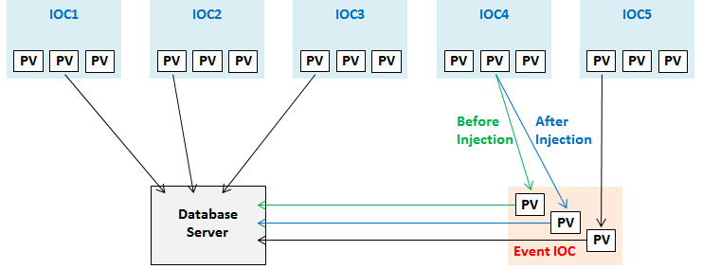
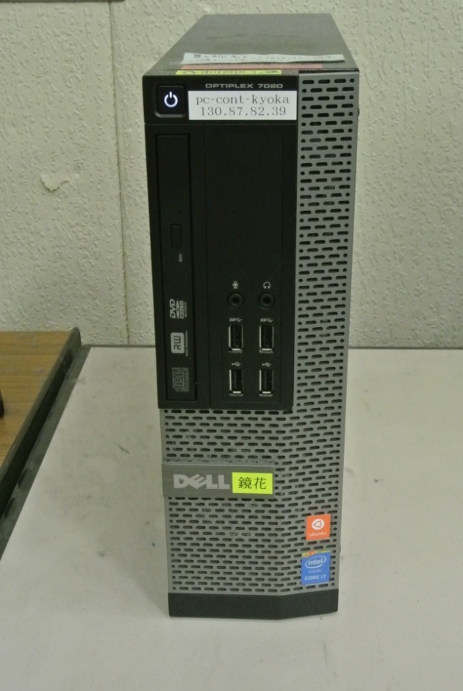
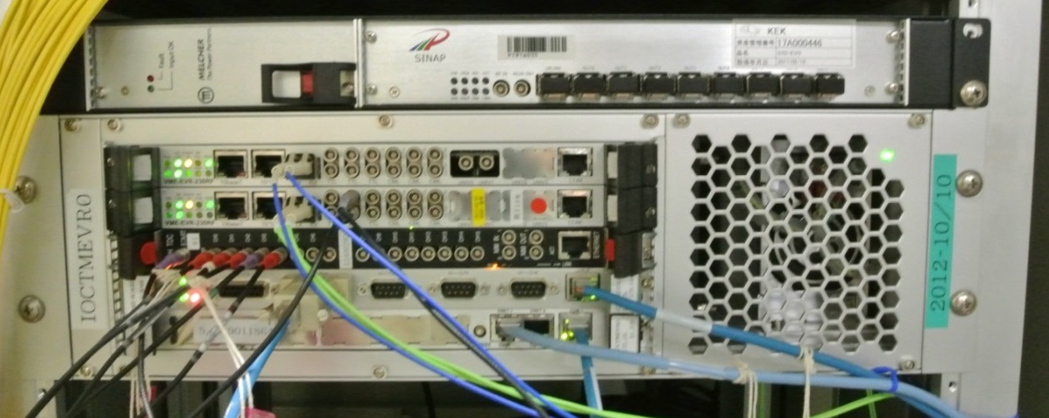
System Configuration
Database server (archiver)
- CSS Archiver
- postgreSQL
Pulse information is once stored on EVR IOC (data collector).
VME/VxWorks IOC with Event Receiver
- Precisely process between every two injection pulse
- Collect injection RF-bucket# and shot ID from data buffer

Slide 5
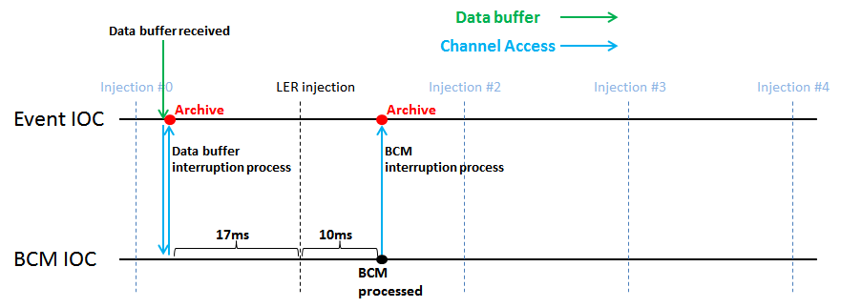
Scheme for archiving injection current
Bunch
Current
Monitor
Event driven
BCM driven
EVR receives which RF-bucket should be checked for next injection via data buffer.
Event IOC collects it!
Bunch Current Monitor (BCM) renews information after every injection. Event IOC collects it!

Slide 6
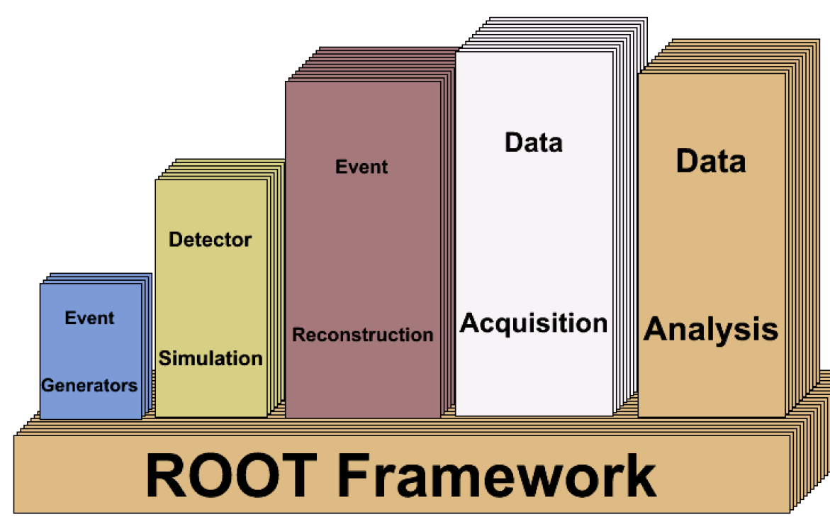
ROOT as offline software
ROOT website: https://root.cern.ch/
- popular software for data handling (analysis) at High Energy Physics
- C++ base
- includes PostgreSQL library, GUI, and so on
Offline process with ROOT
- retreat data from archiver
- put several kinds of data together
- draw graphs and histograms

Slide 7
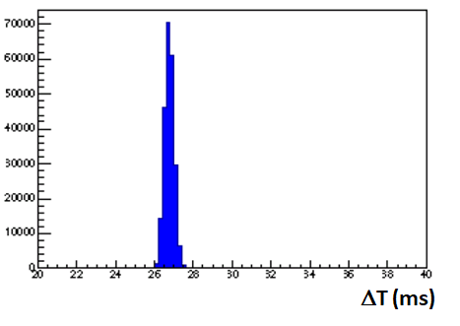
Data retreat and analysis with ROOT
Injected Current:
I_{inj} = I_{after} – I_{before}
Two PVs for I_{before} and I_{after} are with timestamp.
The timestamps should be differ 27ms
if they are for one injection process.
The matching is performed with ROOT.
(Small jitter and 0.2% packet loss caused in CA access)

Slide 8
Comparison with Ordinary System
The injected current is evaluated with more sophisticated way than before.
 | Hardware | Measured information | Frequency
Ordinary system | DCCT | All beam current | 1 Hz
New system | Bunch Current Monitor | Bunch current for injection RF-bucket | 25Hz (every injection pulse)
Comments | Bunch current of RF-bucket to be injected is measured in new system. The RF-bucket# is delivered from EVR. | New system can avoid influence of non-injection RF-buckets. | New system records for all injection pulses.

Slide 9
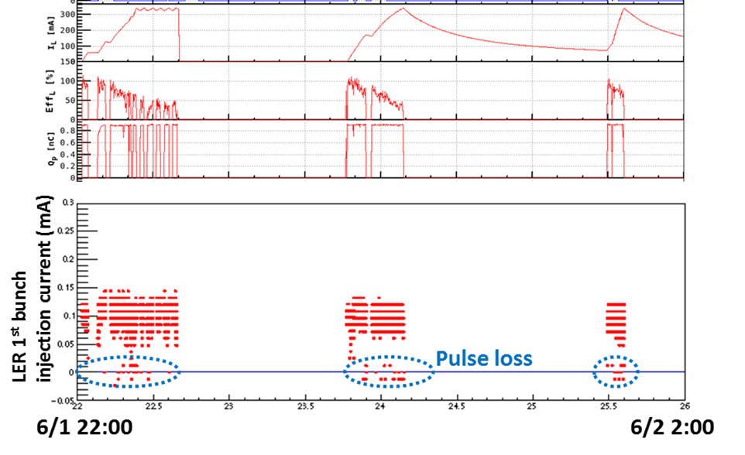
Performance compared with old system
Beam Current
Ordinary system
0.10mA
0.05mA
New system
The new system has following advantages:
- avoid unnecessary influence from non-injection bunches.
- distinguish the beam pulse loss.

Slide 10
Conclusion
We develop the new injection archive system for the SuperKEKB collider.
- It consists of archiver and data collector.
- Data collector utilizes the Event Timing System.
Offline data handling with ROOT
- retreat data
- combine them for each injection
- draw pictures
New system has advantages:
- avoid the influence of non-injection bunches
- distinguish the beam pulse loss

