Slide 1
CS-Studio & Phoebus
Nov 2018
Epics Collaboration Meeting
Kunal Shroff, Kay Kasemir, Claudio Rosati, Evan Smith

Slide 2
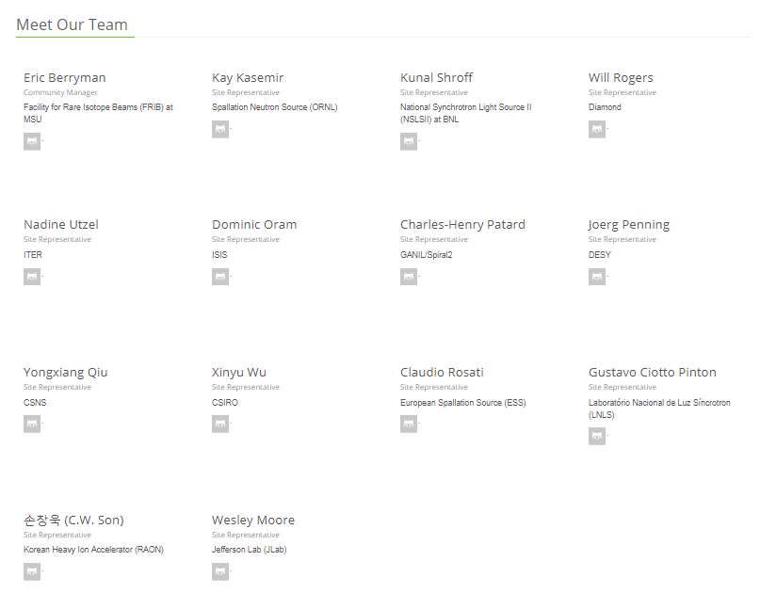
CS-Studio Collaboration
14 Sites which package site specific CS-Studio products
Additionally, many users who do not create their own products.

Slide 3
CS-Studio Collaboration
“When it works, I like it.”
“right click -> send PV name to another plug-in saves me a lot of time”
“I like the concept of a well integrated set of tools that can share data.”
“Integration of the olog, channel navigator, and chart/archiver features are useful.”
“Everything in one place”
“Easy to create GUI's that interact with EPICS PV’s”
“When it does not work, I hate it.”
“slow, clumsy, hard to understand”
“BOY leads to crashes way too often”
“I am having real problems building our own CSS distribution starting from Eclipse Mars RC2”
“Big labs seem to have their experts but I'm under the impression that smaller labs are struggling and so am I when "my expert" is not available.”
“Spend a long time to start a product in Eclipse and Export it.”
Feedback link:
https://docs.google.com/spreadsheets/d/11_nwz0tiSJO4Zs71UI5vD-SRLrHvmd__NjbFEzk_6js/edit#gid=0

Slide 4
CS-Studio: Since ~2006 based on
Great at the time:
  Build Setup
  Module System
  Preferences
  Extensibility
  Graphics … but there are now (better) alternatives
Strong ties to IDE
  Awkward layout constraints for control system user interface
  “Workspace” that’s different from the file system
  Odd menu entries that we don’t need

Slide 5
Here comes the Sun
CS-Studio powered by Phoebus

Slide 6

“Phoebus”
shadowed
Phoebus (Greek for “bright”)
= Apollo as God of the Sun

Slide 7
CS-Studio & Phoebus Goals
To improve user experience
A framework for well integrated control system tools and software
To reduce the barrier of entry for new developers
A simple Build
A development environment that is easy to setup and use
Use generic tools and technologies available as part of the java ecosystem

Slide 8
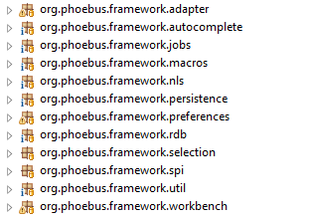
Moving from Eclipse to Phoebus
Preserve the best features of the eclipse framework
Extensible and Pluggable
  RCP Extension Points → Java Services (SPI’s)
  OSGi bundles → Jar files, maybe later Java 9 modules
Preferences
  RCP Preferences → Java Preferences
Perspectives
Jobs
Selection
Adapter
Help

Slide 9
Cs-studio phoebus - users

Slide 10
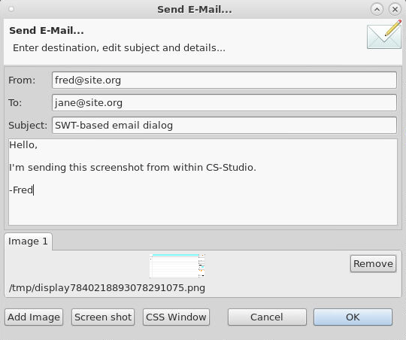
SWT vs. JavaFX
SWT used to be better than AWT
AWT/Swing caught up,
SWT now only used by Eclipse
➔ JavaFX is the latest Java-based UI

Slide 11
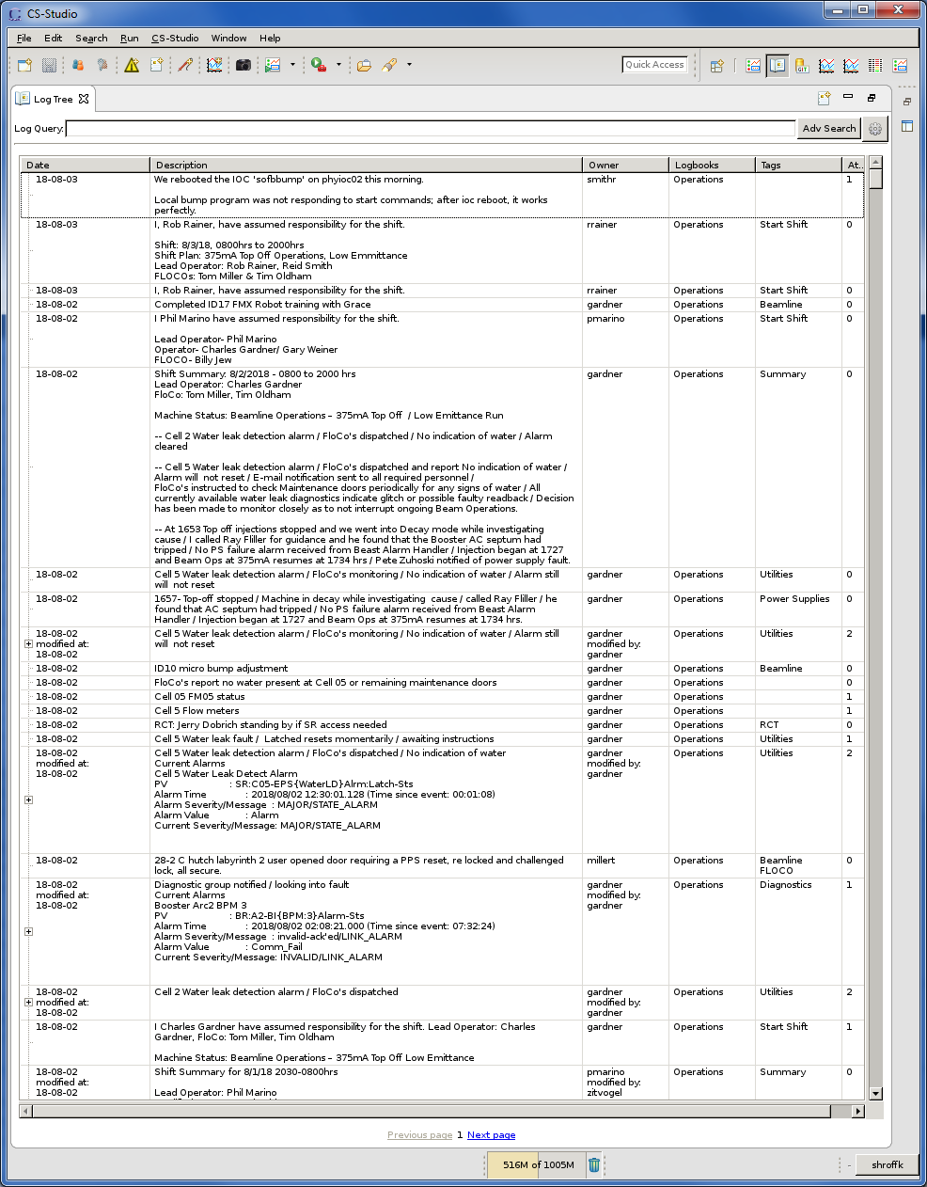
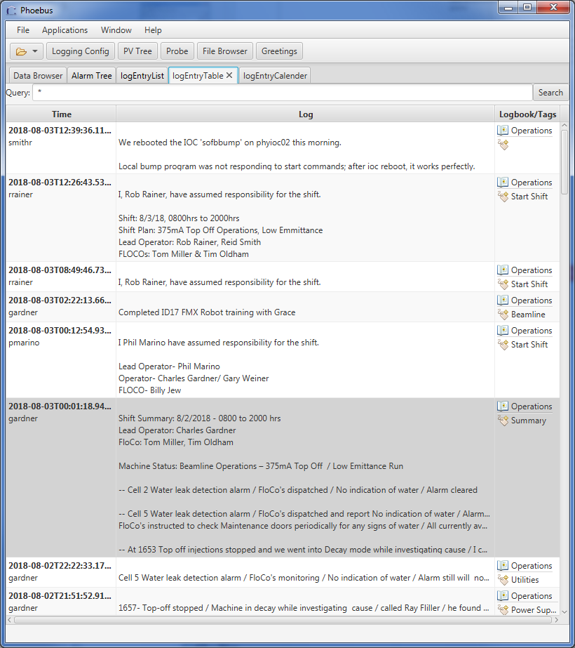
SWT vs. JavaFX

Slide 12
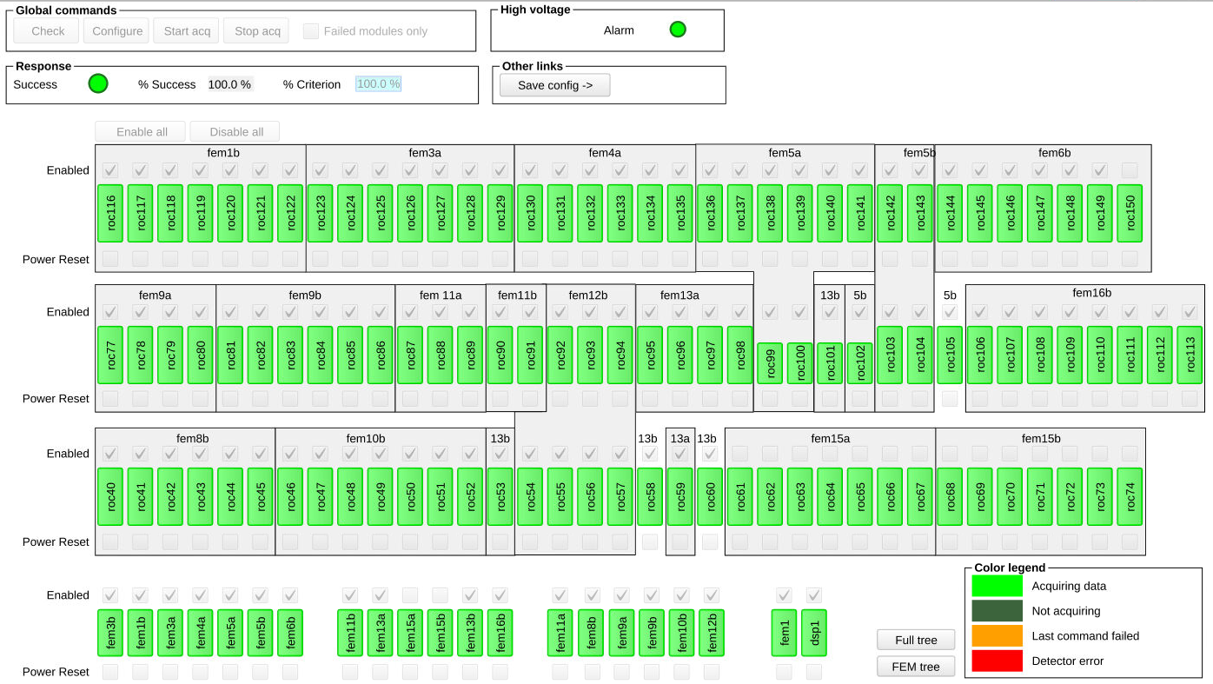
BOY(.opi) / Display builder (.bob)

Slide 13
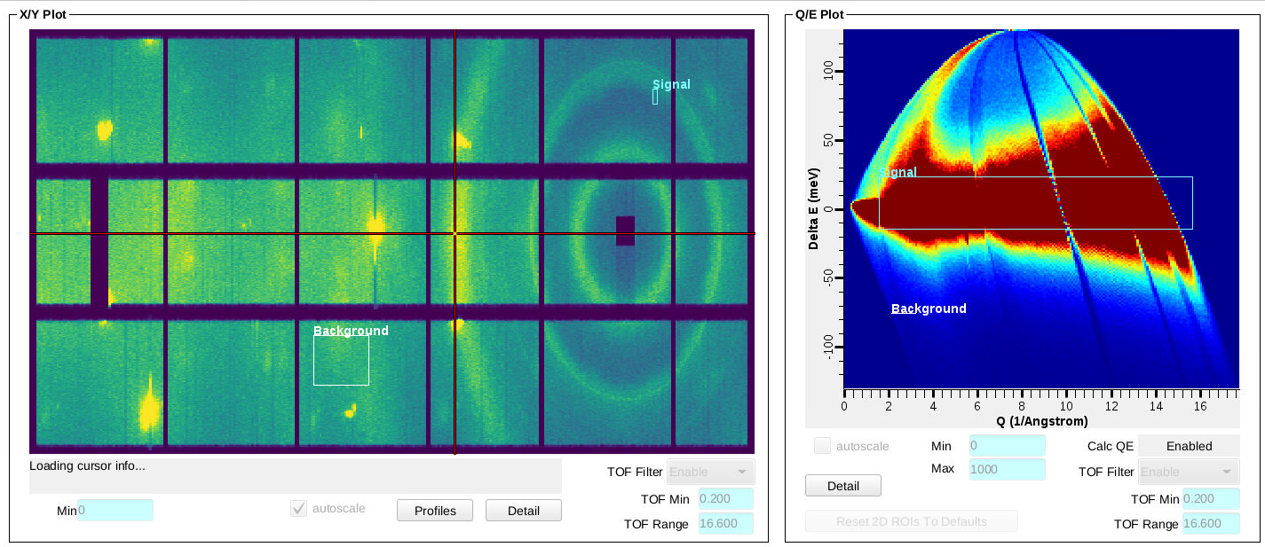
BOY(.opi) / Display builder (.bob)
SNS beam line control screens

Slide 14
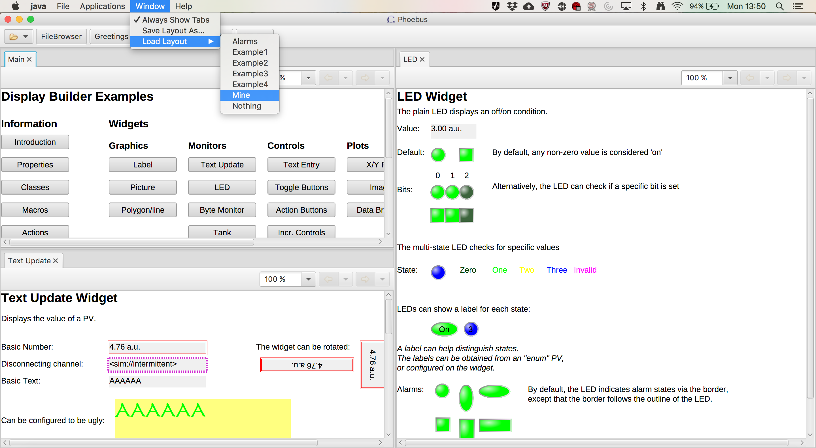
Save and Re-Load Layouts

Slide 15
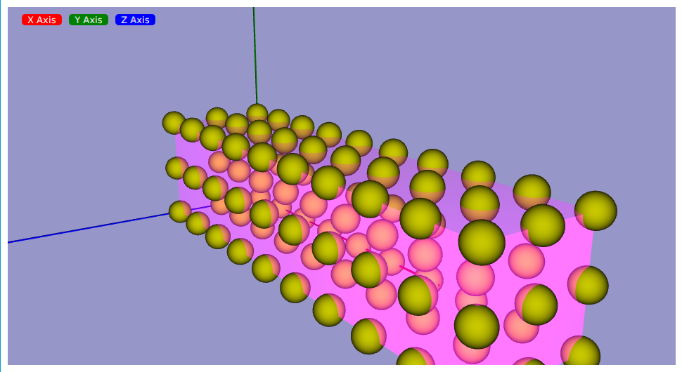
3D views
Javafx 3D library enables the phoebus to support user defined 3D Structure in cs-studio applications
Notes:
Package javafx.geometry defines a 3D bounding box and a fairly powerful Point3D class.
Package javafx.scene provides two 3D cameras (parallel, perspective) and two 3D light sources (ambient, point).
Package javafx.scene.shape has 3D boxes, cylinders, spheres, and most importantly MeshView for arbitrary 3D models with a TriangleMesh for contours and a PhongMaterial (in javafx.scene.paint) for lighted textures.

Slide 16
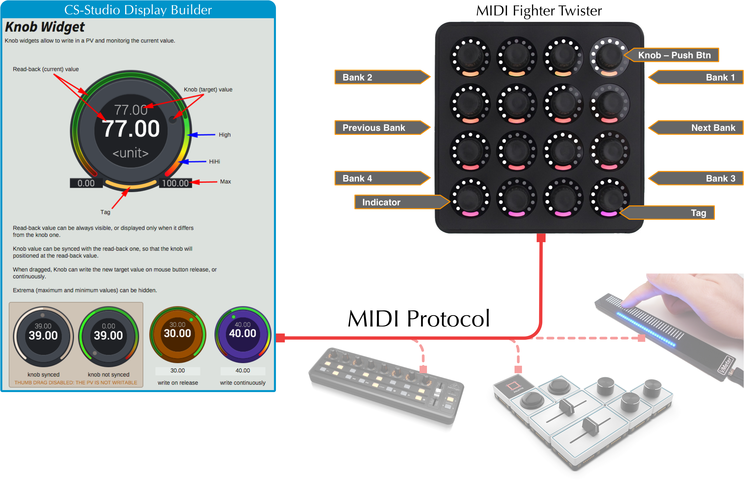
CONTROLLED KNOBS
https://github.com/ESSICS/KNOBS
https://github.com/ESSICS/Controlled-KNOBS

Slide 17
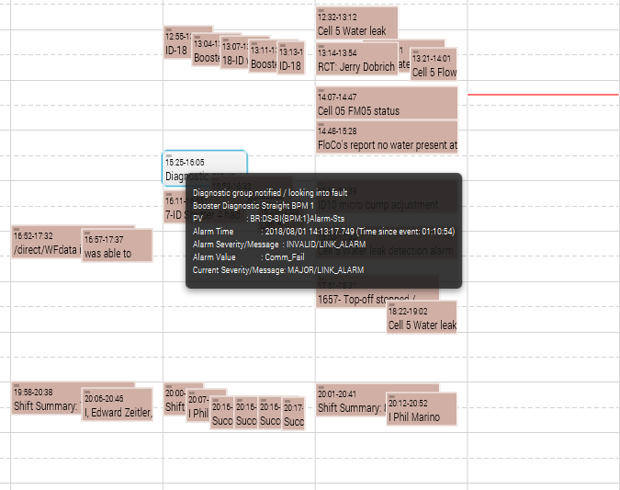
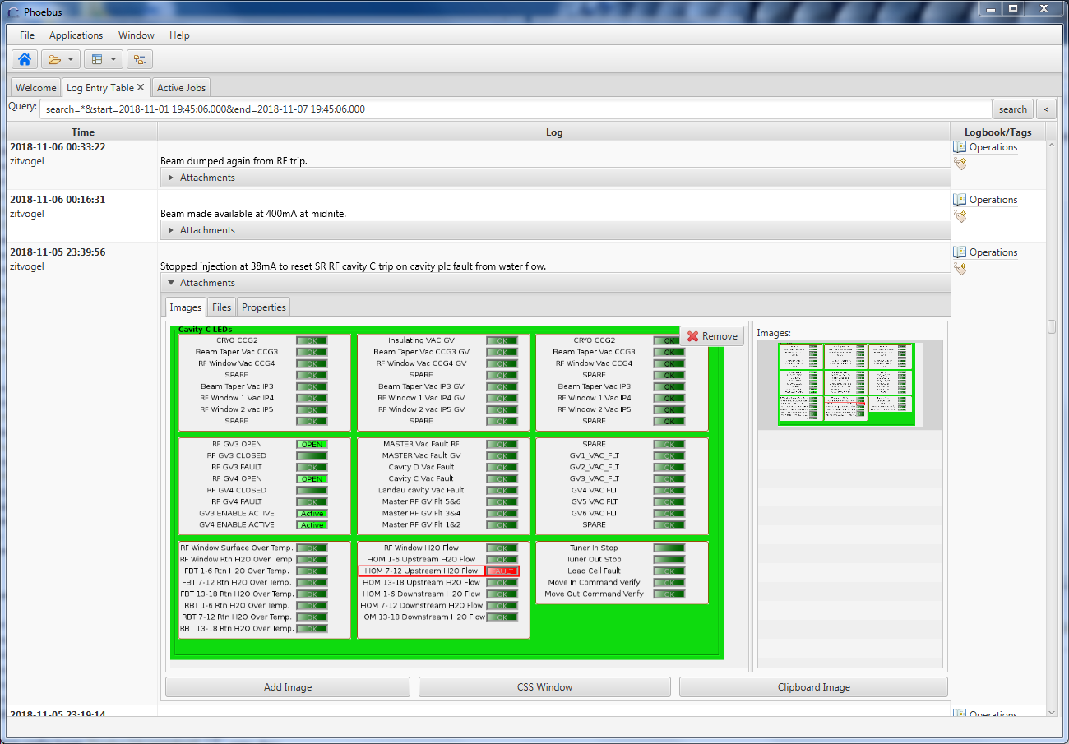
Log Calendar Views
&
Markup Support

Slide 18
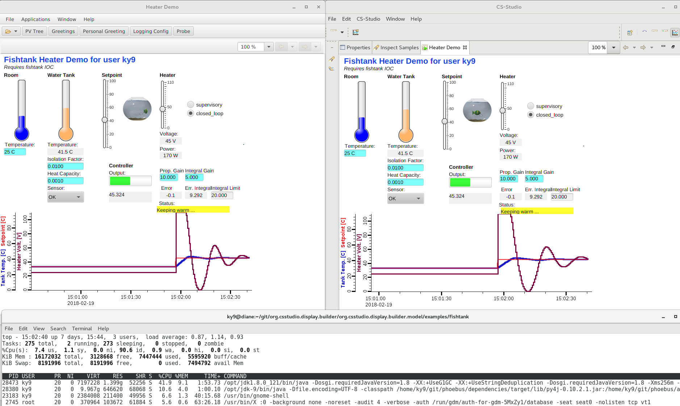
Phoebus:
¼ CPU,
½ Memory
CS-Studio with Eclipse

Slide 19
Cs-studio phoebus - DEveloper

Slide 20
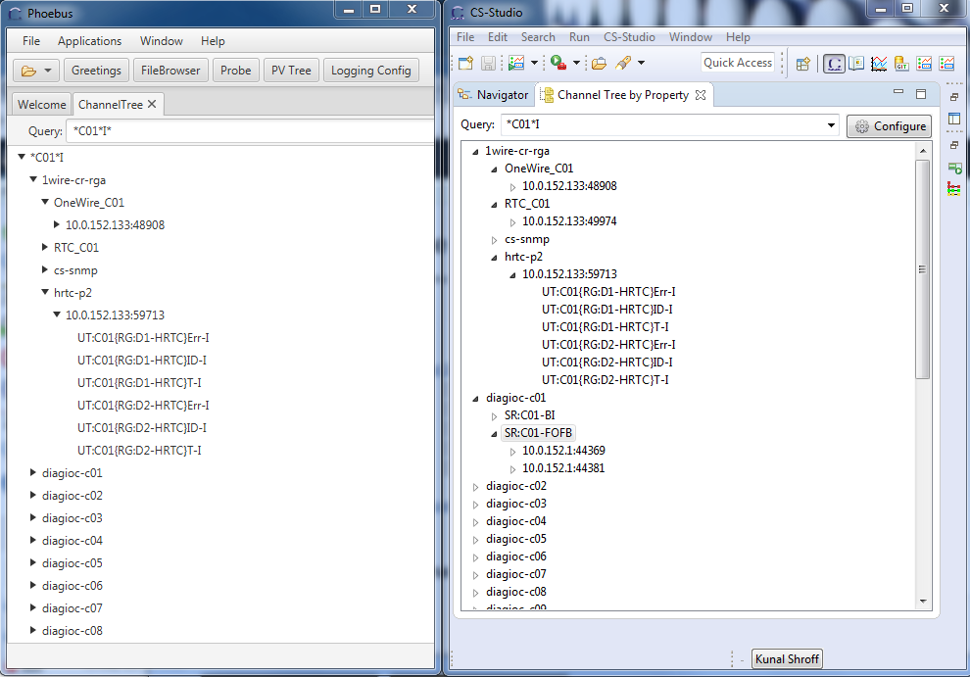
Eclipse based
Channel Finder Tree w/t
Lazy loading
11.2k Loc
Phoebus based
Channel Finder Tree w/t
Lazy loading
4.5k Loc

Slide 21
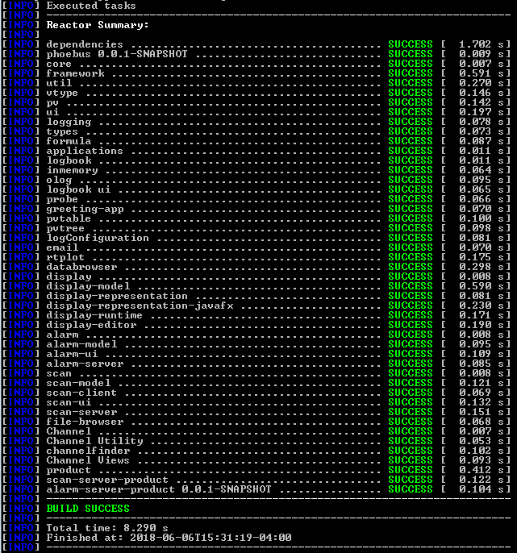

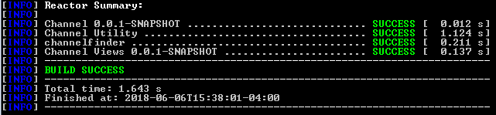
Fast & Simple Build
# clone the sources
git clone https://github.com/shroffk/phoebus.git
# build using maven
mvn clean install
# or
# build using ant
ant clean run
Support Multiple build technologies
ant & maven
Support Multiple CI solutions
Travis & AppVeyor
The Module can be build independently
Simplifies development
Site specific products can be assembled by building only those modules included in that product

Slide 22
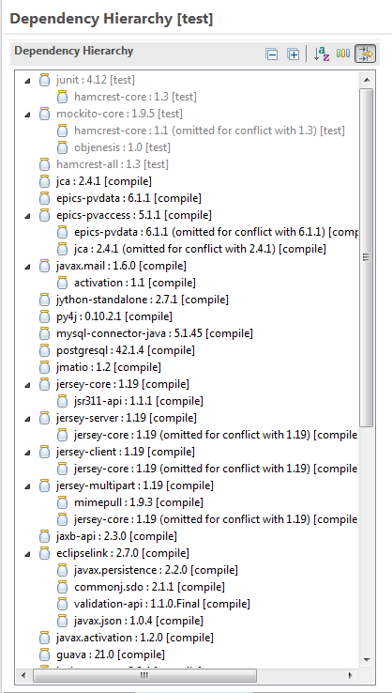
Build Target
Clearly defined dependencies
Maven is used to manage the dependency tree of all the Phoebus applications and their 3rd party dependencies
Phoebus/dependencies
  Produces a lib folder with all dependencies
  The lib folder can be hosted as a zip
-Dmaven.repo.local
  Produces a maven repo with all dependencies
  The repo folder can be hosted as a zip

Slide 23
Simplified Development environment
CS-Studio sans eclipse
Easy to setup
Developers can choose the IDE
No prior knowledge required of eclipse and its internal API’s

Slide 24
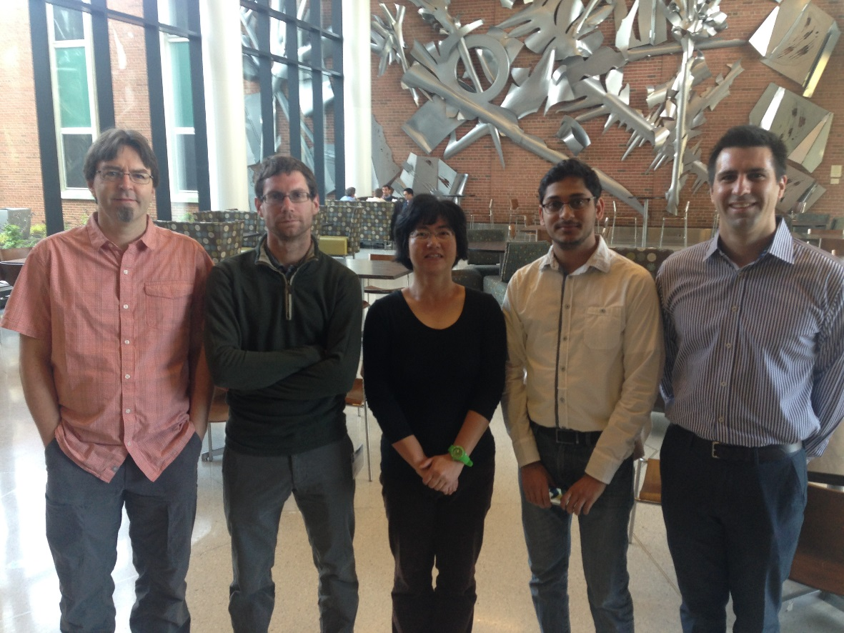
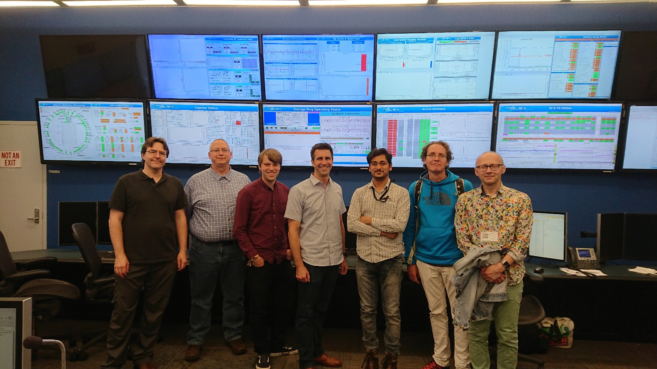
2016 code-a-thon at FRIB
Great coffee
Great beers, pretzels, and cracked fries at hop cat
3 days of struggling with setting up a reliable build and development environment
2018 code-a-thon at NSLSII
Ok Coffee
Ok beers, live music, and brick oven pizza at Patchogue brewery
Less than 3 hours to have everyone complete the build, test offline build, and set up development environment

Slide 25
Stepping out of the Shadow
From Eclipse to Phoebus

Slide 26
Moving from Eclipse to Phoebus
Goals
Minimize the disruption for developers
Make the transition easy for the users

Slide 27
Moving from Eclipse to Phoebus
Minimize the disruption
JavaFX
SWT
The migration from eclipse to Phoebus will be a multi year process
  Each application will be migrated individually.
  Both the eclipse and phoebus based applications will be supported by the cs-studio community.
  Each site will have the flexibility to define their time lines
Display Builder
Display Builder
Data Browser
Data Browser
PV Tree
PV Tree
Probe
Probe
PV Table
PV Table
Alarms
Alarms
Channels
Channels
Scan
Scan
BOY
… more …
… more …
Eclipse
Phoebus
Java 9, 11
Java 9, 11
Composite Product
CS-Studio 4.6

Slide 28
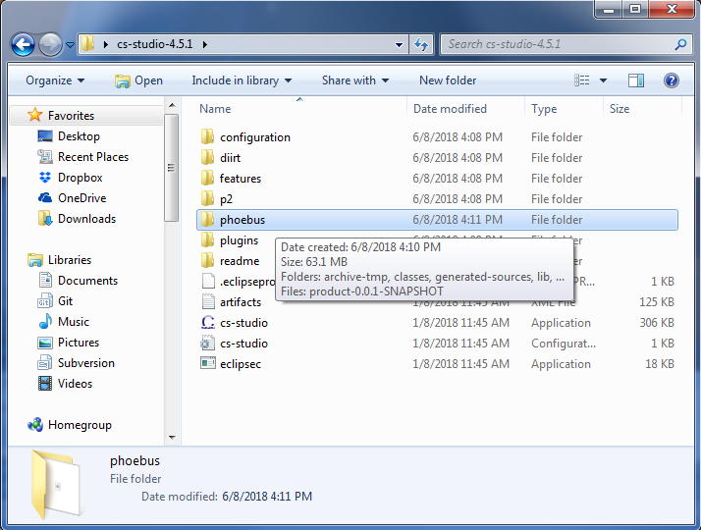
Moving from Eclipse to Phoebus
A easy transition
The Phoebus applications can be packaged with the existing eclipse applications into a single CS-Studio product
Developers can package the appropriate versions of each application to satisfy their site needs

Slide 29
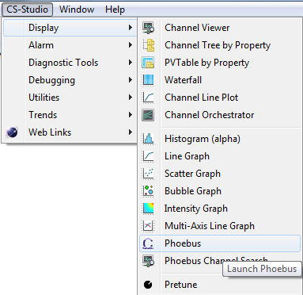
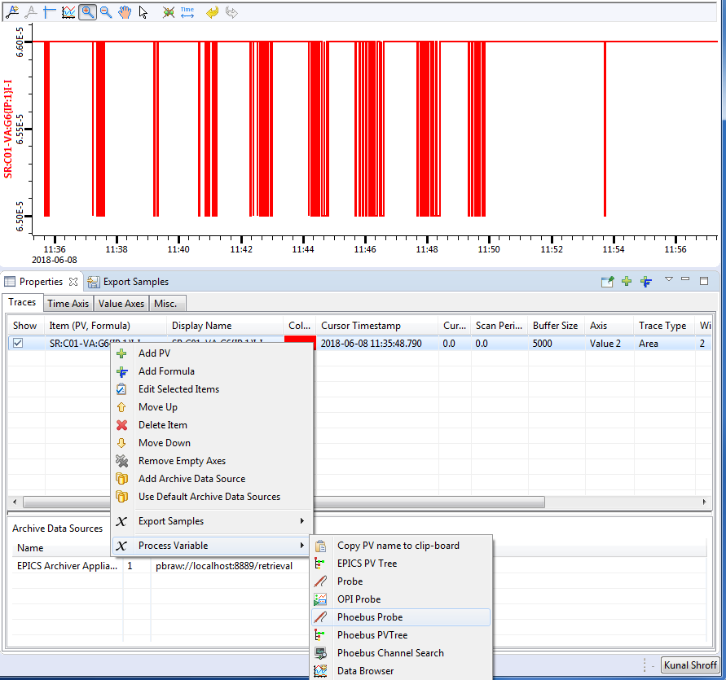
Phoebus Integration in
Existing eclipse products
org.csstudio.phoebus.integration
A plugin which provides a service with methods for launching CS-Studio phoebus applications from inside existing CS-Studio/eclipse products
Launch various phoebus applications via
CS-Studio menu or toolbar actions
CS-Studio context menu actions using the selection
When a users launches an application or a tool, the details of weather it a swt/javafx based eclipse application or a javafx based phoebus applications are transparent to the user.
e.g. The “send an email” or “create a log entry” will open the associated phoebus apps in a new window instead of the eclipse based ones.

Slide 30
Some links
CS-Studio Phoebus
https://github.com/shroffk/phoebus
http://phoebus-doc.readthedocs.io/en/latest/
CS-Studio Phoebus Integration
https://github.com/ControlSystemStudio/cs-studio/issues/2437

