Slide 1
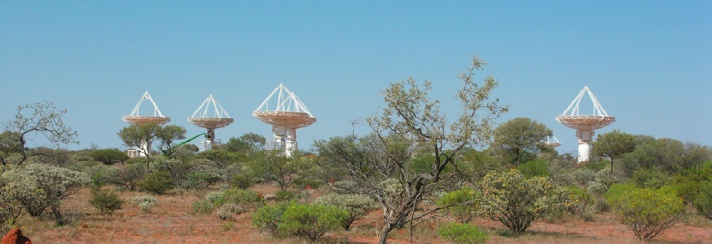
Archiving and Alerting in ASKAP
InfluxDB, Grafana, Kapacitor & Alerta
Craig Haskins
2018 EPICS Collaboration Meeting, Melbourne
16th November 2018
Astronomy and Space Science

Slide 2
DiaMoniCA (MoniCA + Influx + Grafana + Alerta)
Non-epics source (e.g. weather, RFI monitoring)
Grafana
(data vis)
EPICS IOCS
MoniCA (archiver)
InfluxDB
(time series)
Telegraf
(host stats)
Kapacitor
(stream processing)
Alerta
development
open source

Slide 3
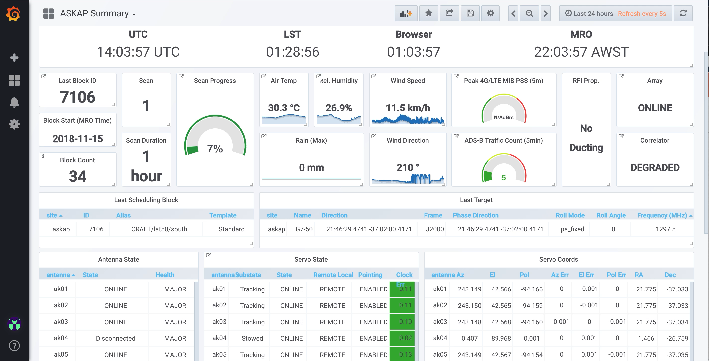
Grafana Real Time & Archive Data Visualization
Grafana update rate good for 5s
Based on HTTP query/response to influx database
Need to get the query expression to Influx correct

Slide 4
Alerting in Kapacitor
InfluxData’s ”Stream Processing Engine”
Data streamed from Influx to Kapacitor as it is archived.
Kapacitor runs “tasks” which process time series data in real time
Operates over all influx tags (single alert specification for all instances of monitoring point)
Built in threshold alerting
User Defined Functions can be written in Python or Go for custom anomaly detection or data manipulation.
stream
|from()
.measurement(‘paf.temps’)
.groupBy(‘antenna’)
|window()
.period(60s)
.every(10s)
|mean(‘pafAverageTemp’)
.as(‘meantemp’)
|alert()
.warn(lambda: ‘meantemp’ > 40)
.crit(lambda: ‘meantemp’ > 45)
.alerta()
.services(‘PAF’)
.event(‘HIHI Alarm’)

Slide 5
Configuring Kapacitor
Build time
Run time
EPICS DB
EPICS IOC
Point Descriptions in Code
Archiver
Archiver Configuration
Parser
InfluxDB
Kapacitor JSON
Kapacitor

Slide 6
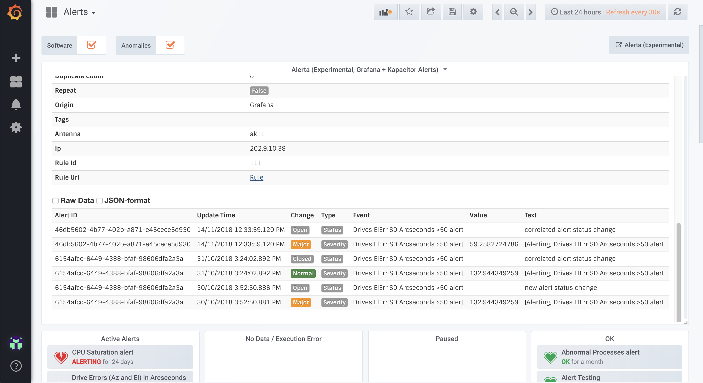
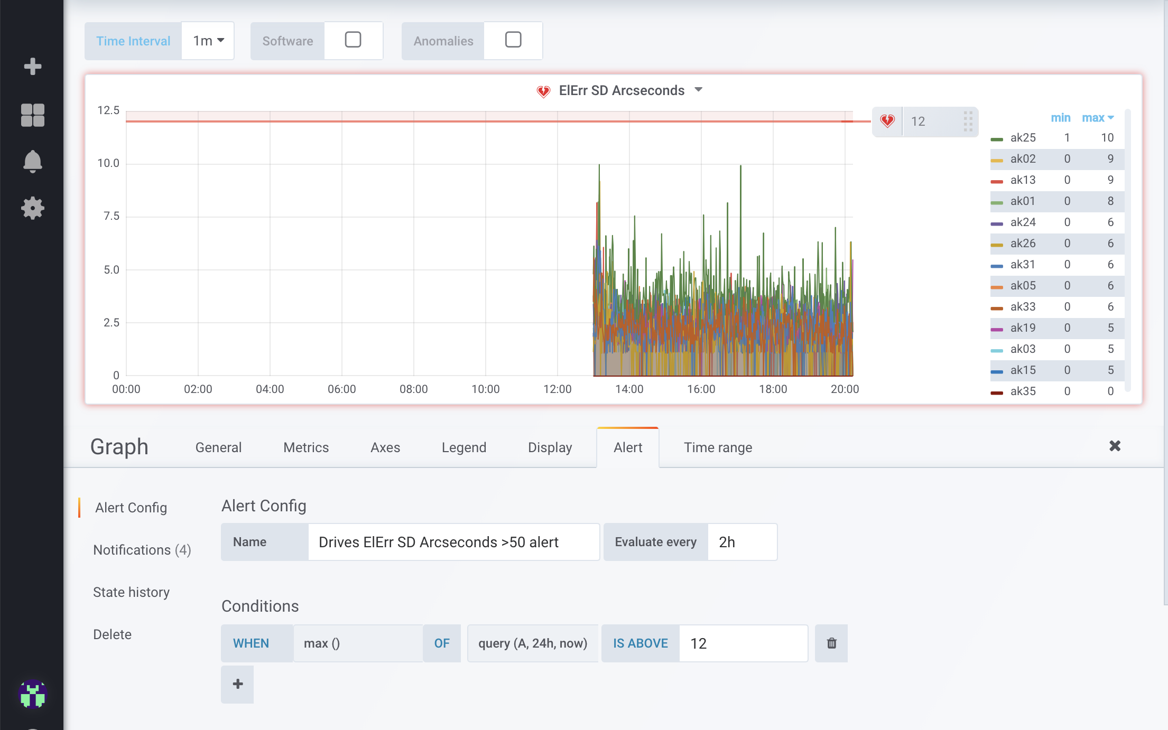
Alert Management
Currently running CSS/BEAST but looking for replacement
Evaluating Alerta
  Python Service with Web UI
  RESTful HTTP API
  Deduplication, correlation and auto acknowledge of alerts.
  Integrates out of the box with Grafana & Kapacitor

Slide 7

Sandbox
Try it yourself
Forked github repo to add Grafana + Alerta
http://github.com/craigh555/influx-sandbox
./sandbox up

Slide 8
Thank you
CSIRO Astronomy and Space Science
  Craig Haskins
  Software Engineer
    t +61 8 6436 8620
    e Craig.Haskins@csiro.au
    w http://www.atnf.csiro.au
Astronomy And Space Science

