Slide 1
Eiger 16M integration
Speakers: Dr Mark Clift, Vesna Samardzic-Boban
Date: 12/11/2018

Slide 2
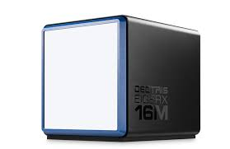
Overview
Goniometer motor system
Oscillation control – Goniometer, shutter coordination
Eiger 16M triggering
Eiger 16M integration with EPICS
Eiger services – cover control, and Nitrogen flow

Slide 3
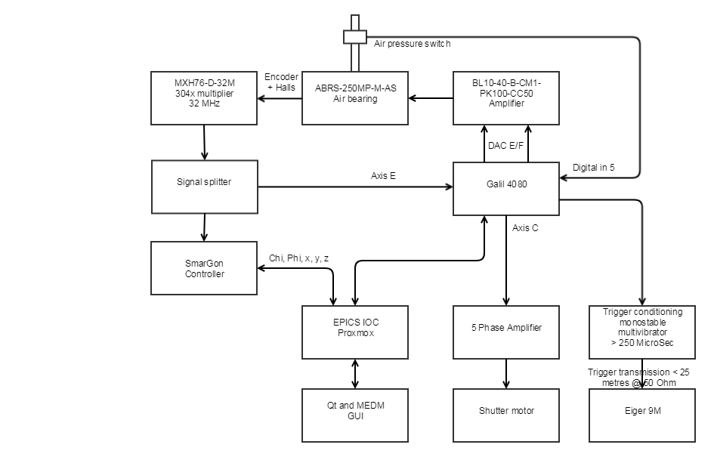
Architecture

Slide 4
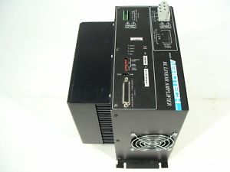
Motor system
Micro-focus beamline – smoothest possible motion required
Aerotech BL-10 linear servo amplifier

Slide 5
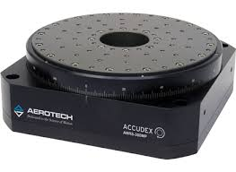
Goniometer
Air bearing is a Aerotech ABRS-250
  3 phase brushless servo
FOC commutation control (encoder based, no halls)
2 Phases are generated by the motor controller
3rd phase generated internally be the BL10
Feedback provides 9998.2 counts per degree
Air pressure enable
Drive velocity up to 180 Degree/Sec

Slide 6
Detector trigger
Software trigger available
Hardware based trigger
Position compare on controller generates trigger based on air bearing position
Monostable multi-vibrator used to generate TTL trigger pulse with maximum 1.5 KHz capability
Trigger delivered via terminated COAX transmission
Triggering determined via oscillation control

Slide 7
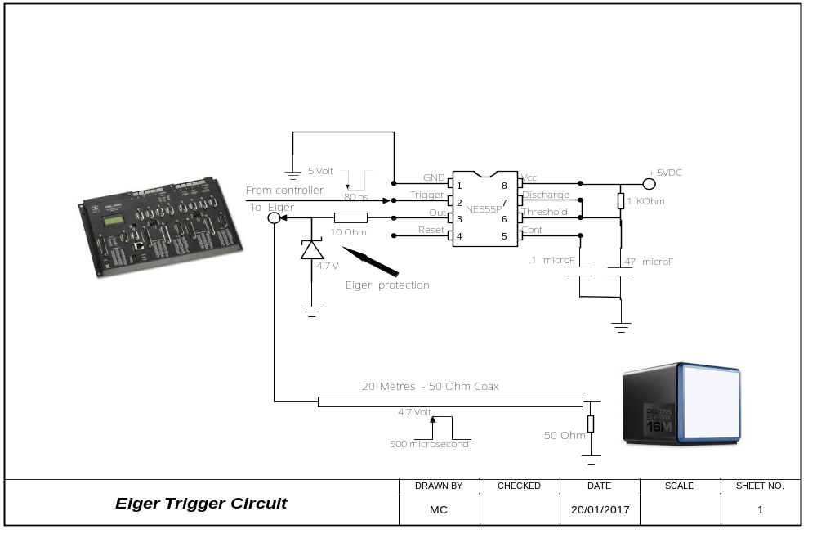
Hardware trigger
Mono stable multi-vibrator
Detector trigger

Slide 8
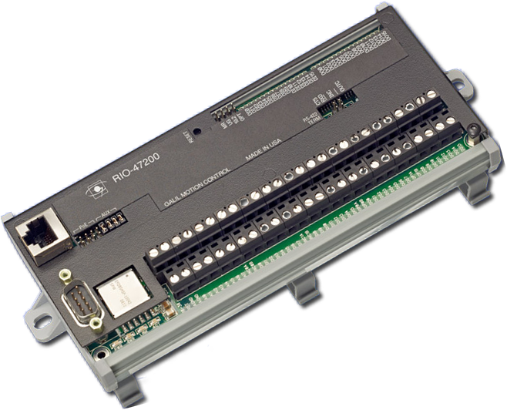
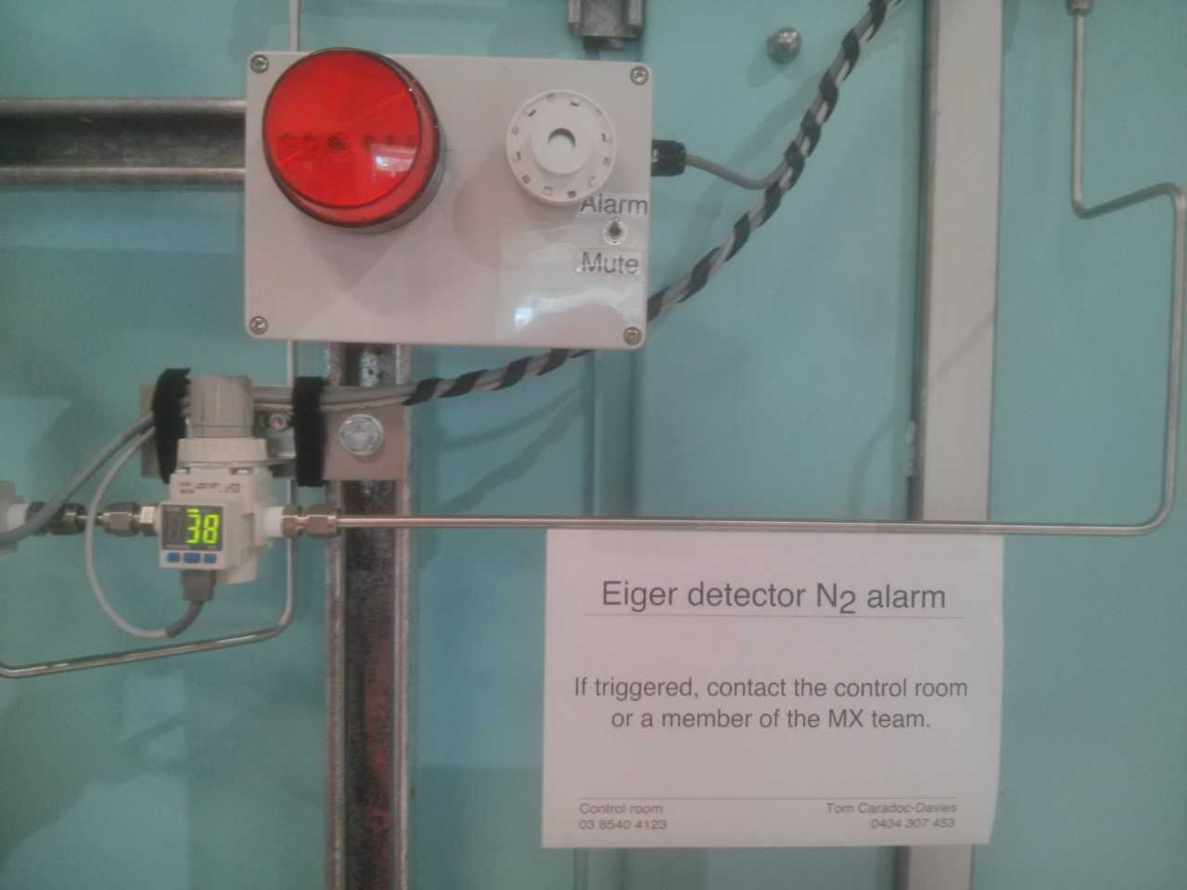
Eiger services
A PLC is used for:
  Detector cover control – Close cover only allowed when Eiger is away from goniometer – cover enable switch on A-frame
  N2 flow monitoring
  SMS alerts

Slide 9
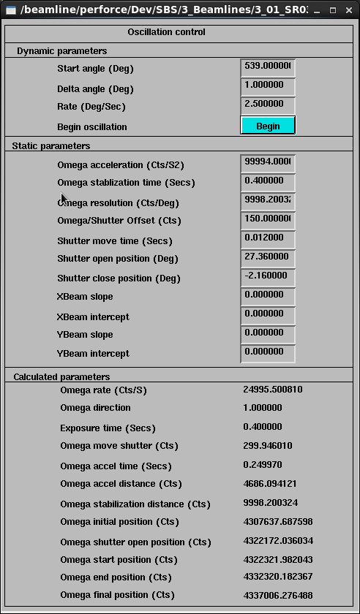
Experiment setup
Oscillation control
  Coordinates goniometer and shutter to expose user sample

Slide 10
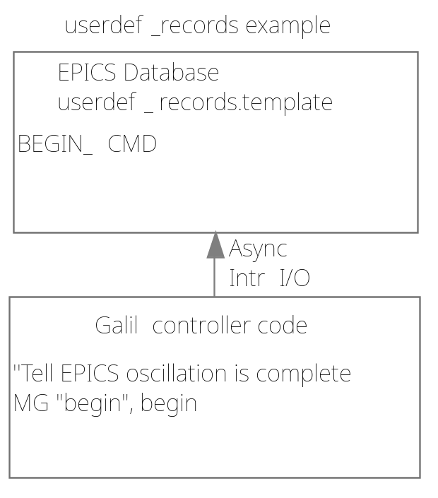
Experiment setup
Oscillation control
  Calculations in EPICS database
  Oscillation interfaces to motor system through user defined records interface (eg. oscillation begin)
    Connects records to motor controller variables
    Supports Intr I/O – good for stop notification

Slide 11
Eiger control – EPICS Layer
Computing architecture for the Eiger system:
  Detector + DCU (D.Control Unit) + EPU (E.Processing Unit)
EPICS IOC hosted on beamline PROXMOX cluster
  Implemented with areaDetector and ADEiger driver modules
  controls Detector (“low level” control) and passes data to DCU (via stream module, then further for pipeline processing to EPU)
  Higher layers incl. experiment control implemented in python
Qt screens for user experiment control
MEDM engineering screens with full detector control

Slide 12
Eiger Triggering
Manual triggering, both HW and SW triggering implemented, available from MEDM screens
Automated HW triggering used as the main experimental mode as explained on earlier slides
  the mode used is EXTSE – Externally Triggered Exposure series – One pulse initiates a series of exposures

Slide 13
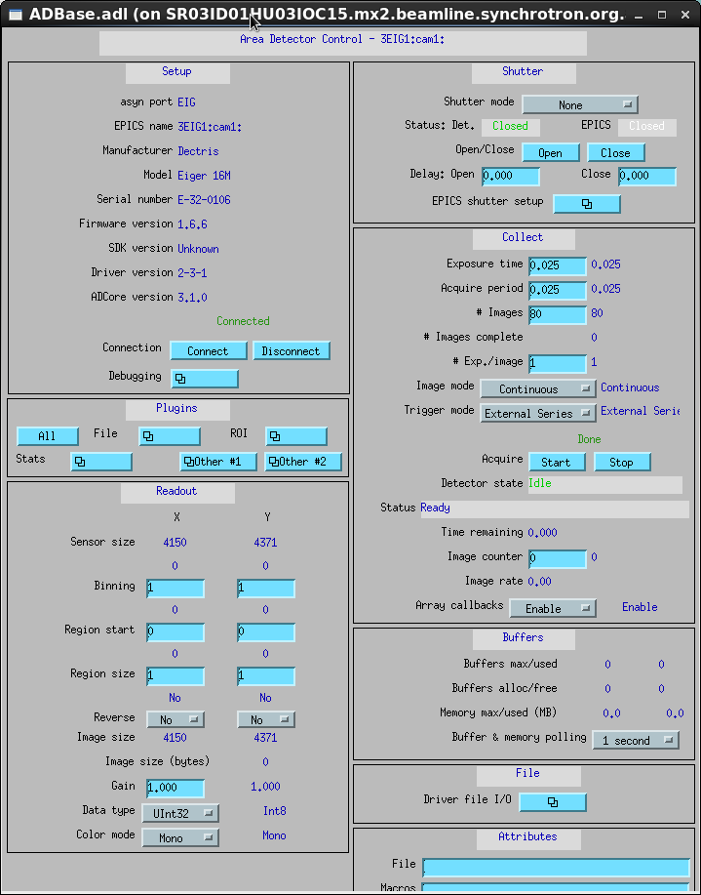
Eiger configuration

Slide 14
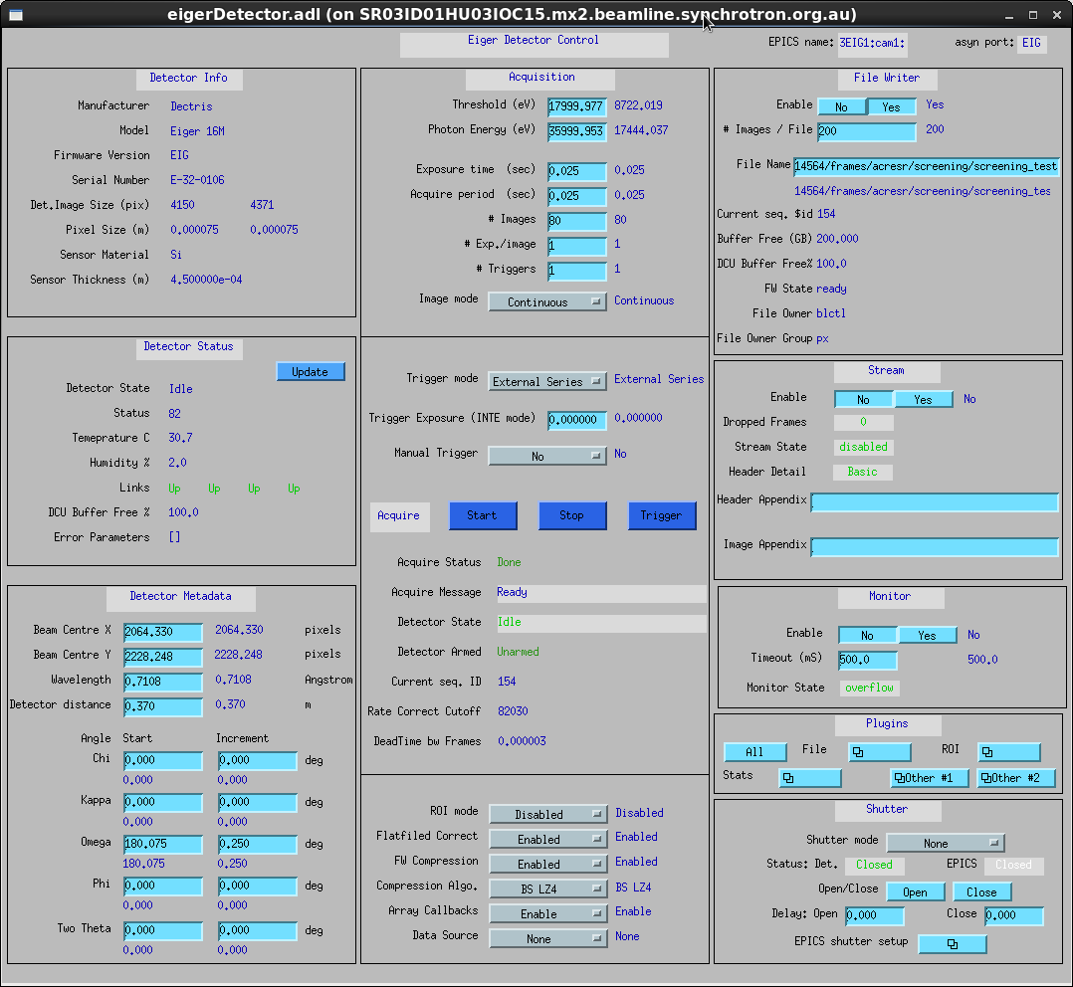
Eiger full control

Slide 15
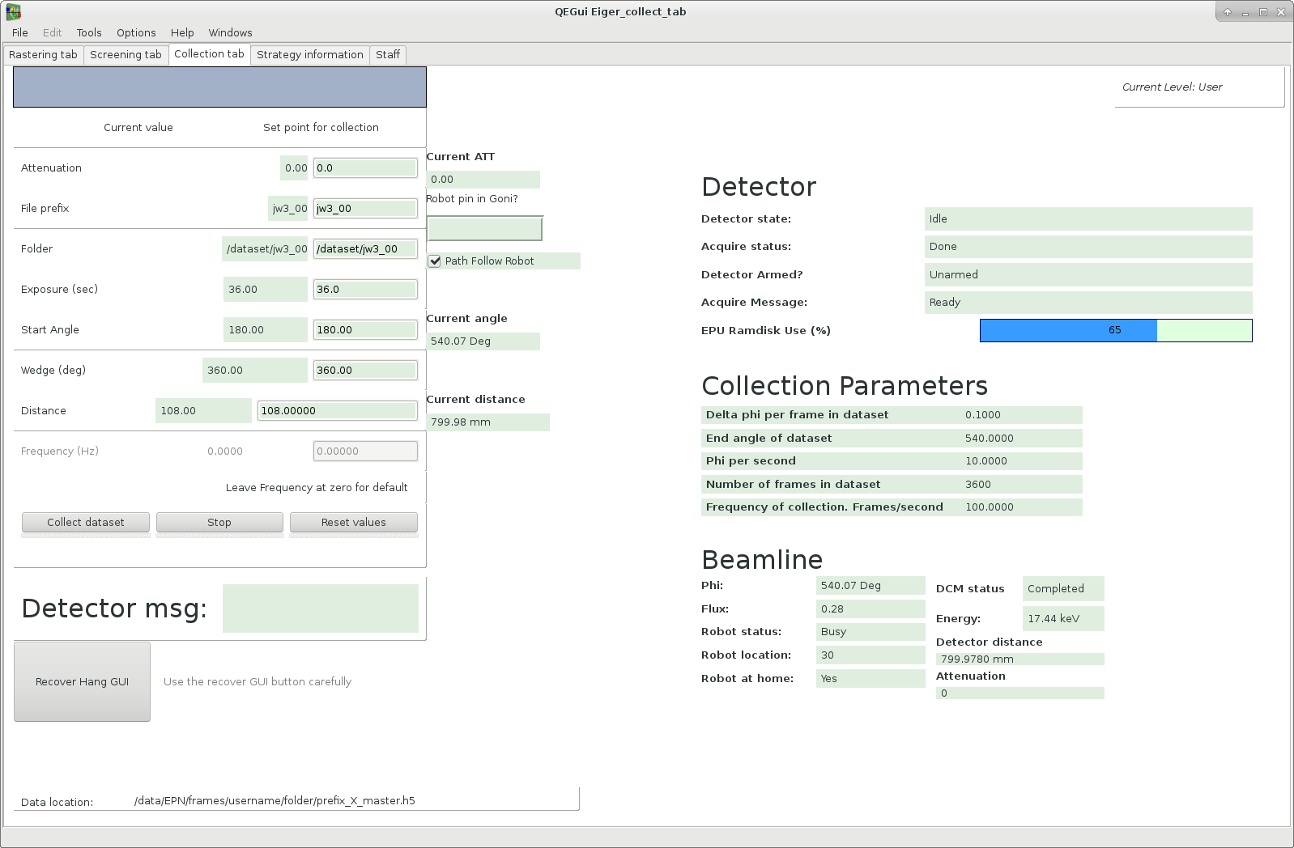
Eiger user screen

