Slide 1
EPICS-FPGA Interface Implementation
Part A
Simin Chen
Date: 12 November 2018

Slide 2
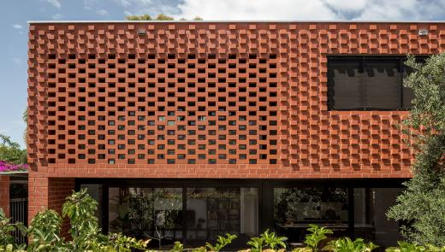
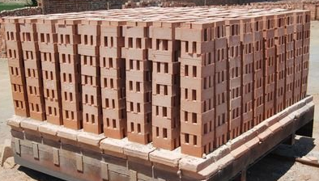
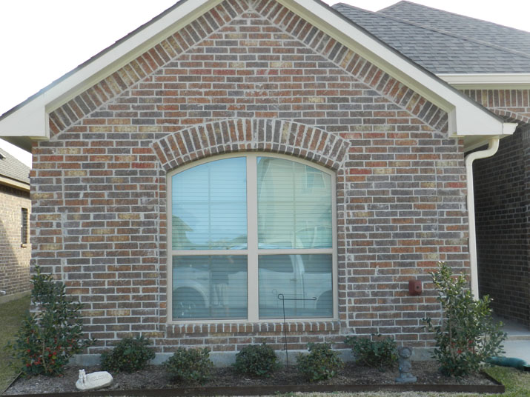
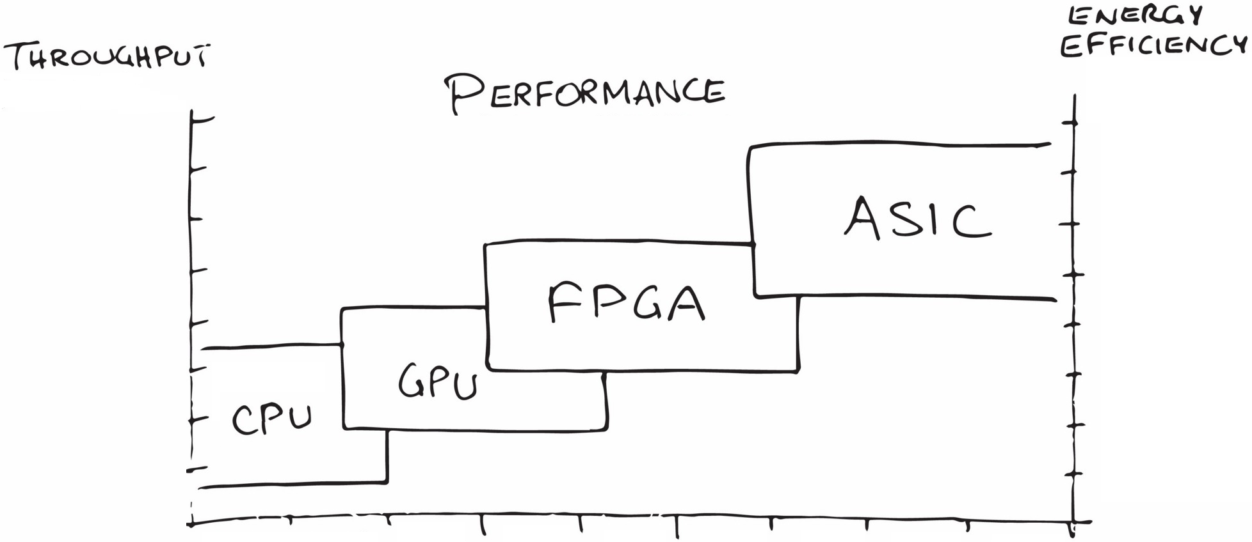
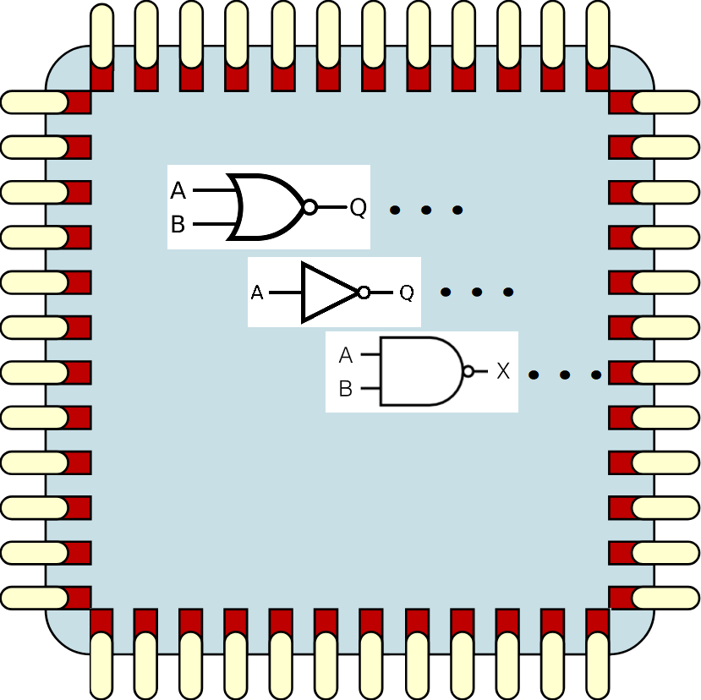
FPGA Background:
  It is not a “processor”！It does not run a program.
  It is a bulk of reconfigurable digital logic suspended in a sea of programmable inter-connects.
+ Mortar
Customer expected functionalities
Config binary
+ Programmable inter-connects
Bulk of reconfigurable
digital logics

Slide 3
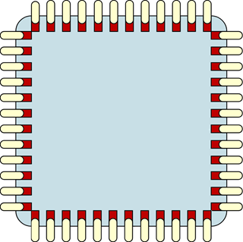
Local EPICS Interfaces:
FPGA
  IOC direct memory/register access over PCI Express bus
  Operating system assigns address span for FPGA memory/register
  High-speed DMA read/write available through particular PCIe endpoints
  IOC and FPGA in the same crate (locally)
  Used in µTCA architecture project
Register 1
Register 2
Register 3
Address bus
Register 4
Data bus
.
.
.
PCIe
IF
Register N
Local
EPICS IOC
PCI Express
Bus
Memory
block

Slide 4
Remote EPICS Interfaces:
FPGA
  Private protocol over Ethernet UDP data packets
  IOC indirect memory/register access over Ethernet connection
  The protocol interpreter bridges the private protocol and the memory/register address span
  No limitation on IOC location
  Use in the FOFB project
Register 1
Register 2
Register 3
Address bus
Register 4
Data bus
.
.
.
Eth.
IF
Protocol
interpreter
Register N
Remote
EPICS IOC
Ethernet UDP
Memory
block
Eth.
header
Protocol
header
Protocol
data payload
Ethernet payload

Slide 5
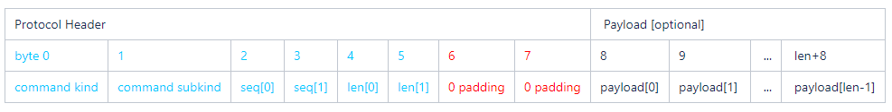
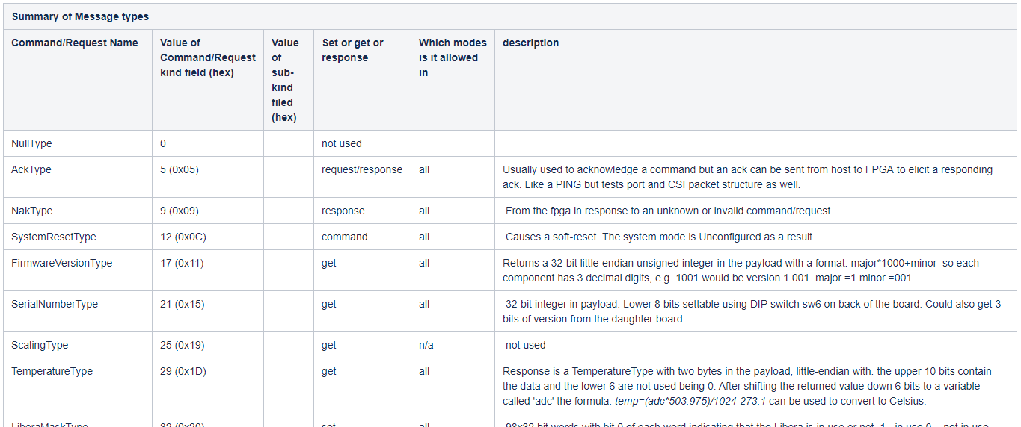
Remote EPICS Interfaces (Cont’d):

