Slide 1
Red Pitaya with EPICS
Andraz Pozar
EPICS Collaboration Meeting
Melbourne 12 – 16/11/18

Slide 2
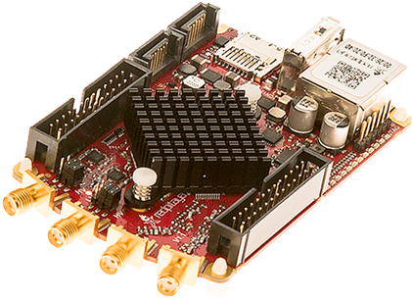
What is Red Pitaya?
“Swiss army knife for engineers” – redpitaya.com
CPU: Dual core ARM Cortex A9+ FPGA
FPGA: Xilinx Zynq 7010 SoC
I/O
  2 RF inputs and outputs with:
    Sample rate: 125 MS/s
    ADC resolution: 14 bits
    Connector type: SMA
    2 configurable voltage ranges: +-1 V or +-20 V
    Bandwidth: 50 MHz
  4 slow ADCs, 4 slow DACs
  16 digital I/Os

Slide 3
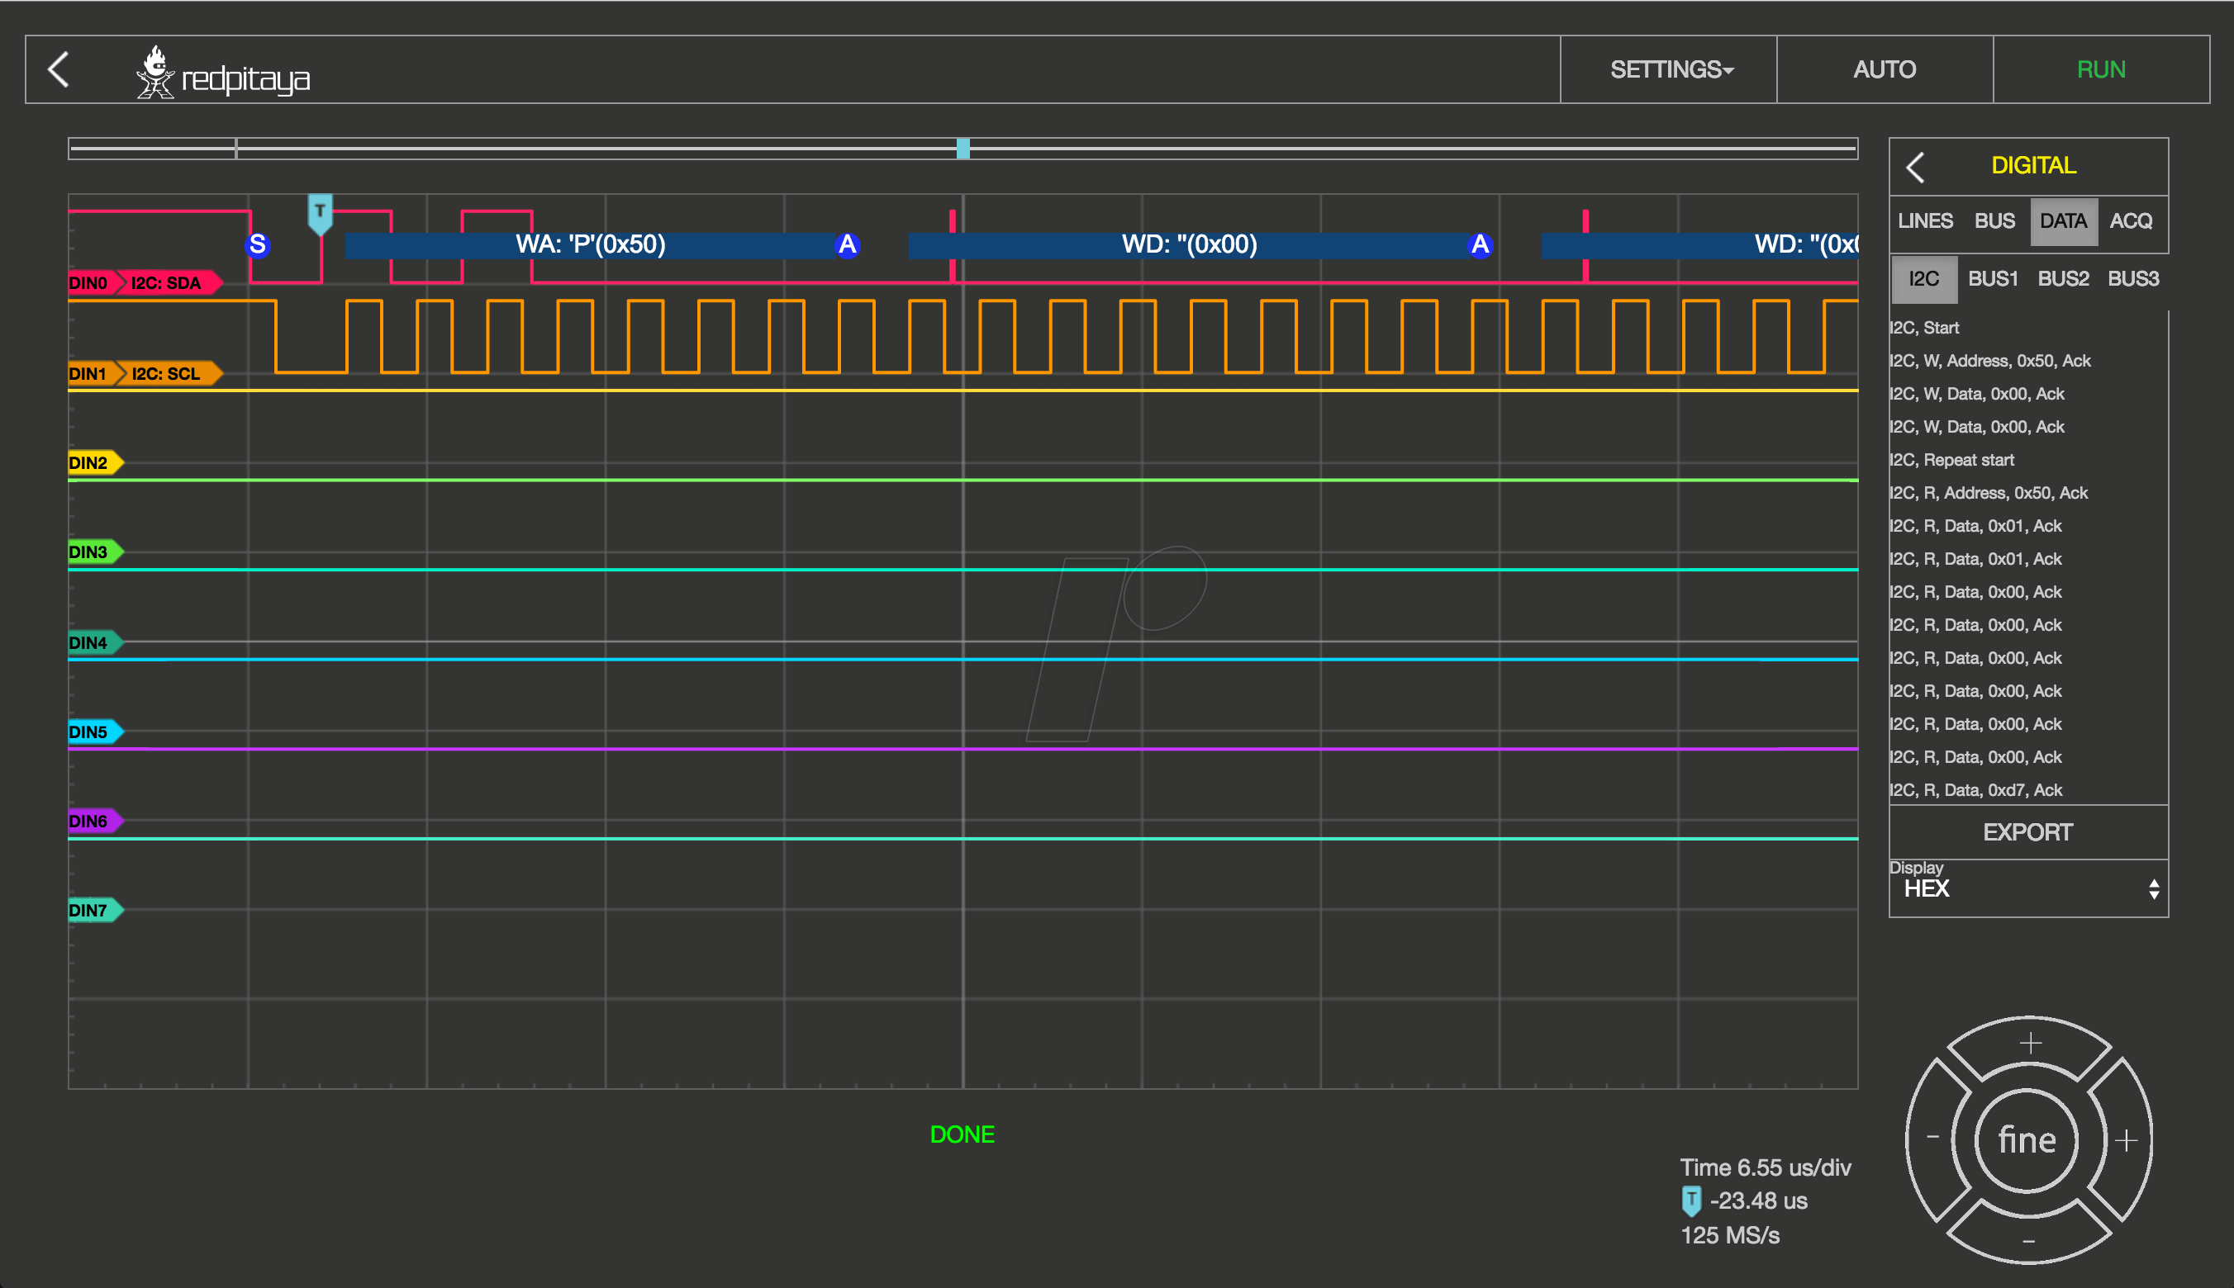
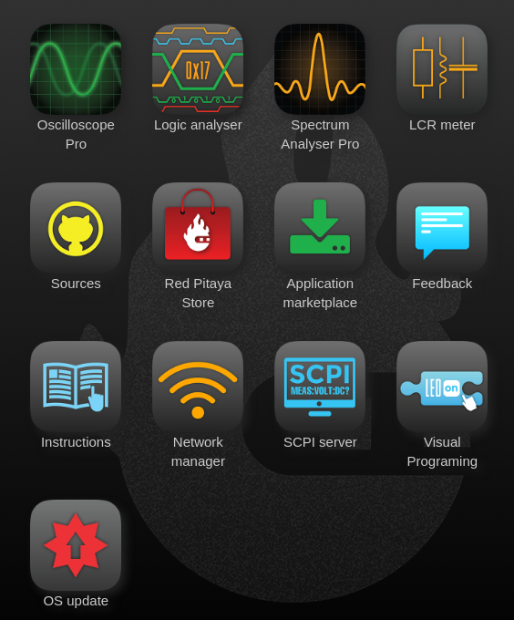
What is Red Pitaya?
Software
  Debian OS
  Shipped with a suite of tools available via website. Web server is hosted on Red Pitaya
  SCPI server (avoid)

Slide 4
What Red Pitaya Isn’t!
Developed to be used in industrial environment. It is sold as an electronics enthusiast toolbox
  Uses SD card for the OS image
  Realistically 12 bit ADC resolution at higher sampling rates
  Not sure about radiation resilience
  Quite a few bugs in the API
  SCPI interface has (had) misleading documentation and is (was) in general broken

Slide 5
When in doubt, write your own!

Slide 6
Red Pitaya asyn port driver - acquisition
Fast inputs
  16354 elements per channel in a waveform
  Trigger sources:
    Soft
    Threshold on one of the fast input channels
    External 3.3 V
  Acquisition modes:
    Single shot
    Continuous
  Acquisition setup:
    Decimation
    Sampling rates
    Averaging

Slide 7
Red Pitaya asyn port driver - generation
Fast outputs
  16354 elements per channel in a waveform
  Trigger sources:
    Soft, external 3.3 V
  Generated signal characteristics:
    Amplitude, offset, frequency, phase
  Generated signal types:
    Standard stuff (square, sine, triangle, ramp, …)
    Arbitrary
  Acquisition modes:
    Burst
      Configurable number of signal repetitions in one burst
      Configurable number of burst repetitions
      Configurable duration of one burst
    Continuous

Slide 8
Building the IOC
Can be built on the Red Pitaya itself (faster with cooling shield)
  20 minutes for EPICS base
  5 minutes for asyn
  1 minute for the IOC
Cross compile
  We use this option for our production environment
  Instructions on how to do it are no github (link on the last slide)

Slide 9
Running the IOC
SCPI service needs to be turned off
NGINX service needs to be turned off or you get funny behavior
FPGA image needs to be loaded before the IOC is started
Standard EPICS environment variables need to be set up
IOC needs to be run as root

Slide 10
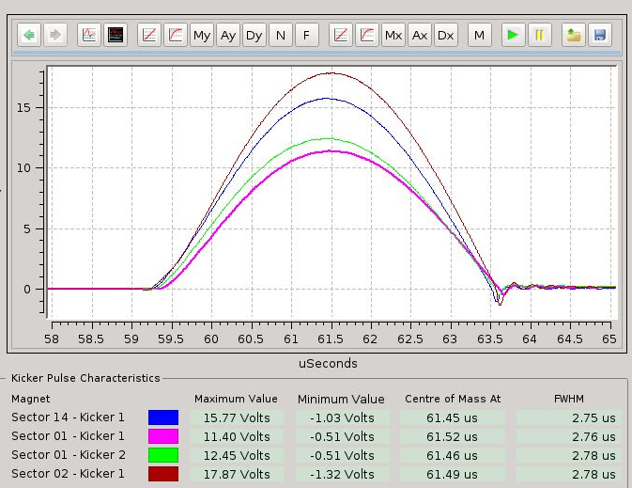
Usage at the AS
As a data acquisition device:
  We use it to monitor pulse profiles of booster to storage ring kicker magnets
As a signal generator:
  It generates a custom waveform used to ramp up the booster RF.
  We utilize the burst option to generate 16k signal point ramp once a second

Slide 11
Conclusion
Decent little board with a nice array of I/O
Cheap: 320 EUR
Seems to be very reliable once you hack your way around the API
Bear in mind that it was not meant to be used in industrial environment. With that in mind, the driver is only tested on one version of the firmware and I’m afraid to test it on anything else ☺
Code: https://github.com/AustralianSynchrotron/redpitaya-epics
Pull requests and issues are welcome and encouraged

Slide 12
Thank you

