Slide 1
Medical Imaging Detectors:
3 detectors of interest.
Date: 14 November 2018

Slide 2
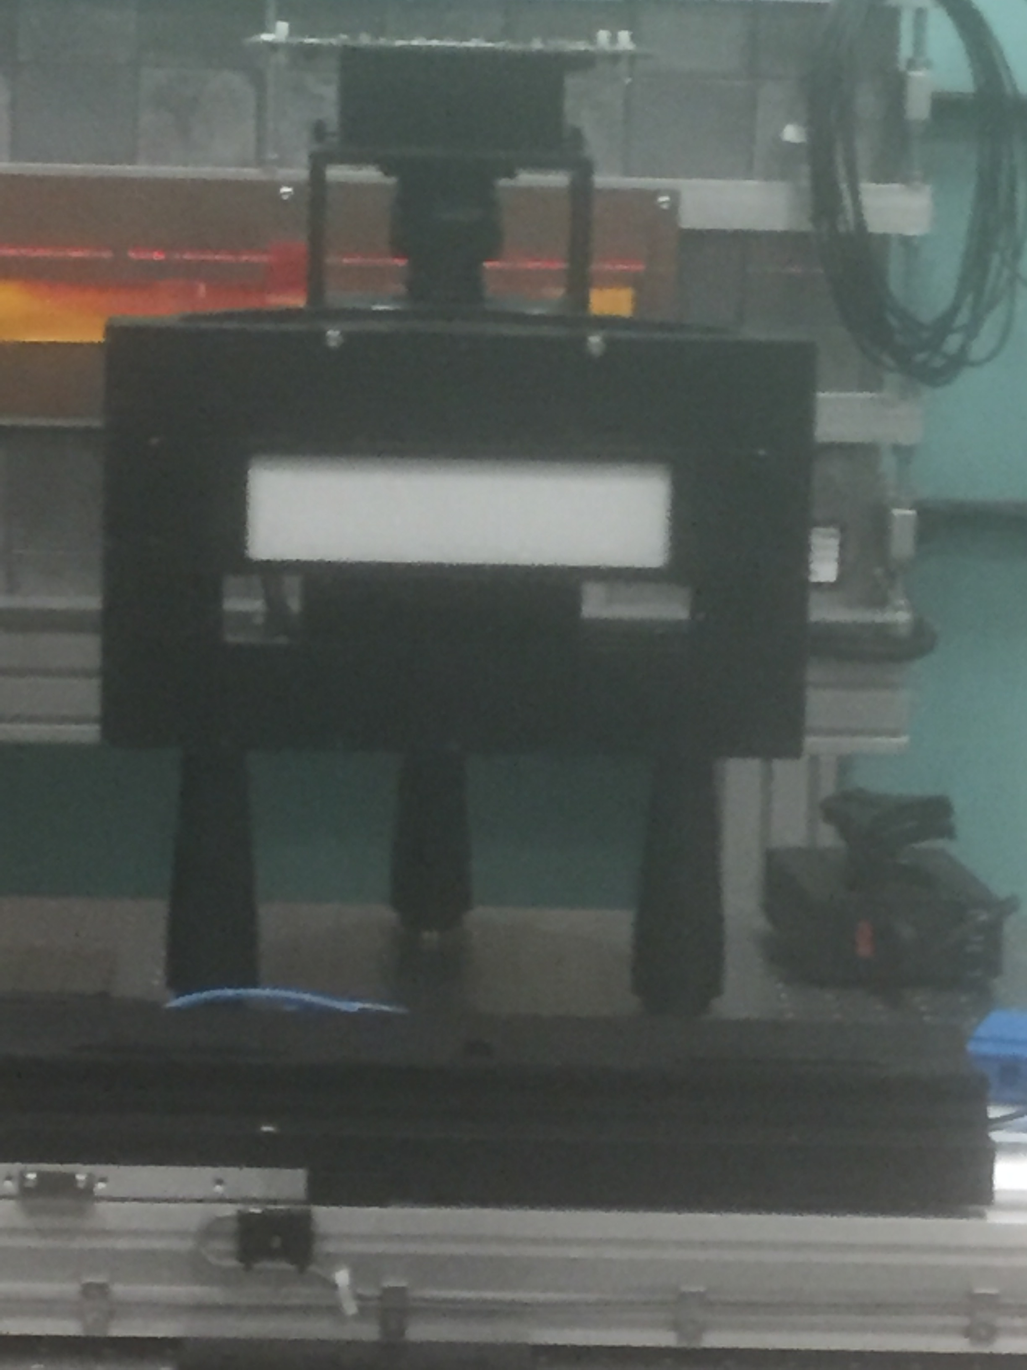
Gpixel GMAX 1205
Purpose: Large object scanning
Interface: NI PCIe frame grabber - Cameralink
OS: Windows
Frame Rate: 10 fps
Pixel Size: 5.5 uM
Image size: 12000 x 4996 pixels

Slide 3
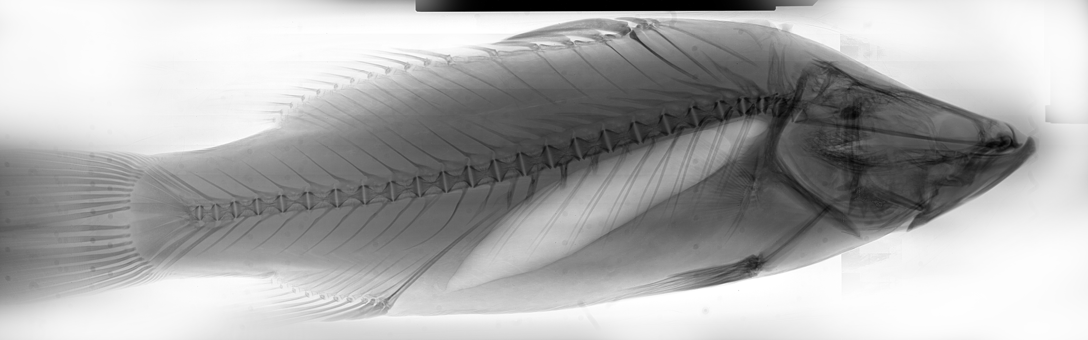
GMAX Sample Image - Barramundi

Slide 4
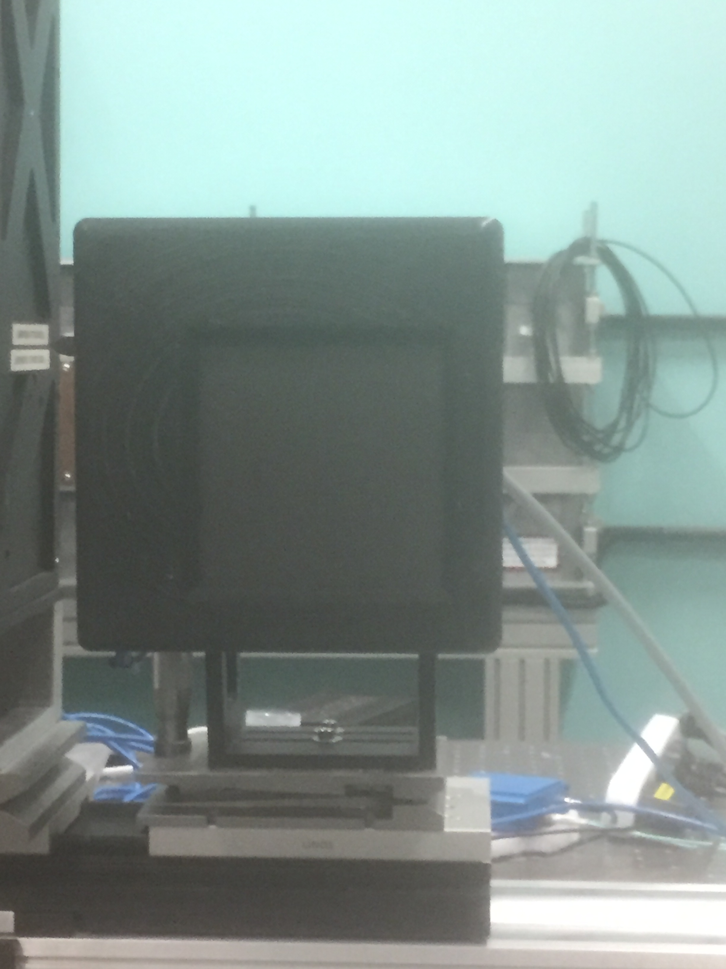
Hamamatsu C10900D
Purpose: CT Imaging
Interface: GigE
OS: Windows
Frame Rate: 16 fps
Pixel Size: 100uM
Image size: 1248 x 1248 pixels
Images/CT scan: 5400

Slide 5
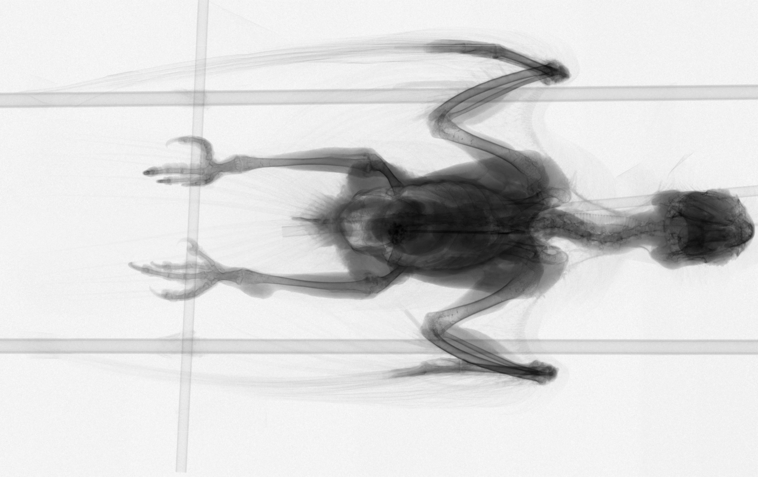
Hamamatsu Sample Image - Galah

Slide 6
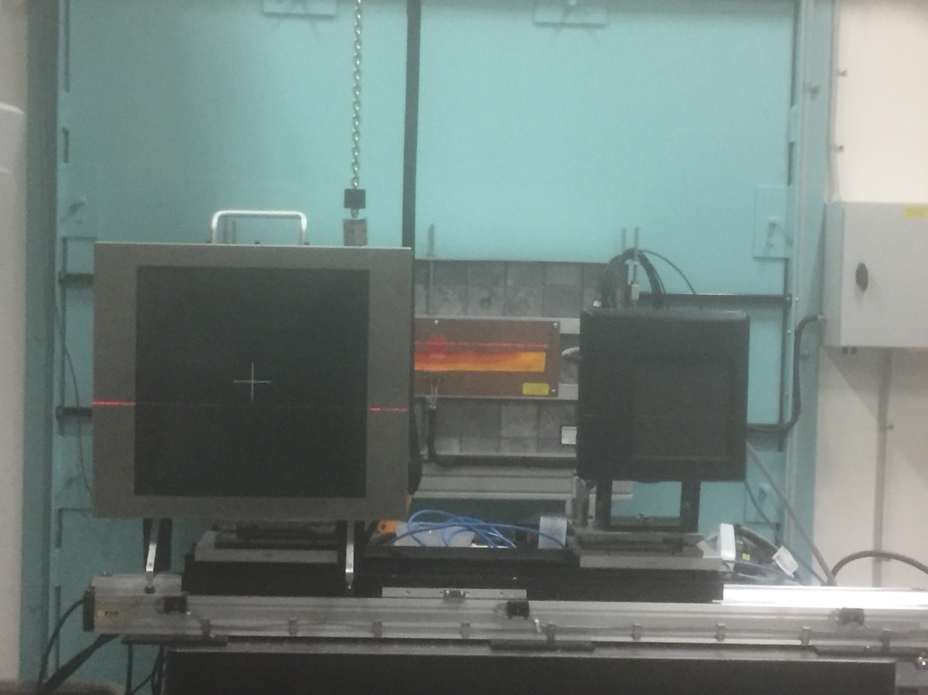
Teledyne Dalsa Xineos-3030HR
Purpose: CT Imaging
Interface: PCIe frame grabber
Cameralink
OS: Windows
Frame Rate: 30 fps
Pixel Size: 100uM
Image size: 30 x 30 cm
2994 x 2997 pixels
17.6 Mb tiff file size
Images/CT scan: 10125
Scan size: 178.2 Gb

Slide 7
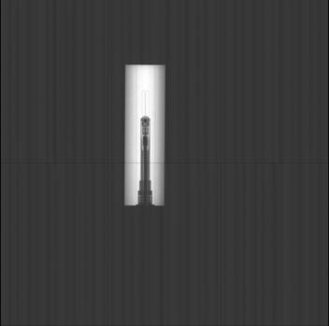

1st Xineos Images
Single Raw Image Noise Image – no illumination

Slide 8
Ongoing Activities
EPICS Area Detector Standardisation
Visual Studio Area Detector project
Xineos Area Detector development
NDArray buffering issues investigation
  image memory allocation and release
  PC hardware upgrade: capability to store a complete CT scan in RAM

Slide 9
Thank you.

