Slide 1
Standardisation of
BRIGHT Beamline Control Systems
EPICS Collaboration Meeting 2018
William Rambold

Slide 2
Overview
Brief look at the state of our current control systems
A glimpse into the BRIGHT future
How we are preparing for it
What we have done so far
What we still have to do
Where to get more information
Conclusion

Slide 3
Where We Are Now
Control system hardware is diverse and aging
  Machine and 8 currently operating beamlines delivered as Turnkey Systems
  Control components and controllers chosen by suppliers
  Subsequent modifications developed as independent projects
EPICS implementations developed independently
  Initial EPICS systems delivered by suppliers
  Beamline EPICS architectures have grown organically over time
  Documentation is often inaccurate or missing
Current challenges:
  Control hardware is aging and becoming more difficult to maintain
  Maintain expertise each type of device controller and hardware platform
  Maintain expertise in each beamline EPICS architecture
  Increasing operational support load

Slide 4
Where We Are Going
BRIGHT programme:
  Will increase number of beamlines from 8 to 16 (plans in place for more)
  Two new beamline projects will start each year
  Control systems for all new beamlines will be designed and developed in–house
Refurbishment programme:
  Replace aging control systems
  Reduce number of different controllers
  Refurbishment to be done without affecting operations
Workload:
  Currently stretched maintaining existing systems
  New term positions will be added during BRIGHT construction phase
  Hard to recruit experienced controls/EPICS engineers - time and effort needed to train
Looks like a recipe for disaster!

Slide 5
Opportunities for Improvement
Lessons learned (by us and other facilities) -
  Reduce number of hardware component types (motors, encoders, etc.)
  Define clear interface and cabling standards
  Reduce number of controller types (motion, I/O, etc.)
  Use a common EPICS control architecture
  Develop a common design and development processes
  Develop template documents to improve documentation
  Encourage external suppliers to conform with our new paradigm
In one word -
  STANDARDISE! (or STANDARDIZE if you are from the Americas)

Slide 6
Approach
Back to basics – re-think the way we do things
Define common control system standards:
  Component, controller, and interface standards
  Separate device control and experiment control functions
  Create a generic control system architecture
  Develop standard IOCs from templates
Create standard processes and supporting tools
  Design and Development process
  Vendor interaction model
  System Breakdown Structure to create control systems
  Test and development platform to pre-configure controllers

Slide 7
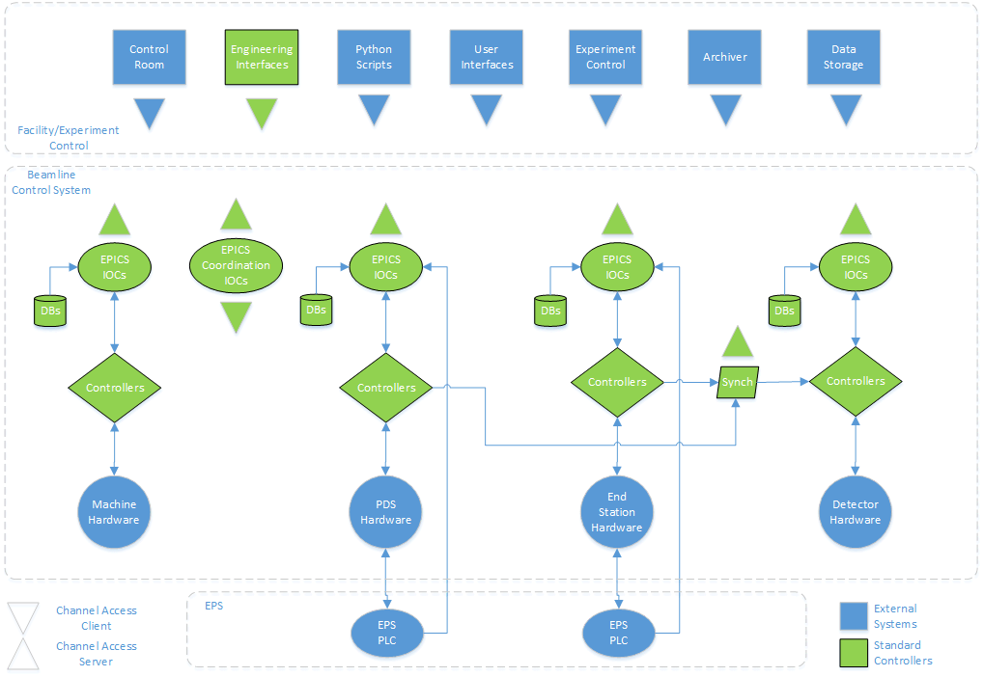
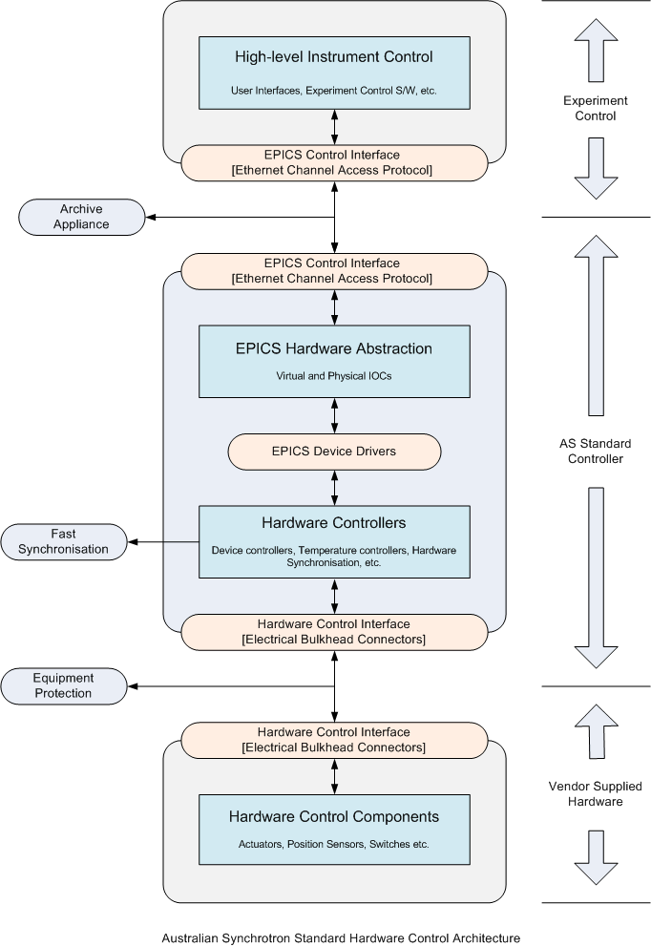
Standard Architecture

Slide 8
Where We Are Now
Control hardware component standards complete
Basic control hardware interface standards complete
Standard motion controller selection complete
Standard data acquisition controllers in requirements phase
Standard control system in design phase
System Breakdown Structure in requirements phase
Test and development platform in procurement phase
Design and development process nearing completion
Vendor interaction model complete

Slide 9
For more details
Conference Talks
  Tomorrow – A process for developing beamline controllers at the Australian Synchrotron
  Friday – A model for developing control systems for vendor suppled beamlines
  Friday – Lightflow – a lightweight, distributed workflow system
  Friday – Control Breakdown Structure and Framework
Or, best of all … talk to us, we welcome you input!

Slide 10
Conclusion
The BRIGHT programme has been a blessing in disguise
  Opportunity to develop a new development paradigm
We could not have done it alone
  Generous support from other facilities
  Full support from senior management – time and resources
  Thank You For Your Attention

