Slide 1
A Process for Developing Beamline Controllers at the
Australian Synchrotron
EPICS Collaboration Meeting 2018
William Rambold

Slide 2
Overview
Introduction
Review of standard architecture
Beamline design and development timeline
Component vs Beamline control
Beamline Control System development Process
What we have done so far
Conclusion

Slide 3
Background
BRIGHT programme drivers
  Eight new beamlines, two per year
  All control systems to be designed and developed in-house
Standardisation efforts
  Standardise control systems as much as possible
  Use standard components and interfaces
  Develop standard IOCs and configurations
  Separate hardware control and experiment control
Still need a process to rapidly develop control systems

Slide 4
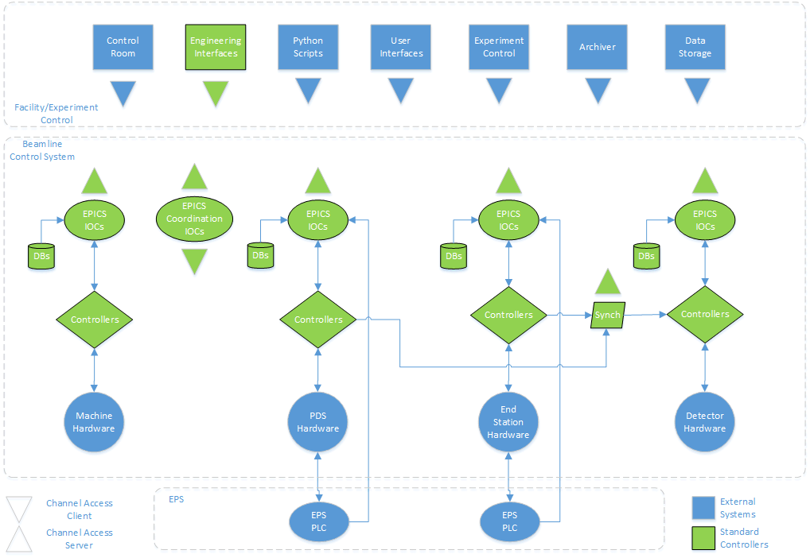
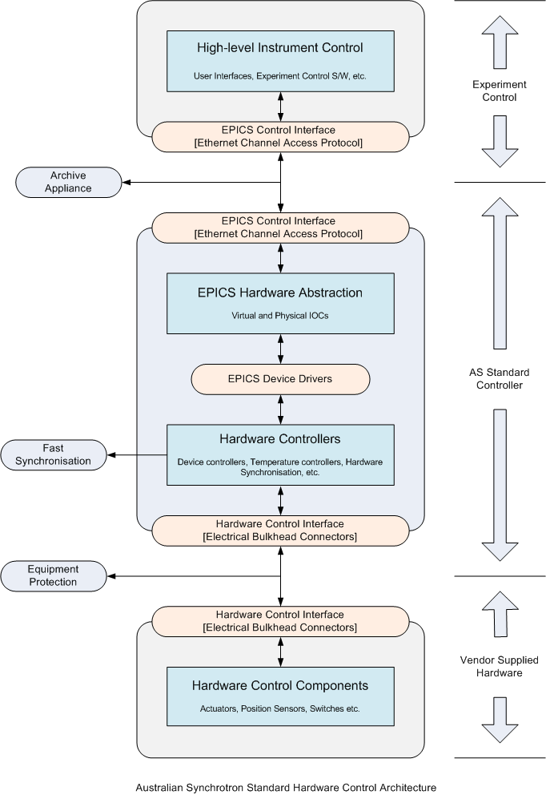
Standard Architecture

Slide 5
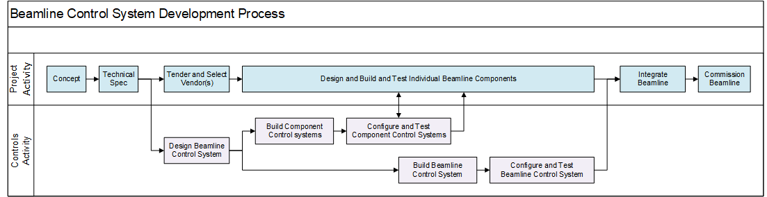
Design and Development Timeline
Basic Component Control Systems are constructed and shipped to equipment supplier for integration and testing
Beamline control system prepared and tested using simulators
Component Control Systems are integrated into overall Beamline Control System when equipment is delivered

Slide 6
Controller Components
Component Control System
  Hardware, software and UIs necessary for external supplier AI&T
  Produced quickly so as not to hold up supplier
  Configured to support beamline hardware before shipping
Beamline Control System
  Component Control System devices (simulated until equipment arrives)
  Controllers for other hardware not supplied by vendors
  Equipment Protection System interfaces
  Support services - archiving, autosave, etc.
  EPICS level coordination and hardware synchronisation if required
  Standard rack and layout

Slide 7
Controller Development Support Tools
Template Control System
  Based on new Standard Controller design
  Provides at least one instance of each standard device controller
  Provides signal breakouts for tuning and debugging
  Implements standard software and user interfaces
Development Platform
  Optical table with dedicated stages, motors, encoders, sensors, metrology, etc.
  Provides all standard preferred components
  Provides standard interfaces simulate externally supplied equipment
  Used to configure Component Controllers and prototype new applications
System Breakdown Structure database
  Captures beamline configuration for auto-generation of IOCs and UIs from templates

Slide 8
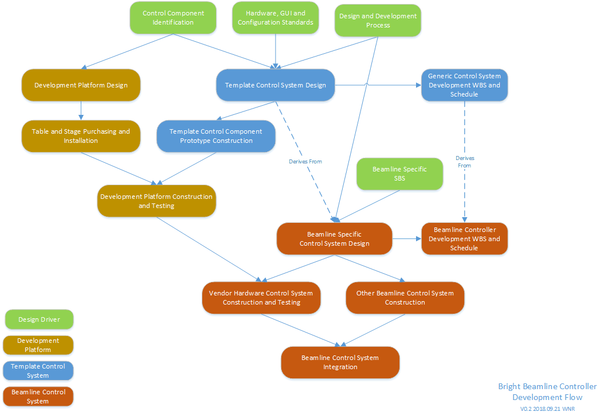
Controller Development Process

Slide 9
Current Status
User scenarios and requirements complete
Standard components and basic interfaces defined
Motion Control standards defined
Data Acquisition standards being developed
Standard test plans in design phase
Template controller hardware and software in design phase
Development platform hardware in procurement phase
Funding and resources secured to complete this work

Slide 10
Conclusion
Standardisation will help to make the rapid development of beamline control systems possible
A robust production process is required to ensure that standard controllers can be delivered to meet supplier and beamline schedules
A process has been developed and the tools needed to support this process will be complete in time to satisfy the first beamline
The process and supporting tools will be tested and refined on the first two beamline builds scheduled for next year
Thank You For Your Attention

