Slide 1
A Model For Developing Control Systems for Vendor Supplied Beamlines
Epics Collaboraton Meeting 2018
William Rambold

Slide 2
Overview
Objectives
Development Model
Project Startup and Design Phases
Construction and Delivery Phases
Pros and Cons
Conclusion

Slide 3
Objectives
In-house build philosophy
  Maximise the standardisation of new beamlines
  Reduce risk of problems at integration
  Reduce vendor costs by providing equipment and expertise
Interaction model
  Define the roles and responsibilities of supplier and vendor
  Clarify expectations on both sides
  Reassure vendors that this has been thought through

Slide 4
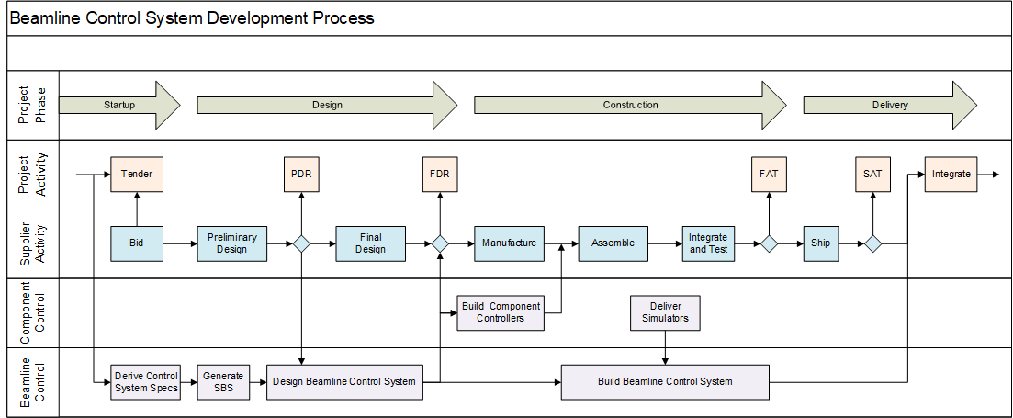
Beamline Controller Development Model

Slide 5
Startup Phase
Lead Controls Engineer (LCE) assigned to project management team:
  Reviews beamline conceptual design
  Assists in developing technical specifications
  Assists in developing tender documents
  Assists in evaluating tender responses
  Monitors and assists vendors during design and construction
  Coordinates and manages Beamline Control System development
Ensures that controls related issues are considered throughout the full project lifecycle from concept through commissioning
Acts as single point of contact for all controls related issues
Works with vendors to help them understand our standards and processes
Ensures that the standard design and development process is followed

Slide 6
Design Phase
Control system specifications are derived from the beamline Technical Specification Report
Specifications converted to a System Breakdown Structure (SBS)
SBS used to start beamline control system design process
In parallel, vendors start their design processes
LCE works with vendors to maximise use of our standards in their design
Vendor preliminary designs used to complete control system design
Vendor and Control System design reviewed together at FDR

Slide 7
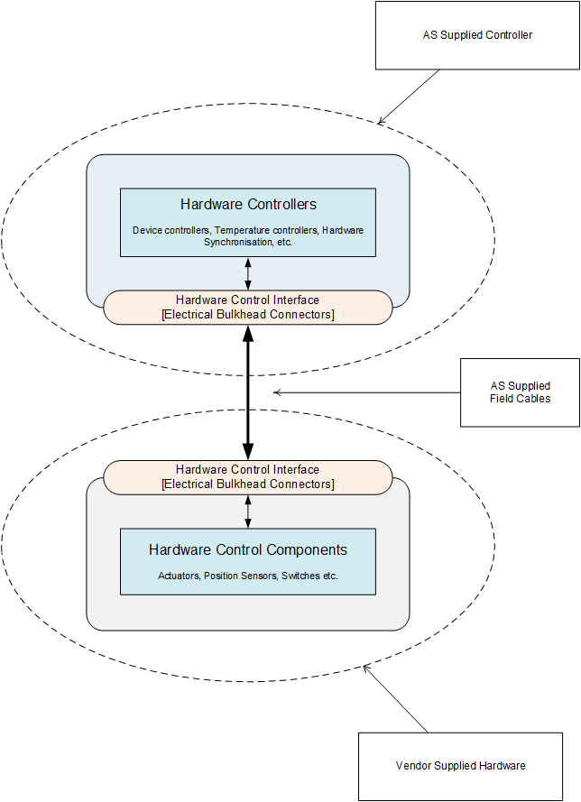
Component Controller
Device controllers for control components supplied by vendor, configured for vendor applications
Component control IOC with EPICS support for vendor supplied components
Standard engineering interfaces
Acceptance Test and Engineering User Interface (ATEUI) for overall equipment control.
Field cables with standard interfaces
Packaged in rack and shipped to vendor

Slide 8
Vendor Assembly, Integration and Test
We provide vendor with support in the setup and use of Component Controller and User Interfaces
Vendor uses the Component Controller for assembly, integration and test of their equipment
We assist in final configuring and tuning of stages, and implementing any required kinematic algorithms or programs in the controllers
Final acceptance tests performed using Component Controller
Component Controller returned with equipment after FAT
During this time AS builds and installs the Beamline Control System

Slide 9
Delivery Phase
Component Controller returns with equipment from vendor
Used to perform Site Acceptance Test of equipment
Hardware controllers are then removed from Component Controller and integrated into Beamline Control racks
EPICS code integrated into Beamline Control System, replacing simulators used for development
Subsequent beamline testing and commissioning and acceptance are done with Beamline Control System

Slide 10
Pros and Cons
Pros
  Increased standardisation of beamline control systems
  Reduced risk of delays and rework on delivery
  Familiarity with equipment before it arrives
Cons
  Assumes that vendors are willing to adopt our standards
  Assumes that vendors are willing to use our hardware
  Requires more support effort and travel on our part
  Many control systems to be developed concurrently

Slide 11
Conclusion
A model for interacting with vendors has been developed that addresses the need for beamline standardisation
Early drafts of model have been reviewed by potential vendors with mostly positive results
First Request for Tenders released this month – willingness of vendors to follow this model yet to be seen
Fall back strategies will be required to manage vendor non-conformance
Keeping or fingers crossed!

