Slide 1
Lightflow a lightweight, distributed workflow system
Andreas Moll

Slide 2
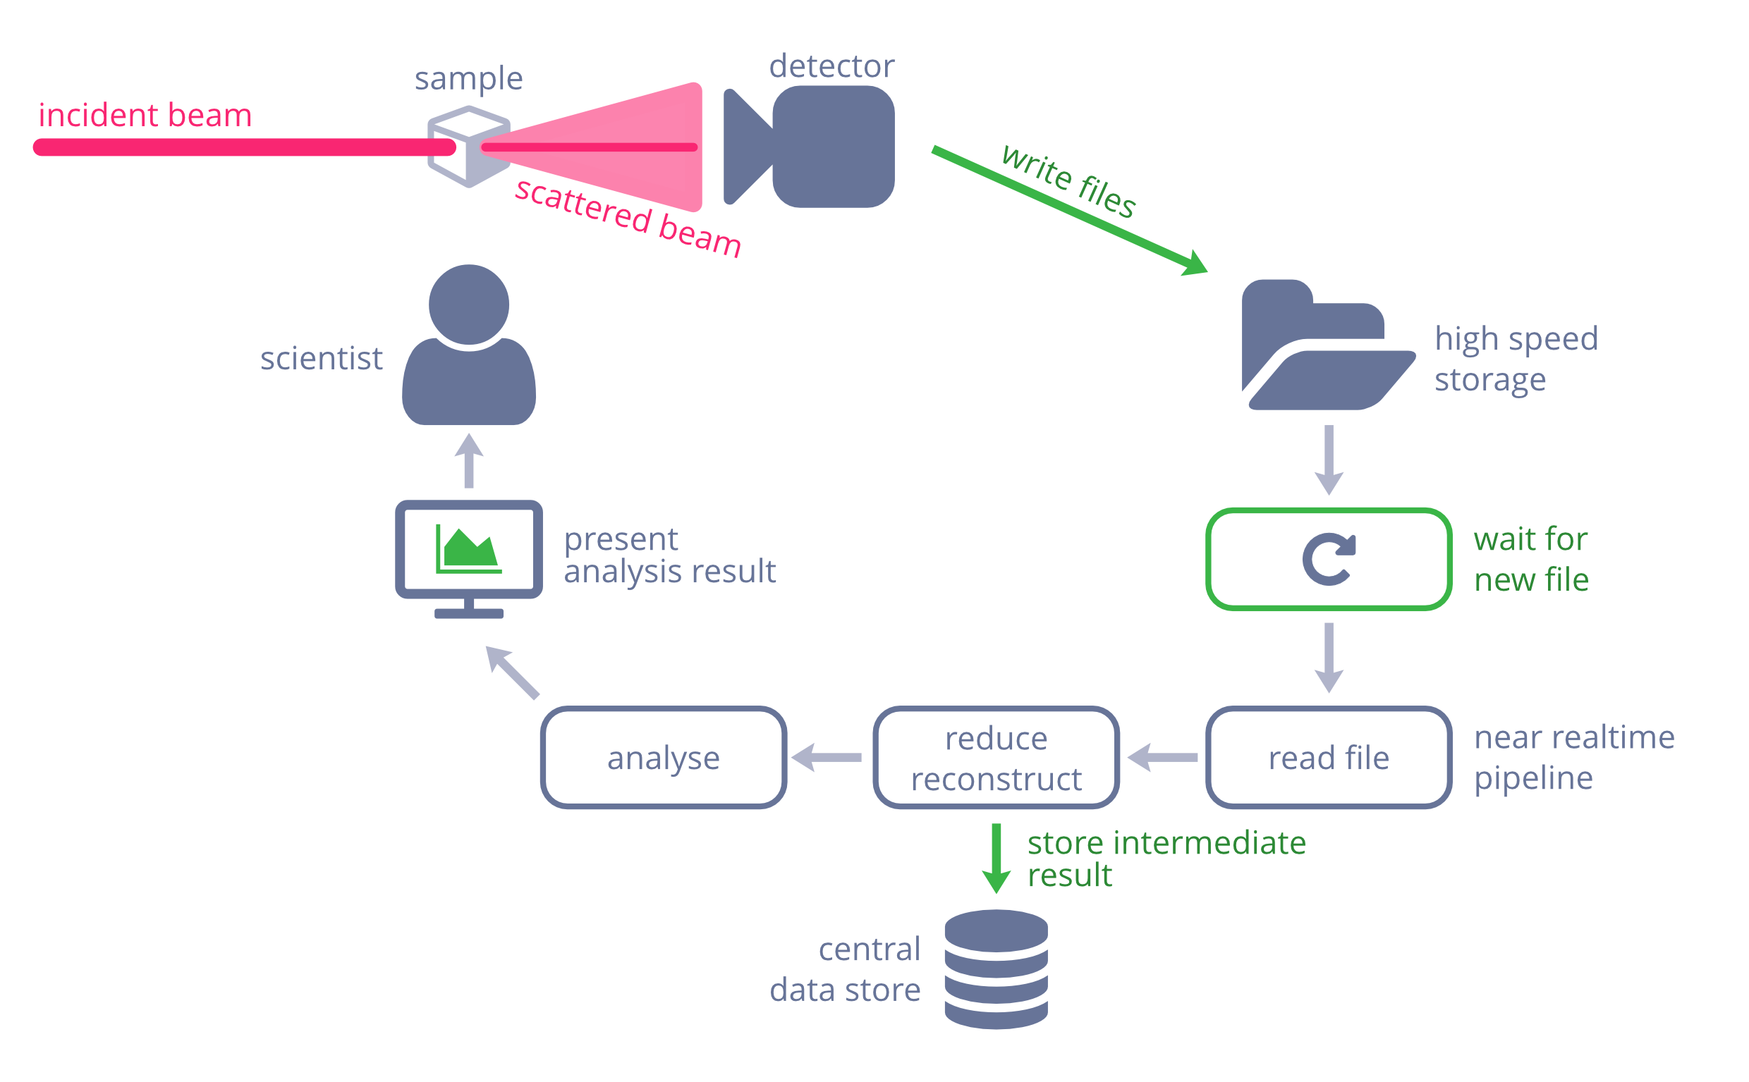
Near realtime feedback
service-like part
watch for file changes
pipeline-like part
task dependencies
exchange data
keep data from prev runs

Slide 3



Wishlist
Python 3.5+
Few dependencies
Infrastructure independent
Basics
Dependencies between tasks
Exchange data between task
Runs locally with minimal effort
Can scale to run on a computing cluster
Workflows are easy to describe
Central store for workflow run data
Essentials
Bonus points
Use facility library/database stack

Slide 4







So many excellent options
There are many excellent workflow systems and tools available
Scientific workflow systems
Examples: Apache Taverna, Discovery Net, Kepler, EDNA, Workspace, Cylc, …
Domain specific systems
Examples: Galaxy, Ruffus, Dpdak, UFO, Savu, Fireworks, …
ETL (Extract Transform Load)
Examples: Airflow, Luigi, Pinball
some came really close to be a match
one (or more) showstoppers for each of them

Slide 5
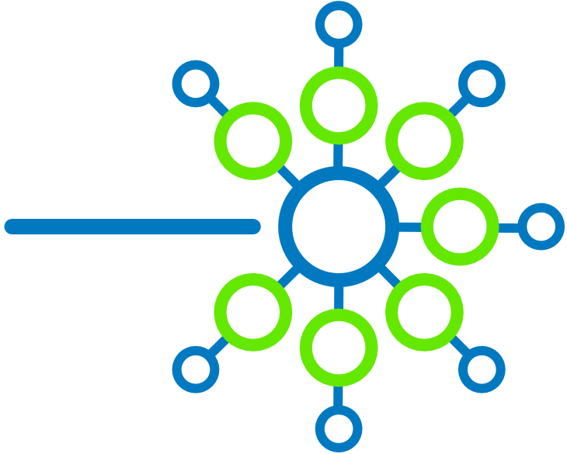
We had a crack at it
Use existing Python libraries
Be inspired by all the other excellent workflow systems
Write minimal code to glue existing libraries together
Lightflow
Directed Acyclic Graph
Python workflow description
Use your favourite libraries
NetworkX
Python standard collections
Workflow description
Infrastructure
worker based
serialise data for network transport
Celery
cloudpickle
Linux
redis
MongoDB
Distributed

Slide 6
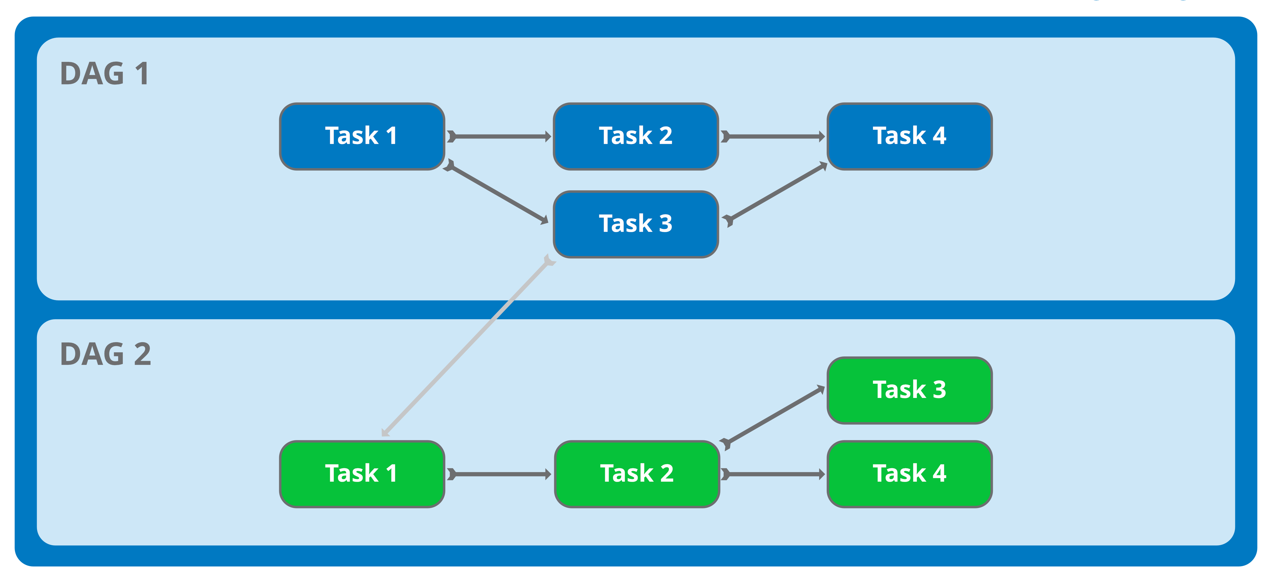
Workflow schematic
Workflow

Slide 7
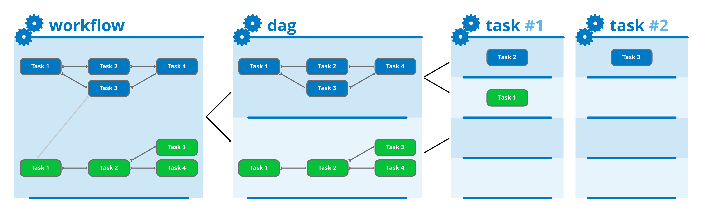
System Architecture
[Worker]
[Worker]
[Worker]
[Worker]
No central daemon
Easy to scale
distributed computing
is hard. Use existing
tools/infrastructure

Slide 8
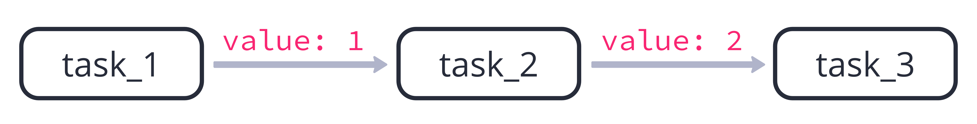
Sequence: Increase a number
Workflows are defined in Python
Can be a single or multiple files
Graph edges described using a dictionary
key: value parent: child
Simple example: increase a number
d = Dag('main_dag')
d.define({
task_1: task_2,
task_2: task_3
})

Slide 9
PythonTask – all you need
d.define({
task_1: task_2,
task_2: task_3
})
name of task instance
task_1 = PythonTask(name='task_1', callback=inc_number)
function (or any other callable)
defines task logic

Slide 10
PythonTask – all you need
task_1 = PythonTask(name='task_1', callback=inc_number)
exchange data
inter-task messages
def inc_number(data, store, signal, context)
central data store
task context

Slide 11
Increase a number task logic
task_1 = PythonTask(name='task_1', callback=inc_number)
task_2 = PythonTask(name='task_2', callback=inc_number)
task_3 = PythonTask(name='task_3', callback=inc_number)
def inc_number(data, store, signal, context):
if 'value' not in data:
data['value'] = 0
data['value'] = data['value'] + 1
print('This is task #{}'.format(data['value']))

Slide 12
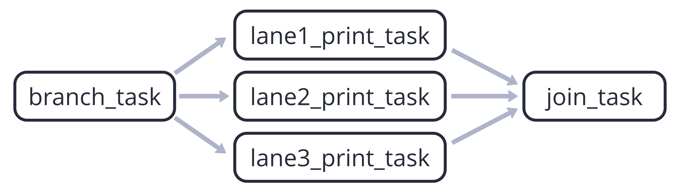
Parallel tasks with lists
d.define({
branch_task: [
lane1_print_task,
lane2_print_task,
lane3_print_task
],
lane1_print_task: join_task,
lane2_print_task: join_task,
lane3_print_task: join_task
})

Slide 13
Near realtime feedback
DAG 1: task with inotify loop
DAG 2: processing workflow

Slide 14
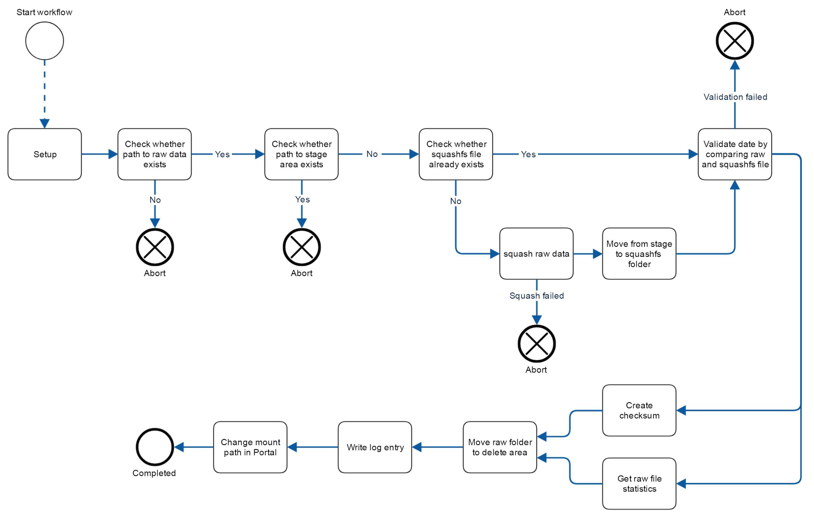
Compress files into squashfs
Start by REST call
trigger-like part
use RESTful
pipeline-like part
sequences
decisions
parallel execution
abort

Slide 15


Wait, there is more
What you get with Lightflow
core system
PythonTask
BashTask
Want more? Use Extensions:
Filesystem
RESTful interface
EPICS
Features I did not have time to talk about:
Arguments
Data aliases
Custom queues
Stop and Abort
Central Store for workflow data

Slide 16
Available from PyPI
$ pip install lightflow
Installs libraries and command client

Slide 17

Source Code
Lightflow
Source Code on GitHub (BSD-3)
github.com/AustralianSynchrotron/Lightflow
australiansynchrotron.github.io/Lightflow/

