Slide 1
A state-machine approach to EPICS interfaces for complex devices
Nader Afshar, Martin De Jonge, David Paterson, Daryl Howard

Slide 2
{{{non-EPICS}control systems}engineer}’s view
Experiment control
Autosave
EPICS
Archiver
Device driver
Device driver
Device
Notes:
Open: A block diagram, inspired by Maia detector design

Slide 3
Device driver for a smart/complex device
Advanced (new) features are essential
High number of parameters and/or functional complexity
Frequent updates, compatibility issues, buggy API’s
E.g. RASCAN, Maia (Hymod) detector, FalconX detector

Slide 4
{ex-{{{non-EPICS}control systems}engineer}} ’s view
Open-source, community support
Reliable once works
10 ways to implement,
100 ways to deploy,
… ways to hack
Structure/Modular design
Model/document
Test/validate
Deployment/change management

Slide 5
Autosave
Experiment control
Archiver
Interface control document
Finite-State Machine
Service
(PyEpics)
EPICS
Device driver
Data Daemon
Device
Notes:
Open: A block diagram, inspired by Maia detector design

Slide 6
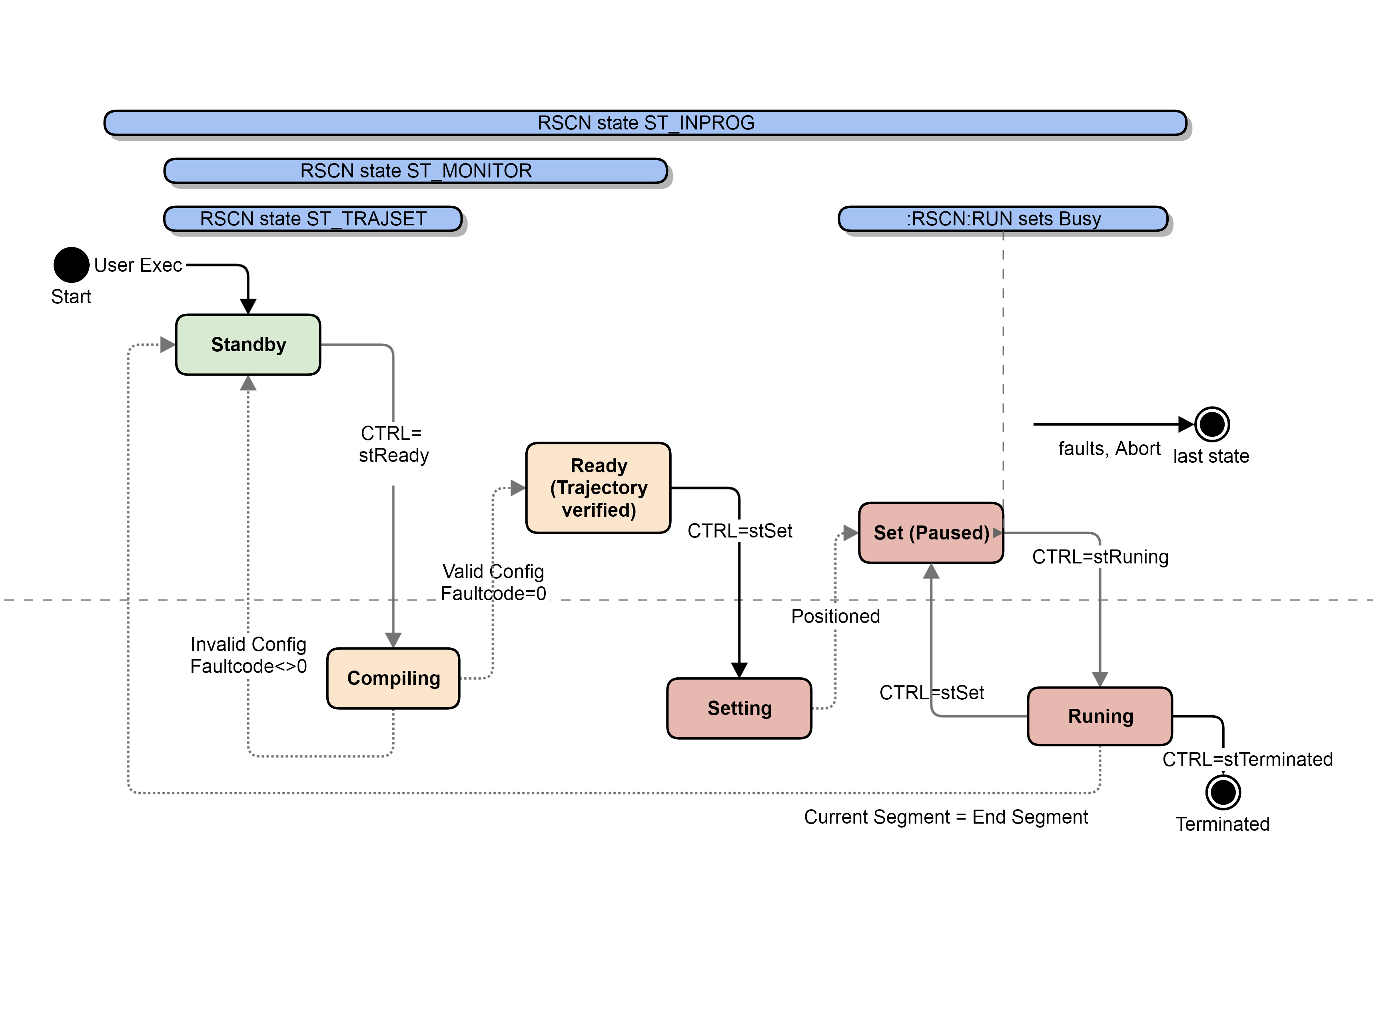
STATE==2, CTRL=4
STATE==CTRL
STATE=3
STATE=2

Slide 7
epicsState
epicsMap
mappedVariable
mappedVariable
…
Device driver
Device

Slide 8
# PVs mapping to $(VAR)
#% autosave 0 VAL
record(ao, "$(P)$(Q)") {
field(DESC, "$(DESC)")
field(OUT, "$(P)$(Q):SET PP MS")
field(PINI, "NO")
field(EGU, "$(EGU)")
field(PREC, "$(PREC)")
}
record(ai, "$(P)$(Q):RBV") {
field(DESC, "$(DESC) readback")
field(DTYP, "$(DTYP)")
field(FLNK, "$(P)$(Q):SYN")
field(INP, "$(GETPROTO)")
field(SDIS, "$(GetSB) CP MS")
field(DISV, "0")
field(PINI, "NO")
field(DISS, "INVALID")
field(EGU, "$(EGU)")
field(PREC, "$(PREC)")
}
record(ao, "$(P)$(Q):SET") {
field(DTYP, "$(DTYP)")
field(SDIS, "$(P)$(Q):ROL PP MS")
field(OUT, "$(SETPROTO)")
field(PINI, "NO")
field(DISS, "INVALID")
}
record(calc, "$(P)$(Q):ROL") {
field(CALC, "(!B) || A")
field(INPA, "$(P)$(Q):SYN.PACT")
field(INPB, "$(SetSB) NPP MS")
field(PINI, "NO")
}
record(calcout, "$(P)$(Q):SYN") {
field(INPA, "$(P)$(Q):RBV PP")
field(INPB, "$(GetSB) NPP MS")
field(INPC, "$(SetSB) NPP MS")
field(CALC, "A")
field(OUT, "$(P)$(Q) PP MS")
field(PINI, "NO")
}
#--------------------
Notes:
mapVar.template

Slide 9
# PVs mapping to P2002
#% autosave 0 VAL
record(ao, "$(P):RSCN:A1_HLM") {
field(DESC, “...desired limit")
field(OUT, "$(P):RSCN:A1_HLM:SET PP MS")
field(PINI, "NO")
field(EGU, "EGU/s2")
field(PREC, "1")
}
record(ai, "$(P):RSCN:A1_HLM:RBV") {
field(DESC, “...desired limit readback")
field(DTYP, "stream")
field(FLNK, "$(P):RSCN:A1_HLM:SYN")
field(INP, "@pmac.proto getVar(P2002) $(PORT)")
field(SDIS, "$(P):RSCN:ST_MONITOR CP MS")
field(DISV, "0")
field(PINI, "NO")
field(DISS, "INVALID")
field(EGU, "EGU/s2")
field(PREC, "1")
}
record(ao, "$(P):RSCN:A1_HLM:SET") {
field(DTYP, "stream")
field(SDIS, "$(P):RSCN:A1_HLM:ROL PP MS")
field(OUT, "@pmac.proto setVar(P2002) $(PORT)")
field(PINI, "NO")
field(DISS, "INVALID")
}
record(calc, "$(P):RSCN:A1_HLM:ROL") {
field(CALC, "(!B) || A")
field(INPA, "$(P):RSCN:A1_HLM:SYN.PACT")
field(INPB, "$(P):RSCN:ST_SETTING NPP MS")
field(PINI, "NO")
}
record(calcout, "$(P):RSCN:A1_HLM:SYN") {
field(INPA, "$(P):RSCN:A1_HLM:RBV PP")
field(INPB, "$(P):RSCN:ST_MONITOR NPP MS")
field(INPC, "$(P):RSCN:ST_SETTING NPP MS")
field(CALC, "A")
field(OUT, "$(P):RSCN:A1_HLM PP MS")
field(PINI, "NO")
}
#--------------------
Notes:
mapVar.db

Slide 10
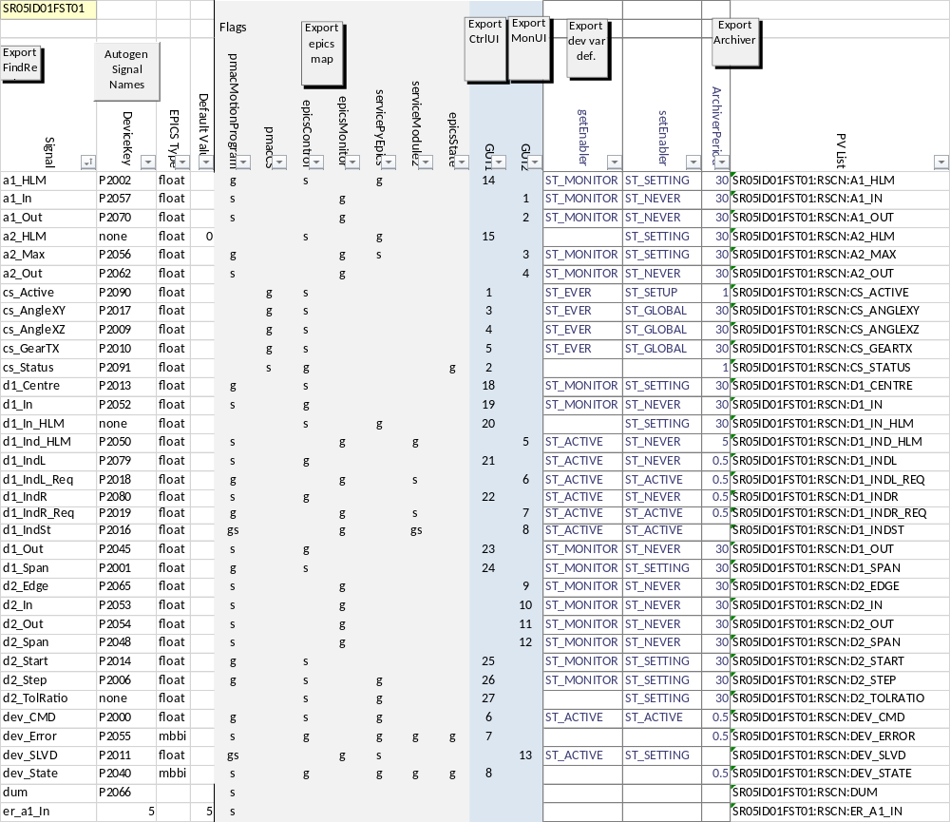
Interface control document

Slide 11
;SLSA MC Development & Configuration tool for TurboPMAC by Nader.Afshar@synchrotron.org.au[]
;Header -1
;Auto generated pmac definition script[]
;Header -1
;No Fault[]p
#define erNONE 0
;[]
#define erv1Delta 1
;[]
#define erd1In 2
;[]
#define erTrjBuilder 3
;[]
#define erERROR4 4
;[]
#define era1In 5
;[]
#define erRange1 6
;[]
#define erRange2 7
;[]
#define erERROR8 8
;[]
#define erStandby 9
;[]p
#define stBlank 0
;[]p
#define stTerminated 1
;Standby, waiting for user setup[]p
#define stStandby 2
;Compiling scan[]p
#define stCompiling 3
;Setup is being verified; either into Ready or back to Standby[]p
#define stReady 4
;Moving to begin position to start scan[]p
#define stSetting 5
;Compiled and moved into position to start scan[]p
#define stSet 6
;Running scan[]p
#define stRunning 7
;rscn program terminated via CTRL[]p
#define stReserved 8
;[]p
#define stResetting 9
;Pmac internal variable[s]p
#define tMin 0.05
;Pmac internal variable[s]p
#define tMax 4
;Scan control word[]gs
#define devCMD P2000
;Fast axis span (span)[EGU]gs
#define d1Span P2001
;Fast axis acceleration desired limit[EGU/s2]gs
#define a1HLM P2002
;Fast axis min allowd outer-skip time[s]gs
#define tOutLLM P2003
;Slow axis acceleration desired limit[EGU/s2]gs
#define a2HLM P2004
;Fast axis min allowd inner-skip time[s]gs
#define tInLLM P2005
;Slow axis line separation (step size)[EGU]gs
#define d2Step P2006
;Fast axis line scan velocity at edges[EGU/s]gs
#define v1Out P2007
;Fast axis line scan velocity pdelta[EGU/s]gs
#define v1Delta P2008
;X-Z scan angle[deg]gs
#define csAngleXZ P2009
;Tomo-X scan gear ratio[deg/mm]gs
#define csGearTX P2010
;[]p
;;Free P2011
;End scan segment[]gs
#define lineEnd P2012
;Fast axis scan starting position[EGU]gs
#define d1Centre P2013
;Slow axis scan starting position[EGU]gs
#define d2Start P2014
;Scan devState word[]g
#define devState P2040
;Current scan segment[]gs
#define lineN P2041
;Scanline total time including inner-skip[s]g
#define tMid P2042
;outer-skip move time[s]g
#define tOut P2043
;inner-skip move time[s]g
#define tIn P2044
;Fast axis outer-skip band[EGU]g
#define d1Out P2045
;Slow axis outer-skip velocity at return point [EGU/s]g
#define v2Out P2046
;Slow axis line exit velocity[EGU/s]g
#define v2In P2047
;Slow axis scan span (span)[EGU]g
#define d2Span P2048
;Current segment direction[]g
#define lineDir P2049
;Fast axis span actual[EGU]g
#define d1SpanOBS P2050
;Pmac internal variable[]p
;;; Xd1 P2051
;Fast axis scan line inner-skip distance[EGU]g
#define d1In P2052
;Slow axis inner-skip move distance[EGU]g
#define d2In P2053
;Slow axis skip distance[EGU]g
#define d2Out P2054
;SkipScan devError code[]g
#define devError P2055
;Slow axis planned trajectory max accel.[EGU/s2]g
#define a2Max P2056
;Fast axis accel. at inner skip move[EGU/s2]g
#define a1In P2057
;Pmac internal variable[]p
#define pX0 P2058
;Pmac internal variable[]p
#define X1 P2059
;Number of subsegments[]g
#define lineSubEnd P2060
;Fast axis line scan mid line velocity[EGU/s]g
#define v1Scan P2061
;Fast axis acceleration actual limit[EGU/s2]g
#define a1Max P2062
;subsegment counter[]g
#define lineSubN P2063
;Edge-skip move time[s]g
#define tEdge P2064
;Raster axis Edge-skip distance[EGU]g
#define d2Edge P2065
;Pmac internal variable[]p
#define dum P2066
;Pmac internal variable[]p
#define pY0 P2068
;Pmac internal variable[]p
#define pY1 P2069
;Sin(Ytheta)[]p
#define pSin P2070
;Cos(Ytheta)[]p
#define pCos P2071
;Pmac internal variable[]p
#define pdelta P2072
;Pmac internal variable[]p
#define ptau P2073
;Active CS number on pmac[]gs
#define csActive P2090
;CS status for active CS number on pmac (CSSTRS)[]e
#define csStatus P2091
;[]
; x
;[]
; x
;[]
; x
;[]
; x
;[]
; x
;[]
; x
;[]
; DIR x
;[]
; DIR x
;[]
; DIR x
;[]
; DIR x
;[]
; HLM x
;[]
; HLM x
;[]
; HLM x
;[]
; HLM x
;[]
; LLM x
;[]
; LLM x
;[]
; LLM x
;[]
; LLM x
;[]
; MRES x
;[]
; MRES x
;[]
; MRES x
;[]
; MRES x
;[]
; OFF x
;[]
; OFF x
;[]
; OFF x
;[]
; OFF x
;[]e
; stAlways x
;State: coordinate system setup[]e
; stCSSetup x
;[]e
; stGlobal x
;[]e
; stInProg x
;State: MONITOR[]e
; stMonitor x
;[]e
; stNever x
;[]e
; stTrajSet x
Notes:
mapVar.db

Slide 12
Device driver for a smart/complex device
Control device via “sequences” of commands and checks
Poll (Scan) parameters via .RBV PVs
Push writeable parameters via .SET PVs
Define and monitor State
Control transitions
Map PVs to variables, sync. up and/or down, based on State

Slide 13
Deployment
Multiple “sources” in multiple implementation “layers”
No hacking please, do the right thing!
A single source, auto-generate all layers at once
No hacking please, its easy enough to generate!

Slide 14
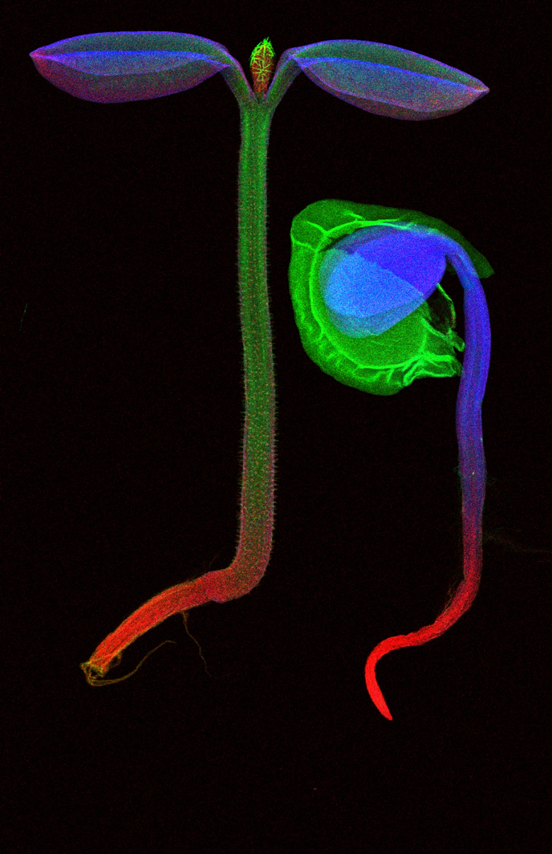
Thank you
nader.afshar@synchrotron.org.au
nadera@ansto.gov.au

